Slide 1
Pouring with Words
Rainy Day Review
Notes:
Say, “Today we are going to have a rainy day review of the ai and ay, our sight words, and a 5 finger retell of the story “Rain, Rain Go Away”.

Slide 2


Caught in the Rain ai and ay Review
ai
ay
Notes:
Say, “Listen closely as I say each word with the ai or ay sound in it. After I say the word you repeat it”
Click to show ai and picture of mail. Say, “ai” sound as in mail” student repeats ai as in mail.
Click to show ay and picture of a day. Say, “ay” sound as in day” student repeats ay as in day.

Slide 3

It’s Raining! It’s Pouring! ai and ay Practice
r
a
i
n
a
r
i
n
Notes:
Click to show the picture and the boxes for missing letters.
Say, “Look at the picture. What is this a picture of?” Wait for student to say rain. “Correct, it is rain.”
Say, “Which combination of letters would I use to fill in the blanks to make the correct word?” Wait for student to say r, then click the r. Wait for student to say a, then click the a. Wait for the student to say i, then click the i. Wait for the student to say n, then click the n. Note: You must click on the letter for it to appear.
Say, “What word did you build? Correct! You built rain.”

Slide 4
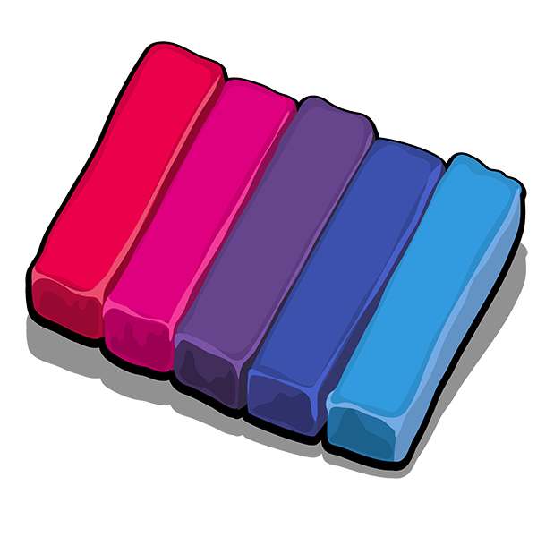
Downpour of ai and ay Practice
c
l
a
y
l
c
a
y
Notes:
Click to show the picture and the boxes for missing letters.
Say, “Look at the picture. What is this a picture of?” Wait for student to say clay. “Correct, it is clay.”
Say, “Which combination of letters would I use to fill in the blanks to make the correct word?” Wait for student to say c, then click the c. Wait for student to say l, then click the l. Wait for the student to say a, then click the a. Wait for the student to say y, then click the y. Note: You must click on the letter for it to appear.
Say, “What word did you build? Correct! You built clay”

Slide 5
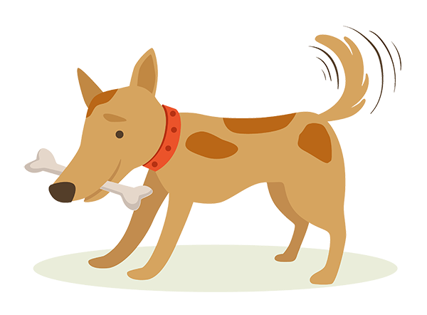
Showers of ai and ay Practice
t
a
i
l
a
t
i
l
Notes:
Click to show the picture and the boxes for missing letters.
Say, “Look at the picture. What is this a picture of?” Wait for student to say tail. “Correct, it is tail.”
Say, “Which combination of letters would I use to fill in the blanks to make the correct word?” Wait for student to say t, then click the t. Wait for student to say a, then click the a. Wait for the student to say i, then click the i. Wait for the student to say l, then click the l. Note: You must click on the letter for it to appear.
Say, “What word did you build? Correct! You built tail.”

Slide 6

Rain, Rain, Go Away! ai and ay Practice
g
r
a
y
r
g
a
y
Notes:
Click to show the picture and the boxes for missing letters.
Say, “Look at the picture. What color is this circle?” Wait for student to say gray. “Correct, it is gray.”
Say, “Which combination of letters would I use to fill in the blanks to make the correct word?” Wait for student to say g, then click the g. Wait for student to say r, then click the r. Wait for the student to say a, then click the a. Wait for the student to say y, then click the y. Note: You must click on the letter for it to appear.
Say, “What word did you build? Correct! You built gray.”

Slide 7
Sprinkling Sight Word Review
goes
those
been
done
Notes:
Say, “I’ll say the sight word and you repeat it after me.”
Click to show the sight word. Say, “goes” Student repeats goes.
Click to show the sight word. Say, “those” Student repeats those.
Click to show the sight word. Say, “been” Student repeats been.
Click to show the sight word. Say, “done” Student repeats done.
The students will need a piece of paper and pencil for the next activity. They will be asked to write their sight words and then read it.
Say, “Please go get a piece of paper and a pencil for the next activity.”

Slide 8
Sprinkling Sight Word Review
goes
those
been
done
Notes:
Say, “I will say a sight word. Then you will write that sight word on a piece of paper and hold it up so I can see it. I will show you the word to check that you spelled it correctly and then you will say the word. Let’s try it!”
Say, “goes.”
Say, “Write the word goes on your paper.”
Click to show the sight word goes to check their work.
Say, “What is the word?” Correct, the word is goes.”
Say, “those.”
Say, “Write the word those on your paper.”
Click to show the sight word those to check their work.
Say, “What is the word?” Correct, the word is those.”
Say, “been.”
Say, “Write the word been on your paper.”
Click to show the sight word been to check their work.
Say, “What is the word?” Correct, the word is been.”
Say, “done”
Say, “Write the word done on your paper.”
Click to show the sight word done to check their work.
Say, “What is the word?” Correct, the word is done.”

Slide 9
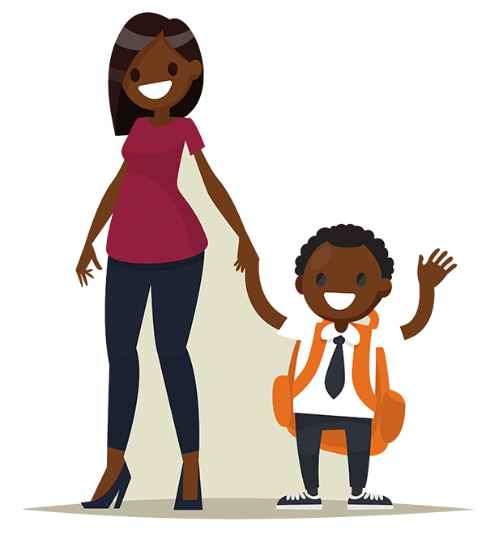
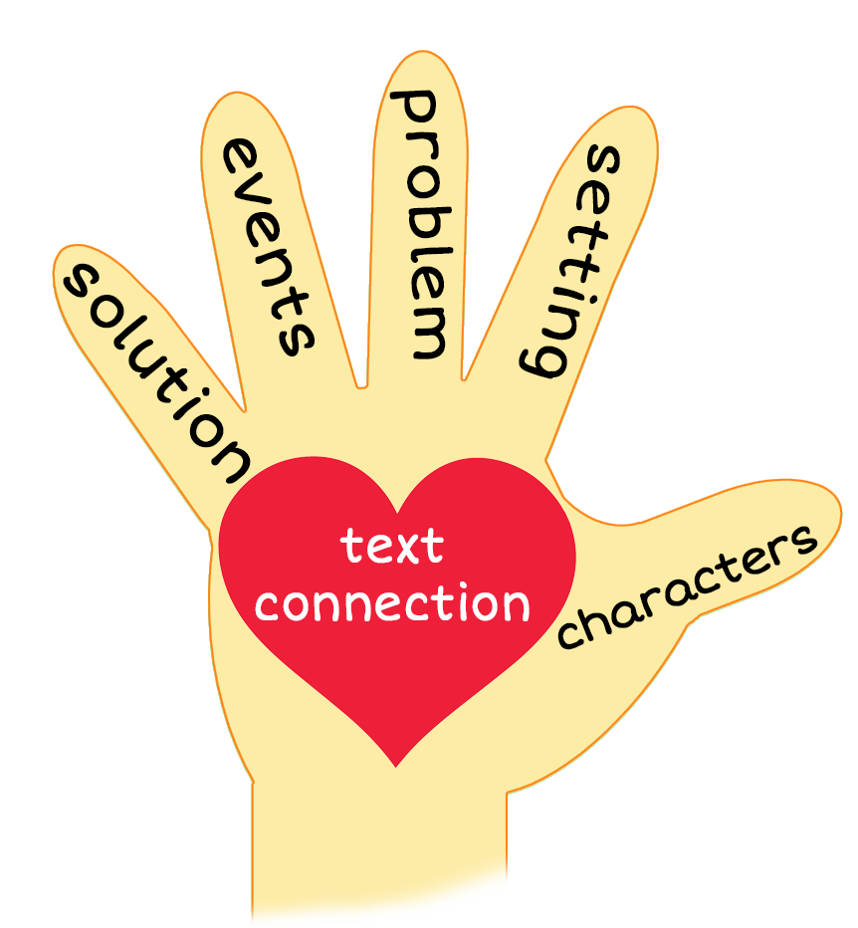
5 Finger Retell
Notes:
Say, “This week you read the story Rain, Rain Go Away. Using the 5 finger retell strategy, can you tell me about the story.
Say, “Hold up your thumb, tell me the characters” (Jay and his Mom)
Say, “Hold up your pointer, tell me the setting” (Jay’s house)
Say, “Hold up your tall finger, tell me the problem.” (Jay wants to play but it’s raining)
Say, “Hold up your ring finger, tell me the events.” (Jay plays with his train, he plays with his sailboat, and paints he paints)
Say, “Hold up your little finger, tell me the ending/solution.” (Rain stops, so Jay goes out to play. It starts to rain again, but Jay decides to play in the rain)
Say, “Make a heart with your fingers, have you ever wanted to play but it was raining outside? What did you do instead? (Answers will vary)

Slide 10
Q & A
Any Questions?

