Slide 1
Come Aboard Our Review
Ahoy oi and oy
Notes:
Say, “Come aboard and review oi and oy, our sight words, and main idea and details of the story “Coins”.

Slide 2


Set Sail for a Review of oi and oy
oy
oi
Notes:
Say, “Listen closely as I say each word with the oi or oy sound in it. After I say the word you repeat it”
Click to show oi and picture of a coin. Say, “oi” sound as in coin” student repeats oi as in coin.
Click to show oy and picture of a toy. Say, “oy” sound as in toy” student repeats oy as in toy.

Slide 3



Destination oi and oy Practice
Notes:
Click to show the pictures. Say, “Can you tell me what each of these pictures are?” (cowboy, boil, foil)
Say, “Tell me what doesn’t belong? What picture does not have an oi sound in the word. Wait for the student to answer.
That’s right! The picture of a cowboy does not have an oi sound in it.

Slide 4
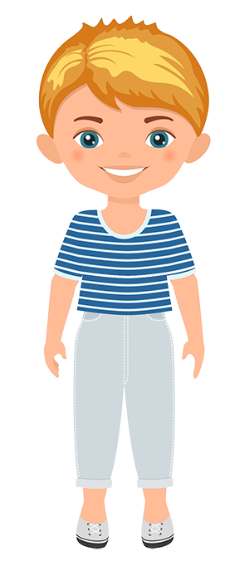


Cruising with an oi and oy Practice
Notes:
Click to show the pictures. Say, “Can you tell me what each of these pictures are?” (boy, acorn, oyster)
Say, “Tell me what doesn’t belong? What picture does not have an oy sound in the word. Wait for the student to answer.
That’s right! The picture of an acorn does not have an oi sound in it.

Slide 5
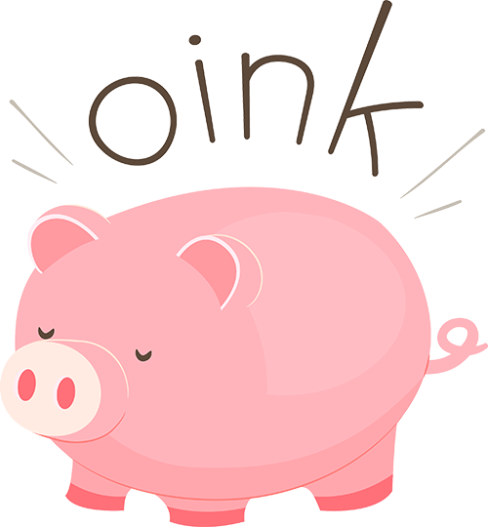
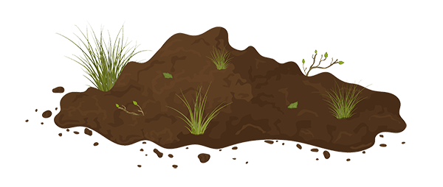

Journey with oi and oy Practice
Notes:
Click to show the pictures. Say, “Can you tell me what each of these pictures are?” (oink, soil, bow)
Say, “Tell me what doesn’t belong? What picture does not have an oi sound in the word. Wait for the student to answer.
That’s right! The picture of a bow does not have an oi sound in it.

Slide 6
Voyage into a Sight Word Review
old
going
were
keep
of
give
walk
when
once
kind
Notes:
Say, “Today we are going to review our sight words from Module 13-18. When I say the sight word you tell me which color square to click.”
Only click that square if the student is correct. If the student is wrong. Say, “That is not the correct sight word. Let’s try again and repeat the sight word.
Continue until all the squares have disappeared.

Slide 7
Sightseeing a Sight Word Review
had
start
open
always
gave
around
these
cut
small
friend
from
Notes:
Say, “Today we are going to review our sight words from Module 12-18. When I say the sight word you tell me which color circle to click.”
Only click that circle if the student is correct. If the student is wrong. Say, “That is not the correct sight word. Let’s try again and repeat the sight word.
Continue until all the circles have disappeared.

Slide 8

Main Idea and Details
Notes:
Click to show the picture of the coins.
Say, “This week you read the story Coins. This story is a non-fiction story. Do you remember what the main idea and details are of a story?” Wait for the student to answer. Say, “Correct, the main idea is what the story is mostly about, and the details support the main idea.”
Ask, “What is the main idea of this story?” (The main idea of the story is we are learning about different coins)
Ask, “What are some details that explain more about the main idea?” (There are 4 coins. The penny worth 1 cent. The nickel worth 5 cents. The dime worth 10 cents. The quarter worth 25 cents)

Slide 9
Q & A
Any Questions?

