Slide 1
At the Castle
A Royal Review
Notes:
Say, “Today we are going to do a royal review of long o and long u with silent e, our sight words, and the 5 finger retell of the story “The Duke’s Plume”.

Slide 2
Royal Kingdom of Long e and Long u With Bossy e
e
cub
her
e
Notes:
Say, “Today we are going to review bossy e. Bossy e can also be called magic e. Remember, bossy e helps the vowel before the consonant say its name.”
Click to show word her. Say, “What is this word? Yes, the word is her.
Watch what happens when I add an e to the end of that word.” Click so the word here appears. Say, “What is the word now? Yes, the word is here.
How did the word change when I added bossy e? Correct! When you add the bossy e the e became a long e!
Click to show word cub. Say, “What is this word? Yes, the word is cub.
Watch what happens when I add an e to the end of that word.” Click so the word cube appears. Say, “What is the word now? Yes, the word is cube.
How did the word change when I added bossy e? Correct! When you add the bossy e the u became a long u! Let’s practice!

Slide 3
The Duke of Long e and Long u With Bossy e
long o
long u
mule
theme
Pete
huge
these
flute
Notes:
Say, “We are going to sort the words under the correct column. Can you read each word?” (mule, theme, Pete, huge, these, flute)
Say, “What column would mule go under? Yes! Mule would go under the long u column.” Click mule to move under the long u column.
Say, “What column would theme go under? Yes! theme would go under the long e column.” Click theme to move under the long e column.
Say, “What column would Pete go under? Yes! Pete would go under the long e column.” Click Pete to move under the long e column.
Say, “What column would huge go under? Yes! Huge would go under the long u column.” Click huge to move under the long u column.
Say, “What column would these go under? Yes! These would go under the long e column.” Click these to move under the long e column.
Say, “What column would flute go under? Yes! Flute would go under the long u column.” Click flute to move under the long u column.

Slide 4
Majestic Sight Word Review
gave
these
around
start
Notes:
Click to show the sight word gave. Say, “What is this sight word? That’s right! The sight word is gave.”
Click to show the sight word these. Say, “What is this sight word? That’s right! The sight word is these.”
Click to show the sight word around. Say, “What is this sight word? That’s right! The sight word is around.”
Click to show the sight word start. Say, “What is this sight word? That’s right! The sight word is start.”

Slide 5
Supreme Sight Word Practice
gave
these
around
start
Notes:
Tell the student, “You are going to practice your sight words using silly voices. I am going to tell you the type of silly voice I want hear, show you the sight word, and then you say it in that silly voice. Are you ready?”
Click to show the word gave. Say, “Can you read this word in a squeaky voice?”
Click to show the word these. Say “Can you read this word in a mad voice?”
Click to show the word around. Say, “Can you read this word in a surprised voice?”
Click to show the word start. Say, “Can you read this word in a sleepy voice?”

Slide 6
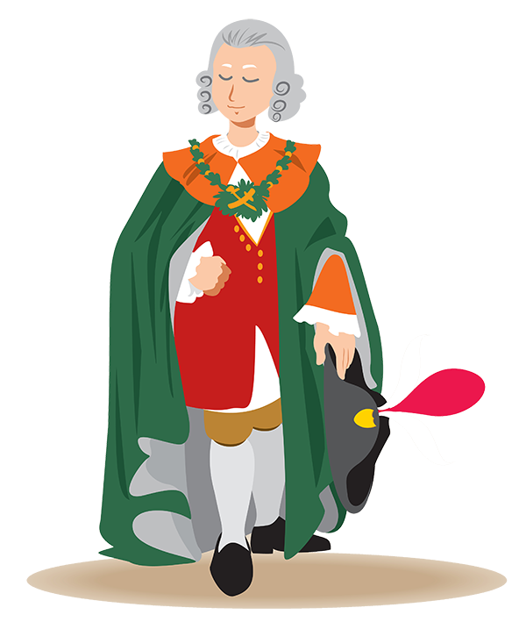

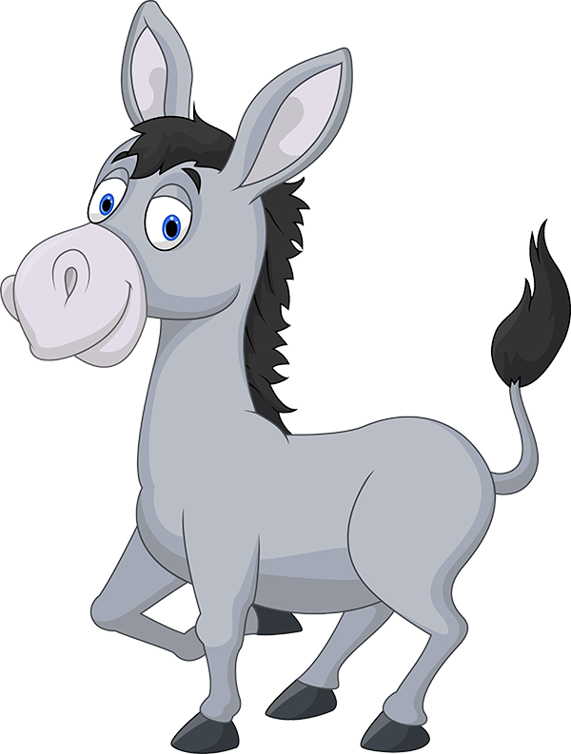
5 Finger Retell
Notes:
Say, “Look at the 5 finger retell chart. Use the chart to help you retell the story The Duke and the Plume.”
Say, “Hold up your thumb, tell me the characters.” (Pete and June or Duke and Mule)
Say, “Hold up your pointer, tell me the setting .” (At a play)
Say, “Hold up your tall finger, tell me the problem.” (Pete is sad. He lost his magic plume.)
Say, “Hold up your ring finger, tell me the events.” (June uses her magic cube to find the plume.)
Say, “Hold up your little finger, tell me the ending/solution.” (The plume is in the tube. The Duke gives Mule his flute and Mule loves its tune. Duke and Mule bow.)
Say, “Make a heart with your fingers, have you ever been in a play? What part did you play? Did you enjoy playing that part? Why or why not?” (Answers will vary)

Slide 7
Q & A
Any Questions?

