Slide 1
The Big Trip
Explore the Long o with Magic e
Notes:
Say, “Today we are going to take a big trip reviewing long o with magic e sound, sight words, and a 5 finger retell of the story “Rosie in Rome”. Are you ready?”

Slide 2
Adventures with Long o with Magic e
e
hop
Notes:
Say, “Do remember what the magic e does to the vowel before the consonant? Yes! The magic e helps the vowel before the consonant say its name.”
Click to show word hop. Say, “What is this word? Yes, the word is hop.
Watch what happens when I add an e to the end of that word.” Click so the word hope appears. Say, “What is the word now? Yes, the word is hope.
How did the word change when I added magic e? Correct! When you add the magic e the o became a long o! Let’s practice!

Slide 3


Passport to Learning Long o with Magic e
bone
c
one
Notes:
Say, “Today we are going to change the beginning sound to make a new word. I will show you a picture and the word. Then I will show you a new picture and you have to change the beginning sound to make the new work. Are you ready?
Click to show the picture of a bone and the word bone. Say, “What word is this? Correct, it’s a bone.
Click to show the picture of a cone and the word with the c missing. Say, “Look at this picture. What letter can we put at the beginning to make this word? Correct, we can add a c to the beginning.” Click for the c to appear. Say, “What word did we make? Yes, cone! Let’s practice some more!!”

Slide 4

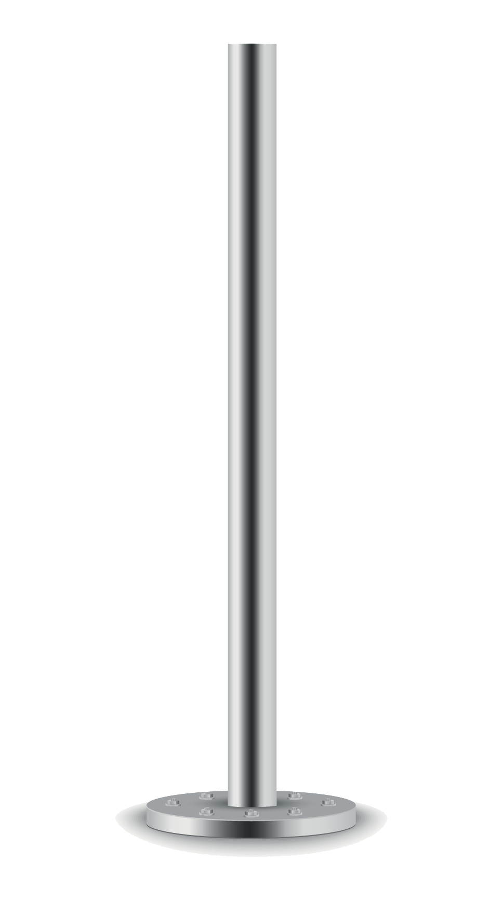
Traveling with Long o with Magic e
hole
p
ole
Notes:
Click to show the picture of a hole and the word hole. Say, “What word is this? Correct, it’s a hole.
Click to show the picture of a pole and the word with the p missing. Say, “Look at this picture. What letter can we put at the beginning to make this word? Correct, we can add a p to the beginning. What word did we make? Yes, pole! Let’s practice some more!!

Slide 5


Packed and Ready for Long o with Magic e
rose
n
ose
Notes:
Click to show the picture of a rose and the word rose. Say, “What word is this? Correct, it’s a rose.
Click to show the picture of a nose and the word with the n missing. Say, “Look at this picture. What letter can we put at the beginning to make this word? Correct, we can add a n to the beginning. What word did we make? Yes, nose!

Slide 6
Ready for a Visit to our Sight Words
had
open
always
kind
Notes:
Click to show the sight words. Say, “I’ll say the sight word and you repeat it after me.”
Say, “had” Student repeats had.
Say, “open” Student repeats open.
Say, “always” Student repeats always.
Say, “kind” Student repeats kind.

Slide 7
Back Home for Mixed-up Sight Word Practice
kind
had
pone
always
open
dink
dha
wasyal
had
open
always
kind
Notes:
Say, “Today we are going to practice unscrambling our mixed-up sight words. Do you remember our sight words? Let’s review them one more time.”
Click to show sight words. Say, “Can you read each sight word to me?” Note: Help the student with any sight words they are still struggling with. Click for the words to disappear.
Click to show mixed up sight word. Say, “Can you unscramble this mixed-up sight word?” Click for word to disappear.
Click to show sight word always. Say, “Correct! The mixed-up word is always.” Click for word to disappear.
Click to show mixed up sight word. Say, “Can you unscramble this mixed-up sight word?” Click for word to disappear.
Click to show sight word had. Say, “Correct! The mixed-up word is had.” Click for word to disappear.
Click to show mixed up sight word. Say, “Can you unscramble this mixed-up sight word?” Click for word to disappear.
Click to show sight word open. Say, “Correct! The mixed-up word is open.” Click for word to disappear.
Click to show mixed up sight word. Say, “Can you unscramble this mixed-up sight word?” Click for word to disappear.
Click to show sight word kind. Say, “Correct! The mixed-up word is kind.” Click for word to disappear.

Slide 8

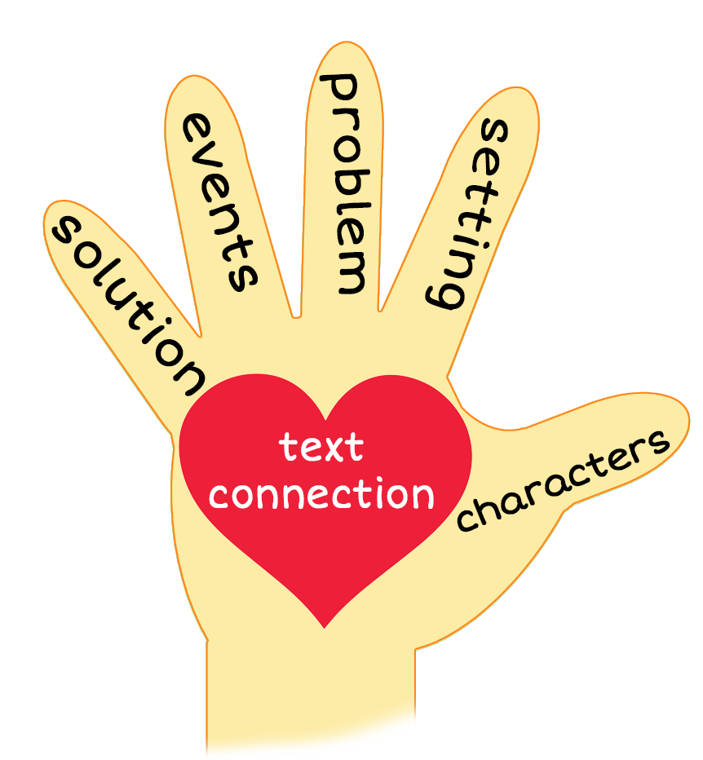

Fancy 5 Finger Retell
Notes:
Say, “This week you read the story Rosie in Rome. Using the 5 finger retell strategy, can you tell me about the story.
Say, “Hold up your thumb, tell me the characters.” (Rosie)
Say, “Hold up your pointer, tell me the setting.” (Rome)
Say, “Hold up your tall finger, tell me the problem.” (Rosie wants to go on a trip)
Say, “Hold up your ring finger, tell me the events.” (She sees a dome, took photos, and ate pesto raviolis)
Say, “Hold up your little finger, tell me the ending/solution.” (Rosie came home, gave a bone to her friend Owen, and went to sleep to dream about her trip)
Say, “Make a heart with your fingers, have you ever gone on a trip far away? If so, where? If not, where would you like to go? (Answers will vary)

Slide 9
Q & A
Any Questions?

