Slide 1
Cooking Up Some Fun with Words
Recipe for oo and u Sounds
Notes:
Say, “Today we are going to cook up some fun with words. We will review /oo/ and /u/ sounds, sight words, and a 5 finger retell of the story “Good Cook’s”.

Slide 2


What’s Cooking? Sounds /oo/ and /u/ Review
oo
oo
boot
book
Notes:
Say, “The vowels oo make two different sounds. They make the /oo/ sound and the /u/ sound. I am going to show you an example, then I’ll say the sound and the word, and then you repeat it. Ready?”
Click to show the letter oo. Say, “This is the letter oo. oo says /oo/”
Click to show the picture of a boot. Say “This is a boot. Boot has the /oo/ sound in it”
Click to show the word boot. Say “oo says /oo/, boot. Now you repeat!” Students says, oo says /oo/, boot. Click to make objects disappear.
Click to show the letter oo. Say, “This is the letter oo. oo says /u/”
Click to show the picture of a book. Say “This is book. Book has the /u/ sound in it”
Click to show the word book. Say “oo says /u/, book. Now you repeat!” Click to make objects disappear

Slide 3


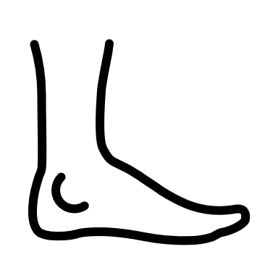

Let’s Get Cooking with oo
Notes:
Show the slide full of different objects.
Say, “Look at these pictures. Can you name these pictures? (food, mop, boat, foot)
I spy a picture with the /oo/ sound in the word. Can you tell me which picture has the /oo/ sound in the word?”
That’s’ right! The word food has the /oo/ sound in it!

Slide 4


Cooking Up the oo Sound
Notes:
Show the slide full of different objects.
Say, “Look at these pictures. Can you name these pictures? (dog, cow, foot, food)
I spy a picture with the /u/ sound in the word. Can you tell me which picture has the /u/ sound in the word?”
That’s’ right! The word foot has the /u/ sound in it!

Slide 5
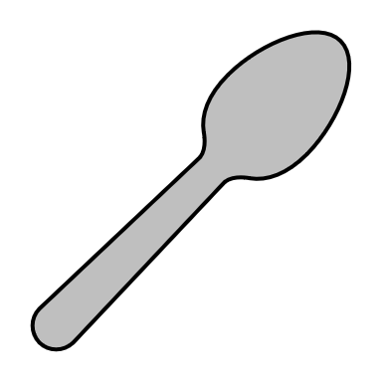



Scoop up the oo Sound
Notes:
Show the slide full of different objects.
Say, “Look at these pictures. Can you name these pictures? (bowl, spoon, frog, book)
I spy a picture with the /oo/ sound in the word. Can you tell me which picture has the /oo/ sound in the word?”
That’s’ right! The word spoon has the /oo/ sound in it!

Slide 6
Cool Sight Word Review
going
once
when
cut
Notes:
Click to show the sight words. Say, “I’ll say the sight word and you repeat it after me.”
Say, “going” Student repeats going.
Say, “once” Student repeats once.
Say, “when” Student repeats when.
Say, “cut” Student repeats cut.

Slide 7
Looking for Sight Word Practice
going
once
when
cut
Notes:
Tell the student, “You are going to practice your sight words using actions I am going to tell you the action I want you to do, show you the sight word, and then you say the word 3 times while doing the action. Are you ready?”
Click to show the word going. Say, “Can you read this word 3 times while doing jumping jacks.”
Click to show the word once. Say, “Can you read this word 3 times while spinning in a circle.”
Click to show the word when. Say, “Can you read this word 3 times while patting your head.”
Click to show the word cut. Say, “Can you read this word 3 times while blinking your eyes.”

Slide 8
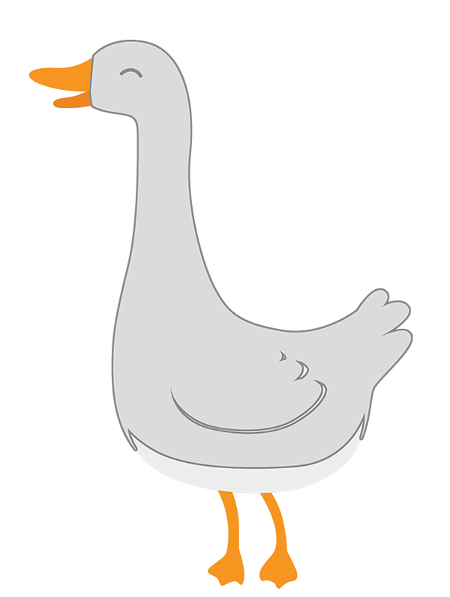
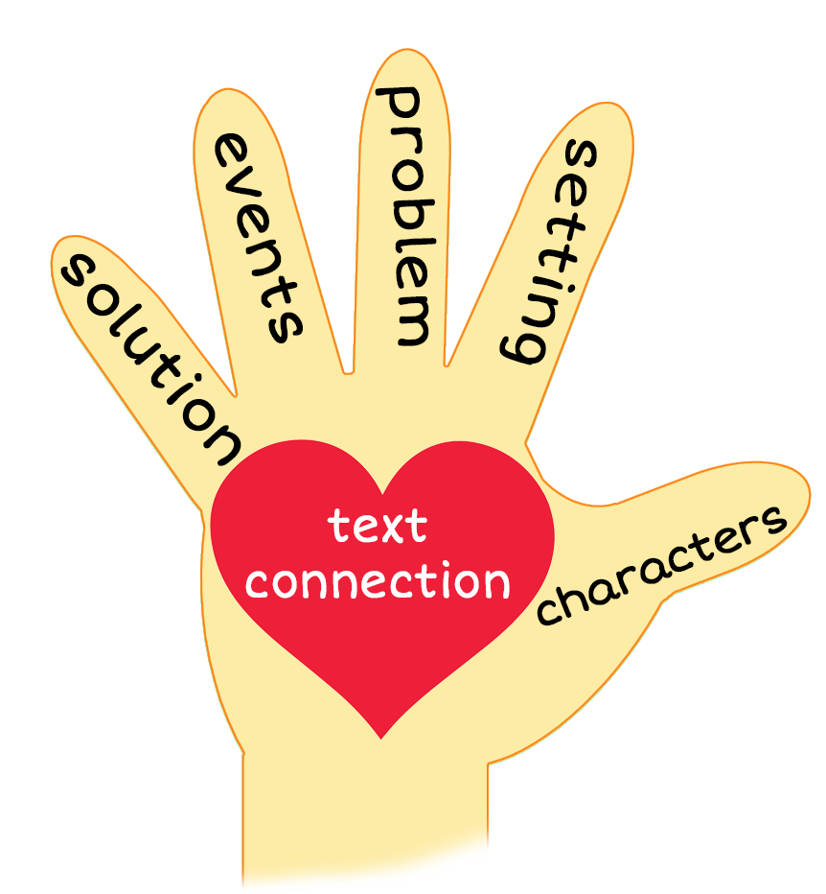
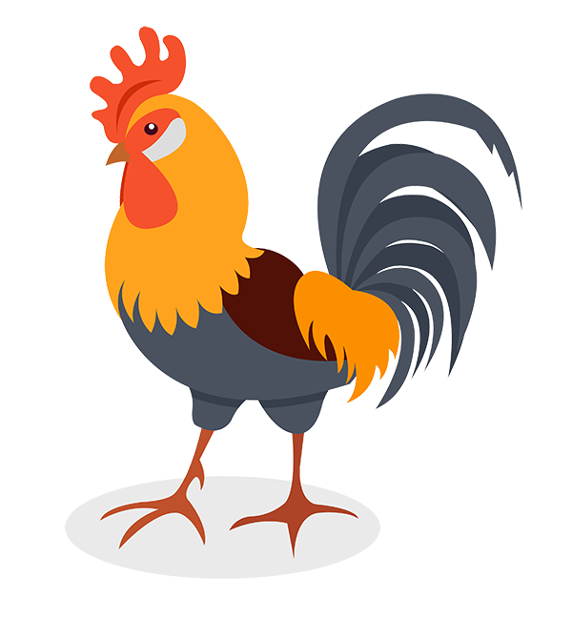
5 Finger Retell
Notes:
Click to show the pictures.
Say, “This week you read the story Good Cook’s. Using the 5 finger retell strategy, can you tell me about the story.
Say, “Hold up your thumb, tell me the characters.” (Goose and Rooster)
Say, “Hold up your pointer, tell me the setting.” (Goose’s house)
Say, “Hold up your tall finger, tell me the problem.” (Goose wants to cook)
Say, “Hold up your ring finger, tell me the events.” (They cook moon pie that is a foot log. They think it’s too big. Rooster cuts it.)
Say, “Hold up your little finger, tell me the ending/solution.” (Rooster and Goose realize it’s good and not too big)
Say, “Make a heart with your fingers, have you ever baked something before? What was it? (Answers will vary)

Slide 9
Q & A
Any Questions?

