Slide 1
Be a Sound Hound
Out and About with ou and ow
Notes:
Say, “Today we are going to have sound hound and review the ou and ow sounds, our sight words, and a 5 finger retell of the story “The Howling Hound”.

Slide 2


Howling about ou and ow Review
ow
ou
Notes:
Say, “Listen closely as I say each word with the ou or ow diagraph in it. After I say the word you repeat it”
Click to show ou and picture of a cloud. Say, “ou” sound as in cloud” student repeats ou as in cloud.
Click to show ow and picture of a owl. Say, “ow” sound as in owl” student repeats ow as in owl.

Slide 3

Let’s be Loud with ou and ow Practice
fl _ _ er
o
w
Notes:
Say, “We are going to practice ou and ow. I will show you a picture and you need to tell me if it has the ou or ow sound in it. Ready?”
Click to show a picture of a flower and the word flower with missing letters. Say, “What sound does this picture have in it, ou or ow?” Click to show the ow. Say “Yes, this is a flower and flower has the ow sound in it!” Let’s try again!

Slide 4

Let’s be Louder with ou and ow Practice
m _ _ se
o
u
Notes:
Click to show a picture of a mouse and the word mouse with missing letters. Say, “What sound does this picture have in it, ou or ow?” Click to the ou. Say “Yes, this is a mouse and mouse has the ou sound in it!” Let’s try again!

Slide 5
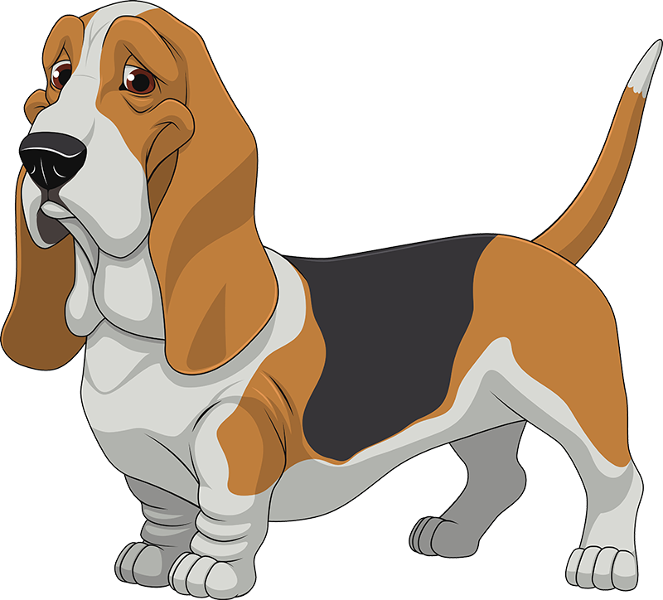
Let’s be the Loudest with ou and ow Practice
h _ _ nd
o
u
Notes:
Click to show a picture of a hound and the word hound with missing letters. Say, “What sound does this picture have in it, ou or ow?” Click to the ou. Say “Yes, this is a hound and hound has the ou sound in it!”

Slide 6
Outstanding Sight Word Review
give
old
were
small
Notes:
Click to show the sight word give. Say, “What is this sight word? That’s right! The sight word is give.”
Click to show the sight word old. Say, “What is this sight word? That’s right! The sight word is old.”
Click to show the sight word were. Say, “What is this sight word? That’s right! The sight word is were.”
Click to show the sight word small. Say, “What is this sight word? That’s right! The sight word is small.”

Slide 7
Sight Word Search
old
give
gave
give
out
told
old
girl
Notes:
Say, “Today we are going to go on a sight word search. I will show you a group of words and you have to tell me which color circles have the two sight word I tell you in it.” Ready? Click to bring up the sight words on screen.
Say, “Tell me all the colored circles that have the word give and old in it.” If the student chooses the correct color, click that circle to reveal the star. If the student chooses the wrong colored circle. (Note: Do not click the circles with the wrong sight word. The slide will disappear.) Say, “That is not our sight word give or old. Let’s try again!” Continue until the student finds all the sight words give and old.

Slide 8
Searching for Sight Words
wall
small
when
were
small
were
smell
wear
Notes:
Click and say, “Tell me all the colored circles that have the word were and small in it.” If the student chooses the correct color, click that circle to reveal the star. If the student chooses the wrong colored circle. (Note: Do not click the circles with the wrong sight word. The slide will disappear.) Say, “That is not our sight word give or old. Let’s try again!” Continue until the student finds all the sight words were and small.

Slide 9






5 Finger Retell
CHARACTERS
EVENTS
PROBLEM
SOLUTION
SETTING
Notes:
Say, “This week you read the story The Howling Hound. Today I am going to show you some pictures and you will need to tell me which story element it goes with the characters, the setting, the problem, the events, or the solution.
Click to show the word characters. Say, “Which picture shows the Characters in the story? Correct! Hound, Mouse, and Owl are the characters in this story.” Click the characters picture for it to disappear.
Click to show the word setting. Say, “Which picture shows the setting in the story? Correct! The house is the setting in this story.” Click the setting picture for it to disappear.
Click to show the word problem. Say, “Which picture shows the problem in the story? Correct! The picture of the gift is the problem in this story. Mouse and Owl can’t figure out how to give Hound a gift.” Click the problem picture for it to disappear.
Click to show the word events. Say, “Which picture shows one of the events from the story? Correct! The bee is an event from the story. Hound got stung when he opened the box.” Click the event picture for it to disappear.
Click to show the word solution. Say, “Which picture shows the solution of the story? Correct! They decided to just give Hound the flower is the solution of this story.”

Slide 10
Q & A
Any Questions?

