Slide 1
A Day at the Circus
Head to the Stage
Notes:
Say, “Today we are going to spend a day at the circus reviewing soft c and g and the dge sound, sight words, and a 5 finger retell of the story “A Walk to the Circus”. Are you ready? Let’s head to the stage!”

Slide 2


Introducing Soft c and g and dge
g
c
dge
Notes:
Say, “Listen closely as I say each word with the soft c, soft g, or dge sound in it. After I say the word you repeat it”
Click to show c and picture of a circle. Say, “c” as in circle” student repeats c as in circle.
Click to show g and picture of a gem. Say, “g” as in gem” student repeats g as in gem.
Click to show dge and picture of a bridge. Say, “dge” as in bridge” student repeats dge as in bridge.

Slide 3


Circus of Words Soft c
city
cat
cub
circus
circle
cot
Notes:
Say, “What sound does the soft c make? Correct! It makes the sss sound”. I am going to show you a set of words. You will tell me which words have the soft c sound. If you get it correct a check mark will appear. If you get it wrong an X will appear and you will need to try again. Ready?”
Click to the show set of words. Say, “Which words have the soft c sound?” Click until all words are found.

Slide 4
Circus of Words Soft g
goat
gem
giant
girl
giraffe
gift
Notes:
Say, “What sound does the soft g make? Correct! It makes the j sound”. I am going to show you a set of words. You will tell me which words have the soft g sound. If you get it correct a check mark will appear. If you get it wrong an X will appear and you will need to try again. Ready?
Click to the show set of words. Say, “Which words have the soft g sound?” Click until all words are found.

Slide 5
Circus of Words dge
cage
wage
bridge
wedge
ride
ledge
Notes:
Say, “What sound does the dge make? Correct! It makes the j sound”. I am going to show you a set of words. You will tell me which words have the dge sound. If you get it correct a check mark will appear. If you get it wrong an X will appear and you will need to try again. Ready?
Click to the show set of words. Say, “Which words have the dge sound?” Click until all words are found.

Slide 6
Big Top Sight Word Review
from
of
walk
keep
friend
Notes:
Click to show the sight word from. Say, “What is this sight word? That’s right! The sight word is from.”
Click to show the sight word of. Say, “What is this sight word? That’s right! The sight word is of.”
Click to show the sight word walk. Say, “What is this sight word? That’s right! The sight word is walk.”
Click to show the sight word keep. Say, “What is this sight word? That’s right! The sight word is keep.”
Click to show the sight word friend. Say, “What is this sight word? That’s right! The sight word is friend.”

Slide 7
Magic Sight Word Memory
walk
keep
of
friend
from
of
from
keep
friend
walk
Notes:
Say, “We are going to play sight word memory. You will tell me a color to click on and then choose another color. If they are a match, then move onto two new boxes. If they are not the same flip them back over so you can try again. Try to remember where they were so you can a match the words the next time!”
Allow the student to continue until all the sight words are matched.

Slide 8
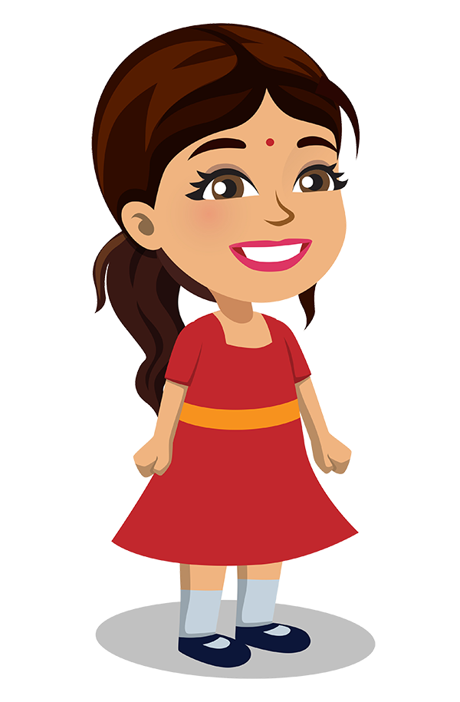
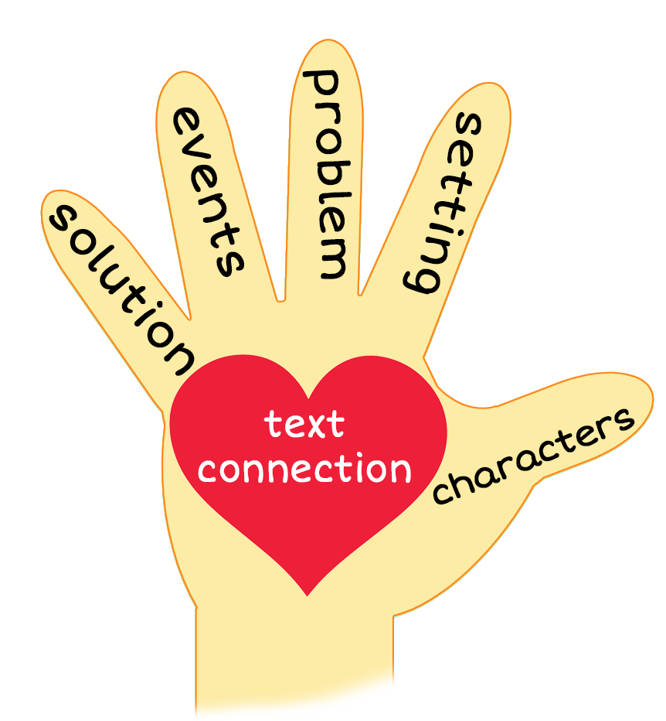

Fancy 5 Finger Retell
Notes:
Click to show the chart and the pictures.
Say, “Look at the 5 finger retell chart. Use the chart to help you retell the story A Walk to the Circus.”
Say, “Hold up your thumb, tell me the characters.”
Say, “Hold up your pointer, tell me the setting.”
Say, “Hold up your tall finger, tell me the problem.”
Say, “Hold up your ring finger, tell me the events.”
Say, “Hold up your little finger, tell me the ending/solution.”
Say, “Make a heart with your fingers, have you ever run into problems on your way somewhere? How did you handle the problems?

Slide 9
Q & A
Any Questions?

