Slide 1
Let’s Go to the Zoo
Magic e Escape
Notes:
Say, “Let’s go to the zoo and review long a with silent e, our sight words, and the 5 finger retell of the story “Ape and the Parade”.

Slide 2


Tame Long a
cane
rake
Notes:
Say, “Today we are going to review the long a with silent e sound. Remember the magic e helps the vowel before the consonant say its name.”
Click to show the picture of a rake and the word rake. Say, “What is this word?” Wait for student to respond. Say, “Yes, this is a rake!” What sound does the a make in rake?” Wait for student to say the long a sound. Say, “Correct! The a says (say the long a sound here) in rake. Click for rake to disappear.
Click to show the picture of cane and the word cane. Say, “What is this word?” Wait for student to respond. Say, “Yes, this is a cane!” What sound does the a make in cane?” Wait for student to say the long a sound. Say, “Correct! The a says (say the long a sound here) in cane.

Slide 3

Long a What Am I?
I am purple.
I am a fruit.
I come in a bunch.
grapes
Notes:
Say, “We are going to play the game, What am I? I will give you 3 clues about the object, and you have to guess what it is. Remember the object will have the long a with silent e sound in it. Are you Ready?
Click to show the first clue. Say, “I am purple”.
Click to show the second clue. Say, “I am a fruit”.
Click to show the third clue. Say, “I come in a bunch”.
Say, “What am I?” Wait for student to answer. Click to show the picture and word grapes. Say, “I am grapes!”
Let’s try again!

Slide 4

What Am I? Long a
I am round.
I can be chocolate.
You put candles in me.
cake
Notes:
Click to show the first clue. Say, “I am round”.
Click to show the second clue. Say, “I can be chocolate”
Click to show the third clue. Say, “You put candles in me”.
Say, “What am I?” Wait for student to answer. Click to show the picture and word cake. Say, “I am a cake!”
Let’s try again!

Slide 5

What Am I? Final Try
I fly in the sky.
I have wings.
I have people on me.
plane
Notes:
Click to show the first clue. Say, “I fly in the sky”.
Click to show the second clue. Say, “I have wings”.
Click to show the third clue. Say, “I have people on me”.
Say, “What am I?” Wait for student to answer. Click to show the picture and word plane. Say, “I am a plane!”

Slide 6
Roaring Sight Word Practice
Notes:
Say, “Today we are going to review our sight words from Module 6-12. When I say the sight word you tell me which color circle to click.”
Only click that circle if the student is correct. If the student is wrong. Say, “That is not the correct sight word. Let’s try again and repeat the sight word.
Continue until all the circles have disappeared.

Slide 7
Screeching Sight Word Practice
them
your
every
six
then
live
fly
may
think
clean
Notes:
Say, “Today we are going to review our sight words from Module 6-12. When I say the sight word you tell me which color square to click.”
Only click that square if the student is correct. If the student is wrong. Say, “That is not the correct sight word. Let’s try again and repeat the sight word.
Continue until all the squares have disappeared.

Slide 8
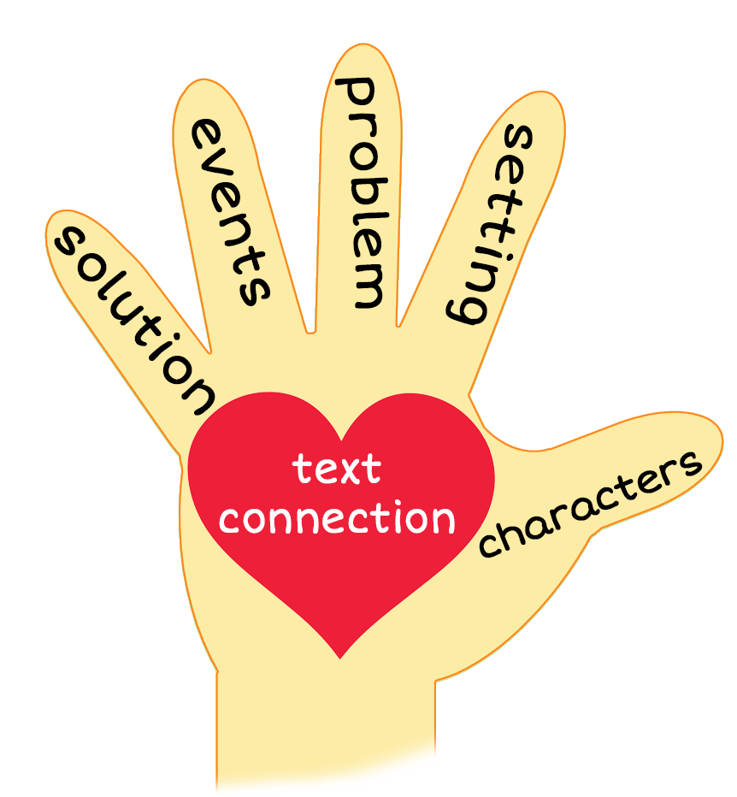
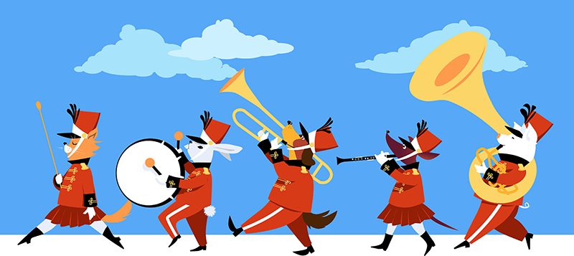

5 Finger Retell
Notes:
Say, “Look at the 5 finger retell chart. Use the chart to help you retell the story Ape and the Parade.”
Say, “Hold up your thumb, tell me the characters.”
Say, “Hold up your pointer, tell me the setting.”
Say, “Hold up your tall finger, tell me the problem.”
Say, “Hold up your ring finger, tell me the events.”
Say, “Hold up your little finger, tell me the ending/solution.”
Say, “Make a heart with your fingers, , have you ever been to a parade? What did you see there?

Slide 9
Q & A
Any Questions?

