Slide 1
A Day at the Beach
Surfing into a Review
Notes:
Say, “Today we are going to surf into a review of ch, wh, and ph, our sight words, and the 5 finger retell of the story “Chimp and Whale at the Beach”.

Slide 2


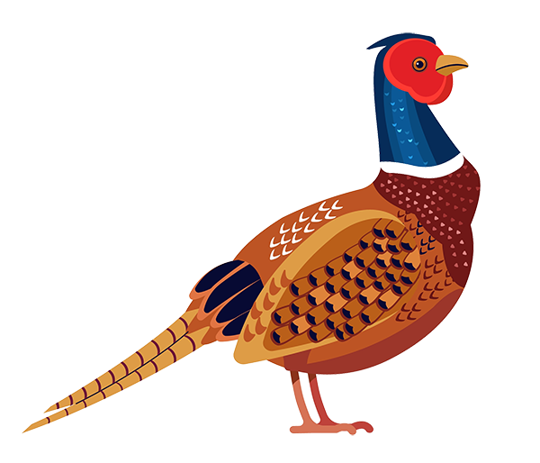
Jump in! to a ch, wh, and ph Review
ch
ph
wh
Notes:
Say, “Listen closely as I say each word with the ch, wh, or ph diagraph in it. After I say the word, you repeat it”
Click to show ch and picture of a chair. Say, “ch” as in chair” student repeats ch as in chair.
Click to show wh and picture of a wheel. Say, “wh” as in wheel” student repeats wh as in wheel.
Click to show ph and picture of a pheasant. Say, “ph” as in pheasant” student repeats ph as in pheasant.

Slide 3







Build your ch, wh, and ph Knowledge
ch
wh
ph
Notes:
Click to show word sort chart and pictures.
Say, “We are going to sort the pictures under the correct diagraph column. Can you name each picture for me?” (whale, cherry, chick, photo, whistle, phone)
Say, “What column would whale go under? Yes! Whale would go under wh.” Click the whale to move under wh column.
Say, “What column would cherry go under? Yes! Cherry would go under ch.” Click the cherry to move under ch column.
Say, “What column would chick go under? Yes! Chick would go under ch.” Click the chick to move under ch column.
Say, “What column would photo go under? Yes! photo would go under ph.” Click the photo to move under ph column.
Say, “What column would whistle go under? Yes! Whistle would go under wh.” Click the whistle to move under wh column.
Say, “What column would phone go under? Yes! Phone would go under ph.” Click the phone to move under ph column.

Slide 4
Sailing to a Sight Words Review
every
live
then
six
Notes:
Click to show the sight word every. Say, “What is this sight word? That’s right! The sight word is every.”
Click to show the sight word live. Say, “What is this sight word? That’s right! The sight word is live.”
Click to show the sight word then. Say, “What is this sight word? That’s right! The sight word is then.”
Click to show the sight word six. Say, “What is this sight word? That’s right! The sight word is six.”

Slide 5
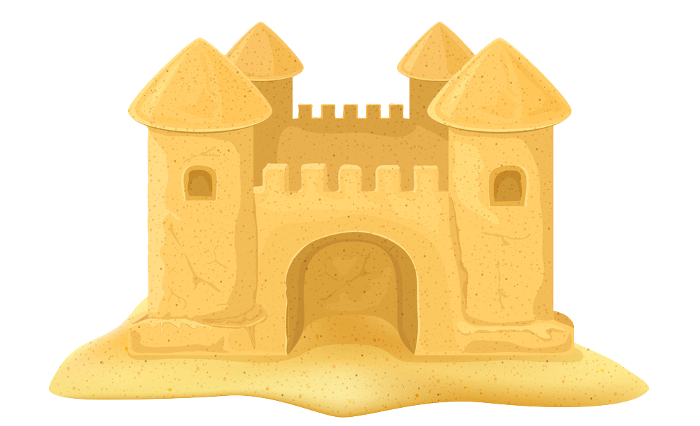
Digging into a Sight Word Practice
every
six
live
then
Notes:
Tell the student, “You are going to practice your sight words using silly voices. I am going to tell you the type of silly voice I want hear, show you the sight word, and then you say it in that silly voice. Are you ready?”
Click to show the word every. Say, “Can you read this word in a mouse voice?”
Click to show the word live. Say “Can you read this word in a monster voice?”
Click to show the word then. Say, “Can you read this word in a pirate voice?”
Click to show the word six. Say, “Can you read this word in a robot voice?”

Slide 6


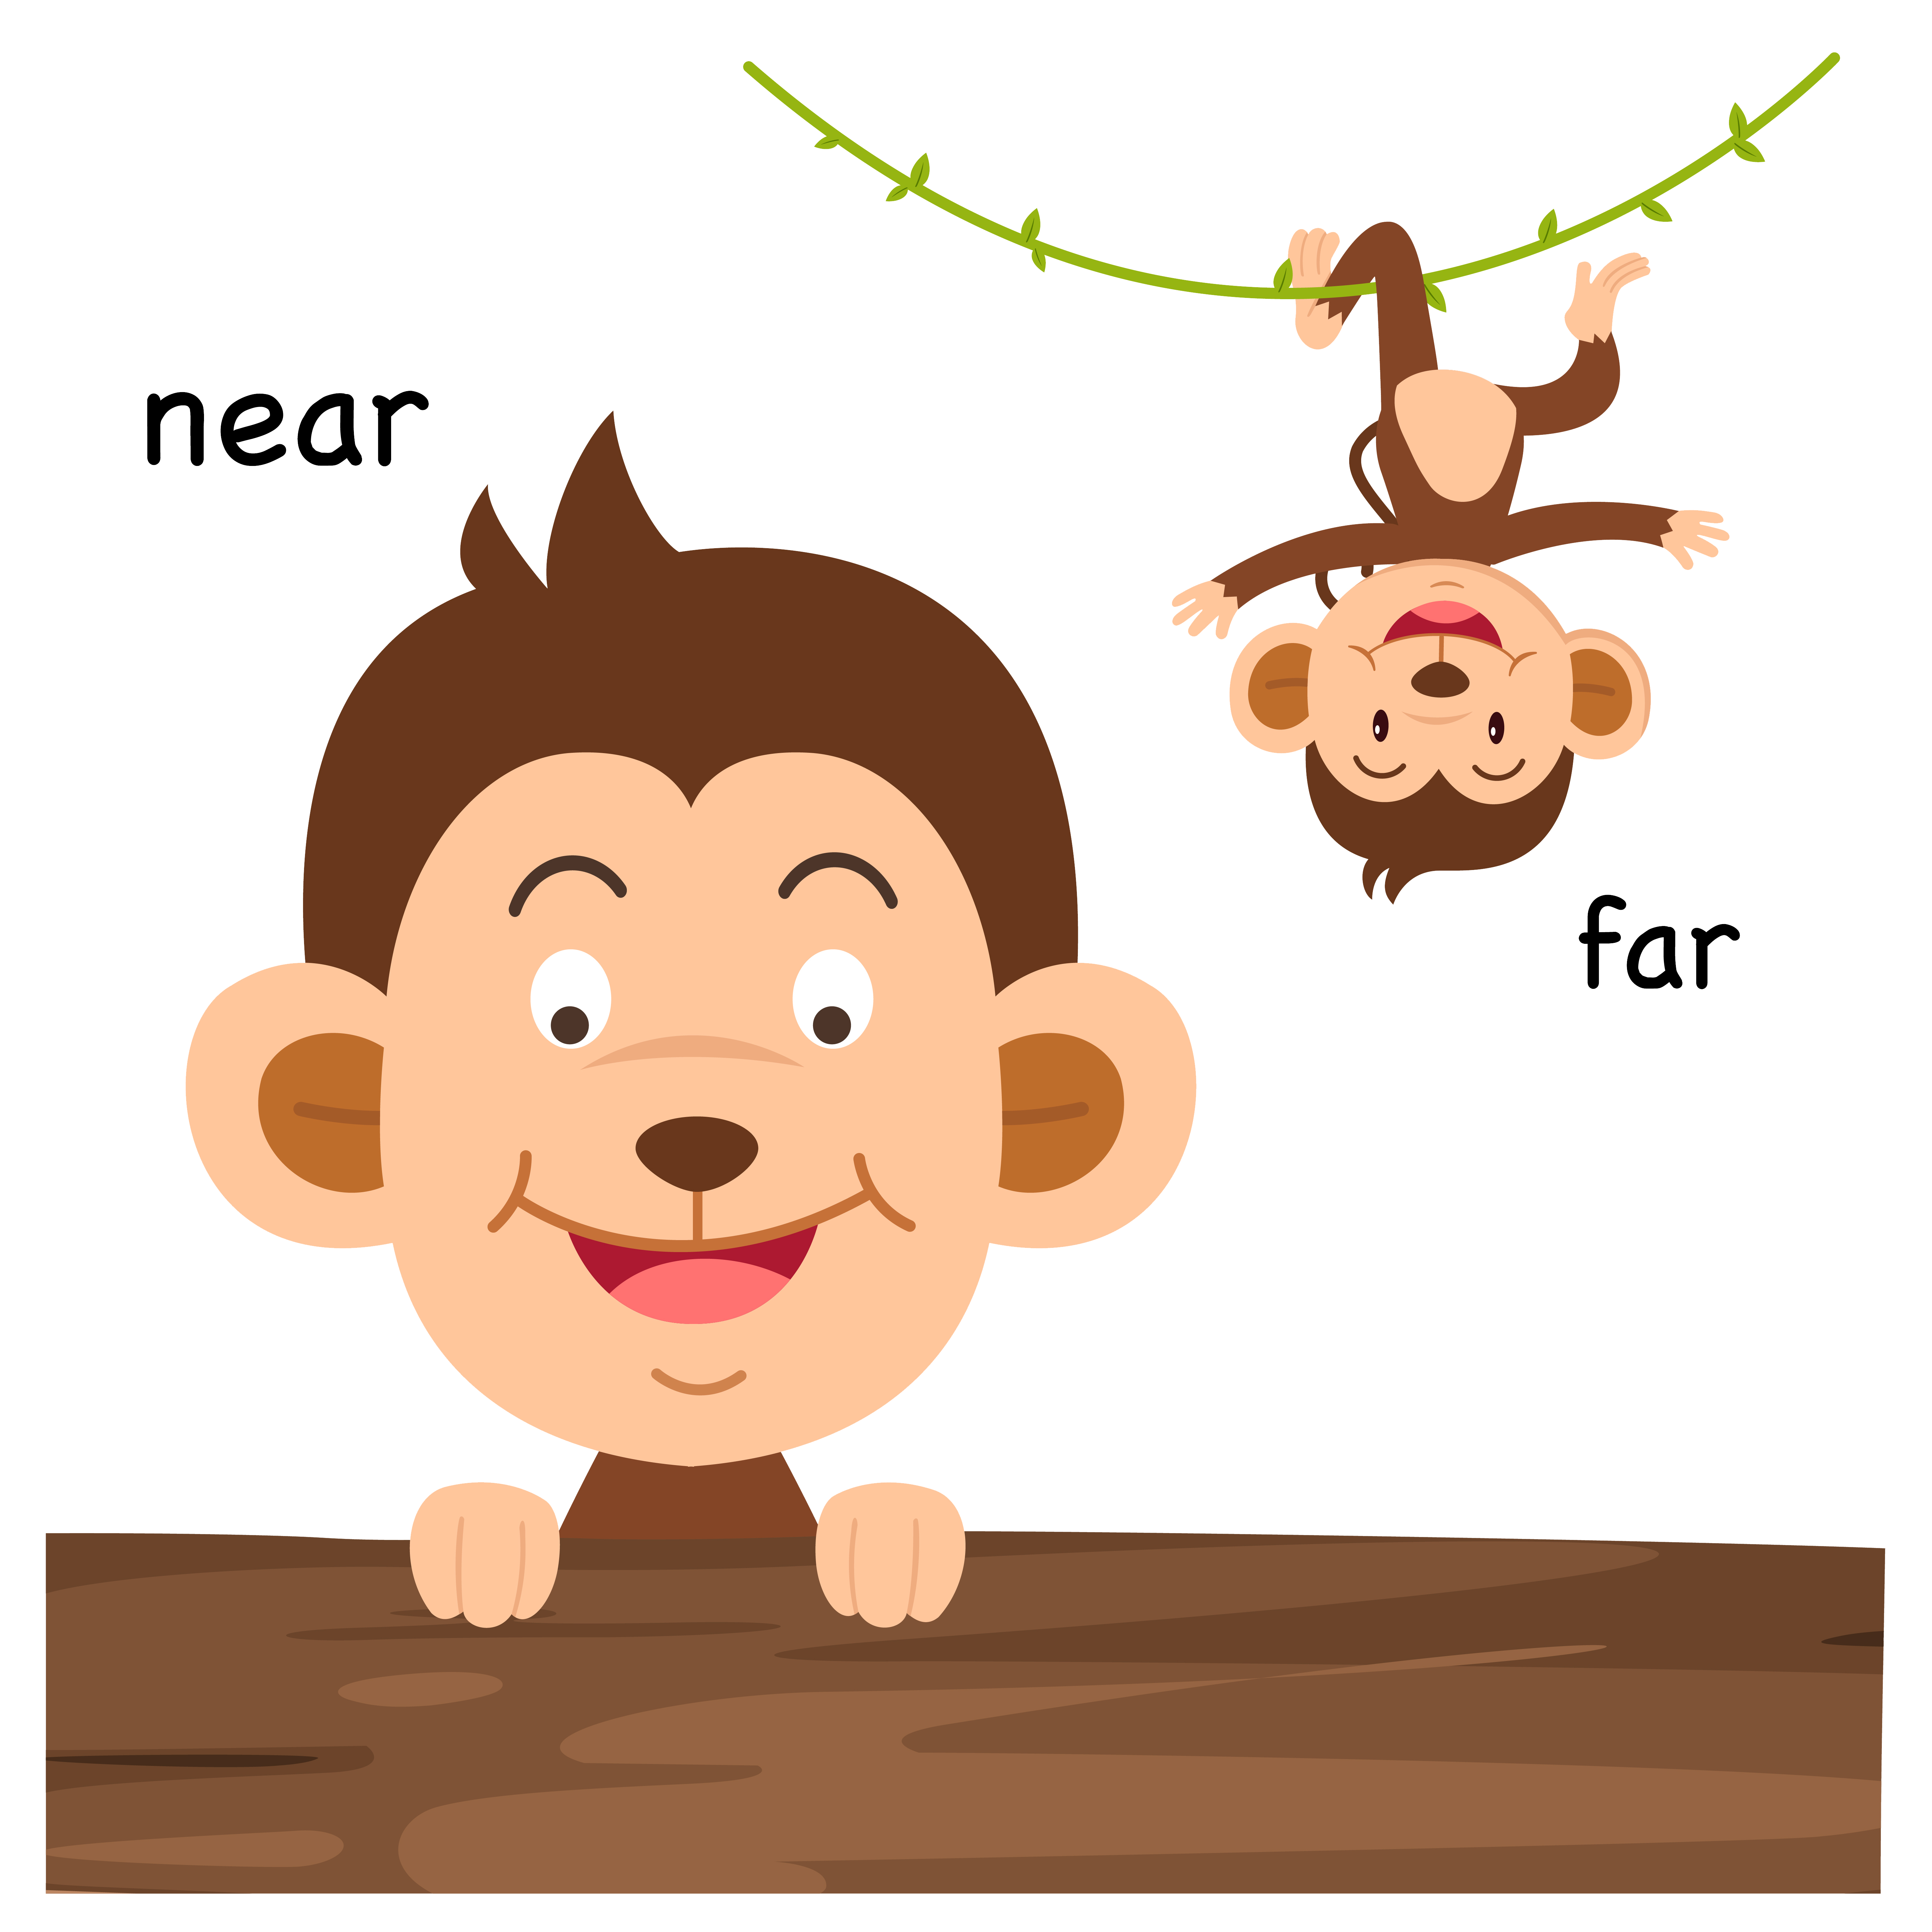



Dive into a 5 Finger Retell
EVENTS
SETTING
SOLUTION
PROBLEM
CHARACTERS
Notes:
Say, “This week you read the story Chimp and Whale at the Beach. Today I am going to show you some pictures and you will need to tell me which story element is goes with the characters, the setting, the problem, the events, or the solution.
Click to show the word characters. Say, “Which picture shows the characters in the story? Correct! Chimp and Whale are the characters in this story.” Click the characters picture for it to disappear. Click for the word character to disappear.
Click to show the word setting. Say, “Which picture shows the setting in the story? Correct! The beach is the setting in this story.” Click the setting picture for it to disappear. Click for the word setting to disappear.
Click to show the word problem. Say, “Which picture shows the problem in the story? Correct! The picture showing Chimp and Whale living far from each other is the problem in this story.” Click the problem picture for it to disappear. Click for the word problem to disappear.
Click to show the word events. Say, “Which picture shows one of the events from the story? Correct! They played checkers is an event from the story.” Click the event picture for it to disappear. Click for the word events to disappear.
Click to show the word solution. Say, “Which picture shows the solution of the story? Correct! They will see each other in 6 months is the solution of this story.” Click for the word solution to disappear.

Slide 7
Q & A
Any Questions?

