Slide 1
Sharpen Your Word Skills
Shining sh and Thankful th
Notes:
Say, “Today we are going to have a raving review of the short e sound, our super sight words, and a 5 finger retell of the story “Megs Pet”.

Slide 2


Review of Diagraphs sh and th
th
sh
Notes:
Say, “Listen closely as I say each word with the sh or th diagraph in it. After I say the word you repeat it”
Click to show sh and picture of a shoe. Say, “sh” sound as in shoe” student repeats sh as in shoe. Click to make it disappear.
Click to show th and picture of a thumb. Say, “th” sound as in thumb” student repeats th as in thumb.

Slide 3

Practice of sh and th Diagraphs
sh
th
Notes:
Say, “We are going to practice the diagraphs sh and th. I will show you a picture and you need to tell me if it has the sh or th sound in it. Ready?”
Click to show a picture of a ship. Say, “What sound does this picture have in it, sh or th?” Click to circle the sh sound. Say “Yes, this is a ship and ship has the sh sound in it!” Let’s try again!

Slide 4

Practice of sh and th Diagraphs
sh
th
Notes:
Click to show a picture of a shower. Say, “What sound does this picture have in it, sh or th?” Click to circle the sh sound. Say “Yes, this is a shower and shower has the sh sound in it!” Let’s try again!

Slide 5

Practice of sh and th Diagraphs
sh
th
Notes:
Click to show a picture of a tooth. Say, “What sound does this picture have in it, sh or th?” Click to circle the th sound. Say “Yes, this is a tooth and tooth have the th sound in it!”

Slide 6
Sight Word Review
could
let
your
them
if
Notes:
Click to show the sight words. Say, “I’ll say the sight word and you repeat it after me.”
Say, “could” Student repeats could.
Say, “let” Student repeats let.
Say, “them” Student repeats them.
Say, “if” Student repeats if.
Say, “your” Student repeats your.
The students will need a piece of paper and pencil for the next activity. They will be asked to write their sight words and then read it.
Say, “Please go get a piece of paper and a pencil for the next activity.”

Slide 7
Sight Word Practice
could
let
your
them
if
Notes:
Say, “I will say a sight word. Then you will write that sight word on a piece of paper and hold it up so I can see it. I will show you the word to check that you spelled it correctly and then you will say the word. Let’s try it!”
Say, “could.”
Say, “Write the word could on your paper.”
Click to show the sight word could to check their work.
Say, “What is the word?” Correct, the word is could.”
Say, “let.”
Say, “Write the word let on your paper.”
Click to show the sight word let to check their work.
Say, “What is the word?” Correct, the word is let.”
Say, “them.”
Say, “Write the word them on your paper.”
Click to show the sight word them to check their work.
Say, “What is the word?” Correct, the word is them.”
Say, “if.”
Say, “Write the word if on your paper.”
Click to show the sight word if to check their work.
Say, “What is the word?” Correct, the word is if.”
Say, “your.”
Say, “Write the word your on your paper.”
Click to show the sight word your to check their work.
Say, “What is the word?” Correct, the word is your.”

Slide 8
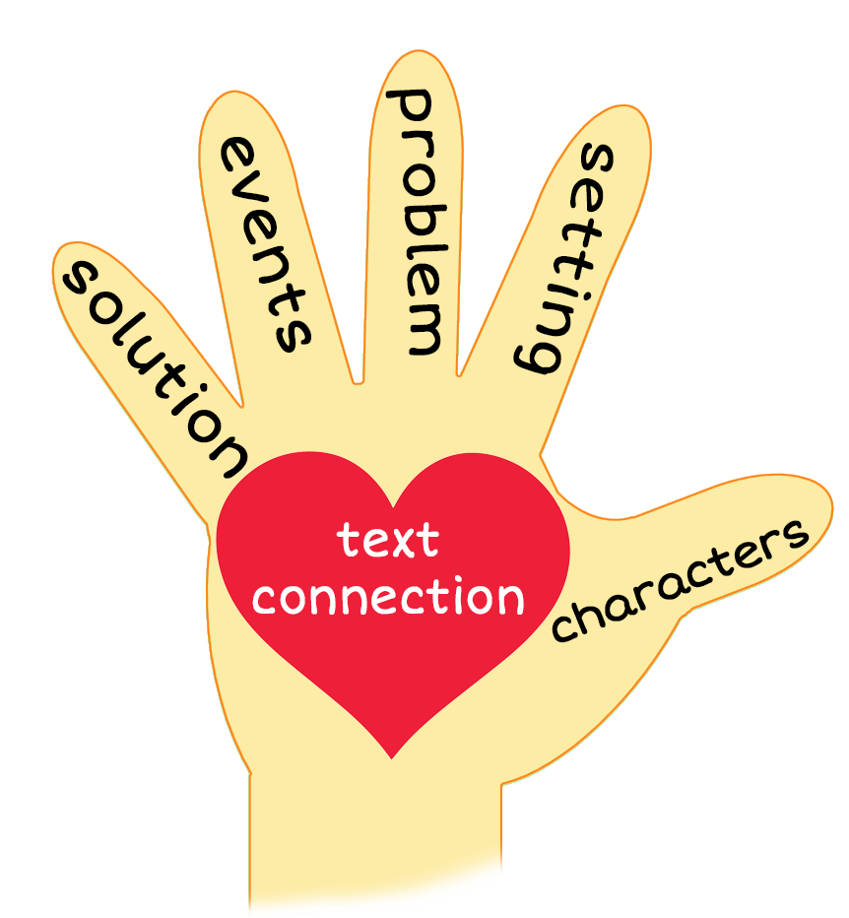

5 Finger Retell
Notes:
Say, “This week you read the story Shark’s teeth. Using the 5 finger retell strategy, can you tell me about the story.
Say, “Hold up your thumb, tell me the characters.”
Say, “Hold up your pointer, tell me the setting.”
Say, “Hold up your tall finger, tell me the problem.”
Say, “Hold up your ring finger, tell me the events.”
Say, “Hold up your little finger, tell me the ending/solution.”
Say, “Make a heart with your fingers, do you brush your teeth? Why is it important to brush your teeth daily?

Slide 9
Q & A
Any Questions?

