Slide 1
Buzz Through Y our Words
Sight Word Bug Splat
Notes:
Say, “Today we are going to buzz through our words and review the short o sound, sight words, and a 5 finger retell of the story “Bug’s Stuff”.

Slide 2

Short i Review
Uu
umbrella
Notes:
Click to show the letter Uu. Tell the students “This is the letter Uu. Uu says uhhh”
Click to show the picture of an umbrella. Say “This is an umbrella. umbrella has the uhhh sound in it”
Click to show the word umbrella. Say “Uu says uhhh, umbrella.

Slide 3

Word Building Short u
g
b _ _
u
un ug ut ub
Notes:
Click to show the picture of the pin and the word with missing letters.
Say, “Look at the picture. What is this a picture of? Yes, it’s a bug. Which combination of letters would I use to fill in the blanks to make the correct word?
Click to show ug. “That’s right! What word did you build? Correct! You built bug.”

Slide 4

Let’s Build Short u Words!
b
t _ _
u
un ug ut ub
Notes:
Click to show the picture of the pin and the word with missing letters.
Say, “Look at the picture. What is this a picture of? Yes, it’s a tub. Which combination of letters would I use to fill in the blanks to make the correct word?
Click to show ub. “That’s right! What word did you build? Correct! You built tub.”

Slide 5

Can you Build short u Words?
n
r _ _
u
un ug ut ub
Notes:
Click to show the picture of the pin and the word with missing letters.
Say, “Look at the picture. What is this a picture of? Yes, it’s a person running. Which combination of letters would I use to fill in the blanks to make the correct word?
Click to show un. “That’s right! What word did you build? Correct! You built run.”

Slide 6
Sight Word Echo
by
know
thank
carry
Notes:
Click to show the sight words. Say, “I’ll say the sight word and you repeat it after me.”
Say, “by” Student repeats by.
Say, “know” Student repeats know.
Say, “thank” Student repeats thank.
Say, “carry” Student repeats carry

Slide 7





Sight Word Bug Splat
Notes:
Click to show the sight words on the bugs. Say, “I am going to say a sight word. You are to tell me the color bug that has that sight word in it.”
Say, “thank” Student will tell you the color of the bug with the sight word thank in it. If the student is correct click the word thank to splat it. If the student is wrong have them try again.
Say, “by” Student will tell you the color of the bug with the sight word by in it. If the student is correct click the word by to splat it. If the student is wrong have them try again.
Say, “know” Student will tell you the color of the bug with the sight word know in it. If the student is correct click the word know to splat it. If the student is wrong have them try again.
Say, “carry” Student will tell you the color of the bug with the sight word carry in it. If the student is correct click the word carry to splat it. If the student is wrong have them try again.

Slide 8
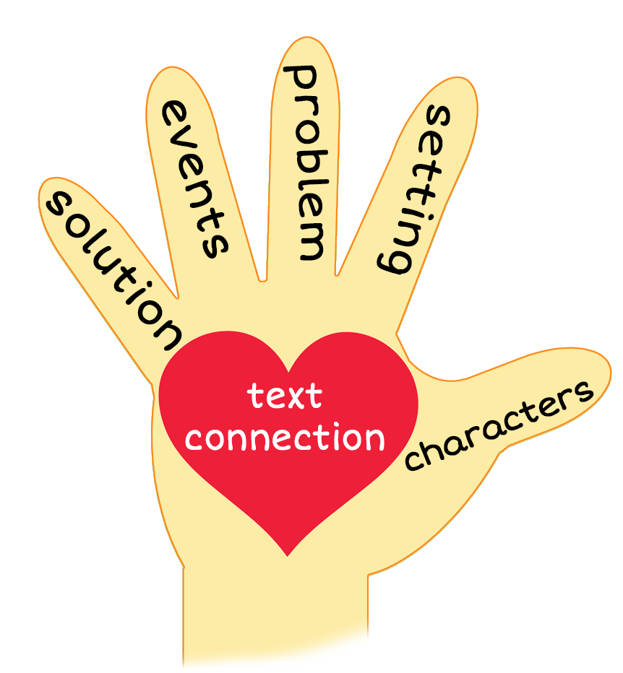
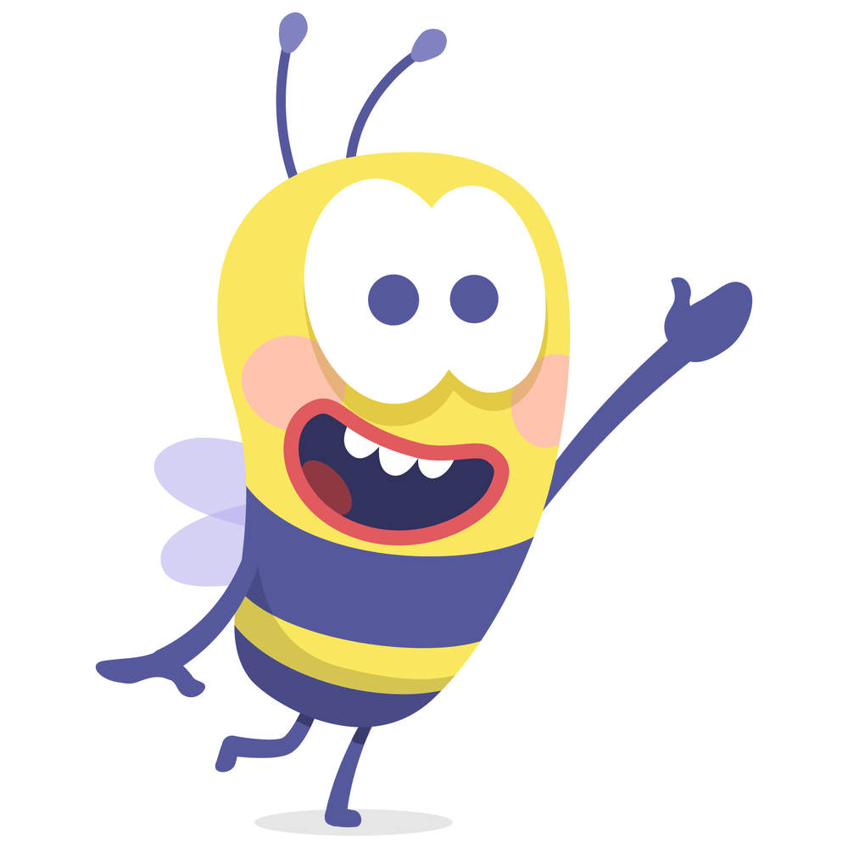
5 Finger Retell
Notes:
Click to show chart and bug. Say, “Look at the 5 finger retell chart. Use the chart to help you retell the story Bug’s Stuff.”
Say, “Hold up your thumb, tell me the characters.”
Say, “Hold up your pointer, tell me the setting.”
Say, “Hold up your tall finger, tell me the problem.”
Say, “Hold up your ring finger, tell me the events.”
Say, “Hold up your little finger, tell me the ending/solution.”
Say, “Make a heart with your fingers, what does this story remind you of?

Slide 9
Q & A
Any Questions?

