Slide 1
Circus of Words
Applaud l-blends
Notes:
Say, “Today we are going to review a circus of words. We will review l-blends, our sight words, and the 5 finger retell of the story “The Clown’s Flowers”.

Slide 2






L-blend Review
pl
gl
cl
fl
bl
sl
Notes:
An l-blend is when the letter l combines with a different letter to form one sound. There are many different l-blends.
Say, “Listen closely as I say each l-blend and a word with that blend. After I say the l-blend and word you repeat it”
Click to show bl and picture of color blue. Say, “bl as in blue” student repeats bl as in blue.
Click to show cl and picture of a cloud. Say, “cl as in cloud” student repeats cl.
Click to show fl and a picture of a flower. Say, “fl as in flower” student repeats fl as in flower.
Click to show gl and a picture of glasses. Say, “gl as in glasses” student repeats gl as in glasses.
Click to show pl and a picture of a plant. Say, “pl as in plant” student repeats pl as in plant.
Click to show sl and a picture of a slide Say, “sl as in slide” student repeats sl as in slide.

Slide 3






L-blend Practice
cl
bl
fl
Notes:
Click to show word sort chart and pictures. Say, “Can you name each picture?” Correct them if they got any incorrect. (flamingo, blocks, clock, blender, flip flops, cliff)
Say, “We are going to sort the pictures under the correct l-blend column.”
Say, “What column would flamingo go under? Yes! Flamingo would go under fl. Click the flamingo to move under fl column. (NOTE: You must click on the picture)
Say, “What column would blocks go under? Yes! Blocks would go under bl. Click the blocks to move under bl column.
Say, “What column would clock go under? Yes! Clock would go under cl. Click the clock to move under cl column.
Say, “What column would blender go under? Yes! blender would go under bl. Click the blender to move under bl column.
Say, “What column would flip flops go under? Yes! Flip flops would go under fl. Click the flip flops to move under fl column.
Say, “What column would cliff go under? Yes! Cliff would go under cl. Click the cliff to move under cl column.

Slide 4
Sight Word Echo
as
just
take
slow
Notes:
Click to show the sight words. Say, “I’ll say the sight word and you repeat it after me.”
Say, “as” Student repeats as.
Say, “just” Student repeats just.
Say, “take” Student repeats take.
Say, “slow” Student repeats slow.

Slide 5
Sight Word Echo
as
just
take
slow
Notes:
Tell the student, “You are going to practice your sight words using actions I am going to tell you the action I want you to do, show you the sight word, and then you say the word 3 times while doing the action. Are you ready?”
Click to show the word as. Say, “Can you read this word 3 times while doing jumping jacks.”
Click to show the word just. Say, “Can you read this word 3 times while spinning in a circle.”
Click to show the word take. Say, “Can you read this word 3 times while patting your head.”
Click to show the word slow. Say, “Can you read this word 3 times while blinking your eyes.”

Slide 6
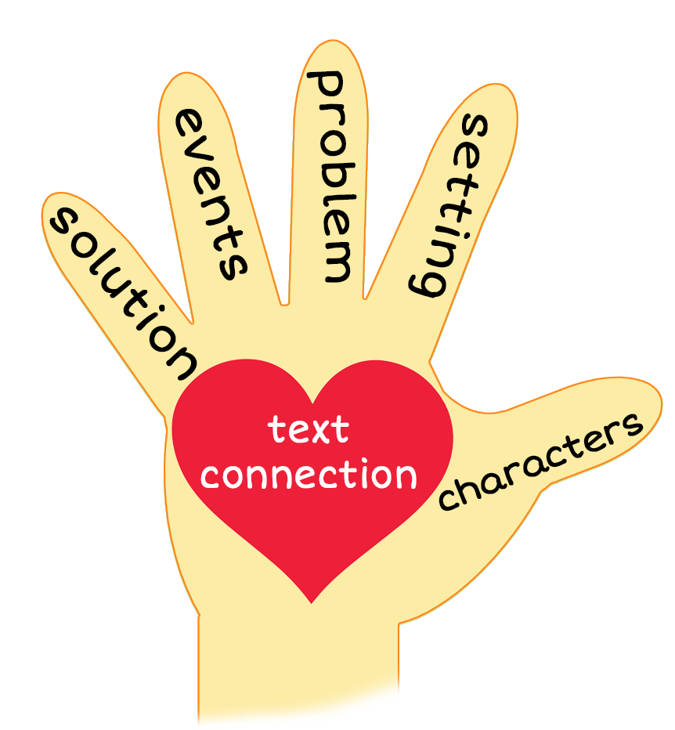

5 Finger Retell
Notes:
Say, “Look at the 5 finger retell chart. Use the chart to help you retell the story The Clown’s Flowers.”
Say, “Hold up your thumb, tell me the characters.”
Say, “Hold up your pointer, tell me the setting.”
Say, “Hold up your tall finger, tell me the problem.”
Say, “Hold up your ring finger, tell me the events.”
Say, “Hold up your little finger, tell me the ending/solution.”
Say, “Make a heart with your fingers, have you ever ran into a problem like this? How did you solve it?

Slide 7
Q & A
Any Questions?

