Slide 1
Super Snazzy Review
Sl -ithery Sn-ake
s-blends
Notes:
Say, “Today we are going to a super snazzy review and review s blends, our sight words, and main idea and details of the story “Snazzy Snake Facts”.

Slide 2




S-blend Review
sp
sm
sc
sk
Notes:
There are many different s blends.
Say, “Listen closely as I say each s blend” Say each s blend, “sc sk sl sm sn sp squ st sw.”
Let’s practice some s blends.
Click to show the letters sc. Say “What sound does sc make together?”
Click to show the picture of a scarecrow. Say “This word has the sc sound in it. Can you tell me what this word is?” Click to remove pictures.
Click to show the letters sk. Say “What sound does sk make together?”
Click to show the picture of a skate. Say “This word has the sk sound in it. Can you tell me what this word is?” Click to remove pictures.
Click to show the letters sm. Say “What sound does sm make together?”
Click to show the picture of a smile. Say “This word has the sm sound in it. Can you tell me what this word is?” Click to remove pictures.
Click to show the letters sp. Say “What sound does sp make together?”
Click the picture to show the spoon. Say “This word has the sp sound in it. Can you tell me what this word is?” Click to remove pictures.

Slide 3



S-blend Practice
Notes:
Click to show the pictures. Say, “Can you tell me what each of these pictures are?” (slippers, truck, snail)
Say, “Can you tell me what blend doesn’t belong? Tell me what picture does not have an s-blend in the word. That’s right! The picture of the truck does not have an s-blend in it.”

Slide 4



S-blend Practice
Notes:
Click to show the pictures. Say, “Can you tell me what each of these pictures are?” (stars, snake, drum)
Say, “Can you tell me what blend doesn’t belong? Tell me what picture does not have an s-blend in the word. That’s right! The picture of the drum does not have an s-blend in it.”

Slide 5



S-blend Review
Notes:
Click to show the pictures. Say, “Can you tell me what each of these pictures are?” (cloud, skunk, spider)
Say, “Can you tell me what blend doesn’t belong? Tell me what picture does not have an s-blend in the word. That’s right! The picture of the cloud does not have an s-blend in it.”

Slide 6
Sight Word Review
Notes:
Say, “Today we are going to review our sight words from Module 1-5. When I say the sight word you tell me which color circle to click.”
Only click that circle if the student is correct. If the student is wrong. Say, “That is not the correct sight word. Let’s try again and repeat the sight word.
Continue until all the circles have disappeared.

Slide 7
Sight Word Review
her
put
an
him
some
how
stop
hurt
any
Notes:
Say, “Today we are going to review our sight words from Module 1-5. When I say the sight word you tell me which color square to click.”
Only click that square if the student is correct. If the student is wrong. Say, “That is not the correct sight word. Let’s try again and repeat the sight word.
Continue until all the squares have disappeared.

Slide 8
Main Idea and Details
Details
Main Idea
The main idea is what the story is mostly about
Details explain more about the main idea
Notes:
Click to show main idea. Ask, “What is the main idea of a text?”
Click to show the definition of main idea. Say, “The main idea is what the story is mostly about.” Click to make main idea disappear.
Click to show details. Ask, “What are the details in a story?”
Click to show the definition of details. Say, “Details explain more about the main idea”

Slide 9
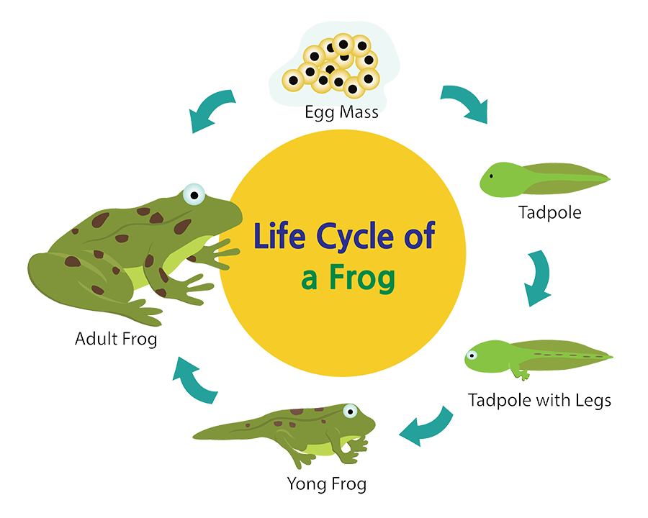
Main Idea and Details
Notes:
[use Shutterstock image ID: 334313393]
Click to show the picture of the snake. Say, “This week you read the story Snazzy Snake Facts. Ask, “What is the main idea of this story? What is it mostly about? What are some details that explain more about the main idea?

Slide 10
Q & A
Any Questions?

