Slide 1
Jogging into a Jam-Packed Review
Outstanding Short o
Notes:
Say, “Today we are going to jog into a jam-packed review. We will review the short o sound, sight words, and a 5 finger retell of the story “The Jog”.

Slide 2

Short o Review
Oo
octopus
Notes:
Say, “We are going to learn about the short o sound.
Click to show the letter Oo. Say,“This is the letter Oo. Oo says ohh”
Click to show the picture of an octopus. Say “This is an octopus. Octopus has the ohh sound in it”
Click to show the word octopus. Say “ Oo says ohh, octopus.

Slide 3




Short o Practice
Notes:
Click to show the slide full of different objects.
Say, “Look at these pictures. Can you name each of these pictures?”
Say, I spy a picture with the short o sound in the word. Can you tell me which picture has the short o sound in the word?” That’s’ right! The box has the short o sound in it!

Slide 4




Short o Practice
Notes:
Click to show the slide full of different objects.
Say, “Look at these pictures. Can you name each of these pictures?”
Say, “I spy two pictures with the short o sound in the word. Can you tell me which pictures has the short o sound in the word? That’s’ right! The log and top have the short o sound in it!”

Slide 5

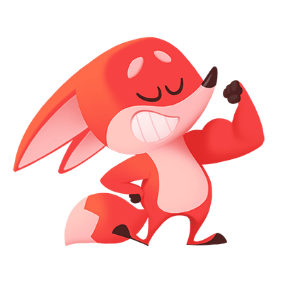
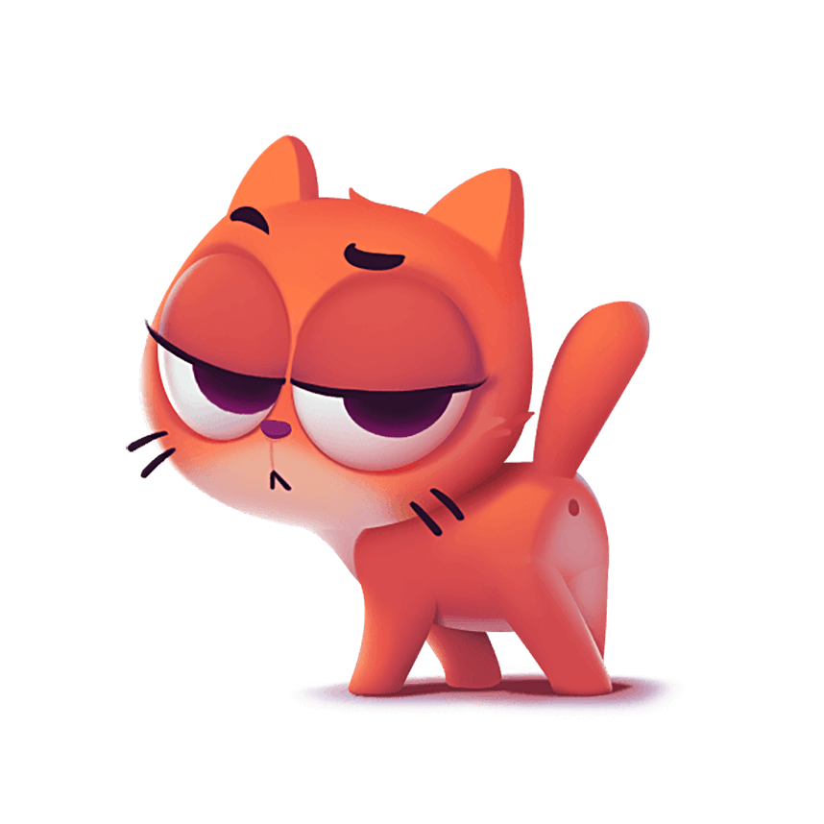

Short o Practice
Notes:
Click to show the slide full of different objects.
Say, “Look at these pictures. Can you name each of these pictures?”
Say, “I spy three pictures with the short o sound in the word. Can you tell me which pictures have the short o sound in the word? That’s’ right! The dog, fox, and frog have the short o sound in it!”

Slide 6
Sight Word Echo
ask
how
stop
hurt
Notes:
Say, “I am going to say the sight word and you repeat it after me.
Click to show the sight word any. Say, “ask” Student repeats any.
Click to show the sight word his. Say, “how” Student repeats his.
Click to show the sight word some. Say, “stop” Student repeats some.
Click to show the sight word bring. Say, “hurt” Student repeats bring.

Slide 7
Sight Word Sentences
Lauren fell off her bike and got hurt.
I need to ask my teacher for help.
How much money is this candy bar?
The car had to stop at the red light.
Notes:
Say, “I am going to read a sentence to you. While I am reading look and listen for the sight words ask, how, stop, and hurt.
Click to show sentence. Say, “I need to ask my teacher for help. Do you see a sight word in that sentence? What is the sight word you see? Yes, ask is the sight word in that sentence. Let’s try another sentence.” Click to make sentence disappear.
Click to show sentence. Say, “Lauren fell off her bike and got hurt. Do you see a sight word in that sentence? What is the sight word you see? Yes, hurt is the sight word in that sentence. Let’s try another sentence.” Click to make sentence disappear.
Click to show sentence. Say, “How much money is this candy bar? Do you see a sight word in that sentence? What is the sight word you see? Yes, how is the sight word in that sentence. Let’s try another sentence.” Click to make sentence disappear.
Click to show sentence. Say, “The car had to stop at the red light. Do you see a sight word in that sentence? What is the sight word you see? Yes, stop is the sight word in that sentence.”

Slide 8

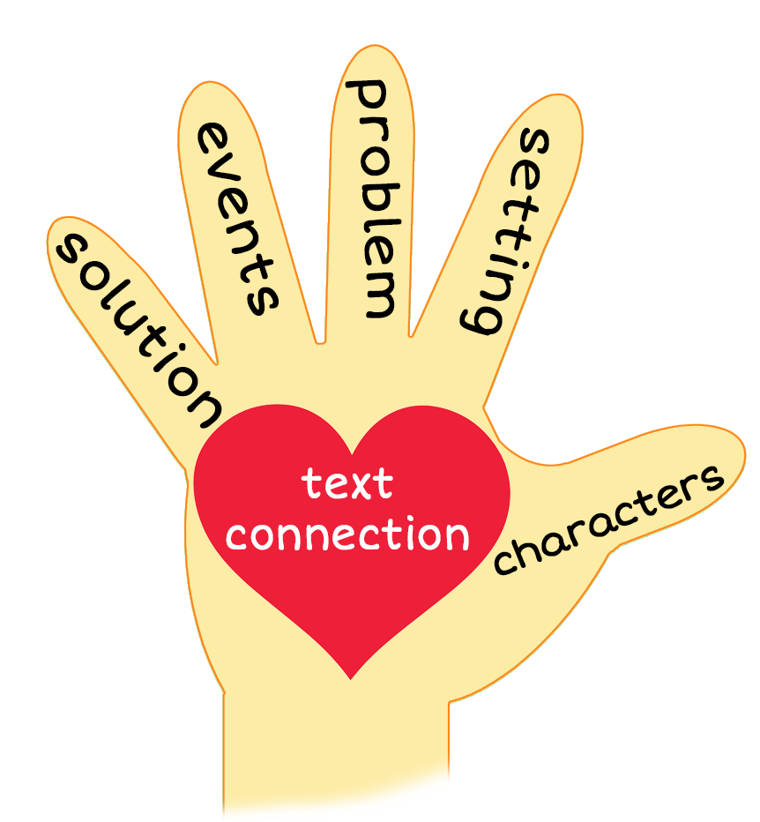
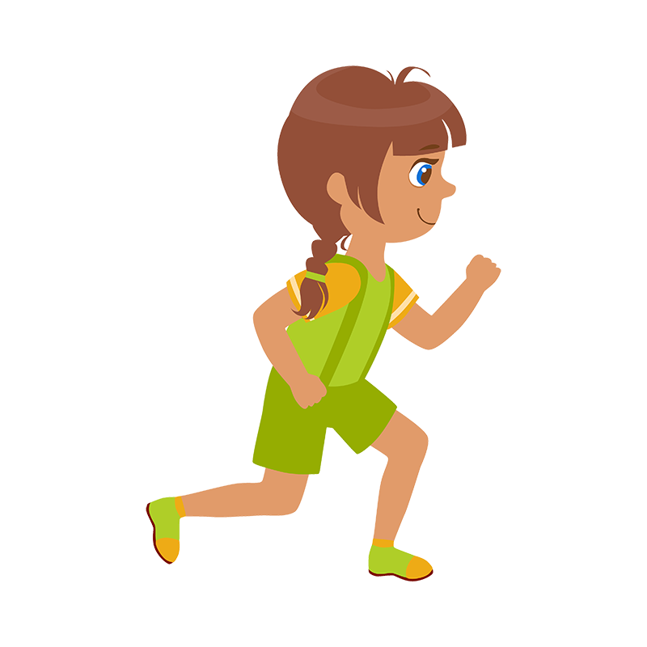
5 Finger Retell
Notes:
Say, “Look at the 5 finger retell chart. Use the chart to help you retell the story The jog.”
Say, “Hold up your thumb, tell me the characters.”
Say, “Hold up your pointer, tell me the setting.”
Say, “Hold up your tall finger, tell me the problem.”
Say, “Hold up your ring finger, tell me the events.”
Say, “Hold up your little finger, tell me the ending/solution.”
Say, “Make a heart with your fingers, have you ever ran into a problem like this? How did you solve it?

Slide 9
Q & A
Any Questions?

