Slide 1
Take a Trip into an Adventurous Review
Finding the Ihh-nvisible Short I
Notes:
Say, “Today we are going to have an adventure reviewing the short i sound, sight words, and a 5 finger retell of the story “The Trip”.

Slide 2

Short i Review
Ii
igloo
Notes:
Say, “We are going to learn about the short i sound.
Click to show the letter Ii. Say,“This is the letter Ii. Ii says ihhh”
Click to show the picture of an igloo. Say “This is an igloo. Igloo has the ihhh sound in it”
Click to show the word igloo. Say “ Ii says ihhh, igloo.

Slide 3

Short i Practice
n
p _ _
i
it ig ip in
Notes:
Click to show the picture of the pin and the word with missing letters.
Say, “Look at the picture. What is this a picture of? Yes, it’s a pin. Which combination of letters would I use to fill in the blanks to make the correct word?
Click to show in. “That’s right! What word did you build? Correct! You built pin.”

Slide 4

Short i Practice
g
p _ _
i
it ig ip in
Notes:
Click to show the picture of the pig and the word with missing letters.
Say, “Look at the picture. What is this a picture of? Yes, it’s a pig. Which combination of letters would I use to fill in the blanks to make the correct word?
Click to show ig. “That’s right! What word did you build? Correct! You built pig.”

Slide 5

Short i Practice
s _ _
i
x
it ig ix in
Notes:
Click to show the picture of the six and the word with missing letters.
Say, “Look at the picture. What is this a picture of? Yes, it’s the number six. Which combination of letters would I use to fill in the blanks to make the correct word?
Click to show ix. “That’s right! What word did you build? Correct! You built six.”

Slide 6
Sight Word Echo
any
his
some
bring
Notes:
Say, “I am going to say the sight word and you repeat it after me.
Click to show the sight word any. Say, “any” Student repeats any.
Click to show the sight word his. Say, “his” Student repeats his.
Click to show the sight word some. Say, “some” Student repeats some.
Click to show the sight word bring. Say, “bring” Student repeats bring.

Slide 7
Sight Word Memory
any
his
bring
some
his
some
any
bring
Notes:
Say, “We are going to play sight word memory. You will tell me a color to click on and then choose another color. If they are a match, then move onto two new boxes. If they are not the same flip them back over so you can try again. Try to remember where they were so you can a match the words the next time!”
Allow the student to continue until all the sight words are matched.

Slide 8

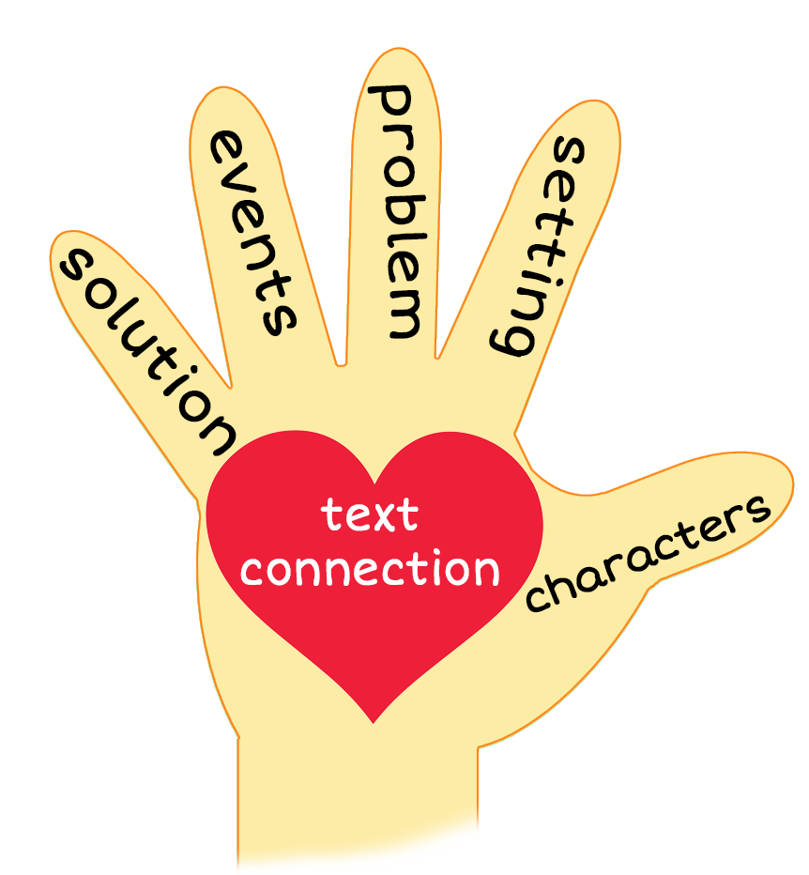
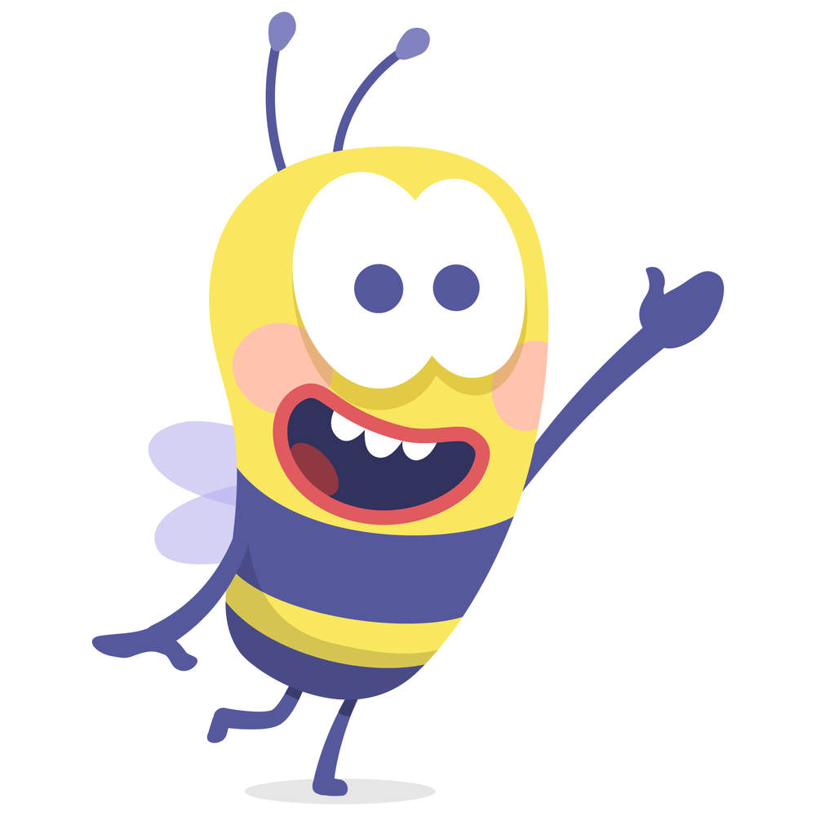
5 Finger Retell
Notes:
Say, “Look at the 5 finger retell chart. Use the chart to help you retell the story The Trip.”
Say, “Hold up your thumb, tell me the characters.”
Say, “Hold up your pointer, tell me the setting.”
Say, “Hold up your tall finger, tell me the problem.”
Say, “Hold up your ring finger, tell me the events.”
Say, “Hold up your little finger, tell me the ending/solution.”
Say, “Make a heart with your fingers, can you relate to these characters in your own life? Why or why not?”

Slide 9
Q & A
Any Questions?

