Slide 1
Be a Word Detective
Finding Clues in Words
Notes:
Say, “Today we are going to be a word detective and review r blends, our sight words, and main idea and details of the story “How Frog Grows”.

Slide 2







Prrr-esenting r Blends
gr
pr
tr
fr
cr
br
dr
Notes:
There are many different r blends.
Say, “Listen closely as I say each r blend” Say each r blend, “br, cr dr, fr, gr, pr, tr.
Click to show the letters br. Say “What sound do br make together?”
Click to show the picture of a broom. Say “This word has the br sound in it. Can you tell me what this word is?” Click to remove pictures.
Click to show the letters cr. Say “What sound do cr make together?”
Click to show the picture of a crab. Say “This word has the cr sound in it. Can you tell me what this word is?” Click to remove pictures.
Click to show the letters dr. Say “What sound do dr make together?”
Click to show the picture of a dress. Say “This word has the dr sound in it. Can you tell me what this word is?” Click to remove pictures.
Click to show the letters fr. Say “What sound do fr make together?”
Click the picture to show the frog. Say “This word has the fr sound in it. Can you tell me what this word is?” Click to remove pictures.
Click to show the letters gr. Say “What sound do gr make together?”
Click to show the picture of a grape. Say “This word has the gr sound in it. Can you tell me what this word is?” Click to remove pictures.
Click to show the letters pr. Say “What sound do pr make together?”
Click to show the picture of a present. Say “This word has the pr sound in it. Can you tell me what this word is?” Click to remove pictures.
Click to show the letters tr. Say “What sound do tr make together?”
Click to show the picture of a tree. Say “This word has the tr sound in it. Can you tell me what this word is?”

Slide 3



Crack the Case – r Blends
Notes:
Click to show the pictures. Say, “Can you tell me what each of these pictures are?”
Say, “Crack the case and tell me what blend doesn’t belong? Tell me what picture does not have an r blend in the word. That’s right! The picture of the flower does not have an r blend in it

Slide 4



Crack the Case – r Blends
Notes:
Click to show the pictures. Say, “Can you tell me what each of these pictures are?”
Say, “Crack the case and tell me what blend doesn’t belong? Tell me what picture does not have an r blend in the word. That’s right! The picture of the plane does not have an r blend in it

Slide 5



Crack the Case – r Blends
Notes:
Click to show the pictures. Say, “Can you tell me what each of these pictures are?”
Say, “Crack the case and tell me what blend doesn’t belong? Tell me what picture does not have an r blend in the word. That’s right! The picture______ does not have an r blend in it

Slide 6
Sight Word Review
an
him
round
shall
Notes:
Click to show the sight word an. Say, “What is this sight word? That’s right! The sight word is an.”
Click to show the sight word him. Say, “What is this sight word? That’s right! The sight word is him.”
Click to show the sight word round. Say, “What is this sight word? That’s right! The sight word is round.”
Click to show the sight word shall. Say, “What is this sight word? That’s right! The sight word is shall.”

Slide 7
Sight Word Review
an
him
round
shall
Notes:
Tell the student, “You are going to practice your sight words using silly voices. I am going to tell you the type of silly voice I want hear, show you the sight word, and then you say it in that silly voice. Are you ready?”
Click to show the word an. Say, “Can you read this word in a whisper voice?”
Click to show the word him. Say “Can you read this word in a baby voice?”
Click to show the word round. Say, “Can you read this word in a pirate voice?”
Click to show the word shall. Say, “Can you read this word in a dog voice?”

Slide 8
Main Idea and Details
Details
Main Idea
The main idea is what the story is mostly about
Details explain more about the main idea
Notes:
Click to show main idea. Ask, “What is the main idea of a text?”
Click to show the definition of main idea. Say, “The main idea is what the story is mostly about.” Click to make main idea disappear.
Click to show details. Ask, “What are the details in a story?”
Click to show the definition of details. Say, “Details explain more about the main idea”

Slide 9
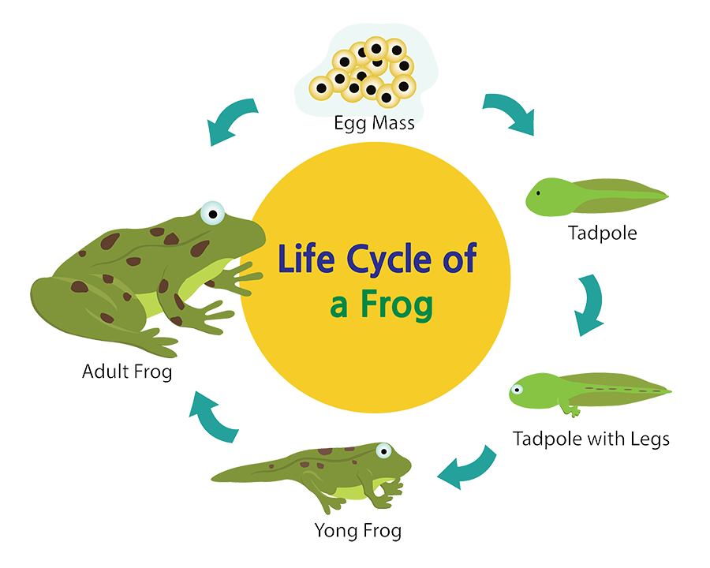
Main Idea and Details
Notes:
Click to show the picture of the life cycle of a frog. Say, “This week you read the story How Frog Grows. Ask, “What is the main idea of this story? What is it mostly about? What are some details that explain more about the main idea?

Slide 10
Q & A
Any Questions?

