Slide 1
Ehh-xcellent Short e
Raving Review
Notes:
Say, “Today we are going to have a raving review of the short e sound, our super sight words, and a 5 finger retell of the story “Megs Pet”.

Slide 2

Ehh-xcellent Short e
Review
Ee
egg
Notes:
Say, “We are going to learn about the ehh-xcellent short e.
Click to show the letter Ee. Say,“This is the letter Ee. Ee says ehhh”
Click to show the picture of an egg. Say “This is an egg. Egg has the ehhh sound in it”
Click to show the word egg. Say “ Ee says ehhh, egg.

Slide 3
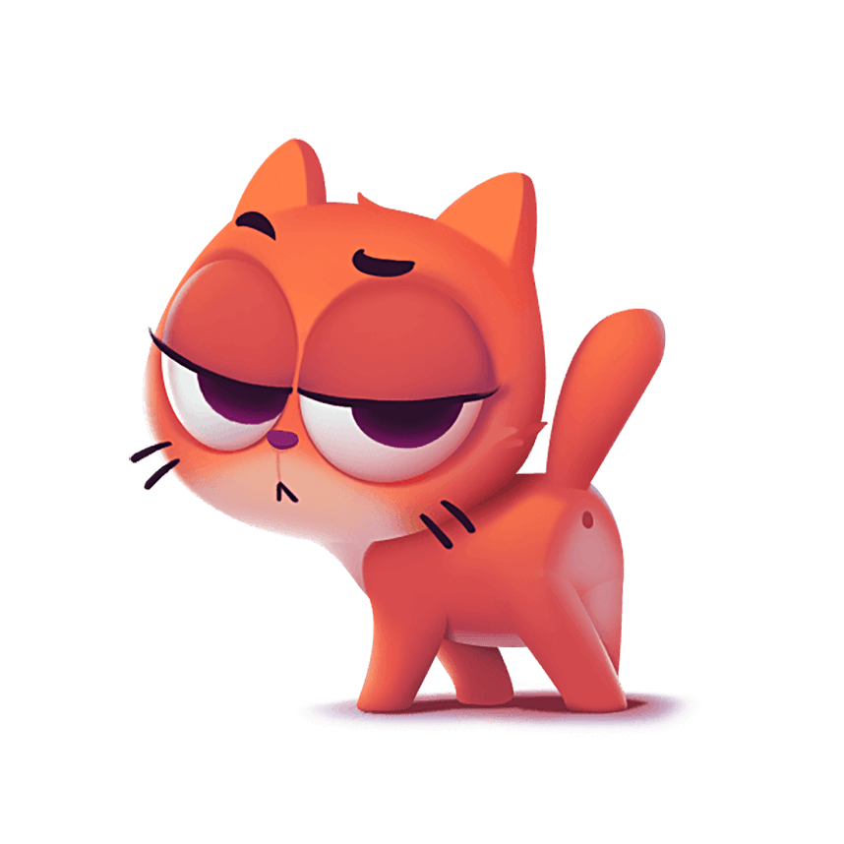



Ehh-xceptional Short e
Notes:
Click to show the slide full of different objects.
Say, “Look at these pictures. Can you name each of these pictures?”
Say, I spy a picture with the short e sound in the word. Can you tell me which picture has the short e sound in the word?” That’s’ right! The elephant has the short e sound in it!

Slide 4




Ehh-xcited Short e
Notes:
Click to show the slide full of different objects.
Say, “Look at these pictures. Can you name each of these pictures?”
Say, “I spy a picture with the short e sound in the word. Can you tell me which picture has the short e sound in the word? That’s’ right! The bed has the short e sound in it!”

Slide 5
Ehh-ffective Short e
Notes:
Click to show the slide full of different objects.
Say, “Look at these pictures. Can you name each of these pictures?”
Say, “I spy a picture with the short e sound in the color word. Can you tell me which picture has the short e sound in the color word? That’s’ right! Red has the short e sound in it!”

Slide 6
Sight Word Review
again
put
her
Notes:
Click to show the sight word again. Say, “What is this sight word? That’s right! The sight word is again.”
Click to show the sight word put. Say, “What is this sight word? That’s right! The sight word is put.”
Click to show the sight word her. Say, “What is this sight word? That’s right! The sight word is her.”
The students will need a piece of paper and pencil for the next activity. They will be asked to write their sight words and then read it.
Say, “Please go get a piece of paper and a pencil for the next activity.”

Slide 7
Sight Word Review
again
put
her
Notes:
Say, “I will say a sight word. Then you will write that sight word on a piece of paper and hold it up so I can see it. I will show you the word to check that you spelled it correctly and then you will say the word. Let’s try it!”
Say, “again.”
Say, “Write the word again on your paper.”
Click to show the sight word again to check their work.
Say, “What is the word?” Correct, the word is again.”
Say, “put.”
Say, “Write the word put on your paper.”
Click to show the sight word put to check their work.
Say, “What is the word?” Correct, the word is put.”
Say, “her.”
Say, “Write the word her on your paper.”
Click to show the sight word her to check their work.
Say, “What is the word?” Correct, the word is her.”

Slide 8
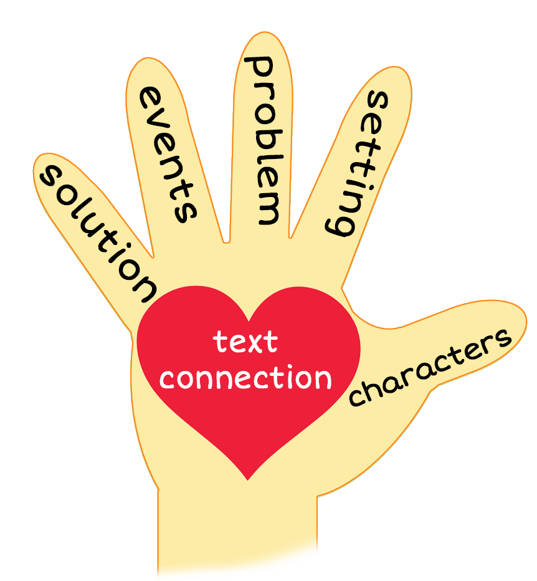
5 Finger Retell
Notes:
Say, “Look at the chart. Can you hold up each of your fingers and tell me each story element?”
Say, “What is the thumb? Yes, it’s the characters.” Click to show the characters.
Say, “What is the pointer? Yes, it’s the setting.” Click to show the setting.
Say, “What is the tall finger? Yes, it’s the problem.” Click to show the problem.
Say, “What is the ring finger? Yes, it’s the events.” Click to show the events.
Say, “What is the pinky? Yes, it’s the solution.” Click to show the solution.
Say, “What is the heart? Yes, it’s the text connection” Click to show the text connection.

Slide 9
5 Finger Retell
Notes:
Click to show the picture. Say, “This week you read the story Meg’s Pet. Using the 5 finger retell strategy, can you tell me about the story.
Say, “Hold up your thumb, tell me the setting.”
Say, “Hold up your pointer, tell me the characters.”
Say, “Hold up your tall finger, tell me the problem.”
Say, “Hold up your ring finger, tell me the events.”
Say, “Hold up your little finger, tell me the ending/solution.”
Say, “Make a heart with your fingers, can you relate to these characters in your own life? Why or why not?”

Slide 10
Q & A
Any Questions?

