Slide 1
Word Quest
Ahhh-mazing short a
Notes:
Say, “Today we are going to go on a word quest. We will practice the short a sound, review our sight words, and do a 5 finger retell using the story “Al’s Jam.”

Slide 2

Ahh-mazing Short Aa Review
Aa
apple
Notes:
Say, “We are going to learn about the ahh-mazing short Aa.
Click to show the letter Aa. Say,“This is the letter Aa. Aa says ahhh”
Click to show the picture of an apple. Say “This is an apple. Apple has the ahhh sound in it”
Click to show the word apple. Say “ Aa says ahhh, apple.
Say, “Please get a piece of paper or whiteboard and a pencil or a white board marker for the next activity.

Slide 3
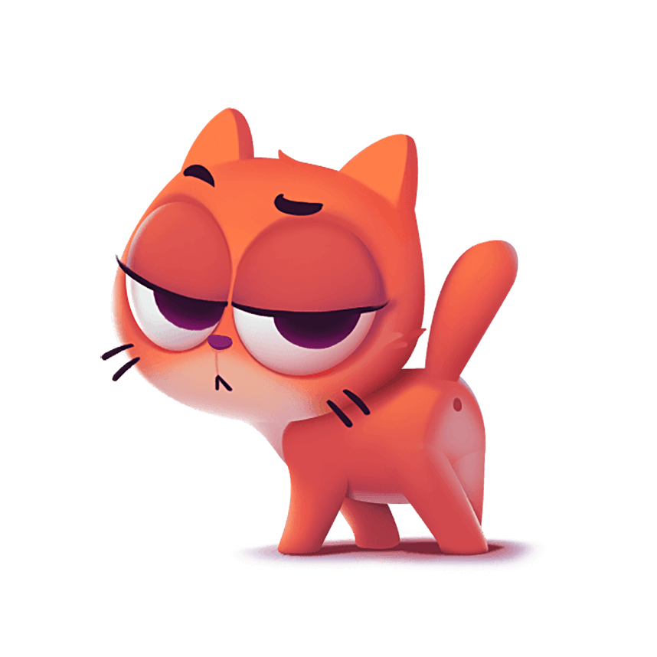
Ahh-mazing Short Aa Practice
Aa
cat
Notes:
Click to show picture of a cat. Ask, “What is this a picture of?” That’s right, it’s a cat.
Say, “Write the word cat on a piece of paper or a white board.” Wait for the student to finish writing the word cat.
Click the show the word cat. Say, “Let’s check your work! Did you write the word cat, c-a-t, cat. Good Job! The word cat has a short Aa sound in it”
Click to show a picture of just the letter Aa. Say “What sound does the short Aa make? That’s right! Aa says ahhh.

Slide 4

Ahh-mazing Short Aa Practice
Aa
ham
Notes:
Click to show picture of a ham. Ask, “What is this a picture of?” That’s right, it’s ham.
Say, “Write the word ham on a piece of paper or a white board.” Wait for the student to finish writing the word ham.
Click the show the word ham. Say, “Let’s check your work! Did you write the word ham, h-a-m, ham. Good Job! The word ham has a short Aa sound in it”
Click to show a picture of just the letter Aa. Say “What sound does the short Aa make? That’s right! Aa says ahhh.

Slide 5

Ahh-mazing Short Aa Practice
Aa
fan
Notes:
Click to show picture of a fan. Ask, “What is this a picture of?” That’s right, it’s a fan.
Say, “Write the word fan on a piece of paper or a white board.” Wait for the student to finish writing the word fan.
Click the show the word fan. Say, “Let’s check your work! Did you write the word fan, f-a-n, fan. Good Job! The word fan has a short Aa sound in it”
Click to show a picture of just the letter Aa. Say “What sound does the short Aa make? That’s right! Aa says ahhh.

Slide 6
Sight Word Review
after jump
has clap
over stomp
better wave
Notes:
Say, “I am going to show a sight word and an action. I will say the word, then you repeat the word and do the action at the same time.”
Click to show sight word and action. Say “after, what is the word?” Student says “after and jumps.”
Click to show sight word and action. Say “has, what is the word?” Student says “has and claps.”
Click to show sight word and action. Say “over, what is the word?” Student says “over and stomps.”
Click to show sight word and action. Say “better, what is the word?” Student says “better and waves.”

Slide 7
Sight Word review
after
over
has
better
Notes:
Say, I am going to say a sight word and you will use the pointer to point to the word after I say it.
Say, “better” Wait for the student to point to the word better. Ask, “What is that word?” The students says, “better”
Say, “over” Wait for the student to point to the word over. Ask, “What is that word?” The students says, “over”
Say, “after” Wait for the student to point to the word after. Ask, “What is that word?” The students says, “after”
Say, “has” Wait for the student to point to the word has. Ask, “What is that word?” The students says, “has”

Slide 8
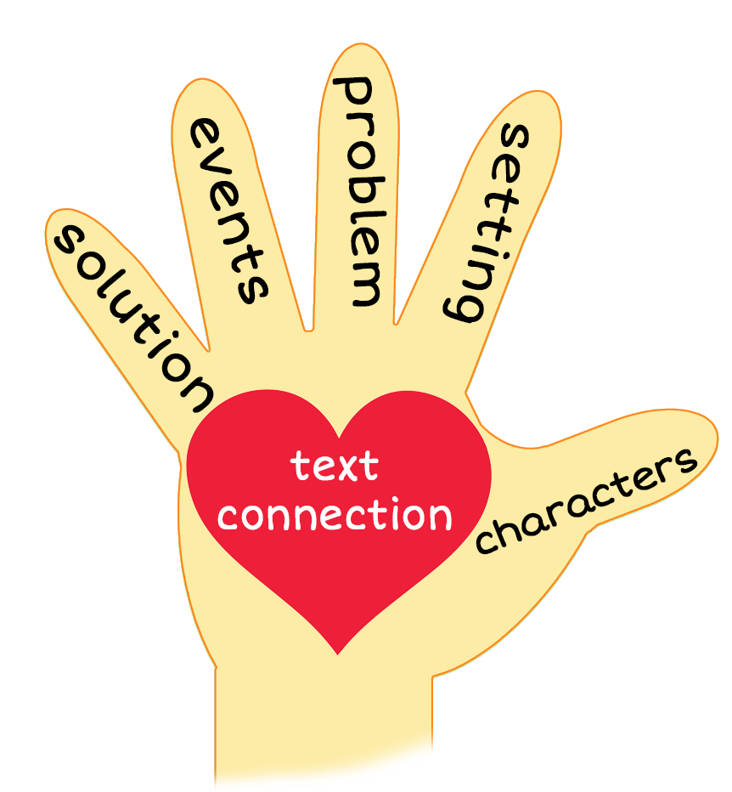
5 Finger Retell
Notes:
Say, “Is there a way to summarize a whole story? Yes, there is! It’s the 5 finger retell. You use the 5 finger retell when summarizing a fiction story.
Look at the chart. (Hold up your fingers with the student as you go over each finger.) Say, “Hold up your thumb, this is the characters. Hold up your pointer, this is the setting. Hold up your tall finger, this is the problem. Hold up your ring finger, this is the events. Hold up your little finger, this is the ending/solution. Make a heart with your fingers (You may need to model this for the student), this is the text connection.”

Slide 9

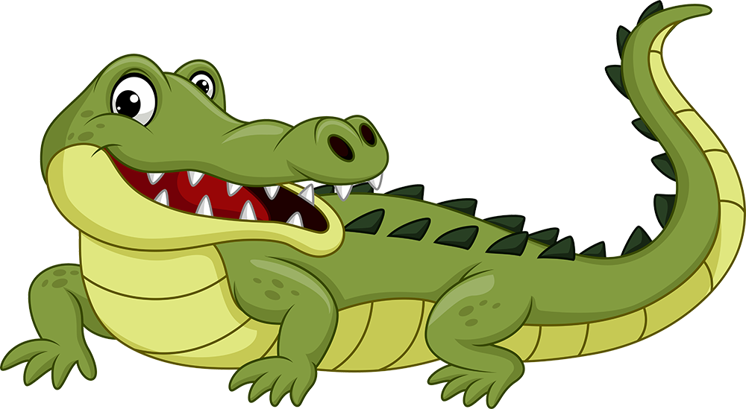
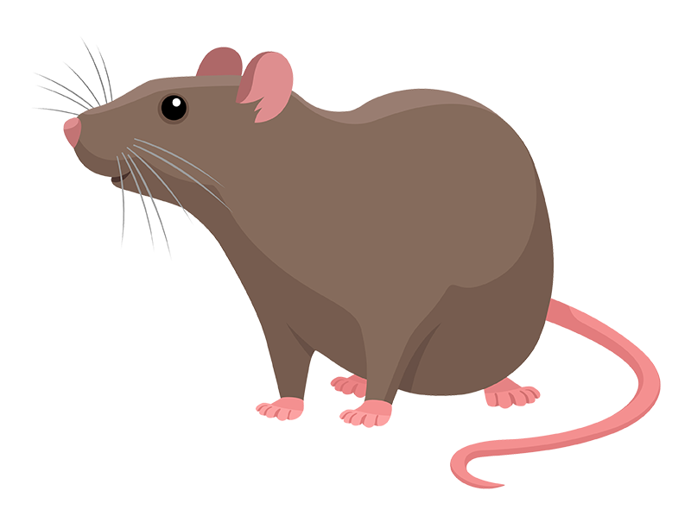
5 Finger retell
Notes:
Click to show the pictures. Say, “This week you read the story Al’s Jam. Using the 5 finger retell strategy, can you tell me about the story.
Say, “Hold up your thumb, tell me the setting.”
Say, “Hold up your pointer, tell me the characters.”
Say, “Hold up your tall finger, tell me the problem.”
Say, “Hold up your ring finger, tell me the events.”
Say, “Hold up your little finger, tell me the ending/solution.”
Say, “Make a heart with your fingers, can you relate to these characters in your own life?”

Slide 10
Q & A
Any Questions?

