Slide 1
Internet Exchanges:
Future-proofing digital infrastructure

Slide 2








DE-CIX at a glance – born with the Internet & powering it everywhere, for everything and everyone
300+
Employees
globally
60 IXs
around
the globe
Neutral
Community
owned
1,000s
enabled
Data centers
Born in
1995
40+
Nationalities
600+
Metros
accessible
50+
Cloud
partners

Slide 3
We build, develop & operate neutral Cloud, AI & Internet Exchanges
Conventional connectivity model for data exchange & cloud applications: N-N connections
Principle of an Internet & Cloud Exchange:
direct connections
Network 5
Network 6
Network 5
Network 6
Network 4
Network 4
Network 3
Network 3
Network 7
Network 7
Network 2
Internet, Cloud & AI
Network 2
….
Exchange
….
Microsoft Azure
AWS Cloud
Microsoft Azure
AWS Cloud
Network 1
Network 1
Google Cloud
Google Cloud
Company
Company
Reduced complexity, increased controllability, performance & security

Slide 4
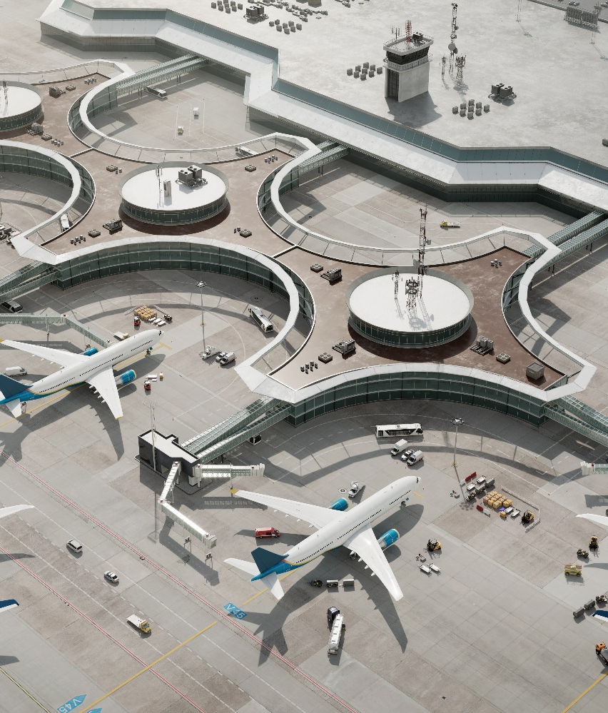
Think of an airport ecosystem
IX operator as airport operator – like a control tower managing high-performance & highly secure traffic flows…
  Data centers as “Terminals”
  Connected networks as “Airlines”
  Data as “Passengers & goods”
IX Purpose
  Interconnect different destinations
  (local, regional or global)
  Enable as short, fast & safe a trip as
  possible between 2 destinations
  (reduce distance, time & risk)
Notes:
here you explain the analogy with an airport

Slide 5
DE-CIX is the world's #1 Cloud, AI & Internet Exchange operator, with the world's largest carrier-neutral interconnection ecosystem
60
Internet & Cloud
Exchanges
50+
Cloud service providers
600+
metros
1,000s
of data centers
4,000+
connected
networks
185+
Tbits capacity
North America
  Chicago, Dallas, Houston,
  Mexico City, New York, Phoenix, Queretaro, Richmond, Seattle
Asia Pacific
  Brunei, Chennai, Delhi, Hyderabad, Jakarta, Johor Bahru, Kuala Lumpur, Kolkata, Manila, Mumbai, Osaka, Penang, Singapore, Tokyo
South America
  Sao Paulo, Rio de Janeiro
EMEA
  Amsterdam, Aqaba, Athens, Baghdad, Barcelona, Berlin, Bucharest, Copenhagen, Doha, Dubai, Dusseldorf, Esbjerg, Frankfurt, Hamburg, Helsinki, Istanbul, Karachi, Kinshasa, Kristiansand, Lagos, Leipzig, Lisbon, Madrid, Marseille, Munich, Oslo, Palermo, Prague, Riyadh*, Ruhr region, Sofia, Stockholm*, Warsaw
* Coming soon

Slide 6

Dubai – our first IX outside of Europe
2012
2022
90%
Kept traffic local
Internet traffic routing
(% local designated
remaining in UAE)
3%
$70-$80
Lowered cost for end-users
Price of International transit
(US$ / Mb / month)
$1
Improved user-experience
200ms
Enhanced latency for
same query
(∼ Round Trip Time in ms)
3

Slide 7


Frankfurt – our IX powering the No 1 Digital Capital 2025
  Data Centers
  inter-
  connected
  Tbit/s
  peak traffic
  Connected
  networks
  24
  18+
  1,077
Economic power
of DE-CIX Frankfurt:
$4+ billion per annum
Performance:
$3.9 billion
p.a.
Localization:
$16 million
p.a.
Resiliency:
$460
million
p.a.

Slide 8

Let’s talk about latency!
Latency is the time it takes for a message to travel through the network and back.
This value is limited by the speed of light and the distance the message must travel.
Applications are very sensitive to and dependent on latency

Slide 9





Why is latency so relevant for digitalization
Business
…
…
e-manufacturing
virtual desktop, videoconferences…
Speed of a blink?
< 1 ms
< 15 ms
∼ 65 ms
100-150 ms
< 80 km
< 1,200 km
< 5,500 km
…
…
Private
Mobility, connected car
live streaming, gaming, e-learning, e-health…

Slide 10
Why is latency so relevant for digitalization
Business
…
…
e-manufacturing
virtual desktop, videoconferences…
Digital applications & content need to be
as close as possible to the end-user
…
…
Private
Mobility, connected car
live streaming, gaming, e-learning, e-health…

Slide 11
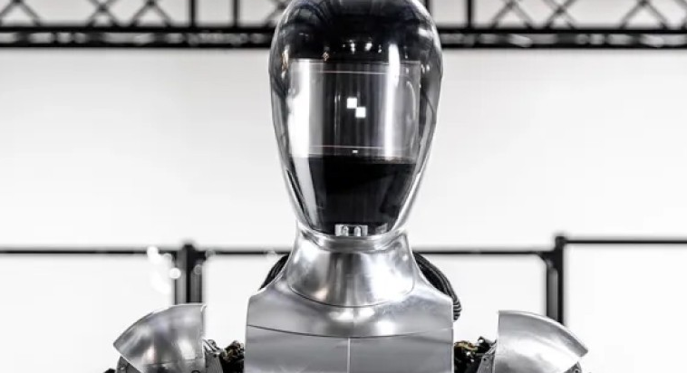


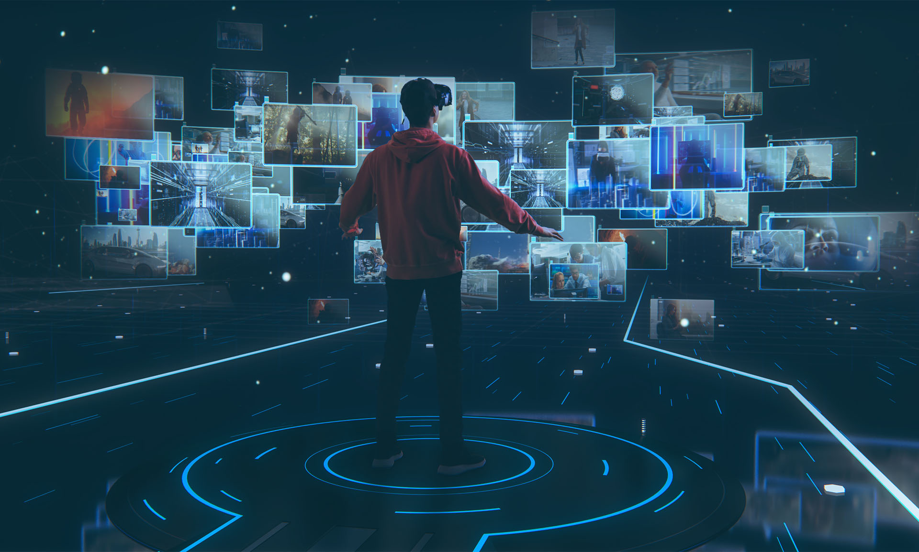







But the future needs even more…
Disruptive technologies and accelerated adoption in various leading sectors
AI
LEO Satellites, 5G, 6G
Immersive
Internet
Augmented &
Virtual Reality
loT
Cloud

Slide 12

A change of paradigm driven by trends & technologies
New services & business models integrating multiple technologies…
AI
LEO Satellites, 5G, 6G
Immersive
Internet
Augmented &
Virtual Reality
loT
Cloud

Slide 13

A change of paradigm driven by trends & technologies
New services & business models integrating multiple technologies…
AI
LEO Satellites, 5G, 6G
Immersive
Internet
Augmented &
Virtual Reality
loT
Cloud

Slide 14

A change of paradigm driven by trends & technologies
New services & business models integrating multiple technologies…
AI
LEO Satellites, 5G, 6G
Immersive
Internet
Augmented &
Virtual Reality
loT
Cloud
(soon likely) all running at the speed of human perception

Slide 15

A change of paradigm driven by trends & technologies
AI
LEO Satellites, 5G, 6G
Immersive
Internet
Augmented &
Virtual Reality
loT
Cloud

Slide 16
A change of paradigm driven by trends & technologies
AI
LEO Satellites, 5G, 6G
Immersive
Internet
Augmented &
Virtual Reality
loT
Cloud
Pushing the limits beyond the borders of today’s Internet
&
Creating new requirements for a new Internet

Slide 17
AI

Slide 18

AI as benchmark to
set the borders of
a new Internet

Slide 19





AI Training
Develop the model in the first place, periodic retraining of the model
Data
Computing
AI model
Looking inside
Transmission
technologies
AI model
AI Inference
(“AI in action”)
AI-based diagnostics,
simulate, predict, pilot
Connected
devices

Slide 20
?
Data
Computing
AI model
DATA JOURNEY
Transmission
technologies
AI model
Connected
devices

Slide 21



!
Data
Computing
AI model
CONTROL THE DATA JOURNEY
Transmission
technologies
AI model
SIMPLICITY
SECURITY & COMPLIANCE
PERFORMANCE
Connected
devices

Slide 22




AI Training requires manageability of multi-cloud data sourcing & computing
Data
everywhere.
Computing power
somewhere.
SENSITIVITY
Latency
Bandwidth
Comp. Power
Risk

Slide 23



AI Inference Triangle
Transmission
technologies
AI model
Connected
devices
SENSITIVITY
Latency
Bandwidth
Comp. Power
Risk

Slide 24
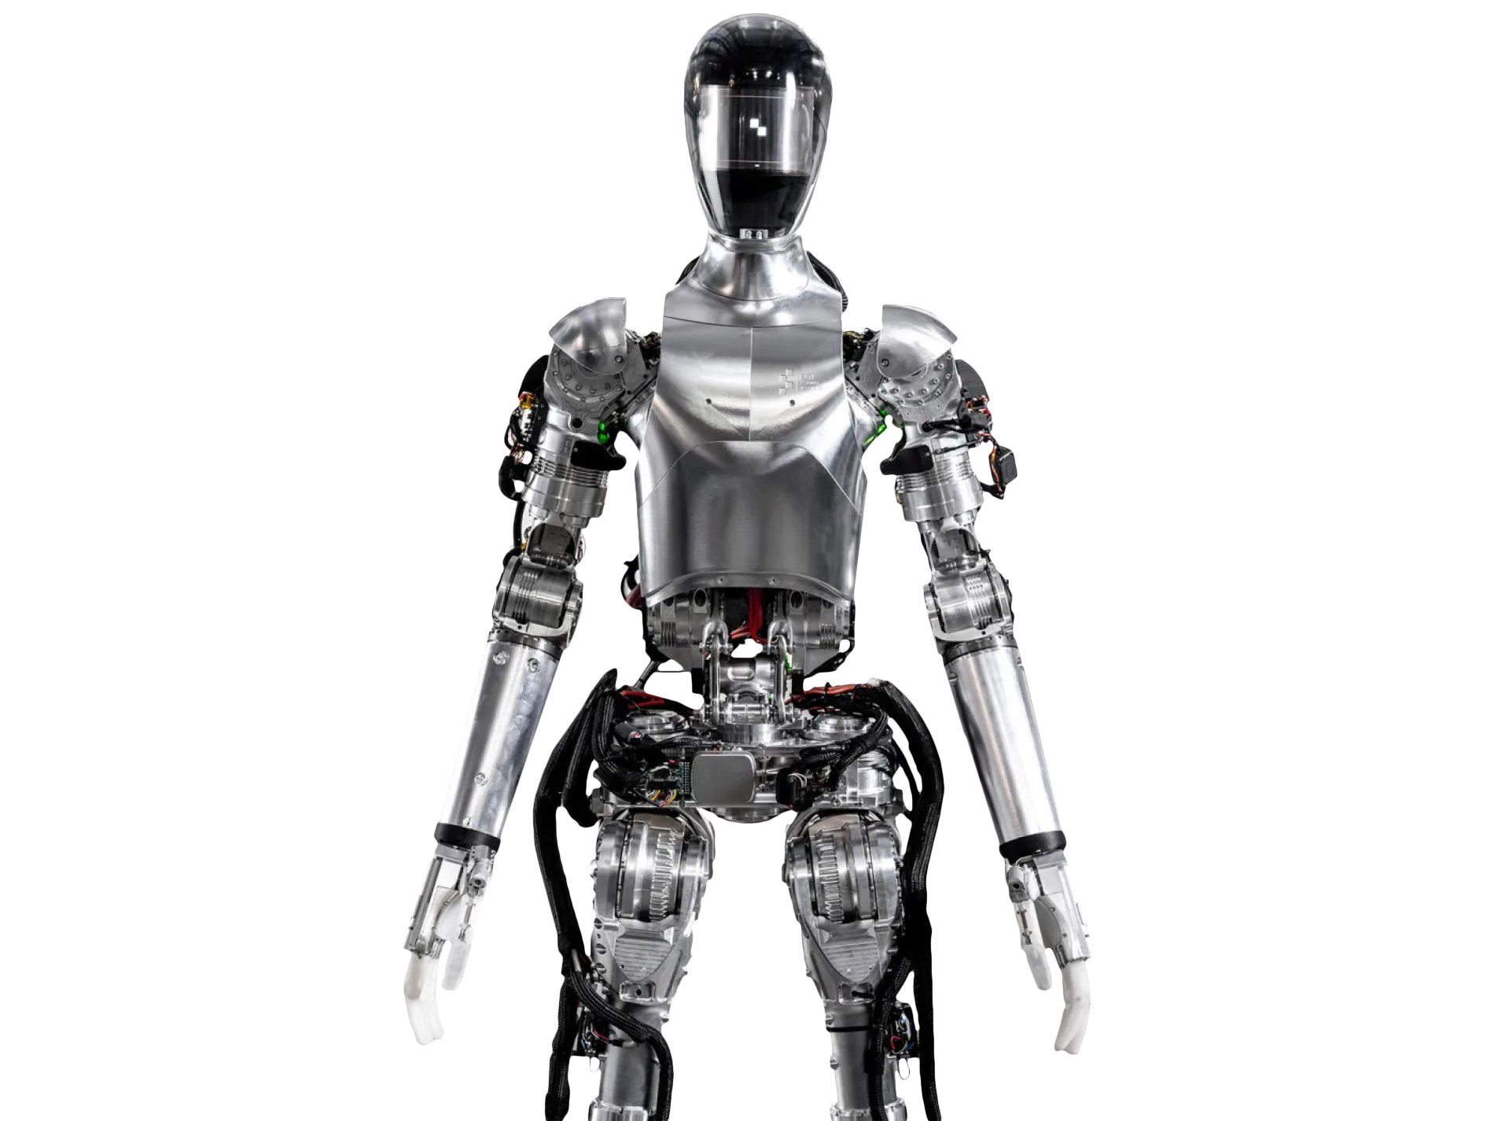


AI Inference requires manageability of multi-AI models
Perception models
Learning
model
Movement model
SENSITIVITY
Multi-AI models.
At the speed of human perception. Anywhere.
Latency
Bandwidth
Comp. Power
Risk

Slide 25





AI Inference requires manageability of multi-AI models
Synchronize multi-AI models
Interoperability, towards real time

Slide 26
AI Inference requires manageability of multi-AI models

Slide 27





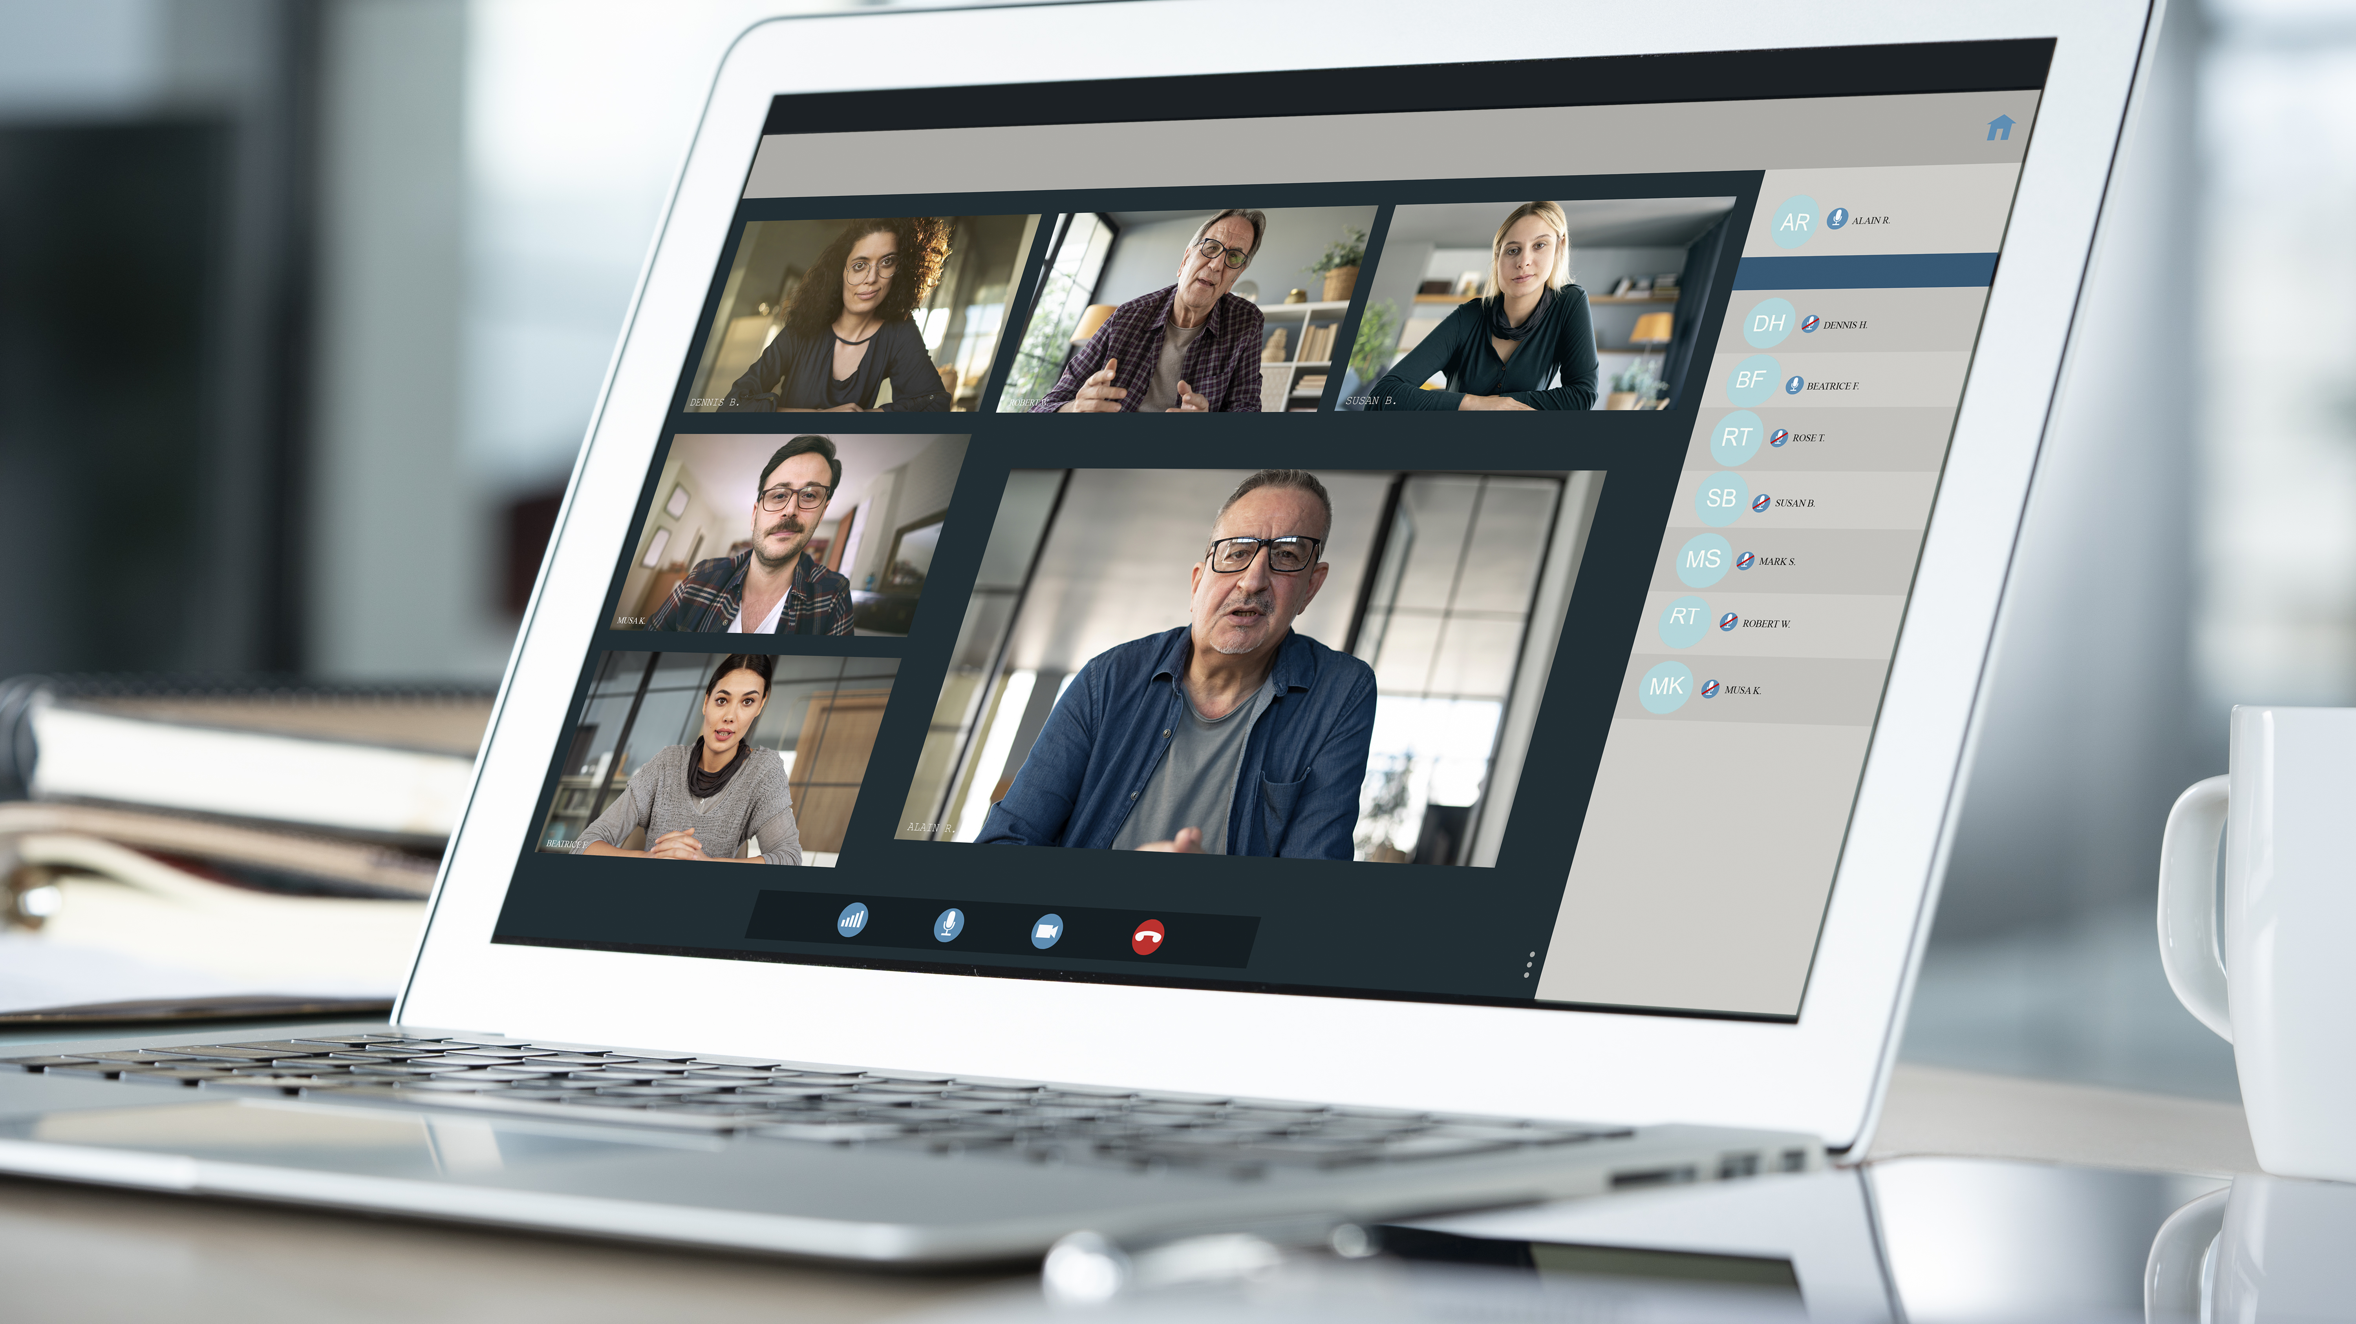
AI Inference requires the speed of human perception
Standard
applications
0.5 ms
13 ms
20 ms
65 ms
< 50 miles
< 750 miles
< 1,100 miles
< 3,200 miles
Distance

Slide 28
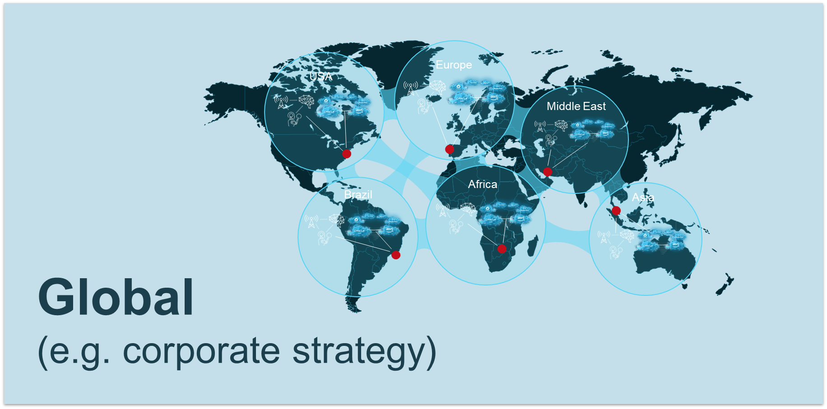
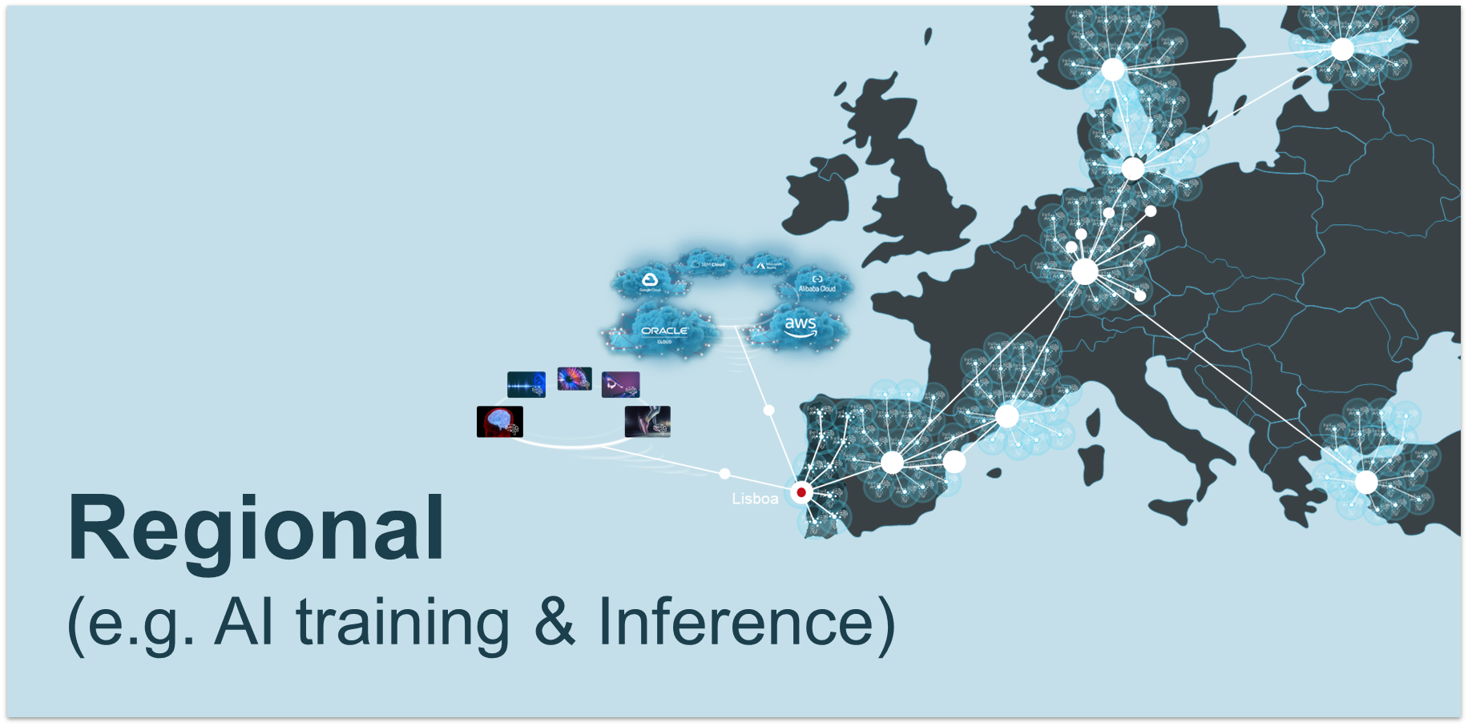
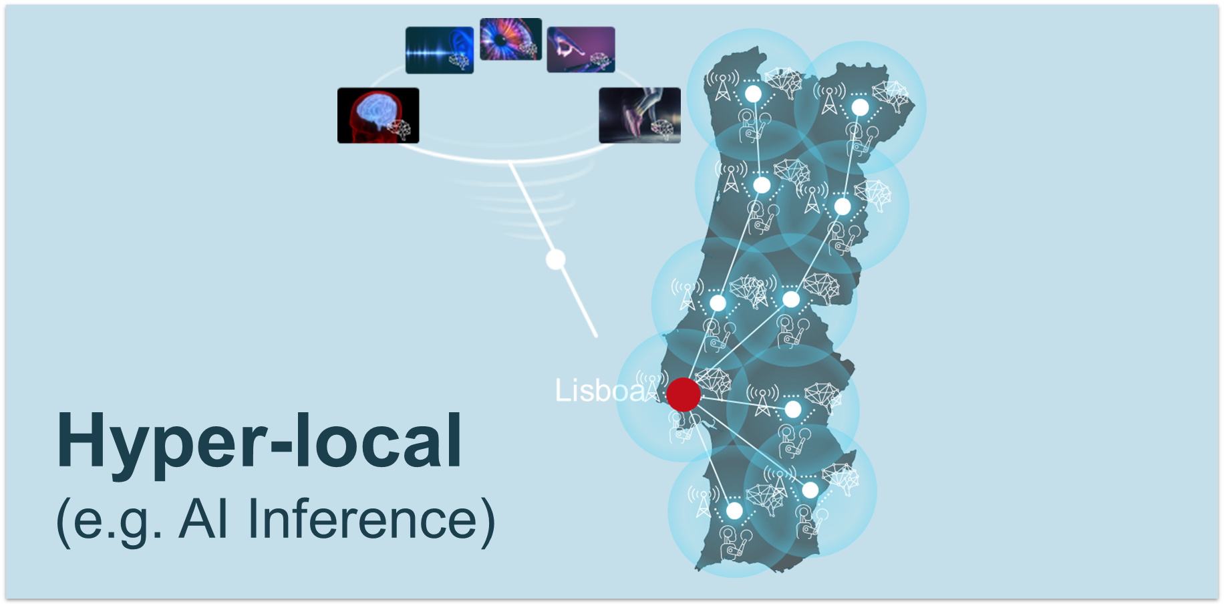
AI ready digital infrastructure
AI-enabled. Edge. Densified. Distributed. Interconnected.
Control of the end-to-end journey of your data: performance
High speed, capacity & reach infrastructure

Slide 29


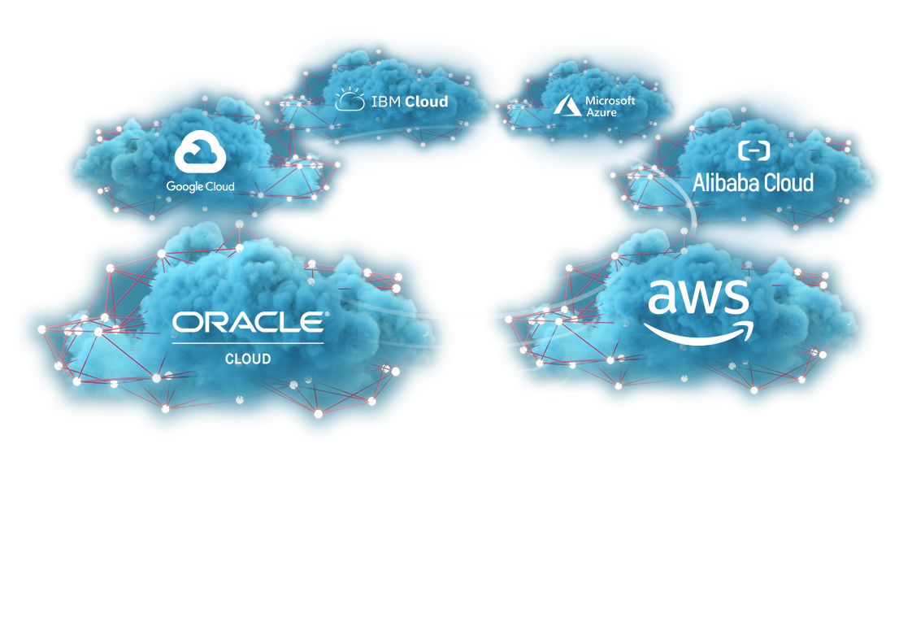
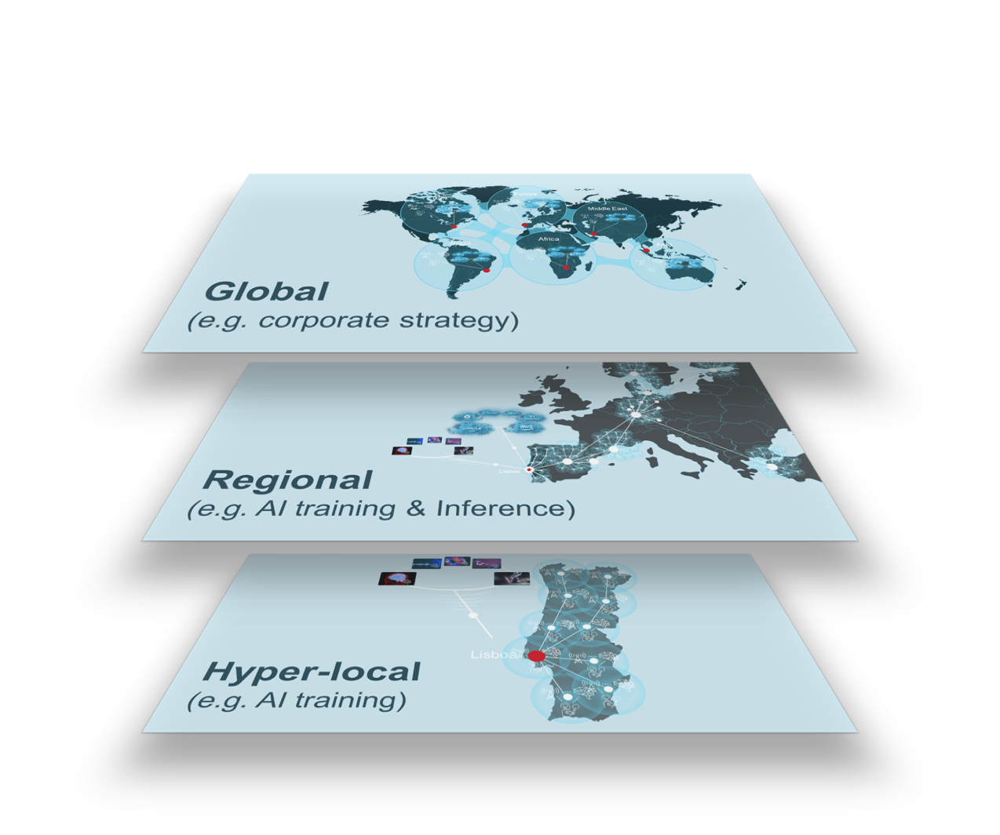
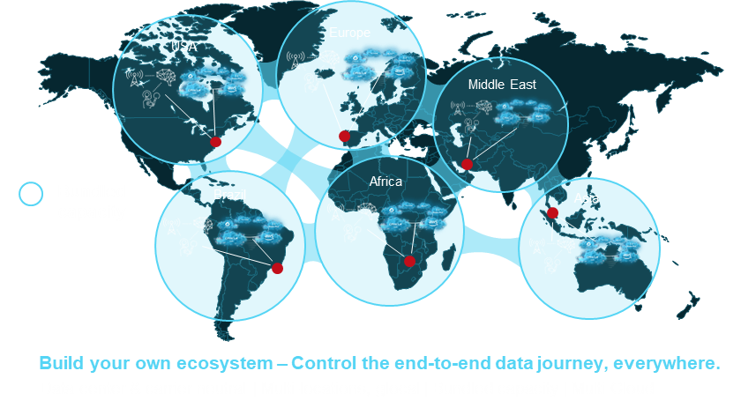
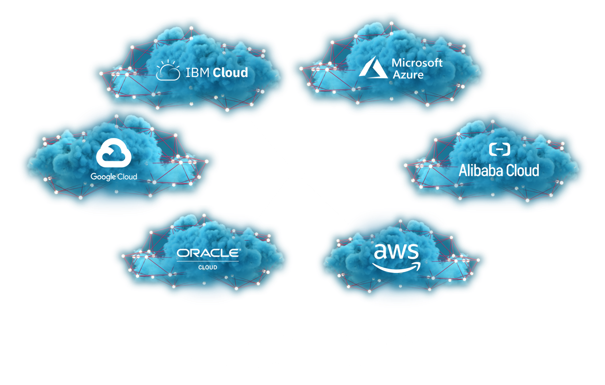
New borders set by AI – Time for a new Internet!
AI training
AI Inference
interoperability
of digital
applications
closer to
the edge, distributed & integrated
build your own
interconnection
ecosystem

Slide 30
New borders set by AI – Time for a new Internet!
AI training
AI Inference
interoperability
of digital
applications
closer to
the edge, distributed & integrated
build your own
interconnection
ecosystem
SIMPLICITY
SECURITY & COMPLIANCE
PERFORMANCE

Slide 31
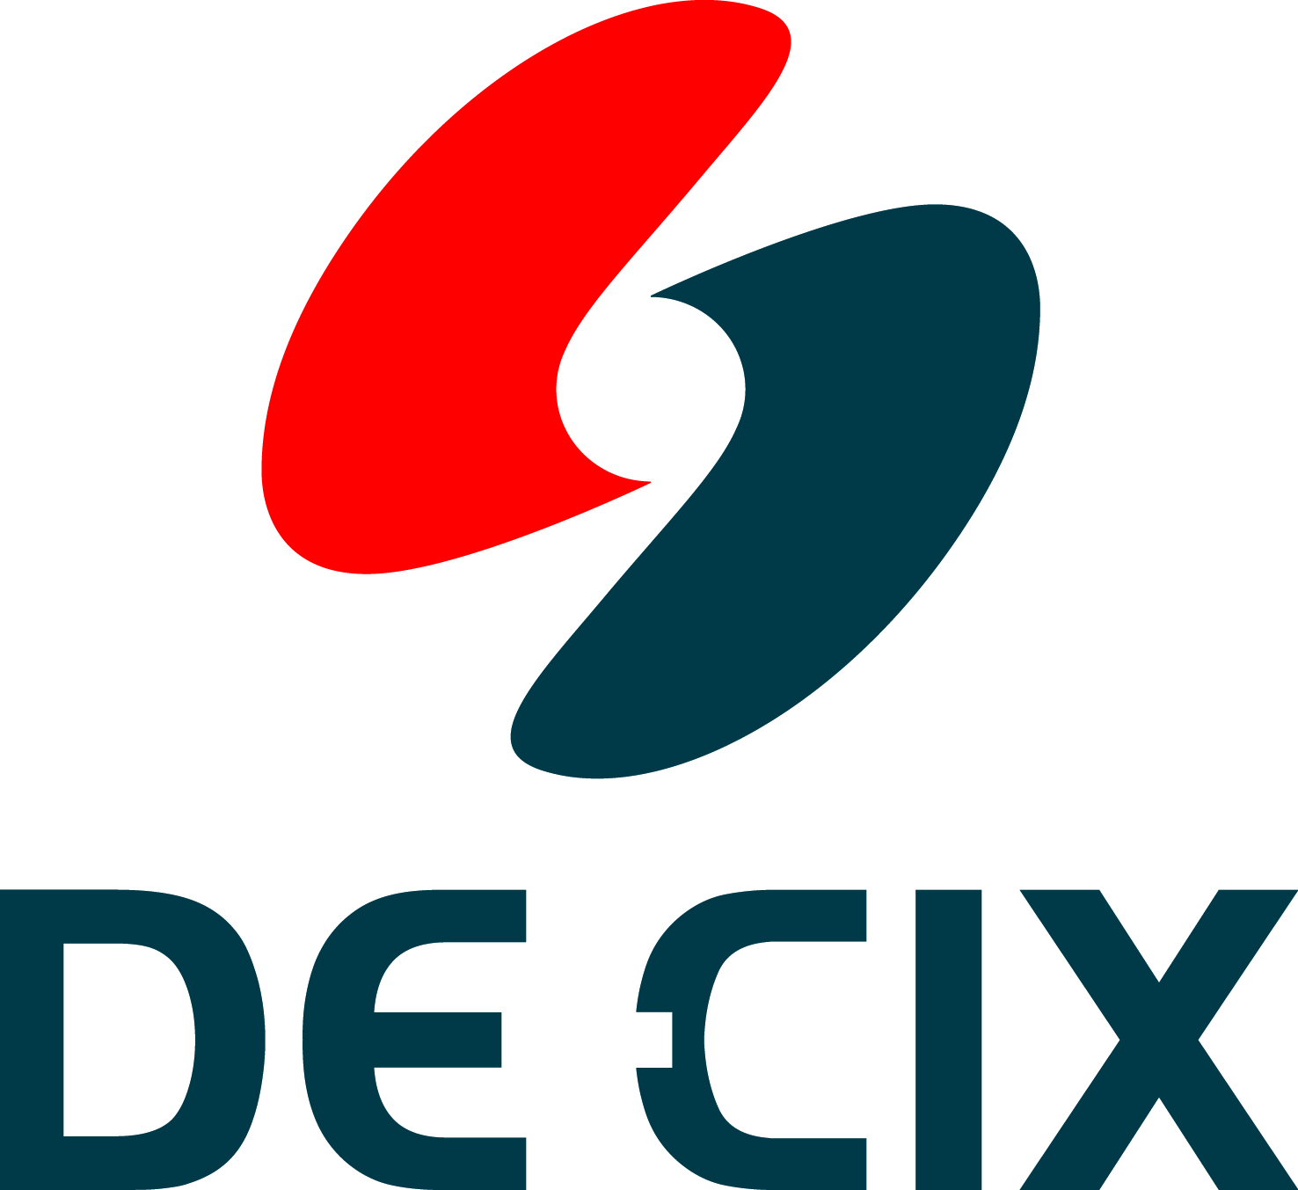
Hot off the press – DE-CIX AI-IX !
DE-CIX has launched the world’s first fully-integrated AI Internet Exchange to support model training and inference
DE-CIX AI-IX enables high-volume AI training
Interconnecting clouds, AI clouds, AI Inference as-a-service & GPU as-a-Service providers with enterprise networks
Offering remote connectivity to AI hubs/regions
e.g. Dallas, accessible from all DE-CIX locations in North America
Soon, DE-CIX AI Exchanges will be made Ultra-Ethernet-ready, capable of supporting geographically distributed AI training within a city

Slide 32
DE-CIX AI-IX for industries
Notes:
IXs are very important for AI applications in industries (Aviation, aerospace, energy, healthcare, transportation) for the lowest latency possible. Without IXs, AI isn’t going to work.

Slide 33
DE-CIX is the world's #1 Cloud, AI & Internet Exchange operator, and the world's largest carrier-neutral interconnection ecosystem
60
Internet & Cloud
Exchanges
50+
Cloud service providers
600+
metros
1,000s
of data centers
4,000+
connected
networks
185+
Tbits capacity
Wichita
North America
  Chicago, Dallas, Houston,
  Mexico City, New York, Phoenix, Queretaro, Richmond, Seattle
Asia Pacific
  Brunei, Chennai, Delhi, Hyderabad, Jakarta, Johor Bahru, Kuala Lumpur, Kolkata, Manila, Mumbai, Osaka, Penang, Singapore, Tokyo
South America
  Sao Paulo, Rio de Janeiro
EMEA
  Amsterdam, Aqaba, Athens, Baghdad, Barcelona, Berlin, Bucharest, Copenhagen, Doha, Dubai, Dusseldorf, Esbjerg, Frankfurt, Hamburg, Helsinki, Istanbul, Karachi, Kinshasa, Kristiansand, Lagos, Leipzig, Lisbon, Madrid, Marseille, Munich, Oslo, Palermo, Prague, Riyadh*, Ruhr region, Sofia, Stockholm*, Warsaw
* Coming soon

Slide 34
Thank You
Ivo Ivanov
CEO DE-CIX Group AG

