Slide 1
Moonshot AI Infrastructure Deployment
Visual Highlights: Racks, Power, Market Forces

Slide 2
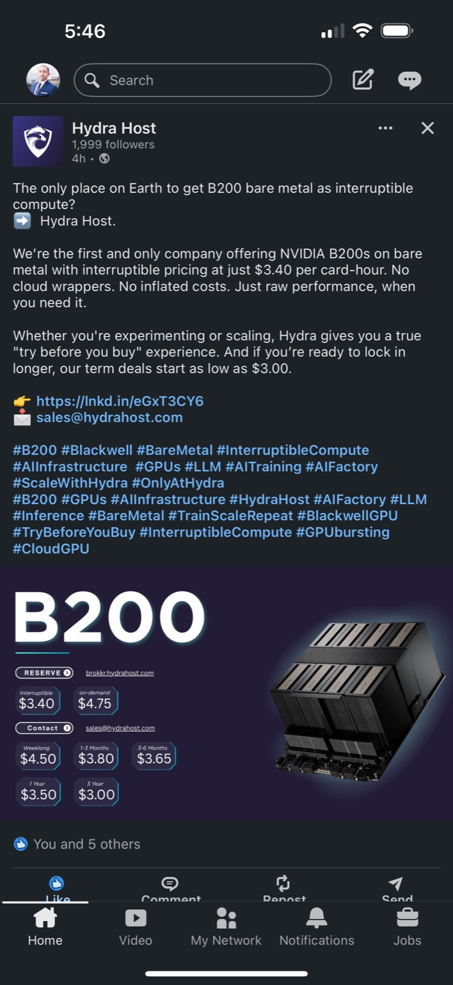
Hydra Host B200 Pricing

Slide 3
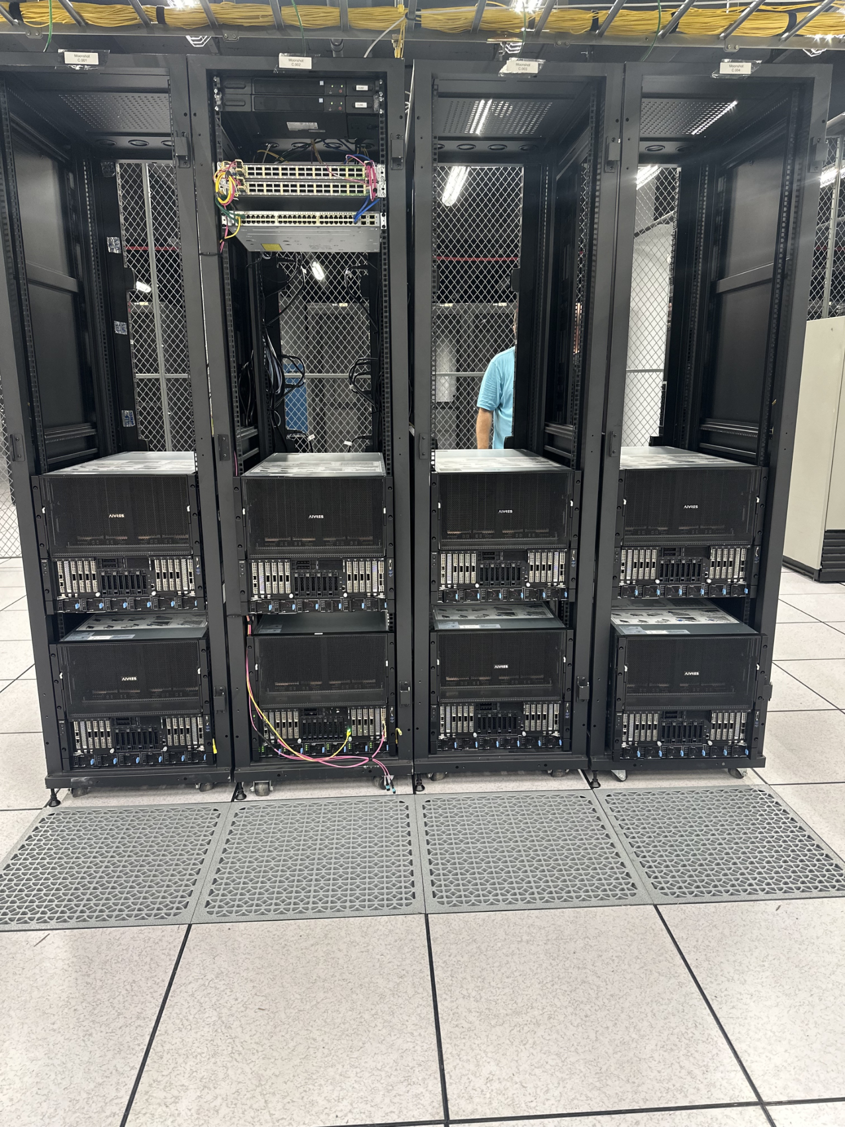
Deployed B200 Racks

Slide 4
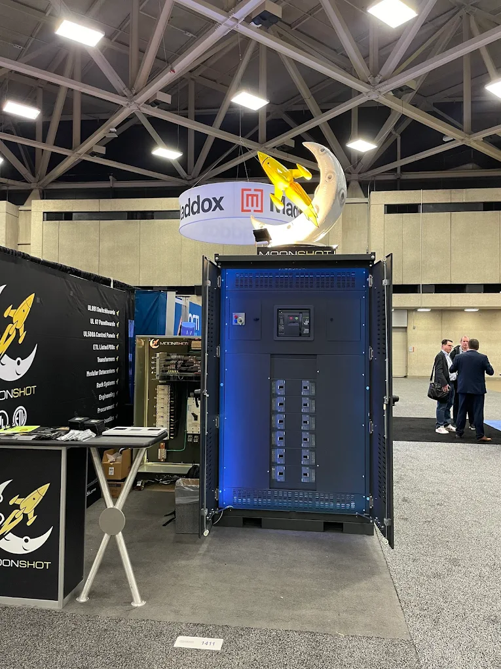
Moonshot Display Panel at Trade Show

Slide 5
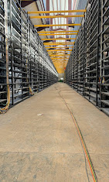
Infrastructure Shell for High-Density Deployment

Slide 6
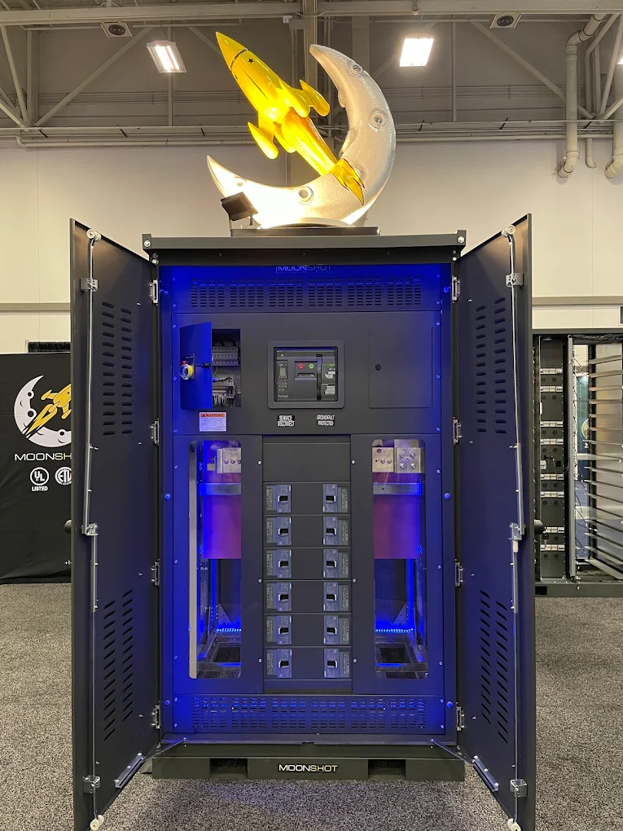
Moonshot Electrical Distribution Panel

Slide 7

Moonshot Logo

Slide 8
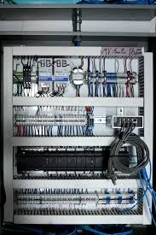
Electrical Wiring Cabinet

Slide 9
Google, Terawulf, Fluidstack Market Relevance

Slide 10

B200 Demand Curve & Pricing Model

