Slide 1


Building Kansas’s first
Internet exchange Point at Wichita state University
Core Infrastructure
for the Next Era of Connectivity

Slide 2
What are iXPs?
Internet Exchange Points (IXPs) are Internet hubs.
They allow local networks of all types (Internet service providers, transport providers, Tier 1 carriers, mobile networks, education networks, and cloud and content providers—such as Netflix and Amazon)--to “meet,” or directly connect with one another locally to exchange data traffic. This is called “peering.”
IXPs literally make the Internet work better.
The closer you are to an IXP, the better your Internet performance will be. This happens by reducing what’s called “latency,” or lag time. IXPs also keep data traffic local that needs to stay local, making the routing of internet traffic more efficient and freeing up long-haul capacity for other uses.
IXPs exist in 57 metro areas across the U.S.
But 14 states and 3 U.S. territories have no IXP at all. An additional 3 states have failing or functionally limited facilities.
Connected Nation Internet Exchange Points
2

Slide 3
What are iXPs?
In communities without an IXP, Internet traffic is “backhauled” to cities that may be hundreds of miles away.
Smaller cities, towns, and rural areas are fully dependent on remote cities for Internet performance. If a natural disaster or terrorist event were to impact those cities, connectivity to the global Internet could go down or be significantly impaired.
Future Internet performance is at risk without a local IXP.
As the Internet continues to evolve, reducing latency will be incredibly important. Autonomous vehicles, drones, artificial intelligence, video streaming, virtual reality, and precision agriculture will require ultra-low-latency connections—latency values that aren’t achievable in regions without an IXP.
IXPs lower wholesale costs for everyone.
Because IXPs are a hub for multiple networks, they naturally become a marketplace for wholesale Internet access (called “IP transit”).
Connected Nation Internet Exchange Points
3

Slide 4
Three Primary benefits
Latency Reduction
By keeping local traffic local and enabling Layer 2 peering to cloud & content networks
Cost Reduction
By fostering a marketplace for transport and wholesale IP transit competition –
90%+ reduction in wholesale costs
Improved Network Resiliency
Naturally creating new network paths into and out of regions
Connected Nation Internet Exchange Points
4

Slide 5
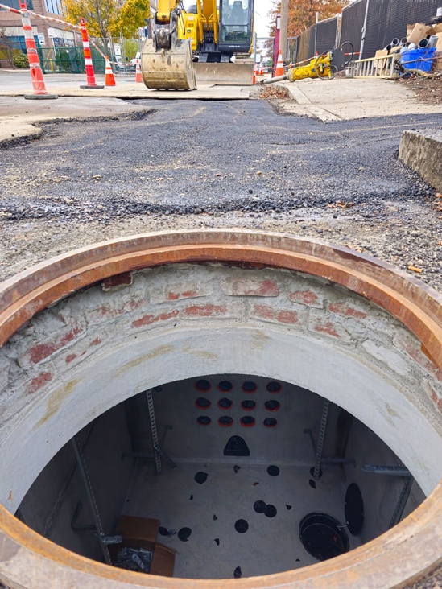
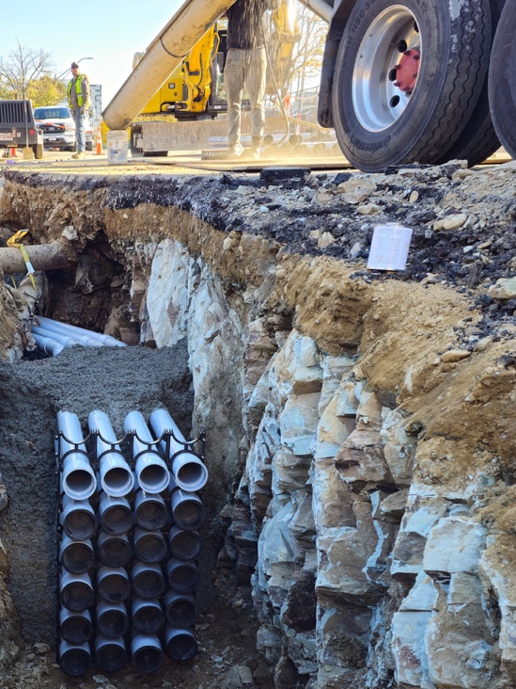
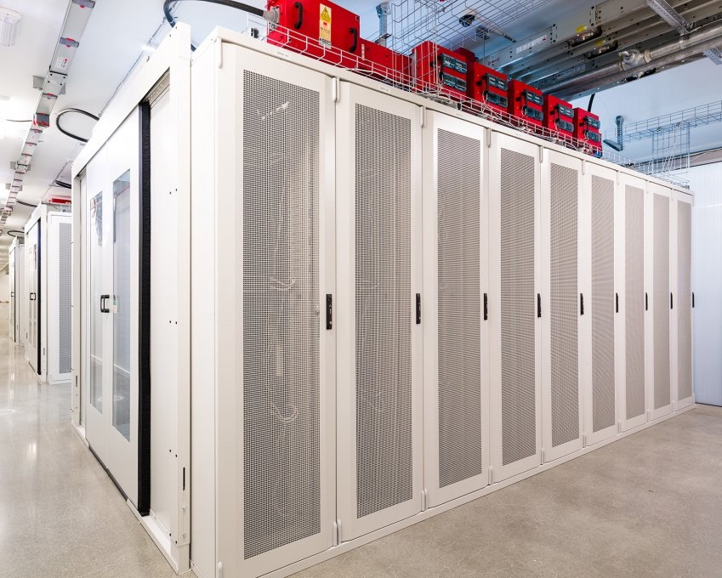
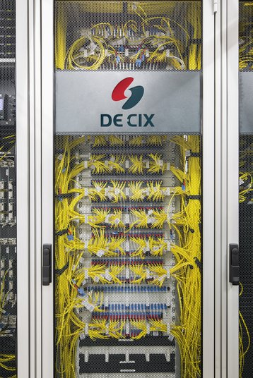
Core interconnection infrastructure
Manholes
Duct Banks
Neutral Colocation
IX Switch Fabric
Connected Nation Internet Exchange Points
5

Slide 6
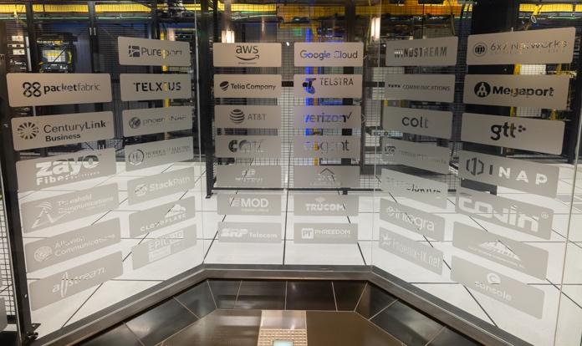
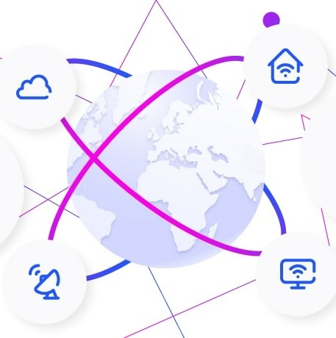






Core interconnection infrastructure
Meet Me Room & Cross Connects
Cloud & Content Peering
Wholesale IP Transit
Connected Nation Internet Exchange Points
6

Slide 7
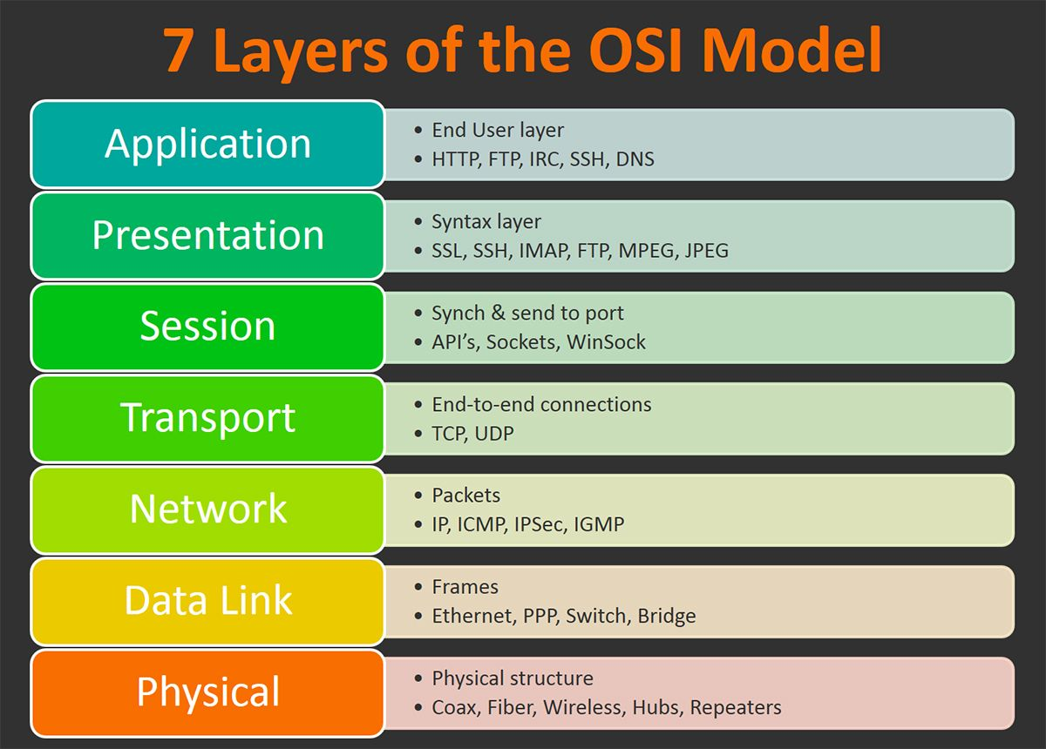
8
Layer 0:
“Real estate”
IXP facilities
Conduit
Manholes
Handholes
7
6
5
4
3
2
1
Connected Nation Internet Exchange Points
7

Slide 8

Alpha site:
Wichita state university
$5 million grant from the State of Kansas
Located on 1.3 acres donated by WSU for 40 years
Adjacent to WSU Innovation Campus - home to:
Airbus, Textron, Spirit AeroSystems, Boeing, NetApp, Deloitte Smart Factory, U.S. Navy’s Digital Twin Program, ATF’s 2nd Ballistics Identification Lab
Expandable modular facility consisting of:
3 modules, ~2,000 sq ft
25 colo cabinets
350 kW; N+1 power/cooling
Meet Me Area for cross connects - 6 open racks
Diverse manholes and points of entry
175mph wind-resistant
Broke ground in May; Operational by Late Spring 2026
iM Data Centers of Fort Lauderdale acting as general contractor and modular building manufacturer
Connected Nation Internet Exchange Points
8

Slide 9
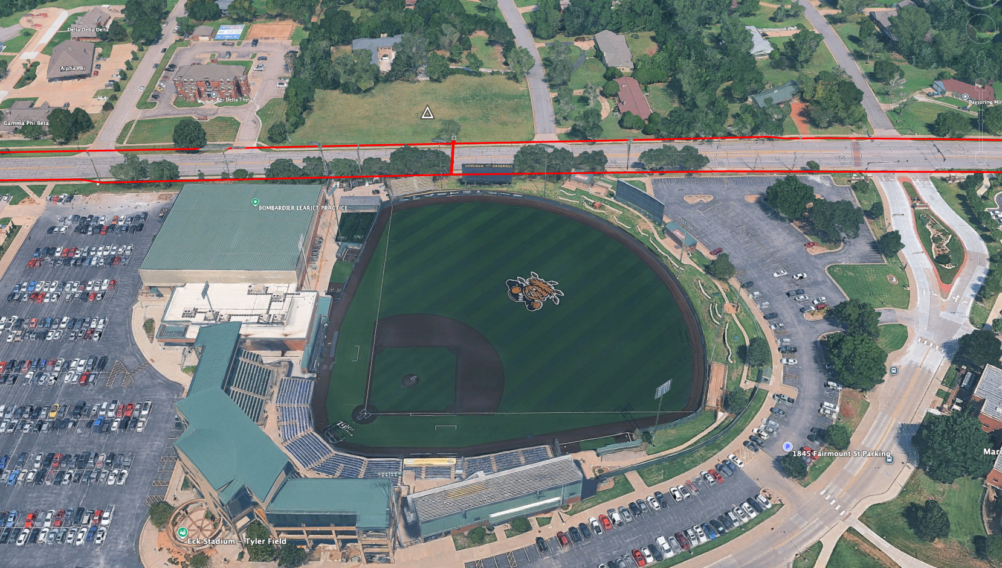
Network interconnection architecture diagram - Wichita
9

Slide 10
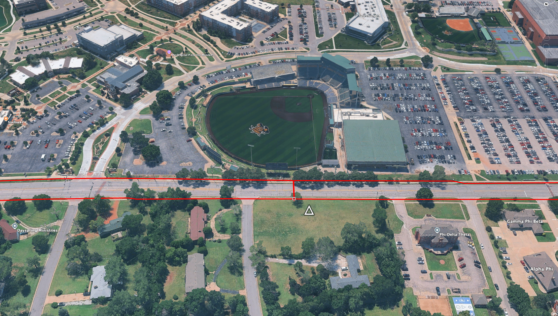
Network interconnection architecture diagram - Wichita
10

Slide 11
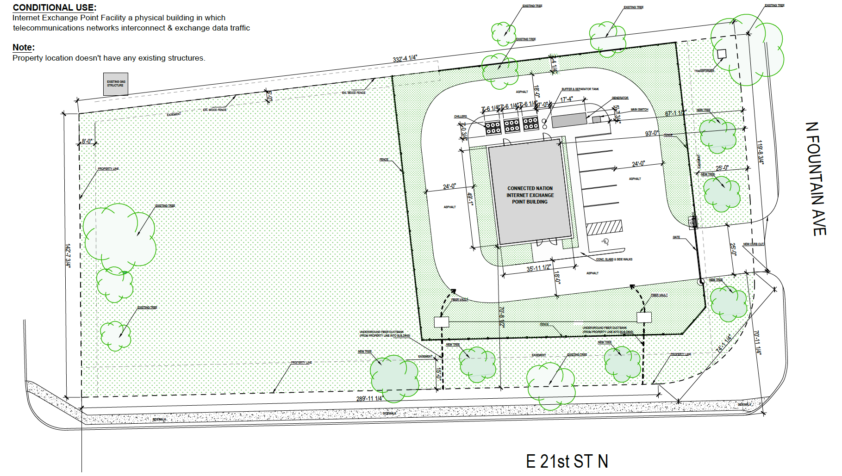
Network interconnection architecture diagram - Wichita
11

Slide 12
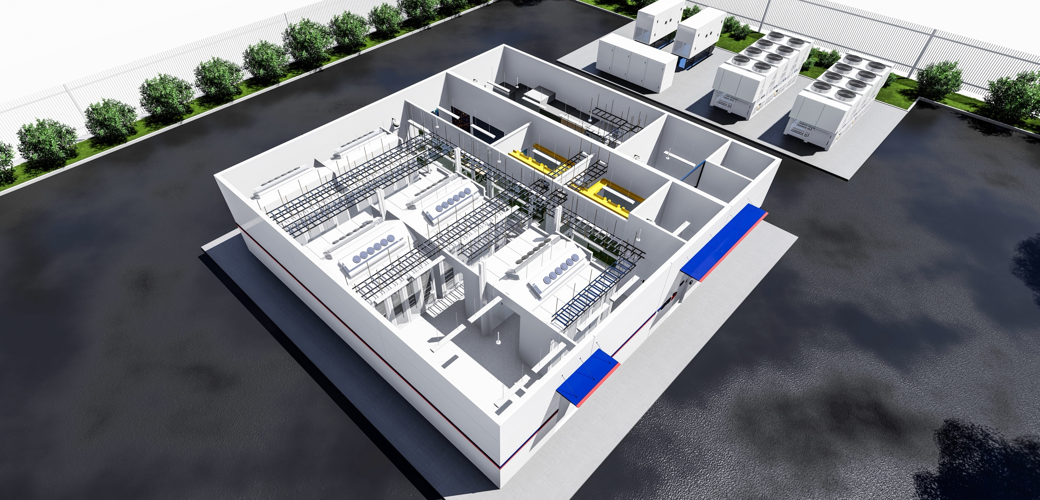
4 modules
40 Cabinets
6 open racks
expandable
Connected Nation Internet Exchange Points
12

Slide 13
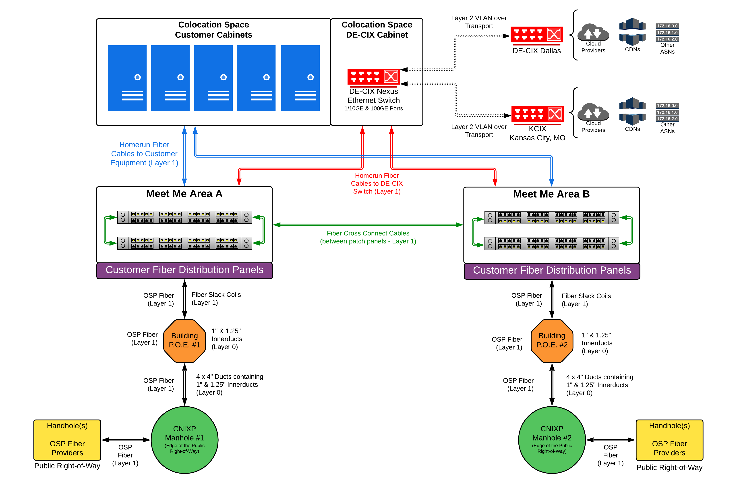
Network interconnection architecture diagram - Wichita
13

Slide 14
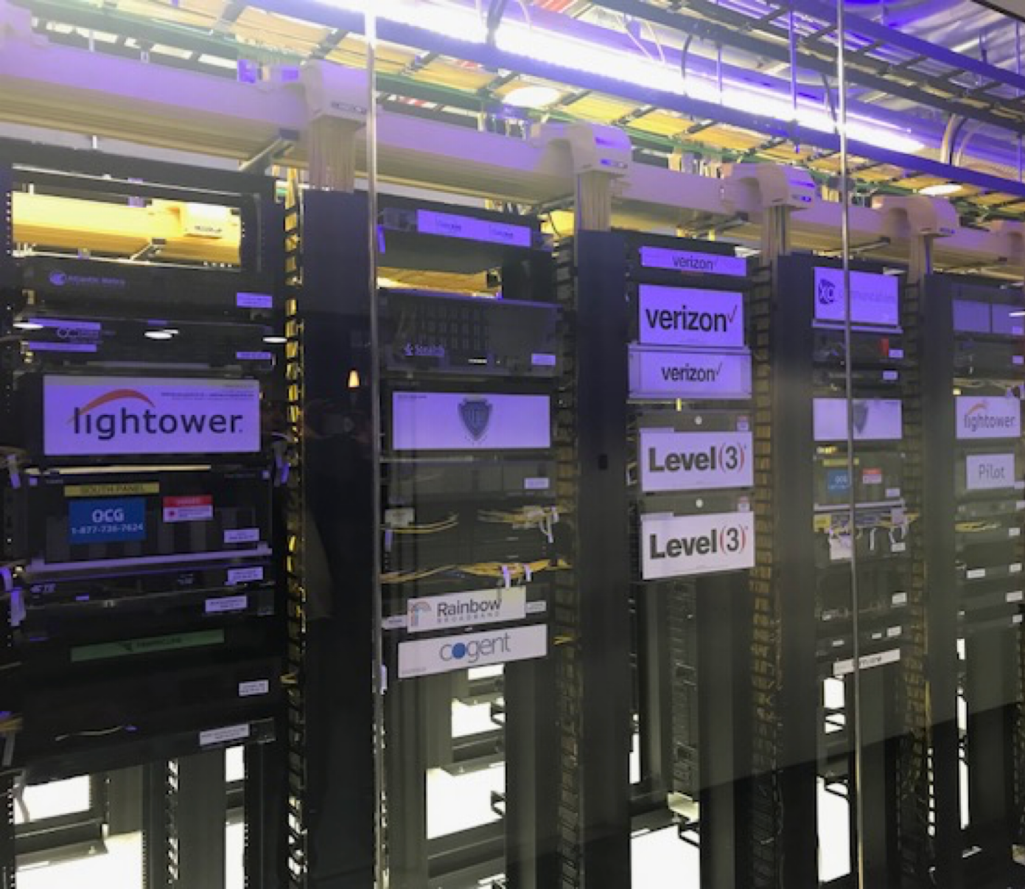
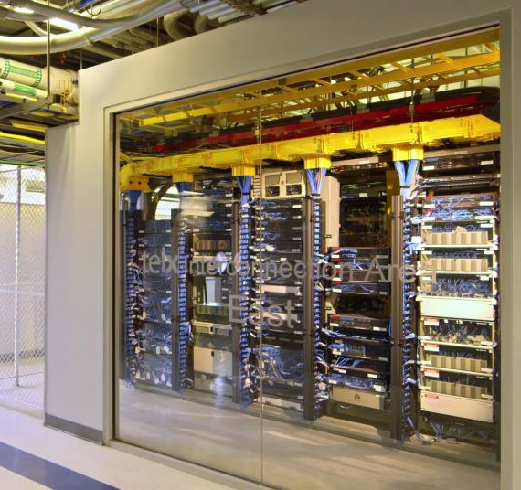
Connected Nation Internet Exchange Points
14

Slide 15
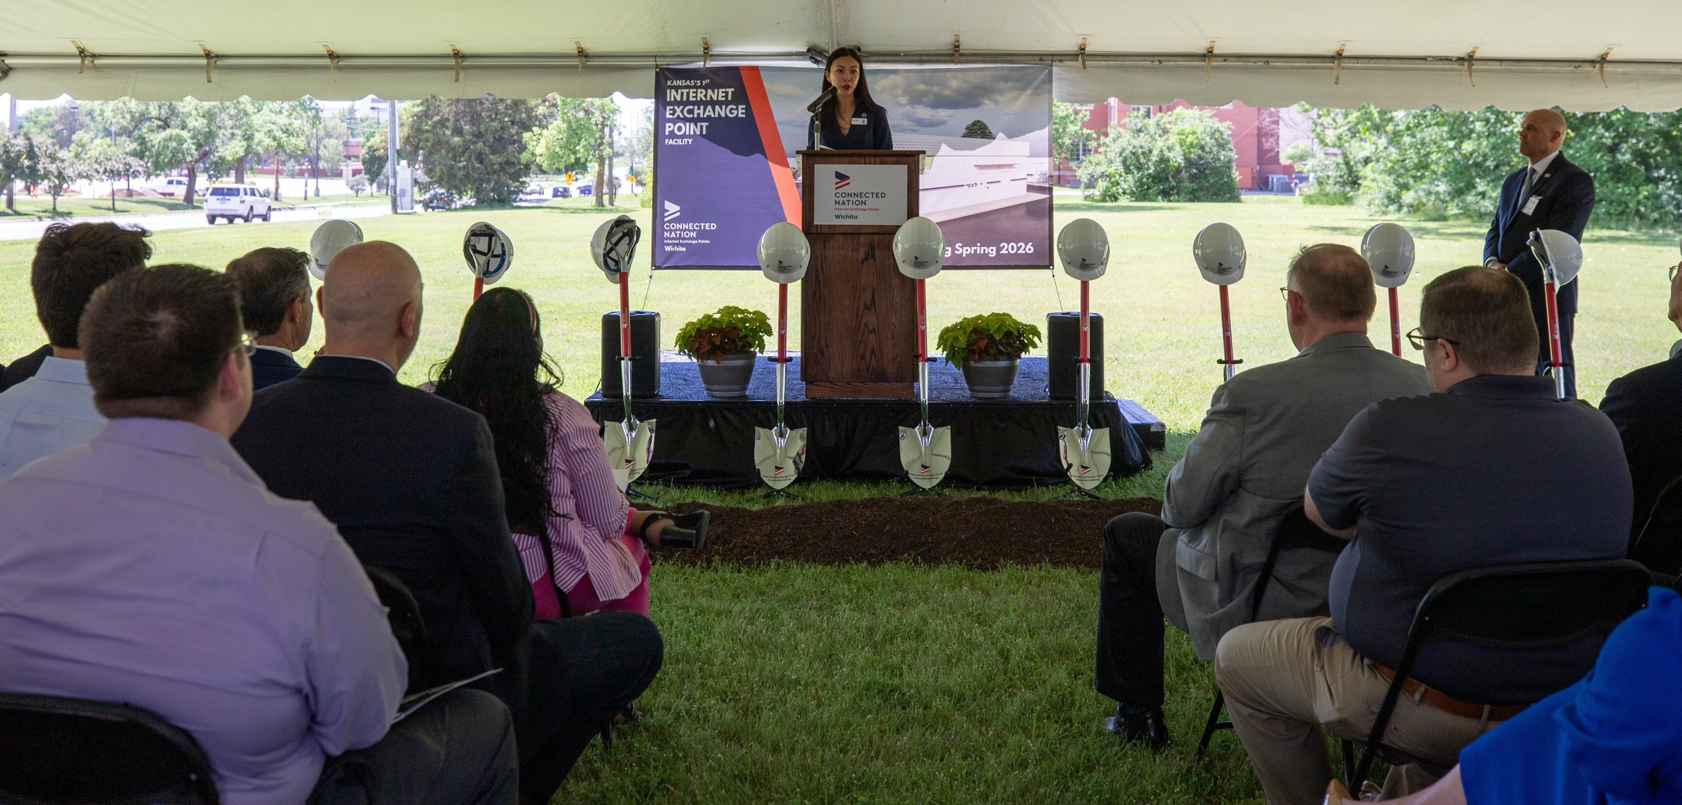
Wichita IXP Groundbreaking – May 15, 2025
15

Slide 16
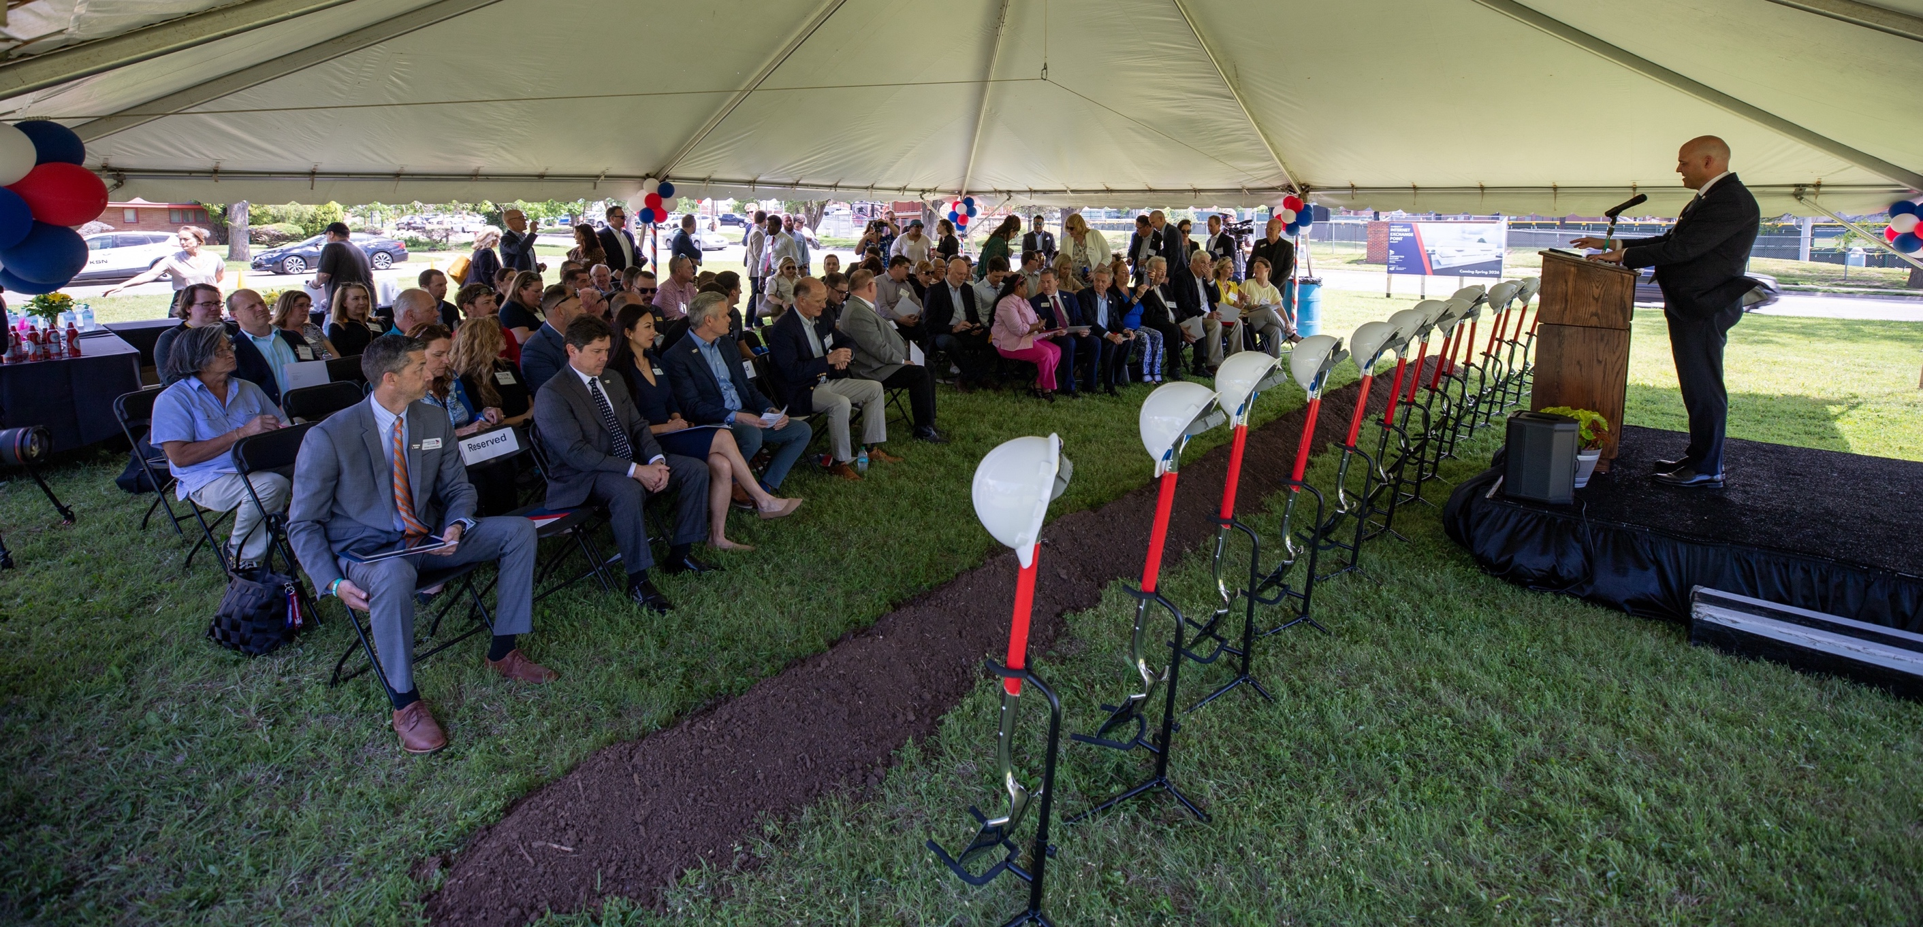
Wichita IXP Groundbreaking – May 15, 2025
16

Slide 17
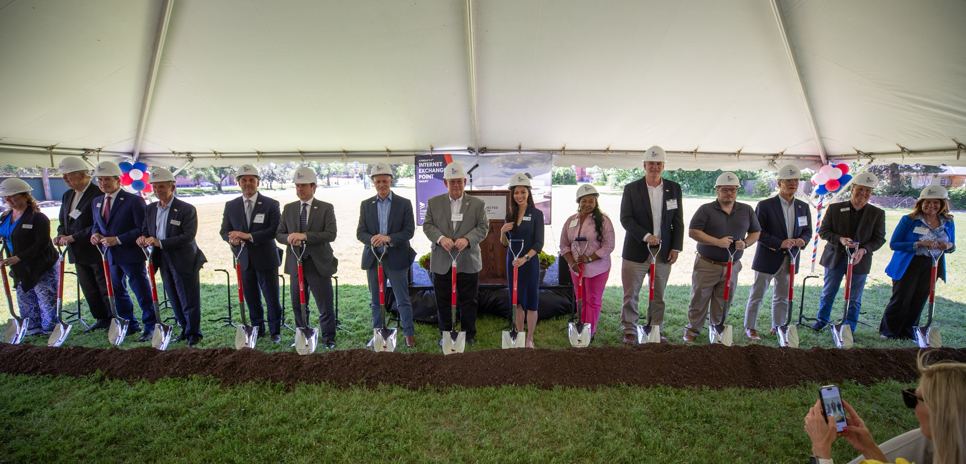
Wichita IXP Groundbreaking – May 15, 2025
17

Slide 18
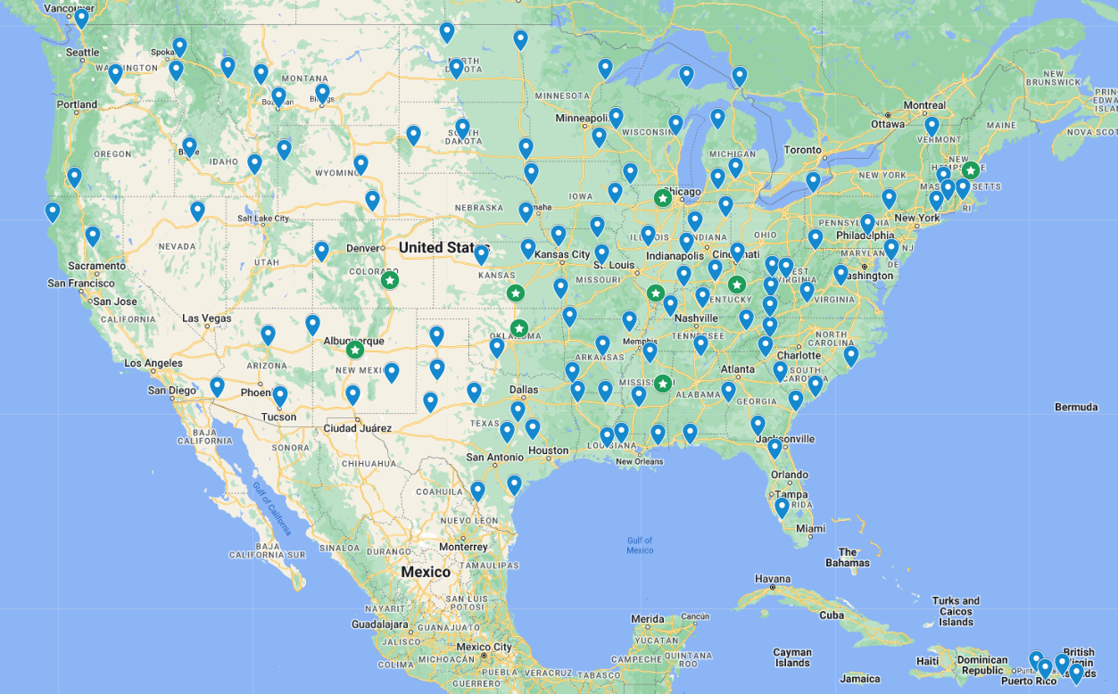
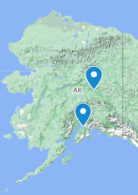
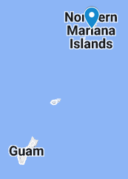
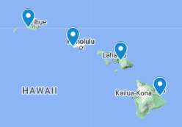

125 Target communities in 44 states
18

Slide 19

Thank you

