Slide 1
Ross Taylor Past Presidents’ Session
Speed Chats Exploring Critical Leadership Issues and Solutions
April 12, 2016
Oakland, CA

Slide 2
NCSM Past Presidents
Henry Kepner (1991-1993)
Steve Leinwand (1995-1997)
Carole Greenes (2001-2003)
Linda Gojak (2005-2007)
Tim Kanold (2007-2009)
Diane Briars (2009-2011)
Suzanne Mitchell (2011-2013)
Valerie Mills (2013-2015)

Slide 3
Speed Chats
Using Social Media, we asked NCSM Mathematics Leaders to submit questions about current critical leadership issues.
If you have an issue you would like to submit now, please write it on the chart or submit on an index card.

Slide 4

Leadership Resources
PRIME and It’s TIME are NCSM publications intended for leaders, in the broadest sense, working together in Leadership Teams, responsible for moving or influencing individuals and groups towards a common goal of improving mathematics achievement for every student..
Notes:
One way to lead and influence teachers is through Leadership Teams working toward a common goal .

Slide 5
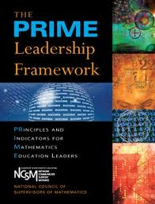
The PRIME
Leadership Framework
Identifies the knowledge and skills needed to lead adults
Belief in success for every teacher and student
Decisions are data-driven in a collaborative setting
Actions are researched-informed
This is the “what”, not the “how”
Notes:
To begin, NCSM developed the PRIME Leadership Framework in 2008. It provided the principles and indicators for mathematics education leaders. This book is a must for you to read and apply to your leadership growth. It identifies the knowledge and skills needed to lead adults and explains the “what” . It’s TIME steps up the accountability for a leader and provides the “how”.

Slide 6



Three Stages of Leadership Development
Know and Model
Collaborate and Implement
Advocate and Systematize
Notes:
REFER THE AUDIENCE TO pages 6-7 in PRIME for AN OUTLIE OF THESE STAGES AND FOR YOUR WORDS OF SUPPORT

Slide 7
INFLUENCE others using PRIME
P – Professional Learning Communities – Use PRIME as a book study
R – Relationships-Use PRIME to explore successful relationships and leadership skills
I – Influence – Use PRIME leadership strategies to explore the CCSSM, assessments, and instructional materials
M – Motivation – Use PRIME leadership strategies to motivate mathematics students and specialists
E – Engagement of leaders in conversation with others – Use PRIME language for discussion starters
Notes:
THE PRINCIPLES ALIGN WITH NCTM - YET WE BRING AN INTEGRATED FOCUS TO THE EQUITY PRINCIPLE AS A STAND ALONE, AS WELL AS AN INTEGRATED STRAND THROUGHOUT THE ENTIRE FRAMEWORK

Slide 8

Complementing PRIME, NCSM published:
It’s TIME: Themes and Imperatives for Mathematics Education
A Math Leader’s To Do List, Field Guide, Game Plan
A Math Leader’s Call to Action
A Math Leader’s Guide to Making a Difference with and through
teachers for all students

Slide 9
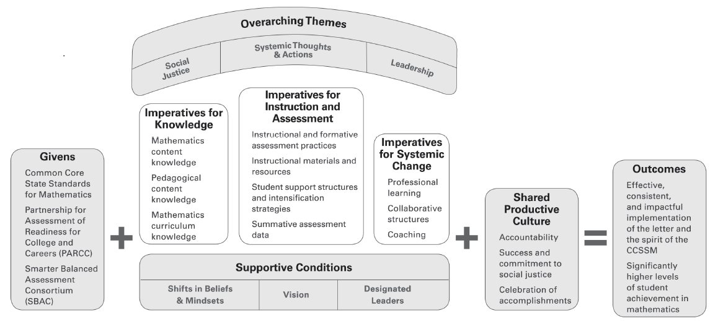
It’s TIME, p.3
Notes:
Here is the framework that builds the infrastructure to “Get to Work” leading mathematics education in you school, school district or state levels.

Slide 10
NCSM Resources to support
Leadership Growth
www.mathedleadership.org
Crosswalk between PRIME and It’s TIME with position papers and other NCSM resources.

Slide 11
The PRIME Leadership Framework: Principles and Indicators for Mathematics Leaders (NCSM, 2008) | It’s TIME Themes and Imperatives for Mathematics Education: A Leadership Framework for Common Core Mathematics (NCSM, 2014) | NCSM Position Papers Series and other Resources
Equity Leadership Every Leader ensures high expectations and access to meaningful mathematics learning for every student. | Social Justice and Shared Productive Culture Accountability Celebration of Accomplishments Success and Commitment to Social Justice Supportive Conditions Shifts in Beliefs and Mindsets Vision Designated Leaders | Improving Student Achievement in Mathematics– by Leading the Pursuit for a Vision of Equity (#3) for Students with Special Needs (#4) by Addressing the Needs of English Learners (#6) by Promoting Positive Self Beliefs (#7) by Expanding Opportunities for Our Most Promising Students in Mathematics (#9) by Expanding Learning Opportunities for the Young (#10)
Notes:
Each of the 4 unifying concepts of PRIME are cross-walked through It’s TIME and position papers and other resources. Here is an example of Equity and Social Justice using the Improving Student Achievement in Mathematics Series.

Slide 12
Call to action – As a Leader use All Available NCSM Position Papers
NCSM Position papers are supporting documents for issues in mathematics education based on research.
  Our Position
  Research That Supports Our Position
  NCSM Leader Actions
  List of References

Slide 13
SPEED CHAT #1
How do I ignite change toward more student-centered instruction in 9-12 mathematics classes?

Slide 14
SPEED CHAT #2
How do I start a statewide mathematics leaders group?

Slide 15
SPEED CHAT #3
I want to start a PLC. How do I do this when my principal will not provide the time for us to meet?

Slide 16
SPEED CHAT #4
What plans does NCSM have to increase the number of leaders who come from diverse areas of the nation and who are more representative of the nation's population?

Slide 17
SPEED CHAT #5
How do we build capacity for building level administrators to see value in and support for high quality math instruction?
How do we get the administration up to speed on the changes necessary for teachers & coaches to be successful with CCSS?

Slide 18
SPEED CHAT #6
How do we shift the public's perceptions/stereo types about mathematics?

Slide 19
SPEED CHAT #7
As a high school math department chair, how can I start a math club for my students?

Slide 20
SPEED CHAT #8
What plans does NCSM have to take action on the Social Justice Position Statement?

Slide 21
SPEED CHAT #9
There is a widespread lack of mathematics content knowledge and pedagogical content knowledge required for teachers to maximize students learning and to effectively implement the Common Core. What systematic, intensive, and high-quality structures are needed to really make a change. What resources are available to help with this?

Slide 22
Ross Taylor Past Presidents’ Session
Speed Chats Exploring Critical Leadership Issues and Solutions
April 12, 2016
Oakland, CA

