Slide 1

Additional Income
Equity Accelerators

Slide 2

Property Type and Income
What type of commercial property do you have?
What does your lease allow for?
Thinking outside of the box

Slide 3
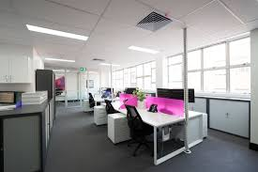
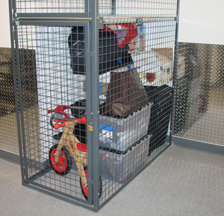
Strata Options
Strata = office suite or shop front
Additional car spaces
Storages cages
Signage?
Extensions to the back
Balconies get higher returns
Views attract better tenants

Slide 4
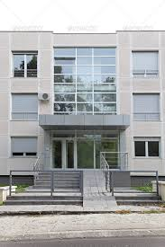
Freehold
Splitting a premise
Signage
Car spaces
Extensions to the premise
Storage sheds
Outdoor area?
Is it on a main road, good drive past traffic
Parking nearby

Slide 5
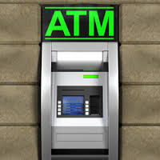
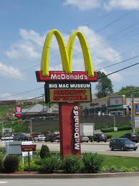
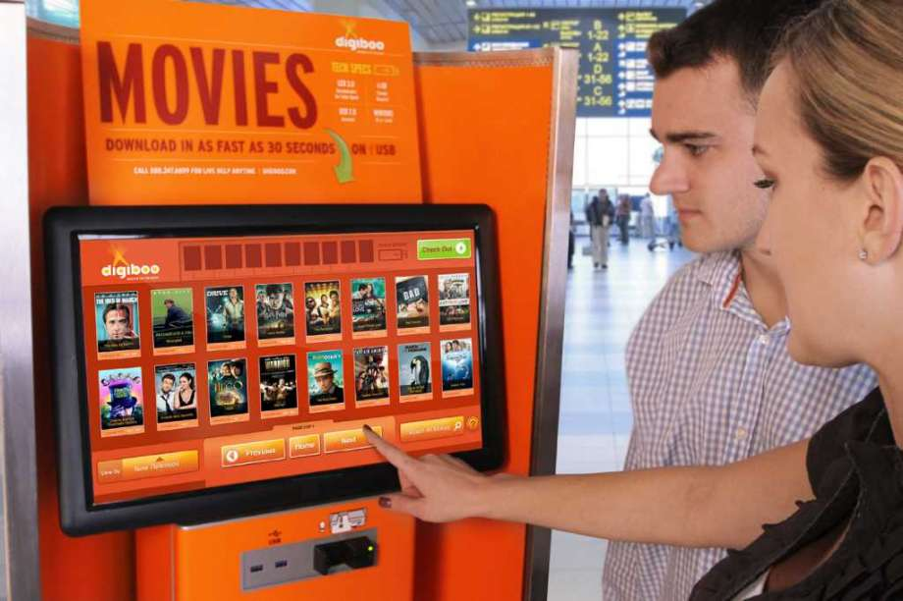
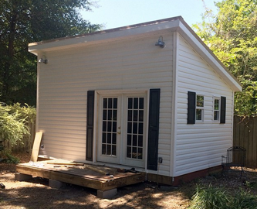
Some other creative options
Movie kiosk
ATMs
Tall display signage
Granny Flats/apartments at the back

Slide 6
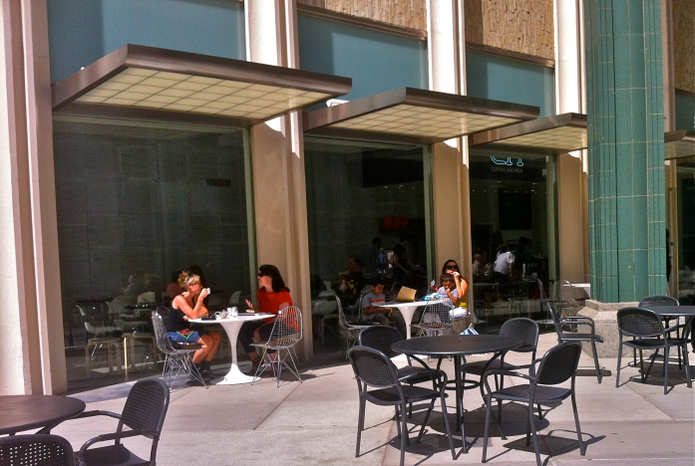
Things to look for in a property
Look for ways to create extra doorways
Rear lane access
Ways to extend on existing property
Can you build upwards?
Can you build out back?
Is the property on a main road?
Any outdoor area available?

