Slide 1

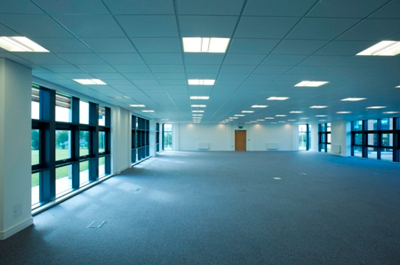
Vacant Possession Commercial Premises
And
Strategies for massive capital gain

Slide 2

Benefits of vacant premises
Downside of vacant premises
Changing your premise to fit a new tenant
Selling for massive capital gains
Live case study

Slide 3
PROS
Great Chance for huge capital gains
Lots of stock to chose from
Vendor are desperate to sell
Potential for good returns with new tenant

Slide 4
CONS
May take 6-9 months to find a tenant
Need to give new tenant rent free period
Paying money for outgoings
Money to refurb the property
Need to pay GST on purchase

Slide 5
PRACTICAL TIPS
Look for a versatile premise
Look for existing facilities
Look for local brand name stores or hubs
Speak to local agents regarding tenant types
Get quotes for cost of simple fitout
Start with small fitout then more later to suit tenant
Start advertising ASAP for tenant

