Slide 1

Sale Lease Back Agreements

Slide 2
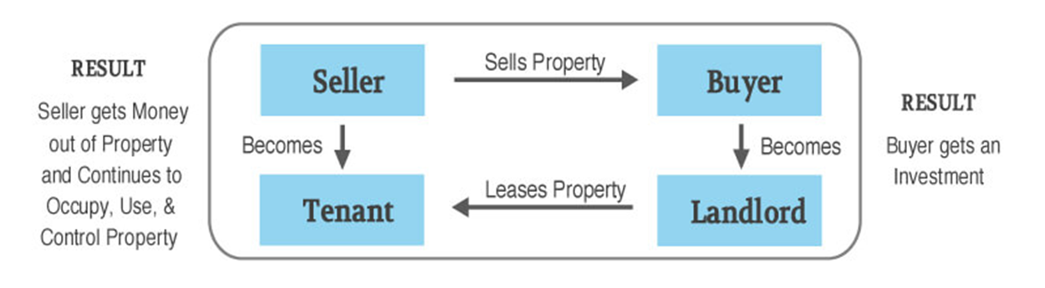
Concept

Slide 3

Process
View the IM
Talk to the agent about leaseback options
Research business profile
Decide on the viability of the business as a tenant
Work out your investment goals
Get lease drawn up by solicitor
Make sale condition on lease been signed

Slide 4

Pros
Secure long term tenant
Saves on agent fees for tenant acquisition
No rent free period
Immediate cash flow
Higher yields
Can be set and forget
Tenant continues to take care of the property
Sell it at a lower yield in the future

Slide 5

Cons
Rent may be misrepresented
Yield maybe misrepresented
Tenant not intending to stay in the long term
Cash flow problems in the tenant business
Building may have defects or major repairs

Slide 6

Look out for
Tenants are paying market rent
Bank Guarantees for 3 months rent
Personal Guarantee of Owner if small business
Rental increases each year at minimum 3%
Tenant pays all the outgoings
Clause in lease about tenant taking care of minor repairs
Minimum 5 year lease – aim for 10 year lease
Check building/strata report for fine print

Slide 7

Due Diligence
Talk to the agent
Understand the tenant’s business
Lease drawn up by a lawyer
Fine print is important
Transparency is key

