Slide 1

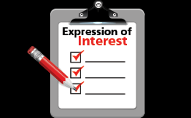
Expressions of Interest

Slide 2
Expressions of Interest
Usually for higher end properties $1 Million plus
Vendor looking to find out what the market will pay
Agent will give you an estimation of what they think the market is worth
Agent generally will provide some past sales figures

Slide 3
Expression of Interest
Adhere to deadline of expressions of interest
Does not mean vendor will sell
Need to submit a form that agent will provide
See sample provide
Agent will submit all expressions of interest at once to vendor
Ask agent for rough price guide before submitting your offer

Slide 4
Expressions of Interest
Typically vendor will negotiate with the top 2
Does not mean vendor will sell
1-2 day for vendor to review offers
Can take up to 1-2 weeks to finalise deal depending on the vendor
Agent will work both parties
Agent will get back to all parties
Be ready to exchange contracts

