Slide 1

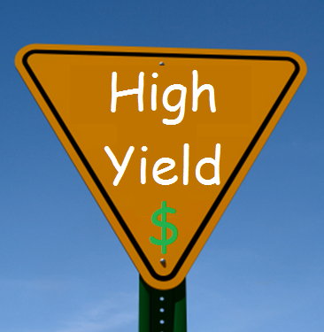
Yields and Calculations
Notes:
Hi Everyone, today we’ll look at Calculating the Yield for commercial properties.

Slide 2

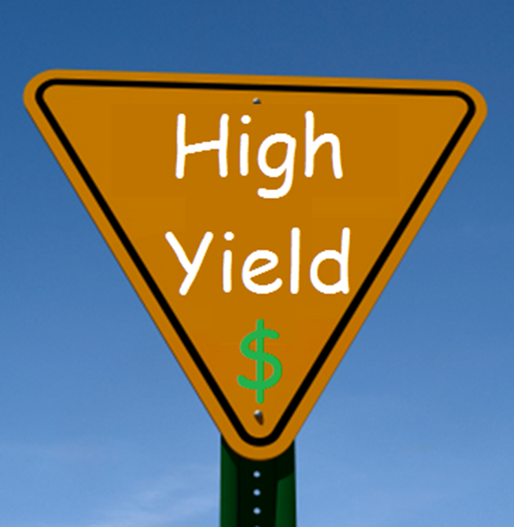
Yields and Calculations
What’s in this Lesson?
Gross and Net Rental Returns
Expenses and outgoings
Calculating the Positive Cash Flow / Yield
Yields and Purchase Price
What drives Yields?
Notes:
I’ll cover the difference between Gross and Net rental return, and I’ll go over the various expenses and outgoings you need to take into account, and other things you’ll need to consider in order to then calculate the positive cash flow, or Yield, that you can expect from the property. We’ll take a look at the relationship between the Yield and the purchase price, and lastly a quick look at the forces that drive Yields.

Slide 3
Yields and Calculations
Gross vs Net Return
Gross Rental Return – Rent before expenses
Net Rental Return – Rent after expenses
Agent can quote either depending on the rent tenant is currently paying
Notes:
So Gross Rental Return is the rent paid by the tenant, before taking out expenses. Net Rental Return is your return after expenses are deducted. These are simple concepts but its important to understand them because later in the video I’ll show how Gross and Net Rental Returns are calculared, and how they affect the value of your property.
Also the Agent can quote your rental return either as Gross or Net. Most of the time it will be Net, but it depends on what kind of rent the tenant is paying. For example, a tenant may be paying an “all expenses included” rent, and from out of that the landlord pays for any expenses associated with their occupation of the premises. In this situation the Agent will quote you a Gross Rental Return.
With a Net return, the tenant pays a base rent, and settles bills and expenses separately.

Slide 4
Yields and Calculations
Expenses and Outgoings
Ask agent for a list of property expenses and estimation of each expenses
Water usage
Electricity
Gas
Telecommunications
Maintenance
Air Conditioners
Cleaning
Gardens, gutters…
Notes:
So when the tenants are paying a Gross Rent, you’ll need to understand what the outgoings are in order to estimate your Net income. So lets look at the kind of expenses we’re talking about.
You’ll need to ask your Agent for details about each of these as they’re different for each property. There are basic costs such as water usage, electricity and gas, telecommunications, any maintenance costs, servicing of air conditioners, cleaning of common areas, and any additional services the property may require. If the premises are free-standing then there may be costs to maintain the garden and clean the gutters. So take the time to discuss all of these with your Agent to make sure you know about every ongoing expense involved with the property.

Slide 5
Yields and Calculations
Expenses and Outgoings
Ask agent for a list of property expenses and estimation of each expenses
Find out land tax threshold for the state you are buying in
Ask for copy of current building insurance
Notes:
Land tax is another consideration, and the threshold for land tax is different with each state so you need to be aware of what it is for the state where you’re buying a property. The state revenue office will have this information, and we also have a document that discusses land tax in more detail.
Lastly, ask the Agent for a copy of the current building insurance, which may be taken out either by the landlord or the tenant depending on the type of property Once you have a copy of the insurance policy, you can see what the level of cover is and the premium, which will be a guide for when you get your own quote for insuring the premises.

Slide 6
Yields and Calculations
Expenses and Outgoings (cont)
Total all outgoings for the property except for building insurance, land tax and mortgage
Building insurance depends on the property
Gross rent – Outgoings = Net Rental Income
Work out interest rate on mortgage
Work out land tax threshold and liability
Get insurance quote
Notes:
So once you’ve received a detailed list of outgoings from the Agent, you want to total them up, leaving out things like building insurance, land tax and mortgage costs.
Building insurance depends on the property. If you’re buying a strata property then there is no building insurance, as the strata covers all of that, along with building maintenance and security costs, all of those are taken care of under strata.
So you want to take your Gross Rent and subtract the Outgoings, not including Building Insurance, Land tax and your Mortgage, and that will give you your Net Rental income.
Next you’ll need to work out the interest rate on your Mortgage. Your broker should give you an estimate of what the interest rate will be on a commercial loan. Also if you’re covering part of the loan through using a residential property as equity, that will be at a lower rate so you need to find out how much each component of your loan is, and therefore work out what the total interest rate repayments would be for the loan.

Slide 7
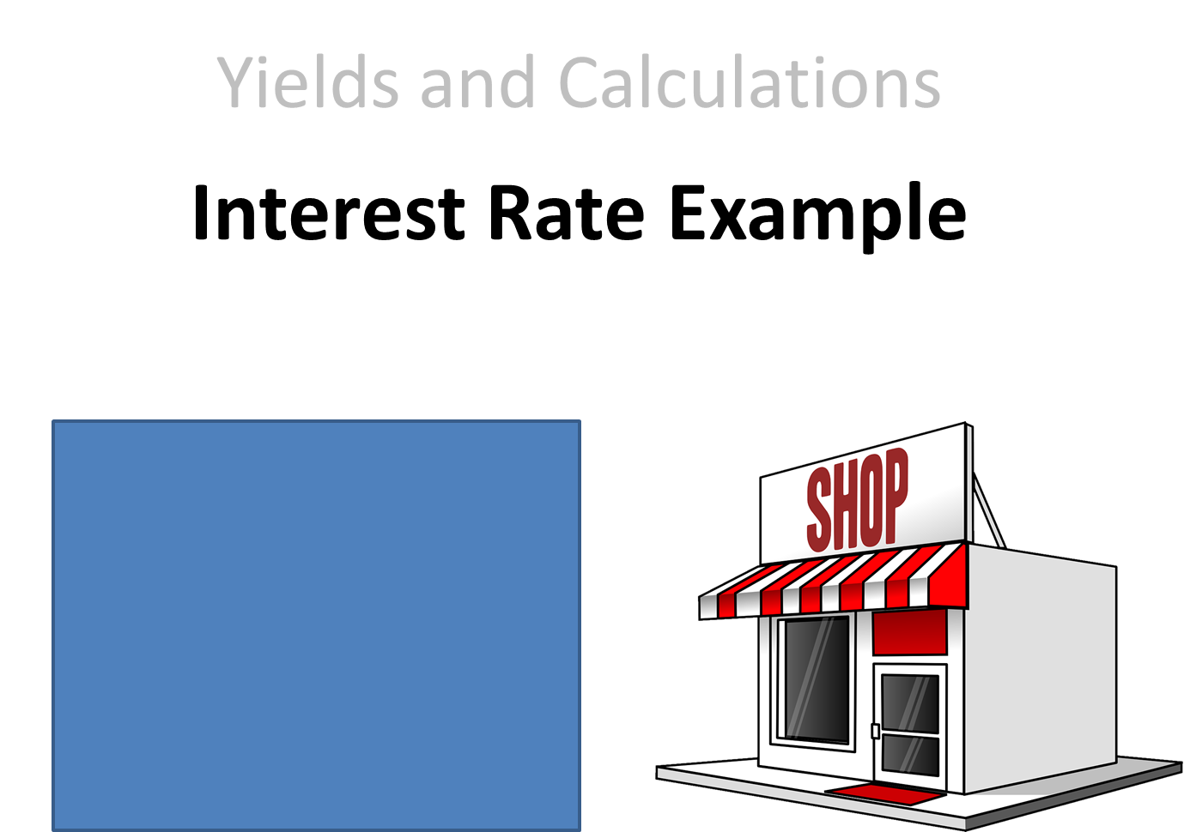

Yields and Calculations
Interest Rate Example
30% Deposit at 4.5%
Remaining 70% at 5.5%
$600,000 at 4.5% = $27,000
$1,400,000 at 5.5% = $77,000
Total = $104,000
Notes:
I’ll just look at a quick example of that. Lets say you’ve bought a commercial property, and you’ve put down a 30% deposit, and you’ve financed that with a loan on your residential property at a hypothetical interest rate of 4.5%. Lets say the purchase is for 2 million dollars,
The remaining 70% of the purchase is covered by a commercial property loan at 5.5%.
Lets say the purchase is for $2 million, that means you have 30%, or $600,000, where you’re paying 4.5% interest per annum which comes to $27,000.
The remaining 70%, or $1,400,000 is at 5.5%, which comes to $77,000. You need to add these together to find the total amount of your mortgage interest repayments, which in this case would be $104,000 per year.

Slide 8
Yields and Calculations
Expenses and Outgoings (cont)
Total all outgoings for the property except for building insurance, land tax and mortgage
Building insurance depends on the property
Gross rent – Outgoings = Net Rental Income
Work out interest rate on mortgage
Work out land tax threshold and liability
Get insurance quote
Notes:
So once you’ve worked out your mortage repayments, hold onto that amount as I’ll show you where that comes into the equation later on.
Next you want to work out whether you’ll be paying land tax and if there are any other liabilities. If this is your first property then most of the time you’re not likely to trigger the land tax threshold so you probably won’t have any liabilities, but if its your second or third property in the same state then most likely you’ll need to pay some form of land tax. Keep in mind that this tax only applies to the land portion of your premises. So if you bought a strata property, the land portion is often miniscule so the land tax could be very small, whereas if you bought a free-standing building you may find that the tax is higher.
If the property is free-standing, you’ll need to some quotes for your building insurance, and compare that with the current insurance on the property.

Slide 9
Yields and Purchase Price
Gross Rental Yield on Purchase Price
Gross Yield (Annual Rental Income)/ Property Price x 100
Example:
$80k/ $900k x 100 = 8.89%
Net Rental Yield on Purchase Price
(Gross Yield – Expenses) / Property Price x 100
Example:
$68k/ $900k x 100 = 7.56%
Notes:
So firstly lets work out the Gross Rental Yield on the Purchase Price, still working on the assumption here that the Agent has quoted you a Gross Rent.
Take that Gross Rental Income and divide it by the asking price for the property, and multiply that by 100, to calculate what percentage the Gross Yield is of the Purchase Price.
Here’s an example. Lets say a property has a current Gross Yield of $80,000, and the asking price to purchase the property is $900,000. 80,000 divided by 900,000 times 100 gives you the Gross Yield percentage, which comes to 8.89%.
But what we really need to know is the Net Rental Yield after expenses are deducted. Once you’ve calculated all of the expenses, subtract them from the Gross Yield, then the same as before you divide them by the property asking price and multiply by 100.
So to continue with the previous example, lets assume the expenses amount to $12,000 per year. Taking that away from the $80,000 Gross Yield gives us $68,000. And that gives us a Net Rental Yield of 7.56% per year.
You need to do this before entering price negotiations with the Agent, as you’ll be able to see at what price the property will not only cover your mortgage and tax payments, but also return you a net yearly profit. You’ll need to decide for yourself what an acceptable Net Yield is for you personally, taking into account the nature and location of the property you’re thinking of buying.
But keep in mind that the Gross Rental Yield alone is not very helpful to you. It’s the Net Yield that will decide how much cash the property puts in your pocket, so its vital that this is calculated accurately.

Slide 10
Yields and Purchase Price (cont)
Net Yearly Rent / desired Yield % x 100
Examples:
$48k net yearly rent / 9.5% x 100 =$505,263.16
$35k net yearly rent / 8.5% x 100 = $411,764.71
Notes:
So we want to look at the Purchase Price and work out how much we’re going to get out of that in terms of Yield, and here’s another way to go about doing that. If you know the kind of yield you’re looking for, you can work out the maximum Purchase price to give you the desired cashflow.
Here’s the equation. You take the Net Yearly Rent, divide it by the Yield % you want, and multiply that by 100. Here’s some examples to help make it clearer.
In this case, the Net Rental is $48,000, and you want a 9.5% yield on the property. That gives you a maximum purchase price of around $505,000. If you go over that price you’ll be earning less yield, and if you can negotiate a lower price then your yield will increase above 9.5%.
Here’s another one. The property’s Net Rental is $35,000, you’re looking for a 8.5% yearly return on your investment, which gives you a max purchase price of around $412,000.

Slide 11
Yields and Purchase Price (cont)
Make a list of desired purchase price with 0.5% increments down wards – this will show relation between purchase price and yield
Example: (based on $48k yearly rent)
@ 8% = $600k
@ 8.5% = $564,705
@ 9% = $533,333
@ 9.5% = $505,263
@10% = $480,000
Notes:
Here’s something else you might find helpful. Its a good idea to calculate a list of what the purchase price would be with different yield percentages, dropping by an increment of 0.5%, and this will show you how the purchase price changes according to what rental yield percentage you’d be happy to accept from the property.
On the previous slide I had an example of a property returning $48,000 net yearly rental.
So if I was happy with an 8% yield every year, that would allow me to pay up to $600,000 for the property.
If I couldn’t accept less than an 8.5% yield, that would cap my purchase price at around $564,000.
And as I continue to increase the yield I’d need from the property, the maximum I can afford to pay drops accordingly. You can see how useful this is when working out whether a property represents good value from your perspective, and also when it comes to sitting down with the Agent to negotiate the price. You might approach it by starting negotiations based on a 10% yield, and maybe decide that 9% is as low as you’re prepared to go. In this example, you’d be putting in an opening offer of $480,000, and you’d be prepared to go as high as $530,000. This will be up to you, but these calculations give you a solid basis on which to make your decision as to whether or not you should purchase, and at what price.

Slide 12
Additional Outgoings
Building insurance - $2k plus
Land Tax – Individual basis
Threshold varies in each state
Mortgage Interest Only – Individual basis
Net Rental – Additional Outgoings
= Positive Cash Flow
Notes:
Of course on top of that we need to look at any Additional Outgoings. These include Building Insurance which can start at as little as $2000, but can rise to over $10,000 depending on the building. Of course, if you have a freestanding building that’s worth $5 or $10 million, your insurance is going to cost a lot more. For a simple freestanding building with 2 or 3 tenants, your building insurance could be around the $6000 range. Of course if you have a Strata apartment, suite or office, you might even own an entire floor of a building, either way you won’t be paying for insurance. There are strata fees but those will be paid by the tenant.
Again you’ll need to find out your individual land tax obligations, because -
- the threshold varies in each state.
You need to look at your Mortgage and how much the interest component costs on its own. This will be unique for everyone as it depends on the interest rate you’re able to borrow at. You can borrow at a full doc loan, the interest rate will be as low as it can be in the market. There are options in the market for people who are low docs with commercial property, and there are also lease-only loans, and remember that if you have equity from your residential property you can use it to dilute the interest rate you’re paying on the commercial property.
So now that you’ve got the Net Rental, having removed the normal day-to-day expenses, you need to take out the additional outgoings from that net rent, and that will leave you with the positive cash flow.

Slide 13
Positive Cash Flow
Net Rental – Additional Outgoings
= Positive Cash Flow
Example: (based on $505,263.16 purchase price)
$48k - $3k (insurance) - $0 (not at threshold)
- $27,789.47 (Interest Only 100% borrowing at 5.5%)
= $17,210.53
/12 (mths) = $1,434.21 per month
/ 52 (wks) = $330.97 per week
Notes:
So here’s an example of how you get to the Positive Cash Flow.
Start with your Net Rental income, and subtract your additional outgoings such as your building insurance if applicable, your land tax and your mortgage repayments, and that will bring your to your positive cash flow, and that’s the exciting bit.
So lets continue on with the previous example of a property with $48 thousand net rental income per year. We’ve decided we need a 9.5% yield which means we can afford a purchase price of $505,000.
For the sake of argument lets assume that your building insurance is $3000. We’ll subtract that from the $48,000, and then we need to look at Land Tax. We bought it for $505 thousand, so the land component of this property will be less than that. Lets say its valued at $400 thousand in this case, which would almost certainly put you under the threshold of paying land tax in most states, assuming you don’t own other properties. Therefore in this case there would be no tax to pay.
For the mortgage, if we’re borrowing 100% of purchase amount with an interest-only commercial loan at 5.5%, that comes to nearly $28,000 in repayments. You can see how important it is to dilute the loan with residential equity if possible in order to reduce this figure. I know its possible to get a commercial loan at a lower rate at the time I’m making this video, but its good to be conservative with this, especially as interest rates might rise again in the future. Anyway, when I subtract that and the $3000 insurance from the net rental I’m left with $17,210.53 per year which is the positive net cash flow for this property.
Over 12 months, that comes to an income of $1434.21 per month, or $330.97 per week. That might not sound like a lot, and it does illustrate why you need to go for a high Yield percentage, and to look for properties with minimal ongoing costs in order to improve the bottom line. Its also a good idea to be conservative in your estimates for the income the property will generate, and allow extra for expenses, as that way if the figures are still attractive to you on a conservative estimate, you might end up making more income from the property than you expected.
But the important thing is that our costs are covered and the property is generating a positive cash flow. $17000 in this case might not seem like a lot, but it all adds up, and will help you get into your next commercial property after which it starts snowballing, and that’s very exciting.

Slide 14

Forces that drive yields
Business confidence
Economic forecast and growth
Industry that support the area
Purchasers/investor
Residential Investment property
Trends can effect different property types
Local area growth potential
Notes:
To conclude this lesson, lets look at the market forces that drive yields in commercial property.
A major one is Business confidence, which will directly impact the length of time a tenant is willing to sign a lease for, whether 2 or 5 or 10 years. Now there are businesses out there who are willing to sign 10 or even 25 year leases, but they’re big organisations such as Bunnings or Petrol stations – but because of the long lease the rental income when you buy the property will often be a lot lower than that paid by a standard business with a 3 to 5 year lease. If there’s an uncertainty in the market, businesses are less willing to sign up for long-term and more likely to go with a 2 to 5 year lease.
Economic Growth forecasts will have a similar effect. Whenever there’s uncertainty, as there was leading up to the Federal Election in 2016, companies were unwilling to sign leases as they were unsure what new policies would be introduced and how that would affect their business. But the moment the government was elected, enquiries came flooding in and activity skyrocketed. People just wanted to be sure that a new government wasn’t going to implement policies that would harm their business, before they felt free to go out and sign a 3 or 5 year lease.
Another factor is the industry that supports the area surrounding the property. Is there agriculture, manufacturing, is it a hub of some sort? Will this industry bring people to the area and create new jobs leading the area to grow, and does the industry itself offer large players who could potentially be your tenants? Its great if you purchase in an area where there are national or multinational companies who’ll lease your building, as that give you a stable and reliable income from your investment.
The mix of purchasers and investors is also important. A classic example is Sydney in 2013, when the commercial rental yields dropped significantly due to the influx of buyers from Asia. They’d been buying residential properties, but when the supply of those properties began to dry up they switched to commercial, and started to buy properties that we wouldn’t consider a safe investment. They were buying properties in particular with low yields where the tenants were banks on long-term leases, and the buyers were paying an astronomical amount of money. Some of the properties were only returning a 4% net rental yield, which is ridiculous. When the banks signed their leases the owners at that time were receiving a yield at around 6.5%, which is already very low, but the temporary influx of overseas buyers pushed it down even further. This kind of thing doesn’t affect regional property as much as it does cities and CBDs, but it is something to bear in mind. If a large number of investors are buying in a particular area the yields will start to drop. This also happens in the residential market, but the great thing about commercial property is that not a lot of people know about it, so there’s less risk of investors flooding into a particular area. So before you buy, you do need to find out about what kind of people are buying in that area. In regional centres a lot of the buyers are local as they’re more comfortable buying in those area, whereas when you look at cities you’ll find things like Sydney people buying in Queensland, and when there’s enough of that happening it that starts to affect the yields.
Of course, Residential Investment property also impacts the Commercial market. This is especially the case when the Residential market is overheated and investors aren’t getting much return, as they may look to the commercial market in order to generate more income. More buyers enter the market, and it doesn’t mean they’ll make smart decisions, just that there are more buyers and this can drive up the price and lower the yields.
Trends can affect things as well. For example, from 2000 to 2010 there was a drive towards serviced offices. A lot of people were making money from them, which resulted in many premises in the city being converted into smaller serviced offices, and that impacted on the rents being paid and of course the net yield was affected as a result, but only on certain types of property. Because of the trend towards serviced offices, investors were looking for vacant buildings that they could turn into two or three units, or they may look specifically for properties with small tenancies, and those properties would fetch a higher rate than usual in the market.
Lastly, consider what’s happening in the suburbs around the market. Are there new building developments in the area? Are new shopping centers going in? Or new business districts perhaps? Look at those and if they’re a major new development you need to see how that will impact on the properties in the area and how it may influence tenancies and land values. Will it raise prices, will it take business elsewhere and cause hardship for you as a commercial property investor? The more aware you are of what’s happening in the local area the better chance you have of making a sound business decision. If you’re buying in a location away from where you live, its advisable to go and spend a couple of days in the area, during the week if possible, to observe the businesses and gauge people’s levels of interest and the growth prospects for the area. You know that if the area is going to grow, you’ll be able to charge a higher rent down the track, and you’ll know that if you lose your current tent you’ll be able to get a new tenant quite easily.
So I hope this lesson has helped clarify how to work out the yields for your property, the importance of using yields to determine your purchase price, and of taking market forces into account when looking to buy a property. If you’d like any further information there are documents you can download for this module. Happy hunting, and I’ll see you in the next lesson!

