Slide 1

Return on Investment

Slide 2
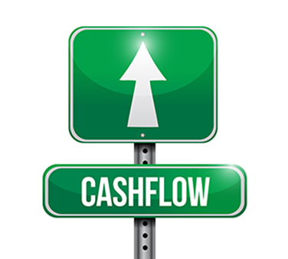
Example
$500k Property at 10% net rental return = $50k per year
20% Deposit (from equity)
80% Borrowings (Commercial Rates)
20% = $100k @ 4% = $4k interest
80% = $400k @ 5.5% = $22k interest
$4k + $22k = $26k interest per year to service property

Slide 3

Additional Fees
Stamp Duty = 20K
Cost of Borrowing and Fees = $5K
$20k + 5K = $25K in Cash to Purchase property

Slide 4
Cash Flow Position
$500k Property at 10% Rental Return = $50k
Tenant pays all outgoings
Total Interest = $26K per year
$50K - $26K = $24K net cash flow or $2k Per Mth
Cash Flow position can change if you pay any outgoings like building insurance, land tax and/or Agent management fees

Slide 5
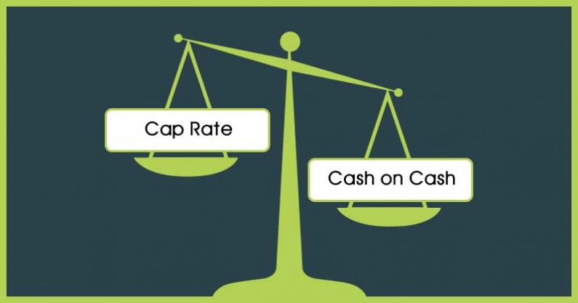

Slide 6
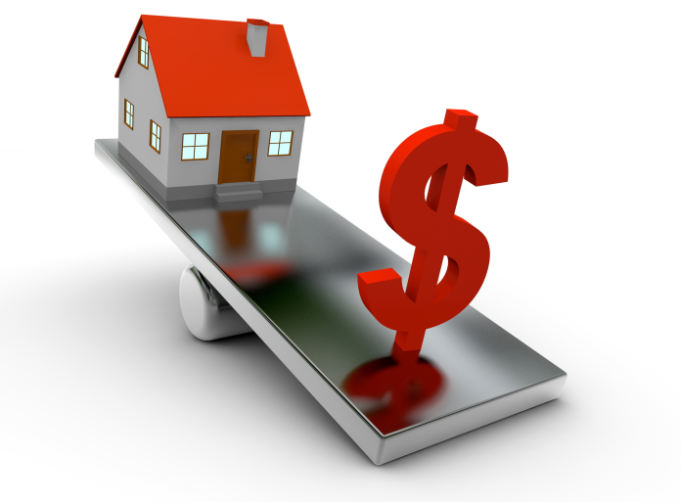
Cash on Cash Return
Cash on Cash = Annual before Tax Cash Flow
Total Cash Invested
If Cash = $25K cash invested
= $24, 000 (net rent)
$25, 000 Cash Invested
= 96% Return on Investment

Slide 7
Cash on Cash Return
If using Equity Deposit = $100K (20% deposit)
+ $25K stamp duty and borrowing costs Cash
= $125k Total Cash Investment
$24,000 (net rent)
$125,000 (total Cash investment)
= 19.2% Return on Cash Investment

Slide 8
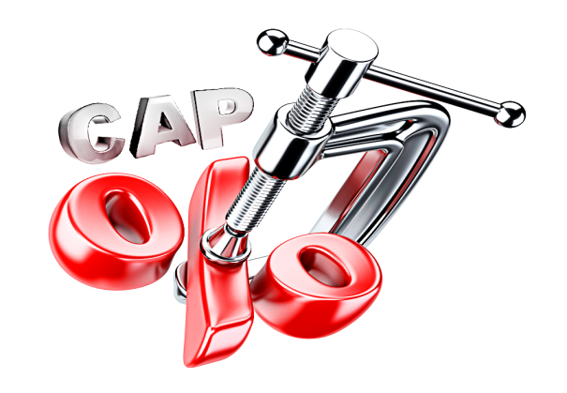
Capitalization Rate
Used to estimate the investor’s potential return on investment
Often termed Cap Rate
Capitalization Rate = Net Operating Income (NOI)
Current Market Value
Capitalization Rate = Net Yield or Net Rental Return

Slide 9
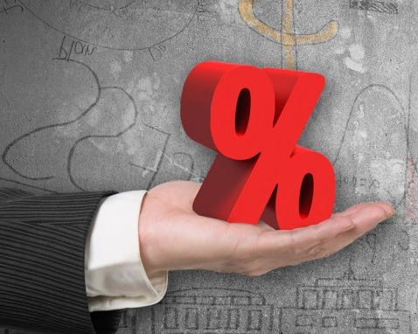

Example
$500K property with rental income of $50K Net
Capitalization Rate = Net Operating Income
(Cap Rate) Current Market Value
= $50, 000
$500, 000
= 10%
Every Year Earning is 10% Value of the property

Slide 10
Recap
Commercial Property is Yield Driven
Work through your cash flow position
Cash on Cash helps you to work out return on investment
Capitalization Rate (Cap Rate) help you to work out yearly cash flow return on investment
Most commercial property is sold on yield or rental return which is the cap rate

