Slide 1

Repairs and Maintenance

Slide 2
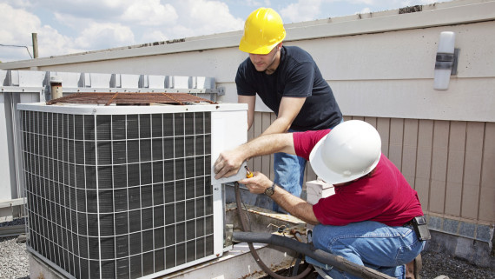
Outgoings vs Maintenance
Outgoings are everyday expenses
  Strata or Building insurance
  Rates
  Water and Electricity
  General cleaning and repairs
Maintenance are large item repairs such as air conditioning, roof and elevators etc

Slide 3
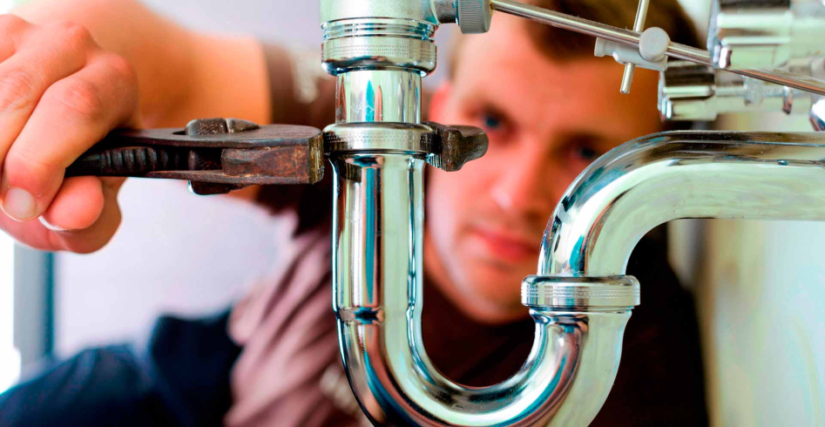
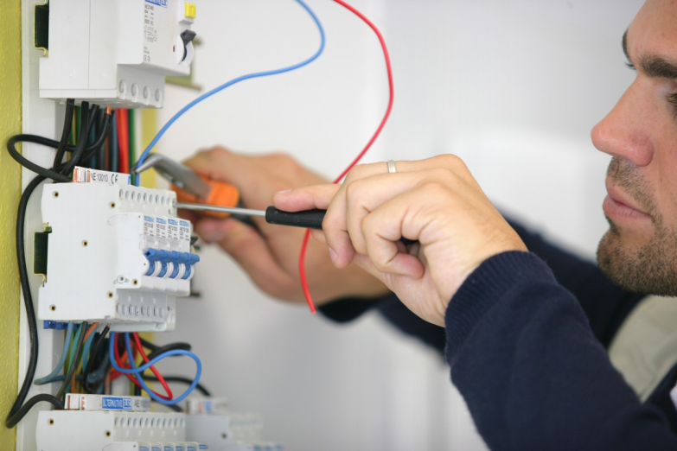
Plumbing and Electricals
Block toilets & hot water systems
Leaking taps?
Light fittings
Rewiring
Common Areas
Separating meters

Slide 4
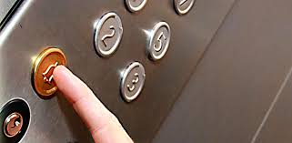
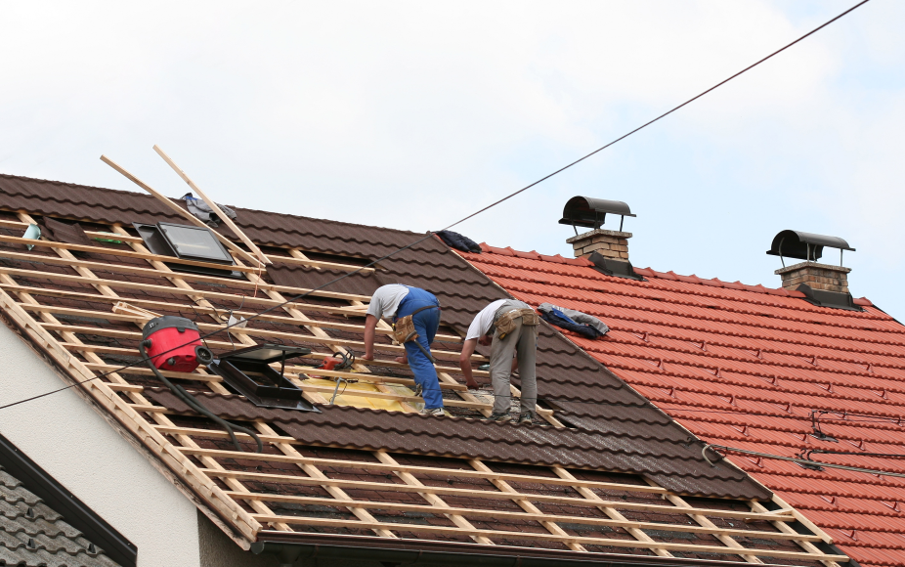

Large Building Repairs
Air Conditioning
Elevators and Lifts
Roof
Compliance – Fire Safety Inspection

Slide 5

Who pays for what?
Tenant fits outs and Refurbs
Your capital improvements to the building
New doorways, locks etc?
New internal plumbing and electricals?
Make Good Clause?

