Slide 1
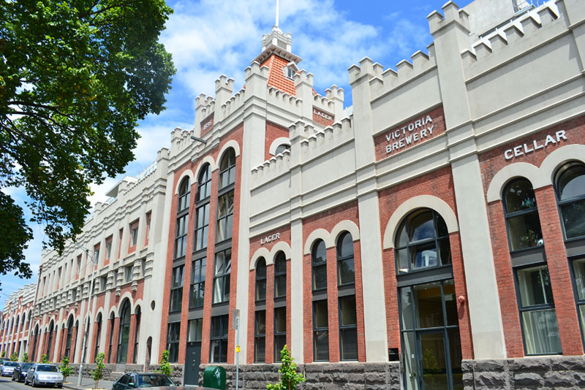
City vs. Regional

Slide 2
City Commercial Property
Largely strata offices, retail shop fronts
Starting from 20-30sq going upwards
Higher rents
Higher strata fees
Easy to find new tenants
Yield from 5% plus
Aim for 8% yield (plus if possible)

Slide 3
City Commercial Property Cont
Start ups on 2 year leases plus options
Medium size companies on 3 year leases plus options
National tenants on 5 year leases plus options
May pay a higher gross rent or base rent plus outgoings
Insurance is covered by strata
Maintenance is covered by strata

Slide 4
City Commercial Property Cont
Start ups prefer CPI increase
All others 3% plus is acceptable
Outgoings are water and electricity
Strata covers maintenance, insurance and security
Landlord covers land tax
Set and Forget Properties

Slide 5
Regional Commercial Property
Freestanding
Can be multiple tenancies OR
One large national tenant
Look for hubs supported by university, trade, industry, military
Population minimum 35k/40K plus
Vibrant communities
More involvement from land lord

Slide 6
Regional Commercial Property Cont
Usual tenants are medium to large enterprises
5 year lease plus option
If one tenant – pay all outgoings including building insurance
If multiple tenants then landlord pays for building insurance
Landlord pays for land tax

Slide 7
Regional Commercial Property Cont
Landlord pays for land tax
Maintenance can be high so check age of air conditioning, roofing and any structural work (building report)
Chose stairs over lifts for less maintenance
Yield start at 8% plus
Aim for 9.5% plus

Slide 8
Regional Commercial Property Cont
Check rental history of the property
  How long has current tenant been there
  What is the current tenant profile
  Are they likely to expand, leave or relocate?
  Who was the last tenant? How long were they there for?

Slide 9
Regional Commercial Property Cont
  Have tenant done any refurb or fit out of current premise? If so, when?
  Who are your neighbouring tenants?
  Any vacancies on the same street or close vicinity
Harder to find tenant if current tenant vacate so need to keep tenant or budget for longer marketing time to find new tenant

Slide 10
City vs Regional
Each has it’s pros and cons
Are you willing to travel?
How much work are you willing to put in?
Do you want to self manage your property?
What is your long term goal?
Yields are higher in regional to cover risk

Slide 11
City vs Regional
Market capital growth is higher in City
Steady market growth in regional
Long leases lower yields
More secure the tenant lower yields
Examine lease thoroughly to check for
  Outgoings
  Lease terms
  Bond/Guarantee

Slide 12
Conclusion
Do your due diligence
Walk around the local area
Know your tenant profile
Know what you are willing to pay
Know your end goal
Be patient with your research – ask all your questions before your contract goes unconditional!

