Slide 1

Exit Strategies
How to sell for massive capital gains

Slide 2

Setting up for the Sale
Commercial property is yield driven
Make sure your lease is in place
Make sure your have options in your lease
Make sure any major repairs have been done on the premise
Research past sale prices in the area

Slide 3

Sales Agents
Meet with sales agents
Ask them to show you comparative sales
Commission is usually 2-3% depending on the price of your property
Discuss marketing plan with sales agent
Discuss the best form of selling – auction, expression of interest, private treaty

Slide 4
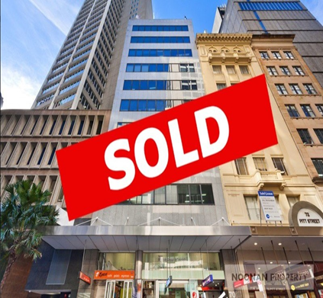
The Right Time to Sell
Time to sell in the middle of your lease
Sell at a lower yield then you brought it from
Sell using the best sales method
Auction – for a hot market
Expression of Interest – for high price property
Private Treaty – Regional

Slide 5
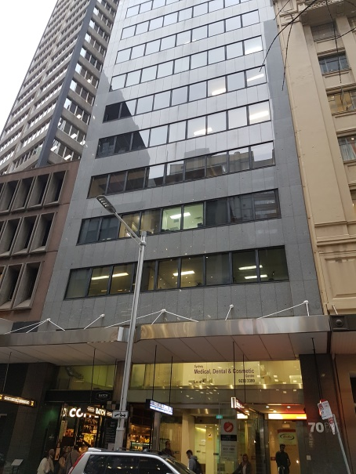
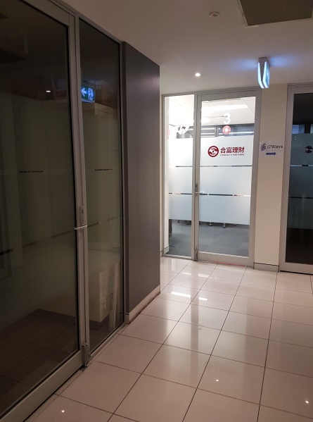
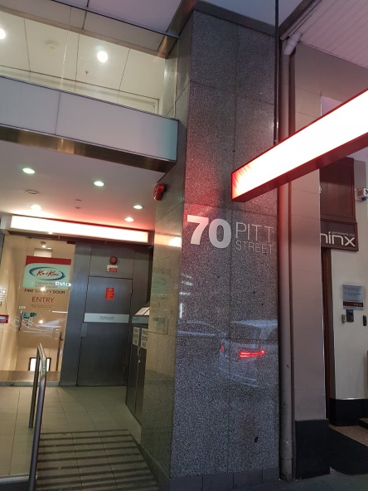
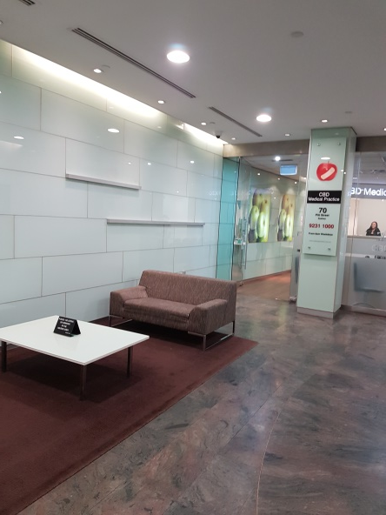
Case Study – 70 Pitt St
Brought at 8.5% Yield
Built up the tenancy – returning 11%
Sold it to a purchase at 6.5%
No lease renewals for minimum of 12months

