Slide 1
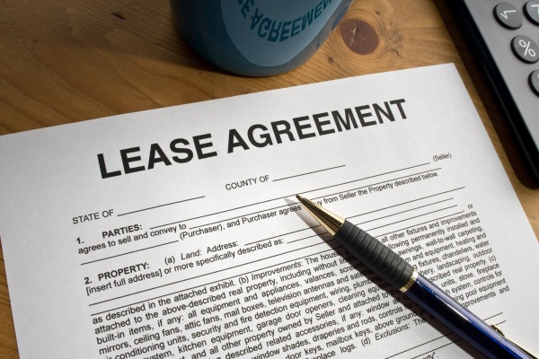
Leasing Incentive and Strategies

Slide 2

Leasing Incentives
Rent Free periods – one month per year
Vacant premise may attract longer rent free
Discount in Rent
Owner does fit out

Slide 3

Which Incentives is better?
Keep your rental high because of compounding effect of rental increases
Offer rent free instead of discounting rent
Negotiate with tenant about fit out options
Look at options that is not going to cost you money upfront

Slide 4

Leasing agents
Find specialist leasing agents
3 month exclusive
Some agent may allow non exclusive contracts
Commission can vary but usually it starts at 10-11% first year rent
Commission goes higher depending on the term of the lease

Slide 5

Leasing Process
The agent will send photographer to take photos of the premise
The will put advertising on internet and organise signage boards
They will get a key for the premise from you or if your property is tenant they will contact the tenant directly for an inspection
They will show people to your premise and then update you on market feedback

Slide 6
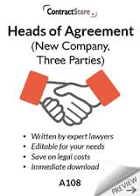
Leasing Process Cont.
Once a tenant is interested they put
forward an offer/proposal
The landlord can either accept, reject or counter offer
Once agreement is accepted a “Heads of Agreement or Agreed Terms” is drawn up by the agent
Both parties sign it and a lease is prepared accordingly
Both parties then sign lease for formalise deal

Slide 7

Important Points to Remember
Tell agent what you are willing to offer in incentives upfront
Follow up with your agent regularly
Ask for any offer to be submitted
Negotiate to keep tenant for longer term
Aim for 3% increase in yearly rental increase
Check your potential tenants out before accepting their offer
Get a solicitor to draw up a formal lease

