Slide 1

Health and Welfare Benefits Under Pressure: Legal Developments, Litigation Risks, and Practical Strategies
Presented By:
Ben Conley, Partner, Seyfarth Shaw

Slide 2

Weight Loss Drug Coverage for 2027 Plan Year
Coverage of GLP-1 drugs for weight loss
• Offer potential for long-term savings, but with significant short-term costs
• Employers continue to review coverage exclusions, dollar caps, medical management techniques
Compliance considerations
HIPAA prohibits discrimination based on health status
– Only a concern if small group targeted
– Safe harbor for changes made at renewal
ADA prohibits discrimination based on disability
– Currently, most courts have ruled obesity is not a disability
ACA ANNUAL-DOLLAR-LIMIT RULE
ACA prohibits annual dollar limits on essential health benefits
• Review plan to ensure GLP-1s could not be characterized as an Essential Health Benefit (EHB)
VIEWER LENS
Cost strategy and compliance design must move together.

Slide 3
Updates on Tobacco Surcharge Litigation
TOBACCO SURCHARGE CASES
Synopsis
Plaintiffs allege plan sponsor charged tobacco surcharge in violation of federal law.
COMPLIANCE FOCUS
Key points
• Focus remains on compliance with HIPAA guidelines
– Limit on incentives
– Opportunity to qualify once per year*
– Reasonable alternative standard
– Participant Notice
CURRENT STATUS
Mixed rulings
Mixed rulings on whether “reward” must be retroactive

Slide 4
Consolidated Appropriations Act of 2026
NEW PBM TRANSPARENCY GUIDELINES
Timing
30 months after enactment (mid-2028)
Summary document
• Plan sponsors must disclose summary document to participants annually
– $10k penalty per failure
DISCLOSURE
Transparency provisions
• PBMs cannot enter into contracts that would limit their disclosure to health plans
Requires semiannual reporting of:
– Drugs issued and pricing
– PBM compensation based on utilization
– High-cost drug reporting
– “Steering” provisions to affiliated pharmacies
ECONOMICS
Full pass-through of rebates
PBM contracts considered “unreasonable” if PBM fails to remit 100% of rebates, fees, alternative discounts, and other remuneration to the plan
• Payments required quarterly (within 90 days of close of quarter)
• Affords plans audit rights
Notes:
HRSA - one HHS sub-agencies tasked with updating women’s health preventive care guidelines

Slide 5
No Surprises Act (NSA) IDR Final Rule
NSA BACKGROUND
No Surprises Act
• Signed into law at the end of 2020 and implemented in 2022
• Established federal protections against surprise medical billing (also known as “balance billing”) for individuals enrolled in group health plans and individual coverage.
• Surprise medical bills = difference between a billed change and the amount health plan/insurance coverage paid.
NSA protections apply to:
1. Emergency services (including both facility and professional charges) received at hospital’s emergency department or independent freestanding emergency center
2. Nonemergency services provided by out-of-network provider during a visit at an in-network health facility
– Example: out-of-network surgeon performing surgery at in-network hospital
3. Out-of-network provider of air ambulance services
Independent Dispute Resolution (IDR)
  NSA established a federal independent dispute resolution (IDR) process to resolve payment disputes between health plans/issuers and out-of-network providers.
  Federal IDR process has received more than 5 million payment disputes since April 2022 launch
  Significant delays and costs
  Ongoing NSA implementation litigation
  **Final Rule released by federal agencies in May to improve operations of IDR process**
Notes:
Surprise medical bills resulted in unforeseen financial burdens on patients who received medical care from an out-of-network provider or facility, often without the patient’s knowledge or notice by the facility/provider that the visit would result in additional charges.
Federal agencies expected approx. 20k disputes, not 5 million and counting!

Slide 6
No Surprises Act (NSA) Operational Issues
PRACTICAL IDR PROCESS CONSIDERATIONS FOR SELF-FUNDED PLAN SPONSORS
Confirm with TPA
Prepare IDR registration information including gathering required data elements & confirm TPAs will register and manage ongoing compliance on their behalf when registry becomes available.
Ask for data from TPA
IDR claim outcomes (volume of disputes, number of wins, number of losses, amounts paid over QPA, etc.).
CONTRACT & SAVINGS
Review TPA/vendor contract
Ensure fee-per-dispute for IDR reviews tracks the reduction at the federal level (i.e., if the federal arbitrators only charge $15/dispute now, the TPA should not still be charging $115).
Review vendor’s shared savings program and how it interacts with the IDR process (if at all).
– Do shared savings even apply to NSA claims?
– Does the vendor still recover a “percent of savings” against billed charges, even when they lose the IDR dispute?
PROCESS OPTIONS
State processes
Federal NSA allows plans to opt-out of the federal IDR process where a state provides a balance billing dispute resolution process.
Some employers examining which states offer and alternative and considering opting into those state-level processes.
Contesting awards
Currently challenging on a practical level, but some TPAs are bringing “book-of-business” level challenges against certain providers who they believe are abusing the system.
Potential carve-out arrangements
These vendors will presumably leverage data to more effectively manage the IDR process, assuming TPA permits carve out of such functions.
Notes:
Some employers are considering directing their TPAs to not pay where an IDR award is clearly in error (e.g., typo in the judgment amount, decision on ineligible claim, etc.). While the law does not provide an easy path to dispute an IDR award, it similarly does not provide a clear path for providers to enforce an arbitrator decision. It’s unclear, from a practical level, how an employer would implement this given that the TPA is largely running the process. Even so, we have learned that some TPAs are bringing “book-of-business” level challenges against certain providers who they believe are abusing the system.
While we have not seen any prominent emergence of vendors in this space, we expect that as TPAs continue to struggle with this process, you may see a cottage industry develop around specialized IDR dispute resolution vendors.

Slide 7
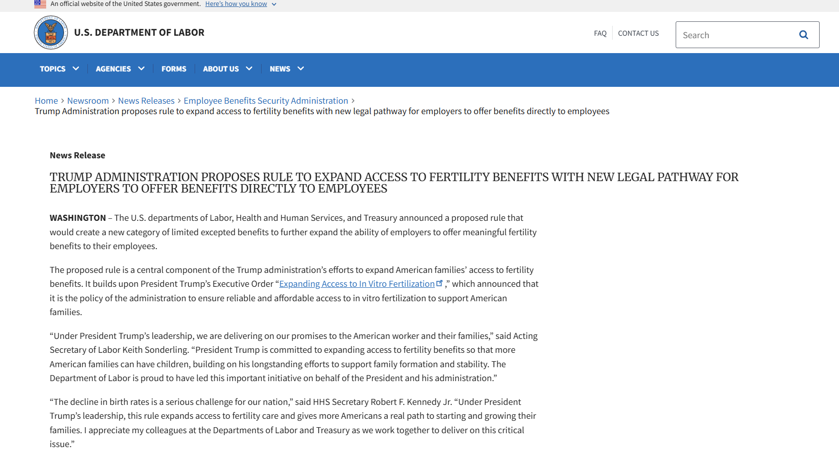
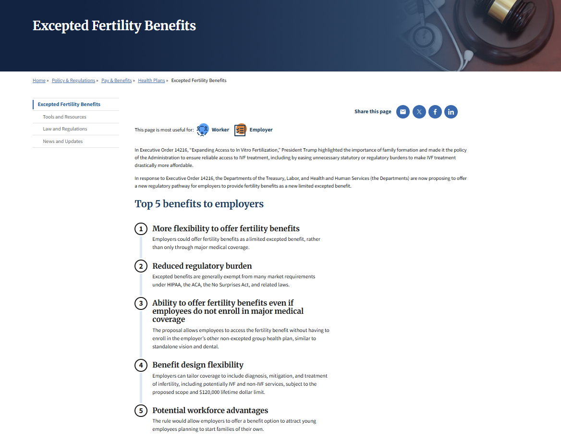
Excepted Fertility Benefits Proposed Rule
FERTILITY BENEFITS
Excepted Fertility Benefits | U.S. Department of Labor
Trump Administration proposes rule to expand access to fertility benefits with new legal pathway for employers to offer benefits directly to employees | U.S. Department of Labor
Notes:
Released on May 10, 2026 – Mothers Day gift and released in response to an early 2025 Executive Order with policy recommendations to expand access to fertility treatment and services, including in-vitro fertilization. This proposed rule also builds on October 2025 guidance from the federal agencies, clarifying that employers could offer fertility benefits through three existing excepted benefit pathways:
a fully insured independent, noncoordinated excepted benefit policy
an excepted benefit HRA, and
an employee assistance program offering coaching and navigator services.

Slide 8
Excepted Fertility Benefits Proposed Rule
WHAT CHANGES
A new excepted-benefit category
Proposed rule would establish a new category of limited excepted benefits.
Excepted benefits not subject to certain ACA requirements including:
– prohibition on lifetime/annual dollar maximums to essential health benefits (EHBs), and
– preventive care coverage without any participant cost sharing requirement (100% preventive care coverage)
• Common examples: stand-alone dental/vision coverage, accident/hospital indemnity plans, etc.
WHY IT MATTERS
A carve-out pathway
Proposed rule (if finalized) would offer a compliant pathway for employers to offer fertility benefits to their employees on a “carve-out” basis.
• Explains that many employers do not cover fertility benefits as part of their major medical coverage
• Aims to encourage more employers to offer this benefit.

Slide 9
Excepted Fertility Benefits Proposed Rule
WHEN & WHAT
January 1, 2027
Effective for plan years beginning on or after January 1, 2027 (if finalized)
• Substantially all benefits must be for the diagnosis, mitigation or treatment of infertility or related reproductive health conditions
– provided by medical professionals authorized to practice under applicable law.
– includes lab tests, medications, genetic testing, and IVF.
CAP & STRUCTURE
$120,000
Benefits capped at a combined lifetime maximum of $120,000 for participants and dependents (indexed for inflation annually)
• Benefits would be required to be provided under a separate policy or otherwise not be an integral part of the plan maintained by the same plan sponsor
ELIGIBILITY & NOTICE
Plan sponsor can only offer this fertility benefit to those employees that are also offered employer’s major medical coverage
– employees not required to enroll in employer’s major medical plan to enroll in fertility benefit
Notice requirement for participants and dependents with prescribed content/rules
– Provided upon enrollment, annually and upon request
Notes:
This would include preventive care services, non-preventive care services, treatment for underlying conditions that may impact fertility/infertility (obviously IVF but also other treatments including nutritional counseling ), and initial treatments for infertility or infertility related reproductive health conditions, regardless of the gender/sex of the individual)
Notice is required to clearly describe the coverage, including its benefits and limitations, how to access in‑network providers and how to submit claims, and must be written in a manner understandable to the average participant.

Slide 10
Excepted Fertility Benefits Proposed Rule
ISSUES TO CONSIDER WHILE WAITING FOR FINAL RULE
HSA eligibility
HSA eligibility concern if excepted fertility benefit provides first-dollar coverage prior to individual satisfying their IRS minimum deductible
Carrier underwriting
Adverse selection/risk pool concerns for insurance carriers considering underwriting an excepted fertility benefit
Participation
Current “unknowns” of who will actually elect coverage once available
Other plan rules
Excepted fertility benefit may still be subject to other group health plans rules, such as COBRA

Slide 11
Trump Accounts Refresher
BACKGROUND
One Big Beautiful Bill Act (OBBBA) created “Trump Accounts”, with contributions that began July 4, 2026
• Structured similarly to IRAs, but for children (under age 18)
• Limited to $5,000/child/year in contributions (adjusted for inflation)
• Contributions are not tax-preferred for contributor but excludable for children
• Must be invested in a “low-cost” mutual fund or exchange-traded fund
• No withdrawals prior to age 18
• Withdrawals after age 18 subject to standard IRA rules
Contribution Pilot Program: Federal government contributes $1,000 to eligible U.S. citizen children born between 1/1/2025 and 12/31/2028
Parents/guardians use IRS Form 4547 to open an initial Trump account and request one-time $1,000 pilot program contribution for eligible children
EMPLOYER CONTRIBUTIONS
Employers can contribute up to $2,500 (adjusted for inflation) to Trump Accounts of employees’ children or teenage employees
– New section added to Internal Revenue Code (Section 128)
– Per-employee limit (not per-dependent limit)
– Ex: Employer may only contribute up to $2,500 total in 2026 for employee with 2 (or more) children
• Contribution program can be offered via salary reduction under Section 125 cafeteria plan
– Contribution must be made to Trump Account of employee’s dependent, not to employee
– Otherwise, deferred compensation concerns
TAX & ADMINISTRATION
Tax treatment:
– Excluded from employees’ gross income
– Contributions by employer appear to count toward $5,000 annual limit
• Requires written plan document and employee notification
• Subject to same nondiscrimination testing rules as dependent care assistance programs (DCAPs)
– Guidance issued recently (see next slide)

Slide 12
Trump Accounts: New Proposed Rules for Employers
PROGRAM DESIGN
IRS proposed regulations on Trump Accounts
Rules for implementing employer-funded Trump Account program:
• Maintain a separate written plan addressing notice, reporting, certification and trustee communication procedures
• Limit employer/employee-pre-tax contributions to $2,500 annual exclusion per employee – not per child
• Allow employees to pick any available trustee/custodian – employers may not restrict contributions to trustees they select
• Permit pre-tax salary reduction under a Section 125 cafeteria plan only for a dependent’s account, not for employees themselves (e.g., workers under age 18)
ELIGIBILITY & TAX
Verifying eligibility
• Employers can rely on employee attestation that they have a qualifying tax dependent
• Employers must verify that money is going into a valid Trump Account
• Satisfy nondiscrimination testing – same as DCAP (and employer contributions/employee pre-tax deferrals are combined with DCAP contributions for testing purposes.
For tax purposes, employer contributions/employee pre-tax contributions are excluded from income tax but subject to FICA

Slide 13
DCAPs: New Nondiscrimination Guidelines
THE TEST
55%
Average Benefits Test
The average DCAP benefit for non-HCEs must be at least 55% of the average benefit for HCEs
• Example: if HCEs average a $6,000 benefit, non-HCEs must average at least $3,300
Trump Account guidance updated/clarified DCAP rules (more than 45 years later…)
New rules can be relied on pending final guidance
Biggest clarification relates to 55% Average Benefits Test
PREVIOUS UNCERTAINTY
Who belongs in the average?
The IRS never said who belongs in the average – every eligible employee, or only those actually receiving a benefit
Conservative testing counted every eligible non-HCE, including those electing $0, which dragged the non-HCE average down and caused failures – a growing risk since the limit rose to $7,500
Problem: non-HCEs may not be participating because they have no kids
NEW CLARIFICATION
Participants only
The average counts only employees who actually receive DCAP benefits during the plan year – non-participants are out of the denominator
• Many plans that failed under the old approach will now pass.
A failure can also be corrected by including the excess in HCEs’ income by January 31 after the testing year (previously, corrections had to be made prior to 12/31)

Slide 14
Thank you
Contact Information:
  For more information, please contact:
  Ben Conley (BConley@seyfarth.com)

