Slide 1

MISSOURI RIVER ENERGY SERVICES • HR MEMBERS CONFERENCE • THURSDAY, OCT. 1
Powering the Pipeline
Connecting to Tomorrow’s Workforce
Sara Vander Zanden
Director of State Workforce Development, Center for Energy Workforce Development (CEWD)
Notes:
Welcome / cold open. (0:00) Introduce yourself and CEWD in 30 seconds. Note that you're joining virtually and that there will be an in-person, table-based discussion built in around the midpoint — flag now that a room facilitator will run that segment so no one is caught off guard later.

Slide 2





TODAY’S SESSION
What We’ll Cover
~8 MIN
~10 MIN
The Need
Small-Group Discussion
What the data says about where energy workforce pressure is highest right now.
Talk through your own toughest-to-fill roles at your table.
CEWD Tools & Resources
Putting It Into Practice
Career Explorer, 50+ career pathway one-pagers, targeted outreach kits, and EIF 2.0 curriculum.
Real examples and where to start closing the biggest gaps.
Notes:
(~1 min) Walk the roadmap fast — this slide is orientation, not content. Name-check the small-group discussion now so people know it's coming and can start thinking about their own toughest-to-fill roles.

Slide 3
SECTION 1
The Need: What the Data Shows
Where energy workforce pressure is highest and closing in fastest.
Notes:
Section transition. (~0:30) One line: "Let's ground this in data before we talk solutions."

Slide 4
THE NEED
Energy Is Hiring at a Scale We Haven’t Seen
8.5M
32M
17M
15M
energy jobs in the U.S. today — 5.4% of all U.S. employment
people energy employers expect to hire between 2025 and 2035
of those are net-new jobs created by growth
more are replacement hires — largely retirements
The pipeline has to widen, not just refill.
Source: U.S. Department of Energy, 2025 U.S. Energy & Employment Jobs Report (USEER); Brookings, 2024.
Notes:
(~2 min) Anchor stat slide. Land the 32M number hard — this is the "why we're all in this room" number. Emphasize 17M new vs. 15M replacement: growth alone would be a lot; growth AND churn together is the real story.

Slide 5




THE NEED
The Occupations Under the Most Pressure
Electricians
Welders
Nuclear
Mining
81,000 must be hired and trained every single year, for a decade.
A projected shortfall of 320,000 welders by 2029.
A projected need for 376,000 nuclear workers by 2050.
More than half the current workforce retires by 2029; just 162 mining-engineering B.S. grads in 2023.
Sources: U.S. Dept. of Labor, 2025; American Welding Society, 2025; U.S. Dept. of Energy; Society for Mining, Metallurgy & Exploration, 2025.
Notes:
(~2 min) Pick 1–2 of these to go slightly deeper on based on what MRES members likely hire for (lineworkers/electricians most relevant to municipal utilities). Don't read all four with equal weight — let electricians and mining (retirement-driven) carry the emotional weight.

Slide 6



THE NEED
The Retirement Wave Meets a Recruiting Crunch
Retirements Are Outpacing New Talent
Today, about 2.4 energy workers are approaching retirement for every 1 worker under 25 entering the field.
Skilled trades are the 2nd-hardest roles to fill in our country
46% of employers called skilled-trades positions “very difficult” to fill in 2024 — behind only highly-skilled medical roles like doctors and nurses.
Most energy employers are stuck
In a 2025 survey of 700+ energy companies, more than half reported critical hiring bottlenecks — concentrated in applied technical roles like electricians, pipefitters, and plant operators.
Sources: IEA, World Energy Employment 2025; SHRM Talent Trends, 2024.
Notes:
(~1.5 min) This is the "why now" slide — tie retirement + recruiting difficulty together as compounding, not separate, problems. All three stats here are energy-sector-specific (IEA 2025 survey of 700+ energy companies; SHRM’s cross-industry ranking that places energy-relevant skilled trades roles). If asked, the "one other category" ahead of skilled trades in the SHRM ranking is highly-skilled medical roles (doctors, nurses).

Slide 7
THE NEED
The Skills Gap Beneath the Surface
76%
52%
43%
of energy & utilities employers report a talent and skills gap in their existing workforce
of jobs require training beyond high school but short of a 4-year degree
of workers have actually had access to that kind of skills training
Sources: ManpowerGroup, 2024; National Skills Coalition, 2025.
Notes:
(~1.5 min) The turn: it's not just headcount, it's readiness. All three stats are energy/utility-specific or directly about the broader U.S. skills-training pipeline — the 43%-vs-52% gap is the one to slow down on.

Slide 8
THE NEED
Where It Lands: The Picture Shifts by State
Most Total Energy Jobs
Most Energy Jobs Per Capita
Your Region: MRES States
Energy jobs & share of all state jobs
Texas
Wyoming
North Dakota
990,100
#1
58,722 jobs · 14.0% of all jobs (2022 data)
California
North Dakota
Minnesota
941,500
#2
131,027 jobs · 4.4% of all jobs (2024 data)
Iowa
Michigan
West Virginia
86,693 jobs · 5.6% of all jobs (2024 data)
394,000
#3
South Dakota
27,966 jobs · 6.2% of all jobs (2022 data)
North Dakota alone is one of the most energy-job-dense states in the country. This is exactly why regional, employer-driven consortia are where pipeline gaps actually get closed.
Source: U.S. Dept. of Energy, USEER state data. TX/CA/MI/WY/ND(rank)/WV/MN/IA figures are 2024 data (2025 report); ND/SD figures in the region box are the most recent matched jobs+% pair published (2022 data).
Notes:
(~1 min) Localize this — the third column now shows jobs and % of all jobs for all four MRES states side by side. Flag verbally that ND/SD figures are the most recent matched public pair (2022); if you have more current internal numbers for those two, swap them in.

Slide 9
SECTION 2
From Data to Action
Three categories of solutions
Notes:
Section transition. (~0:30) "So where do we find them, and how do we get them ready? Three buckets."

Slide 10



FROM DATA TO ACTION
Three Categories of Solutions
01
02
03
Data & Planning
Awareness & Outreach
Curriculum & Training
Know exactly which roles are under pressure in your footprint — and plan your pipeline around it.
Get more of the right people looking at energy as a career — and speak to them in a way that lands.
Build a consistent, work-ready baseline before day one, so onboarding is faster and more consistent.
01
Notes:
(~1.5 min) Frame these three pillars as the organizing structure for the rest of the talk — you'll revisit awareness, curriculum, and data explicitly as you move through the tools section.

Slide 11
~10 MINUTES • TALK AT YOUR TABLE
Let’s Hear From the Room
In groups of 4–6:
Which of your priority occupations is under the most pressure right now — and what’s the #1 barrier to filling it?
Bonus:
What would “work-ready” look like for that role on someone’s very first day?
7 min: discuss at your table
3 min: share 1 takeaway with the room
Notes:
FACILITATED SEGMENT (~10 min). You are virtual for this part — hand off clearly to the in-room facilitator before going quiet. Suggested handoff line: "I'm going to step back for about ten minutes while [facilitator name] runs this at your tables — I'll rejoin right after." Facilitator: read both prompts aloud, keep visible time (7 min discuss / 3 min share), and cue 2–3 tables to share one takeaway each before advancing. Have the facilitator flag any recurring themes in the chat/notes so the speaker can reference them when rejoining.

Slide 12
SECTION 3
CEWD Tools & Resources
Built by the industry, for the industry — free to put to work today.
Notes:
Section transition. (~0:30) Rejoin here after the discussion — consider referencing 1 thing you heard from the room (via facilitator notes) before moving on.

Slide 13
CEWD TOOLS & RESOURCES
Two Doors Into Everything That Follows
Almost everything in this section lives on one of two CEWD sites — built for two very different audiences.
FOR THE INDUSTRY
FOR CANDIDATES & EDUCATORS
cewd.org
getintoenergy.org
Member resources, workforce data & fast facts, and state consortia info — built for HRand workforce professionals.
CEWD’s consumer-facing site — career exploration, pathway content, and outreach campaigns for students, job seekers, and the educators who guide them.
Bookmark both — nearly every tool coming up lives on one of these two sites.
Notes:
(~1 min) Orientation slide — quick, not deep. This just gives people the two URLs to keep in their back pocket before the specific tools start. Mention that getintoenergy.org is the one to hand to candidates/students/teachers, cewd.org is the one for their own team.

Slide 14


CEWD TOOLS & RESOURCES — AWARENESS & OUTREACH
Explore, Then Apply: getintoenergy.org
Two connected tools — the Energy Explorer quiz to find a fit, and the Job Board to act on it.
FIND YOUR FIT
APPLY NOW
The Energy Explorer Quiz
Get Into Energy Job Board
A short, interactive quiz that matches interests and skills to real energy career pathways — then surfaces wages, training routes, and required credentials for each match.
10,000+ open positions across the energy industry
Real employer postings, searchable by job type, location, and more.
Point candidates straight from the quiz to a real opening — both live on getintoenergy.org, no account needed.
Notes:
(~2 min) Two tools, one flow — quiz first, then apply. If a live demo isn't possible virtually, describe it as: take the quiz, see matched pathways with wages/training/credentials, then click straight through to real open roles on the Job Board. The 10,000+ open-positions number is worth saying out loud slowly — it's the most concrete, current stat in this whole section.

Slide 15

CEWD TOOLS & RESOURCES — AWARENESS & OUTREACH
50+ Career Pathways
Interactive landing pages and print-ready flyers for energy occupations — built to hand to a student, a job fair visitor, or a counselor.
Each two-pager covers:
Covers roles across the full grid:
Role overview & day-to-day
Lineworkers
Plant operators
Earning potential
Natural gas technicians
Nuclear roles
Electricians
Engineers
Key competencies
Instrumentation & controls techs
And 40+ more
Career advancement path
Notes:
(~1.5 min) Tangible, physical resource — mention these are ready to print and hand out at job fairs, career days, or to hiring managers today.

Slide 16
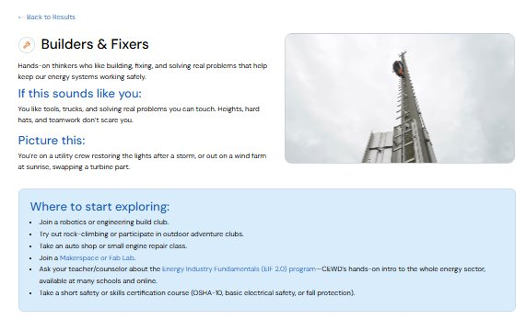
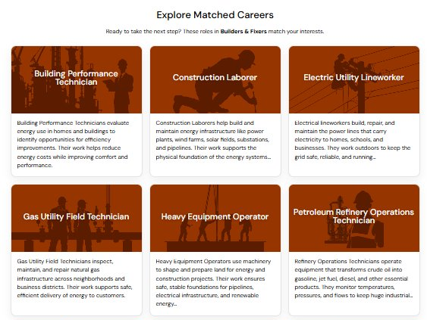
CEWD TOOLS & RESOURCES — AWARENESS & OUTREACH
50+ Career Pathways
Notes:
(~1.5 min) Tangible, physical resource — mention these are ready to print and hand out at job fairs, career days, or to hiring managers today.

Slide 17
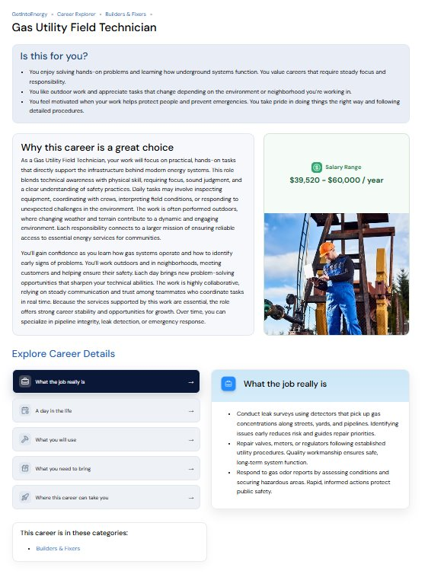
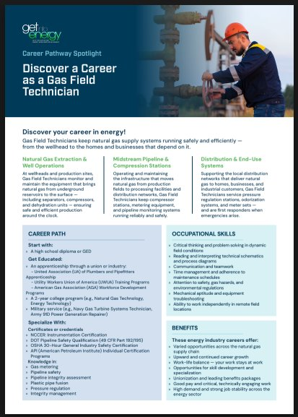
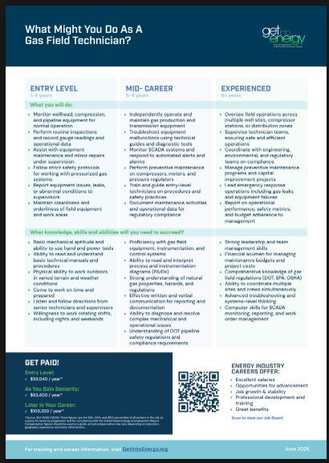
CEWD TOOLS & RESOURCES — AWARENESS & OUTREACH
50+ Career Pathways
Notes:
(~1.5 min) Tangible, physical resource — mention these are ready to print and hand out at job fairs, career days, or to hiring managers today.

Slide 18



CEWD TOOLS & RESOURCES — AWARENESS & OUTREACH
Outreach Tuned for the Audiences You Need
Veterans
Women
Gen Z
TroopsToEnergyJobs.org translates military skills and MOS codes directly into energy career paths.
Hire PowHER and the PowHER Hours podcast build visibility and real stories for women in the skilled trades. Mentor program available for mentors and mentees.
GetIntoEnergy.org delivers social-first, story-driven content built for how younger candidates actually explore
Notes:
(~2 min) This is often the slide HR audiences engage with most — pause slightly longer here. Consider asking (rhetorically, no need to break for discussion) which of these three audiences is hardest for MRES members to reach today.

Slide 19
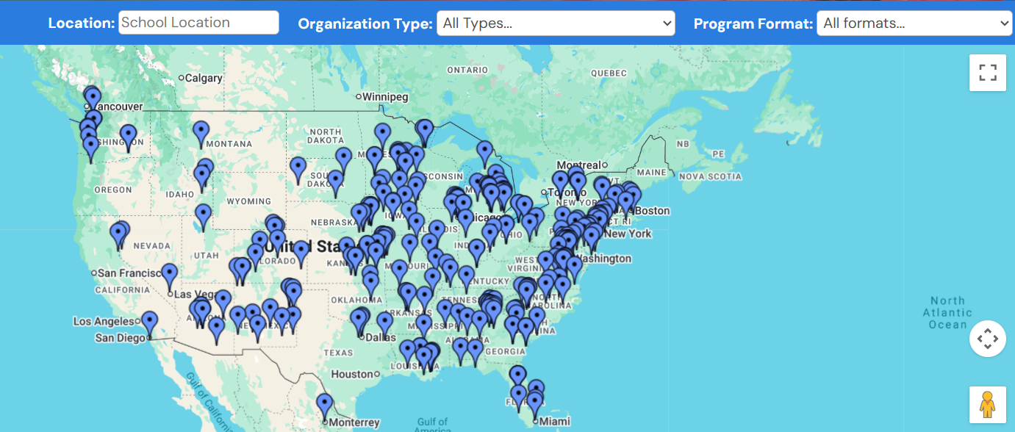


CEWD TOOLS & RESOURCES — CURRICULUM & TRAINING
EIF 2.0: The Curriculum Behind the Pipeline
A free, 120-hour virtual curriculum, available in English & Spanish, building one consistent, industry-recognized baseline — used two different ways:
By Employers
By Training Partners
Woven into onboarding so every new hire starts from the same solid foundation — before they specialize.
Built into high school, CTE, technical college, and pre-apprenticeship coursework to graduate candidates who are work-ready.
10,000+ industry-recognized credentials earned to-date.
https://getintoenergy.org/energy-education-program-locator/
Notes:
(~2 min) EIF 2.0 is likely the most substantive resource in the deck — slow down. Make the distinction clear: same content, two doors in (employer onboarding vs. training-partner pre-apprenticeship).

Slide 20
CEWD TOOLS & RESOURCES — CURRICULUM & TRAINING
NCCER Energy Readiness — Launching 2027
A competency framework picking up where EIF 2.0 leaves off — built through the CEWD & NCCER partnership, now in development.
Picks up where EIF 2.0 ends
Portable & nationally recognized
In development now
Builds on EIF 2.0’s foundation with hands-on skill verification.
Built on NCCER’s trusted credentialing model, so employers everywhere can trust what it certifies.
Announced by CEWD & NCCER; targeted for 2027 — worth planning for in your training strategy.
Not live yet — but worth building into your 2027 training and credentialing plans.
Notes:
(~1.5 min) Important: this is NOT live yet — it launches in 2027. Frame it as "coming soon, plan for it" rather than something to point people to today. Key distinction from EIF 2.0: EIF 2.0 is foundational knowledge available now; Energy Readiness will be a verified, hands-on-competency credential built on NCCER’s model.

Slide 21
CEWD TOOLS & RESOURCES — DATA & PLANNING
State Energy Workforce Consortia
Strategic partnerships between industry, education, workforce systems, and community stakeholders that define a state’s talent needs and build solutions together — active in ~20 states today, with more forming every year.
CONSORTIA ARE:
WHAT CONSORTIA MAKE POSSIBLE
Employer-Led
01
02
Align Workforce Efforts — and Prevent Duplication
Establish a Collective Voice
Cross-Sector
Coordinate employers, educators, and workforce boards so investment reaches the right partners.
Create the employer-led voice state agencies need to prioritize energy workforce efforts.
Region-Specific
03
04
Build the Energy Talent Pipeline
Attract the Future Workforce
Action-Oriented
Expand training capacity for high-demand roles through aligned curricula and credentials.
Build career visibility through K–12 engagement and targeted recruitment.
Notes:
(~1.5 min) This slide answers "who do I call and how does this actually work" — if MRES members ask about starting one, the honest answer is that it starts with employer interest, not a CEWD sales pitch. Keep this grounded in the real model rather than overpromising a specific state timeline.

Slide 22
PUTTING IT INTO PRACTICE
Where to Start: Closing Your Biggest Gap
1
2
3
Name your highest-pressure roles
Match outreach to who you’re missing
Standardize onboarding with EIF 2.0 & Energy Readiness
Use your own attrition and retirement data to flag which occupations hit a wall in the next 3–5 years.
Point veterans, women, and Gen Z candidates to the CEWD outreach tools built for each audience.
Give every new hire the same foundation on day one, so specialized training starts faster.
Notes:
(~1.5 min) This is the "so what do I do Monday morning" slide. Go slightly slower here than anywhere else in the tools section — it's the payoff.

Slide 23


THANK YOU
Let's Keep Building the Pipeline
Explore These Resources
Sara Vander Zanden
cewd.org/resources
Director of State Workforce Development
Fast facts, one-pagers, and the full toolkit
Center for Energy Workforce Development
getintoenergy.org
Career Explorer & career awareness content
cewd.org
Notes:
(~1 min) Close warm. Repeat the resource URLs slowly since people are likely writing them down. Open it up for live Q&A if time remains.

