Slide 1
Leadership, Workforce & Community Development
Andrew Johnson
Director of Member Strategy & Services

Slide 2

Let’s Talk About the ‘Why’
MRES members continue to identify several ongoing challenges:
  Developing future leaders and
  succession planning
  Workforce recruitment and retention
  Knowledge transfer from experienced staff
  Building a strong talent pipeline
  Building trust and credibility in the communities they serve
Notes:
To start our conversation today, I think it’s important to talk about the why – Why does MRES invest so much time and effort into leadership, workforce and community engagement opportunities.
These programs and services are primarily based on member feedback, and the feedback we’re getting from members has been consistent the past several years.
Whether it’s through regular conversations or during member surveys where we directly ask utility leaders what their main challenges are – what keeps them up at night –
MRES members continue to talk about the following challenges:
Developing future leaders and succession planning
Workforce recruitment and retention
Knowledge transfer from experienced staff
Building a strong talent pipeline – building that bench strength of a competent, professional staff
Key Message
Members have made it clear: building the next generation of utility leaders and employees is critical to long-term success.
And promoting the value of public power is a key way they can

Slide 3
From Feedback to Action
How these programs and services support MRES strategic goals:
  Strengthen member utilities
  Promote the value of public power and joint action
  Develop community advocates for local utilities
  Ensure municipal utilities remain sustainable and effective for future generations
Notes:
Member Feedback Guides MRES Programs and Services
MRES has responded by making Leadership Development, Workforce Development and Community Engagement strategic priorities.
How These Priorities Support MRES Strategic Goals
Strengthen member utilities
Promote the value of public power
Demonstrate the value of joint action
Develop community advocates for local utilities
Ensure municipal utilities remain sustainable and effective for future generations
Key Message
These programs exist because members asked for them and because strong people create strong public power utilities.

Slide 4
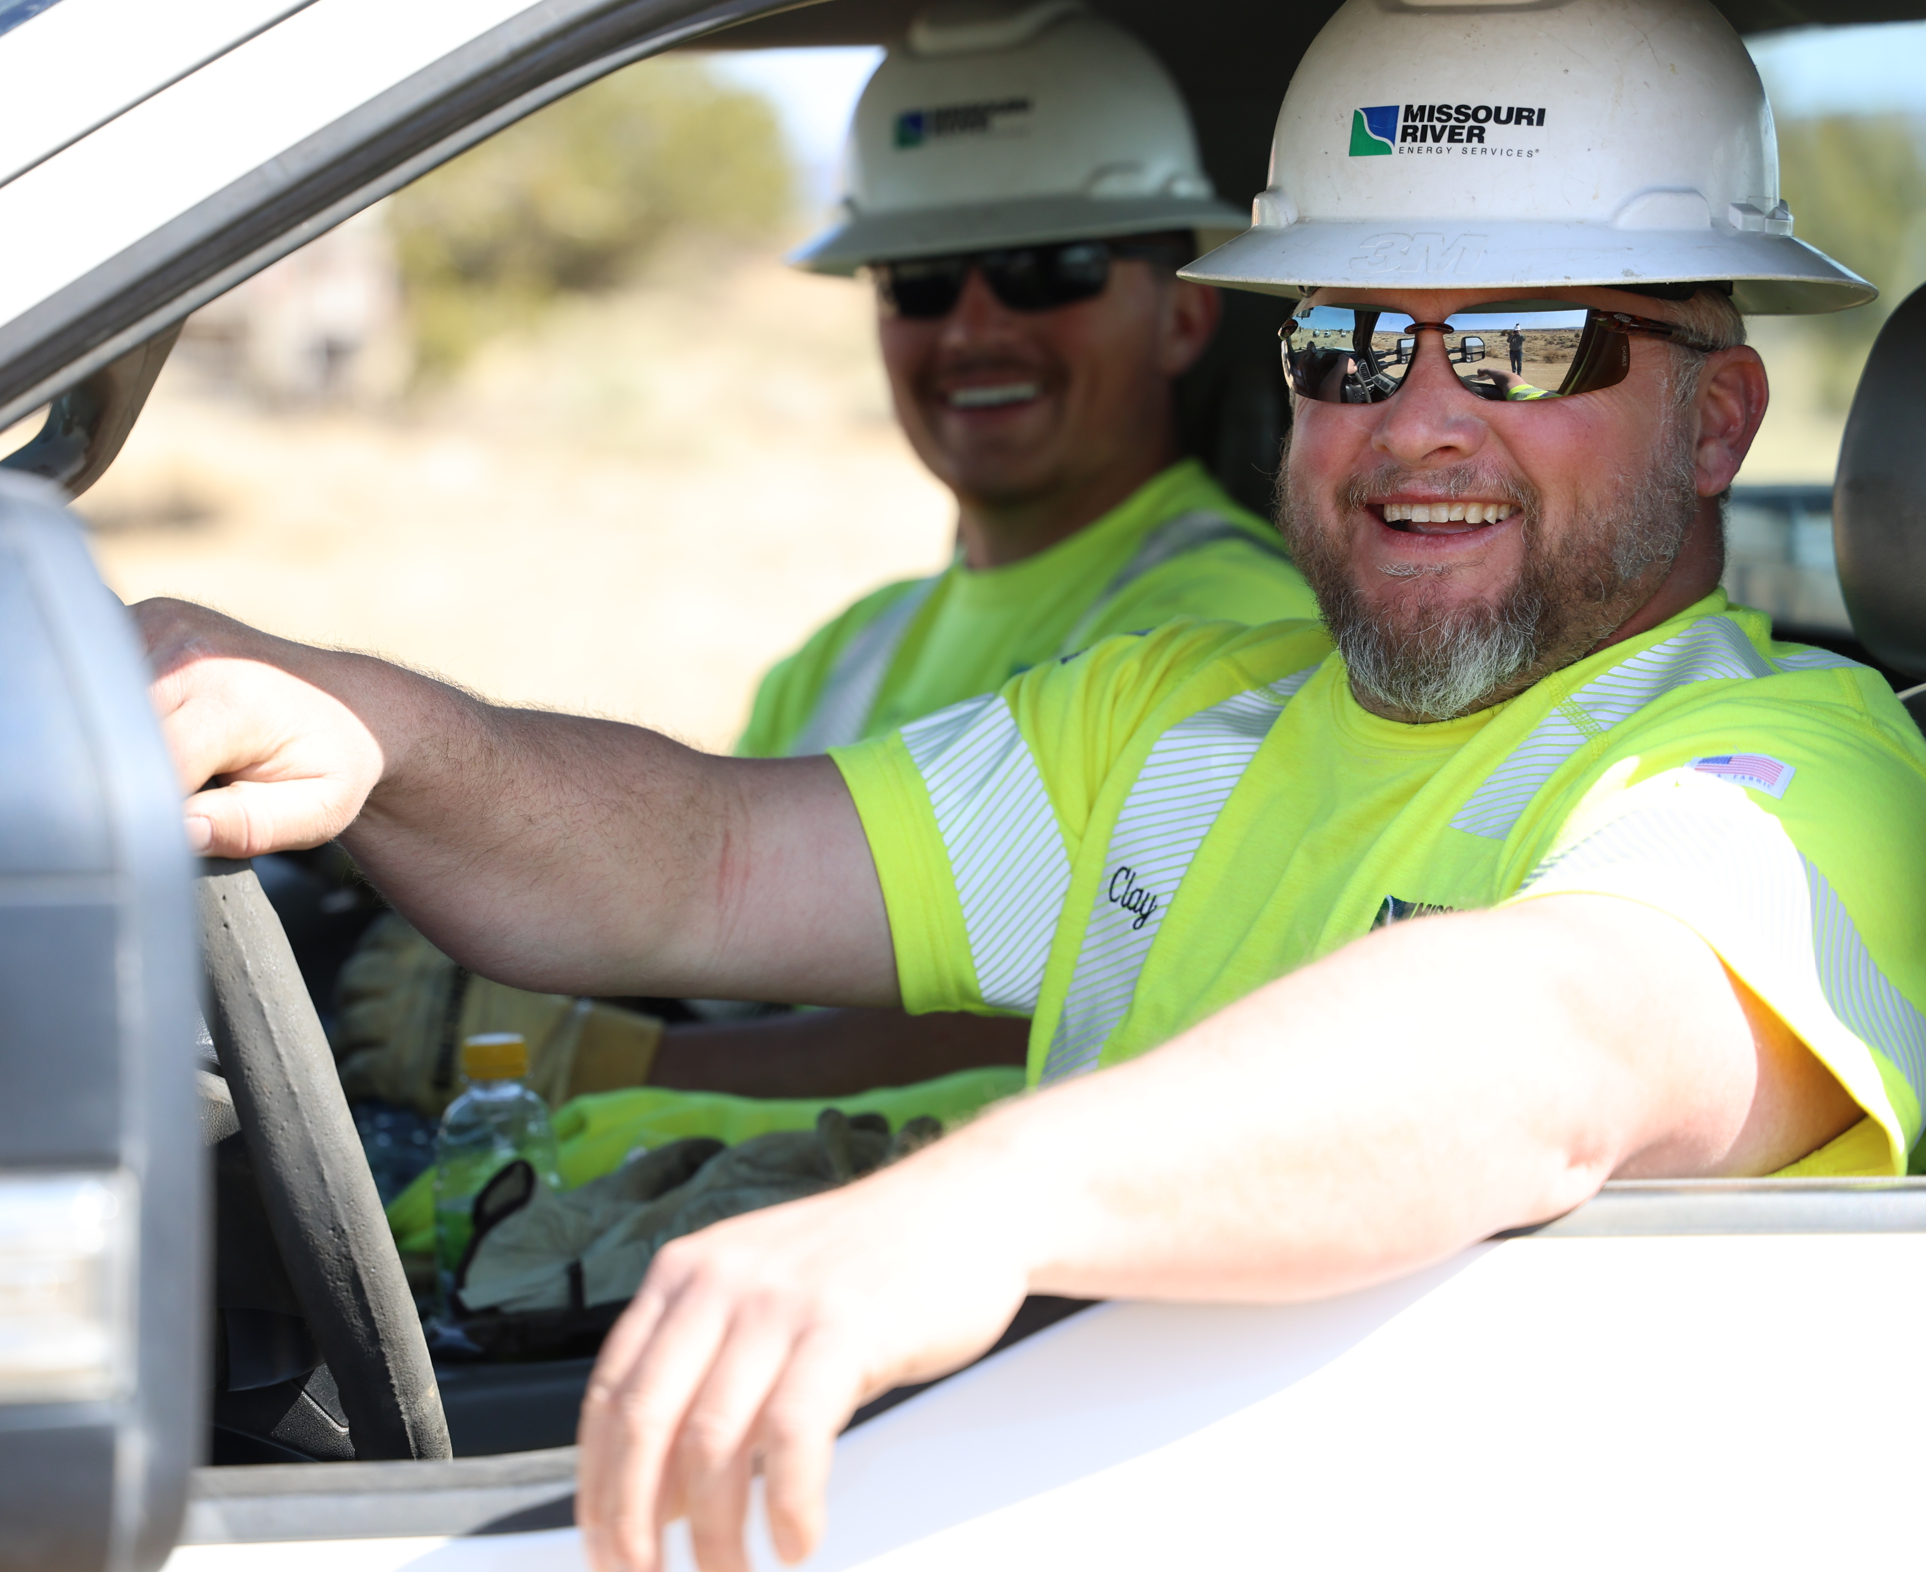
Developing Tomorrow’s Leaders
Workforce challenges facing public power:
  Retirements and loss of institutional knowledge
  Increasing complexity of utility operations
  Need for stronger supervisory and management skills
  Competition for skilled workers
Notes:
Workforce Challenges Facing Public Power
Retirements and institutional knowledge loss
Increasing complexity of utility operations
Need for stronger supervisory and management skills
Competition for skilled workers
MRES Solution
A leadership development pathway that serves employees at every stage of their careers.

Slide 5
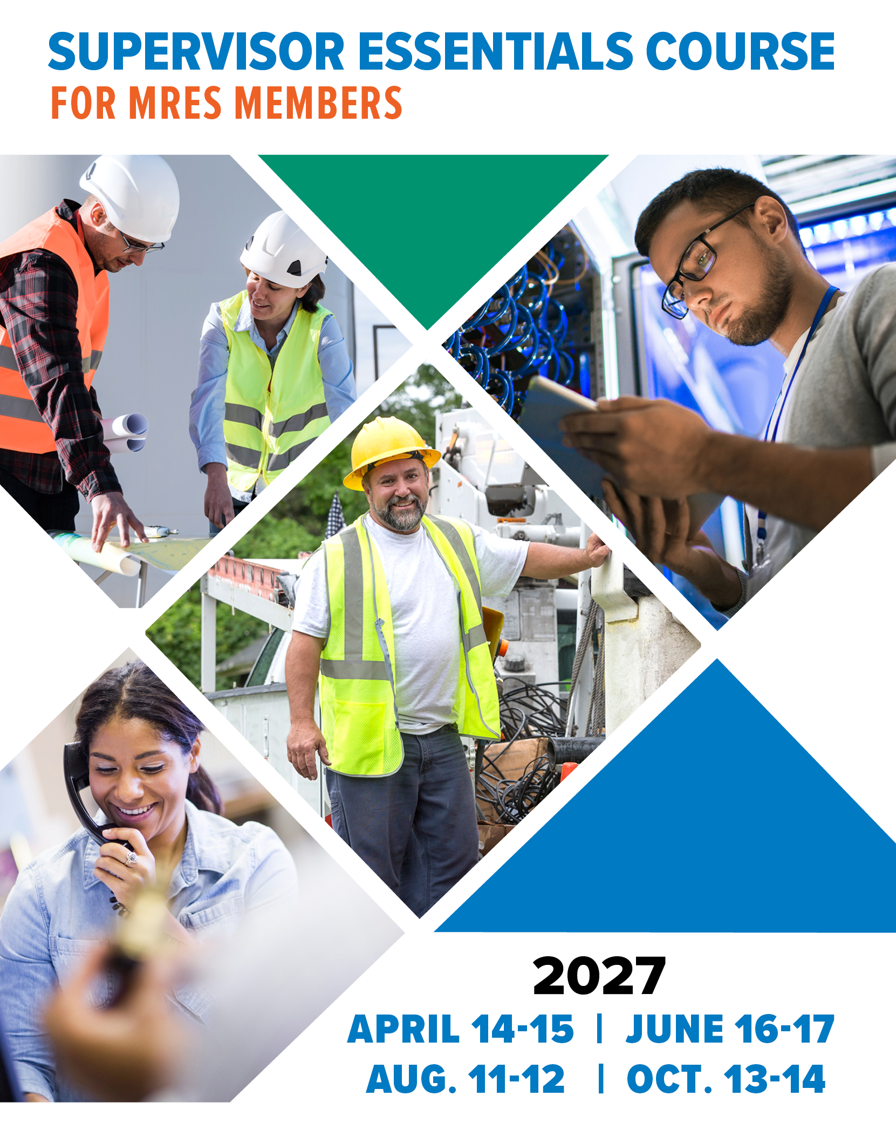
Supervisor Essentials
Key topics of the course:
  Transitioning to leadership
  Communication & relationships
  Managing people & performance
  Building a healthy team culture
Notes:
One of the first steps in that pathway is our Supervisor Essentials Course, which prepares frontline leaders for success:
The MRES® Supervisor Essentials course emphasizes the tools, knowledge and connections for new leaders to accelerate the transition into a supervisory role.
This four-session, year-long course is geared specifically toward frontline staff either in the field as line crew (electric, water, wastewater, street) or front office in customer service.
It is for supervisors, managers or those aspiring to move up to a position as a crew leader or supervisor.
Some of the key topics covered are:
Transitioning to Leadership: Moving from peer to supervisor while establishing trust, credibility, and effective working relationships.
Communication & Relationships: Understanding communication and personality styles and managing relationships upward, downward, and across the organization.
Managing People & Performance: Delegating effectively, setting goals, coaching employees, and managing performance.
Building a Healthy Team Culture: Addressing conflict constructively and developing a positive, productive workplace culture.

Slide 6
Supervisor Essentials
Organizational benefits:
  Improves supervisor effectiveness
  Increases employee retention
  Creates stronger teams
  Reduces workplace conflict
  Improves productivity and culture
  Registration for the 2027 course is openg mrenergy.com
Notes:
Organizational Benefits
Improves supervisor effectiveness
Increases employee retention
Creates stronger teams
Reduces workplace conflict
Improves productivity and culture
Bottom line?
Great utilities need great front-line leaders. Supervisor Essentials helps members build them.

Slide 7

The LEAD Course
Key topics of the course:
  Collaboration
  Communication
  Change and mastering accountability
  Failing vs. failure
Notes:
Another leadership offering is the LEAD Course.
The Leadership Excellence and Development, or LEAD Course, is designed for utility and/or city staff at all levels who are now, or aspire to become, leaders and influencers in their work.
This one-year, four-session course will provide a wealth of knowledge, awareness, perspective, and skill development that is needed for your utility and city.
Some of the key topics covered are:
April 7-8: Collaboration (Getting the Most Out of Your Team) and Conflict (Working Through Difficult Times)
June 2-3: Communication (Presence of a Leader) and Character
(The Mind of a Leader: Lenses)
Aug. 4-5: Change (How a Leader Navigates Change) and Mastering Accountability (Understanding and Equipping for this Critical Topic)
Oct. 6-7: Failing Versus Failure (Understanding the Differences Between These Two Terms and How They Create Positive and Negative Change in a Group) and Practicing Leadership

Slide 8
The LEAD Course
Organizational benefits:
  Builds future managers and supervisors
  Creates succession pipelines
  Improves employee engagement and retention
  Develops leadership capacity across the organization
  Registration for the 2027 course is openg mrenergy.com
Notes:
Organizational Benefits
Builds future managers and supervisors
Creates succession pipelines
Improves employee engagement and retention
Develops leadership capacity across the organization
Presentation Takeaway
Leadership is not a position. LEAD helps members cultivate leadership throughout their organizations.

Slide 9

Leadership Legacy Academy
New for this year!
Key topics of the course:
  Shadow
  Safety (psychological safety)
  Self
  Sustainability
Notes:
We’re also excited to announce that starting in 2027 we will be offering the Leadership legacy academy, which is a 201-level course for LEAD Course graduates. This program addition is in direct response to feedback received from past LEAD Course graduates who are part of an ongoing LEAD On Cohort.
Tell story of 2026 LEAD On luncheon … 40 hands went up.
The Leadership Legacy Academy is a year-long transformational experience built around four powerful foundations — four S-factors of leadership: Shadow, Safety, Self, and Sustainability.
We believe legacy leadership begins with the courage to examine our shadow — the blind spots, habits, and patterns that shape our influence.
It grows when we create psychological safety where trust can flourish.
It deepens as we lead from a grounded understanding of self — identity, character, and purpose.
And it endures when we build sustainability — systems, culture, and habits that outlast our position. This Academy is not about adding leadership tools; it is about becoming the kind of leader whose impact echoes long after the title changes.

Slide 10
Leadership Legacy Academy
Strategic benefits:
  Supports succession planning efforts
  Develops mentoring and coaching skills
  Encourages long-term organizational thinking
  Creates sustainable leadership cultures
  More details and registration info coming soon!
Notes:
Building Leadership That Lasts
Purpose A focused leadership experience designed to help experienced leaders strengthen their leadership impact, create lasting organizational influence and prepare future generations of leaders.
Some of the academy’s strategic benefits are:
Supports succession planning efforts
Develops mentoring and coaching skills
Encourages long-term organizational thinking
Creates sustainable leadership cultures
Why It Matters
As experienced utility leaders retire, organizations need intentional strategies for transferring knowledge, culture and leadership capability.
Legacy leadership ensures that leadership knowledge remains within the organization long after individuals move on.
As mentioned, this is also one-year, four-session course, and an invite with course details and registration information will soon be sent to members.

Slide 11
Outcomes for Member Utilities
Leadership and workforce development impact:
✅ Stronger leadership pipeline
✅ Improved succession planning
✅ Better employee retention
✅ Increased management effectiveness
✅ Enhanced organizational culture
✅ Stronger public power knowledge
Notes:
So, what are the expected outcomes member utilities can expect from MRES leadership and workforce development programs?
✅ Stronger leadership pipeline
✅ Improved succession planning
✅ Better employee retention
✅ Increased management effectiveness
✅ Enhanced organizational culture
✅ Stronger public power knowledge
Key Message
Investing in people is one of the most effective ways to strengthen utility performance.

Slide 12
Community Engagement Opportunities
Public power utilities succeed when communities understand:
  The value their utility provides
  How local decisions impact reliability and affordability
  The benefits of community ownership
  Career opportunities available within the utility industry
Notes:
Why Community Engagement Matters
Primarily, community engagement ensures Public Power's Unique Advantage is valued and understood by not only our members, but also the customers they serve
Public power utilities succeed when communities understand:
The value their utility provides
How local decisions impact reliability and affordability
The benefits of community ownership
Career opportunities available within the utility industry
The bottom line is community engagement helps promote both:
The value of public power
The value of joint action
Again, these are in alignment with our strategic priorities that are shaped by member feedback.

Slide 13

Municipal Power Advantage®
MPA reports highlight the value of your community-owned utility:
Affordability and reliability
Local control and service
The economic and community impact the utility has within the community
Outlines the partnership the member has with MRES
Notes:
The MRES Municipal Power Advantage® (MPA) program helps our members communicate the economic value of all the benefits the local electric utility provides to the community.
MPA reports also educates policy makers, utility staff and customers about the utility’s value and increases the public's awareness and perception of the municipally owned electric utility.
Key Benefits Highlighted by MPA reports:
Provides an overview of our members’ power supply, including their WAPA allocation and the supplemental power provided by MRES
Affordability
Reliability
Local Control and Service
The economic and community impact the utility has within the community
Outlines the partnership the member has with MRES, along with the long list of programs and services MRES provides
Member Benefits
Strengthens community support
Educates policy makers
Improves public understanding
Reinforces the value of municipal ownership
What’s included:
50 printed copies
50 at a glance summaries
social media package
digital link to a flip book
digital PDF
MPA helps utilities say the quite pard out loud and tell their story using facts, data and specific examples of local impact the member utility has on the community.

Slide 14

Ambassador Program
MRES ambassadors help build community understanding and support:
Value of public power — local ownership, local control, affordability and reliability
Promote the value of MRES membership and joint action
“Another voice in the room”
Notes:
Purpose
Develop trusted local champions who help raise awareness of public power and the value of MRES membership within their communities.
Key Message
The program was started in 2022 as a community engagement initiative that extends the reach of local utilities and MRES through trusted relationships and grassroots advocacy.
The MRES Ambassador Program helps build community understanding and support for:
The value of public power – Primarily the benefits of local ownership and control
The value of MRES membership and joint action – in other words, 61 member utilities working for the common good
Why it matters: Strong local advocates help strengthen community trust, public understanding, and policymaker support.

Slide 15

Strategic Planning
MRES provides facilitation services that help members:
  Identify long-term organizational goals
  Assess workforce/leadership risks and develop succession strategies
  Prioritize community and utility initiatives
  Align utility and city leadership around a common vision
Notes:
Every successful city and utility, regardless of size, establishes long-term plans, strategies and guidelines on which to base budgets and priorities. Our guided strategic planning process helps utility managers, city administrators and governing officials chart a course for the city and utility that translates the vision into strategic priorities with measurable goals.
Strategic Planning is a core member service we offer to our members:
How MRES Helps
MRES facilitates strategic planning processes that help members:
Identify long-term organizational goals
Assess workforce and leadership risks
Prioritize community and utility initiatives
Develop succession strategies
Create actionable implementation plans
Align utility and city leadership around a common vision
Works best in one 6-hr or two 3-hr sessions
Typically we recommend a full session every 3-5 years unless there has been a significant event or major change in the community
We also recommend an annual 2-hr session to review progress and update the timeline
$1,000 flat fee for members – covers up to two sessions if they’re on consecutive days
Each facilitation will be customized to the member’s needs
We will talk with the manager and the facilitator to determine their needs, and we will discuss ideas and options that could work for them
Determine who will be participating and their representing interests
Coordinating schedules to what works best for the member
The key takeaway here is that strategic planning establishes a roadmap members can use to create and and implement an actionable plan that can address critical issues the utility is facing today and well into the future.

Slide 16
Scholarship Program
Program highlights:
  Up to 12 scholarships awarded annually in two categories:
    Five $1,000 college scholarships
    Seven $2,000 powerline/lineworker scholarships
  Builds talent pipelines
  Encourages careers in public power
  Supports local students
  Builds goodwill with utility customers
Notes:
Creating the Future Workforce
MRES awards scholarships for students pursuing careers related to the electric industry. [mrenergy.com]
Program Highlights
Up to 12 scholarships awarded annually
Five $1,000 college/undergrad scholarships
Awarded to students pursuing careers related to the energy industry
Eligibility requirements: Students must live in a household receiving power from an MRES member utility
Renewable … making them worth up to $4,000
Seven $2,000 lineworker/powerline program scholarships
Open to anyone enrolling in a powerline/lineworker program at one of seven tech schools located in the MRES membership footprint
one-time only
Workforce Benefits
Builds future talent pipelines
Encourages careers in public power
Supports local students
Addresses industry workforce shortages
Annually the application process kicks off Dec. 1 and closes mid-march. Awards are announced early enough now so that utilities can present the awards to local students at scholarship award nights at area high schools.
Key Takeaway
Scholarships create a bridge between today's students and tomorrow's utility workforce.

Slide 17

Smart Energy Squad Program
Program highlights:
  Designed for fifth-grade students
  Turnkey classroom experience
  Interactive student kits
  Teacher, parent and student portals
  Co-branded utility materials
  Local school engagement opportunities
  Cost-shared with MRES
Notes:
Creating the Future Workforce
Designed for fifth graders, this program is the perfect opportunity to provide local students with invaluable knowledge for the future, and they will be taught the importance of energy efficiency, sources of electricity and renewable energy in a fun and interactive way.
The Smart Energy Squad is a turnkey program that will offer digital tools, content customization, student kits, and kit production and delivery. In addition, online teacher, parent and student portals are available and will be co-branded with your utility's logo and the MRES logo.
Program Features
Turnkey classroom experience
Interactive student kits
Teacher, parent and student portals
Co-branded utility materials
Local school engagement opportunities
Community Benefits
Builds positive utility relationships
Educates future customers
Creates community visibility
Connects utilities with schools and families
Last year was a record-setting year, as we had
Smart Energy Squad helps utilities build awareness, trust and community connections early.

Slide 18
Community Co-Sponsorship Program
Helps members strengthen community connections:
Co-sponsored events lead recognize the local utility as an event sponsor
Recognition of MRES as a sponsoring partner
Leads to public education or awareness opportunities
Messaging about public power and community ownership
Examples of eligible activities:
Community celebrations, local festivals, golf outings, educational outreach activities, community service initiatives
Notes:
Supporting Communities While Promoting Public Power
Since 2018, MRES has focused on communicating the Value of Public Power to customers and communities.
In 2021, the MRES Board expanded this effort to include communicating the Value of Joint Action through MRES.
The Community Co-Sponsorship Program was revitalized as a way to accomplish both objectives.
Purpose
The MRES Community Co-Sponsorship Program helps member utilities strengthen community connections while increasing awareness of both the local utility and the value of joint action through MRES.
How the Program Works
MRES helps fund community events that include:
Recognition of the local utility as an event sponsor
Recognition of MRES as a sponsoring partner
Public education or awareness opportunities
Messaging about public power and community ownership
Examples of Eligible Activities
Community celebrations
Local festivals
Town anniversaries
Customer appreciation events
Educational outreach activities
Community service initiatives
Benefits for Member Utilities
✅ Enhances visibility of the local utility
✅ Demonstrates community investment
✅ Strengthens customer relationships
✅ Builds awareness of public power benefits
✅ Highlights the value of joint action through MRES
✅ Supports events that bring the community together
Key Takeaway
The Community Co-Sponsorship Program allows utilities to invest in their communities while telling the public power story and demonstrating the value of the MRES partnership.

Slide 19
Community Engagement Impacts
Results for member communities:
✅ Increased public awareness
✅ Builds trust and credibility
✅ Creates a better understanding of public power benefits and improves
support for major decisions
✅ Builds stronger community relationships and partnerships
✅ Greater appreciation for the local utility
Notes:
Results for Member Communities
✅ Increased public awareness
✅ Builds trust and credibility
✅ Creates a better understanding of public power benefits and improves support for major decisions
✅ Builds stronger community relationships and partnerships
✅ Greater appreciation for the local utility
The bigger picture
For a municipal utility, community engagement is ultimately an investment in the relationship between the utility and the community it serves. The stronger that relationship is, the easier it becomes to build trust, navigate change, respond to community needs, and demonstrate why local public power matters.
Community engagement turns a municipal utility from a service provider into a trusted community partner.

Slide 20
Why These Programs Matter
By investing in people and community engagement, MRES helps members:
✅ Build stronger organizations
✅ Strengthen the public power model
✅ Develop future utility professionals
✅ Increase community support
✅ Demonstrate the value of joint action and MRES membership
Notes:
Why These Programs Matter
MRES provides these opportunities because members have consistently identified workforce development, leadership succession and employee retention as significant challenges.
By investing in people, future leaders and community engagement, MRES helps members:
Build stronger organizations
Strengthen the public power model
Develop future utility professionals
Increase community support
Demonstrate the value of joint action
Final Takeaway
Strong utilities begin with strong people, and strong people develop through intentional investment. Plus, MRES is also intentional about helping members build stronger relationships with the communities they serve.

Slide 21
Questions?
Andrew Johnson
Director of Member Strategy & Services
andrew.johnson@mrenergy.com
605-338-4042

