Slide 1
Members & MRES Transmission Services
Richard Dahl
Director – Transmission Services

Slide 2
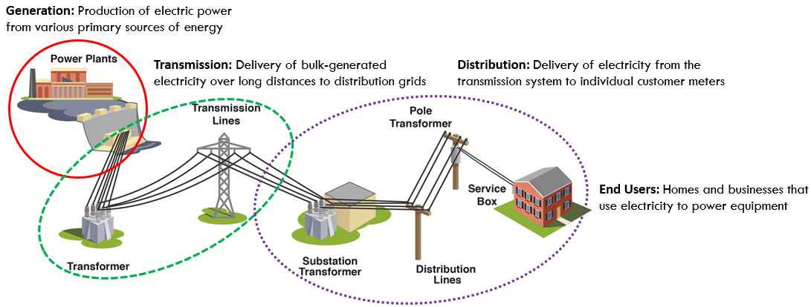
What is transmission?
Notes:
345 kV, 230 kV, 115 kV, 69 kV, 41.6 kV
Elaborate on what transmission planning is.
Explain how MRES does not own a contiguous system between power supply and load. We own snippets. TOs rely on each other. Everything affects everything.
RTOs: Stress that adherence to RTO tariff and its business practices and procedures are not optional. They are mandatory.

Slide 3
MRES and transmission
MRES owns transmission jointly & discretely, largely in Minnesota:
  Utility partners perform operations & maintenance.
  MRES does our own transmission planning.
  Part of highly interconnected multi-utility grid. Not dedicated to members.
Regional Transmission Organizations (RTO: MISO and SPP)
  All members are in an RTO. MRES & MRES members are obligated to follow the respective RTO’s tariff related to planning, operations, transmission service rates, Annual Transmission Revenue Requirements (ATRR) for members, & more.
Notes:
345 kV, 230 kV, 115 kV, 69 kV, 41.6 kV
Elaborate on what transmission planning is.
Explain how MRES does not own a contiguous system between power supply and load. We own snippets. TOs rely on each other. Everything affects everything.
RTOs: Stress that adherence to RTO tariff and its business practices and procedures are not optional. They are mandatory.

Slide 4
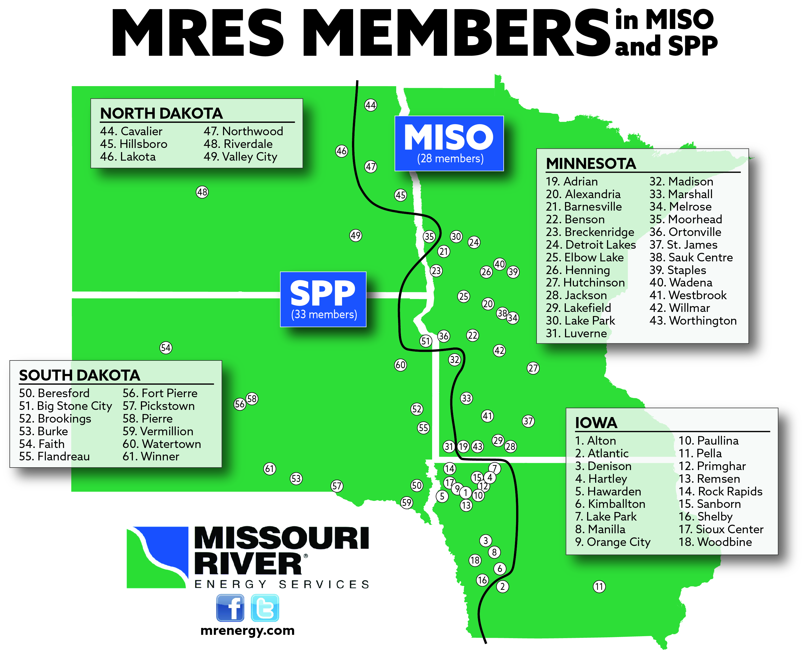
RTO vs. Member Map
Members w/ transmission in SPP:
  Brookings (fut.), Denison, Moorhead, Orange City, Pierre, Sioux Center, Vermillion, Watertown
Members w/ transmission in MISO:
  Alexandria, Atlantic, Benson, Breckenridge, Detroit Lakes, Hutchinson, Marshall, Pella, Willmar, Worthington

Slide 5
Load Interconnections
Point load connections
  For larger loads (>0.5 -1 MW): Required transmission studies & process per federal approved tariff & reliability standards needs to take place.
Transmission Process/ Capability
  MRES transmission planning team can help provide estimates of how much incremental load can be served, explain RTO processes and timelines, etc. Help with distribution & transmission interface.
  Important to contact MRES early to understand feasibility, process timelines, and potentially scale of upgrades and lead times needed.
Notes:
Note that we do not perform distribution planning services. Will interface with consultant.
NOTE MUCH HAPPENING IN TARIFF AND POLICY WORLD ON THIS. NOT A STATIC PICTURE.

Slide 6
Transmission Expansion/ Upgrades
RTO requirements
  Upgrades to existing transmission system, additions to the transmission system including connecting a new transmission substations to the grid must be coordinated with the RTO and local transmission utilities.
Tariff and Reliability Compliance
  We navigate the RTO procedures & perform the formal NERC Transmission Planner compliance for MRES and members.
Lead times
  RTO and utility processes takes time, many months.
  Important to start the conversation with MRES transmission staff early.

Slide 7
Transmission Expansion/ Upgrades
MRES transmission planning
  We participate in RTO planning activities and work with neighboring utilities to resolve transmission concerns. Relationships with other utilities are key to this effort.
Needs driven
  Transmission upgrades must have hard drivers to get cost recovery under an RTO tariff. We strive to optimize solutions that resolves qualifying needs, if possible add load serving margin, & as possible offer investment opportunity for MRES or MRES members.
Notes:
Note that a member could pay for upgrades, but they cannot reserve capacity on it.
Note that building load serving margin is not a need that qualifies for cost recovery, but at times building transmission upgrades to resolve hard needs, adds margin.
Make high level comment on ATRR for transmission. 10%....

Slide 8
Operations Assistance
Transmission Operations Challenges
  We help members interact with transmission utilities if there are operational challenges by asking questions, trying to optimize reliability, and performing analysis to help inform best outcomes for members.
We do not have real time visibility or a 24/7 desk, but …
  We have tools, skills, & contacts to help with difficult situations. Often related to damaged 3rd party transmission equipment or maintenance and construction outages.

Slide 9
NERC Compliance
Some members have NERC compliance needs:
  Usually if looped 115 kV or higher voltage
  If peak load is >= 75 MW
  If a member owns relays with Under Frequency Load Shed (UFLS)
MRES assistance
  Availability of NERC Subject Matter Experts, we are/ can be your NERC Transmission Planner, provide guidance on NERC Transmission Owner compliance, connect with consultants, member info meetings.
Notes:
Spell out NERC in conversation

Slide 10
Transmission Rates
Annual Transmission Revenue Requirements (ATRR)
  We help members that own transmission facilities for the “common good” to collect on ATRR – get a revenue stream for such transmission they own. We also look for opportunities for transmission expansion where warranted where an ATRR could be collected.
Transmission Service Rates Paid
  MRES interacts with the RTOs as the Network Integration Transmission Service customer. This entails settling financially with RTOs. Also review other utilities’ transmission rates to help ensure rates paid are fair.

Slide 11
MRES Transmission Investments
Board Goal
  Transmission revenue = transmission service charge
Challenges to get there
  Often incumbent transmission owners have right-of-first-refusal (ROFR) to build new transmission facilities and get the cost recovery/ ATRR on those.
  Needs driven projects through RTO planning processes. Utilities can influence and propose, but not unilateral projects.

Slide 12
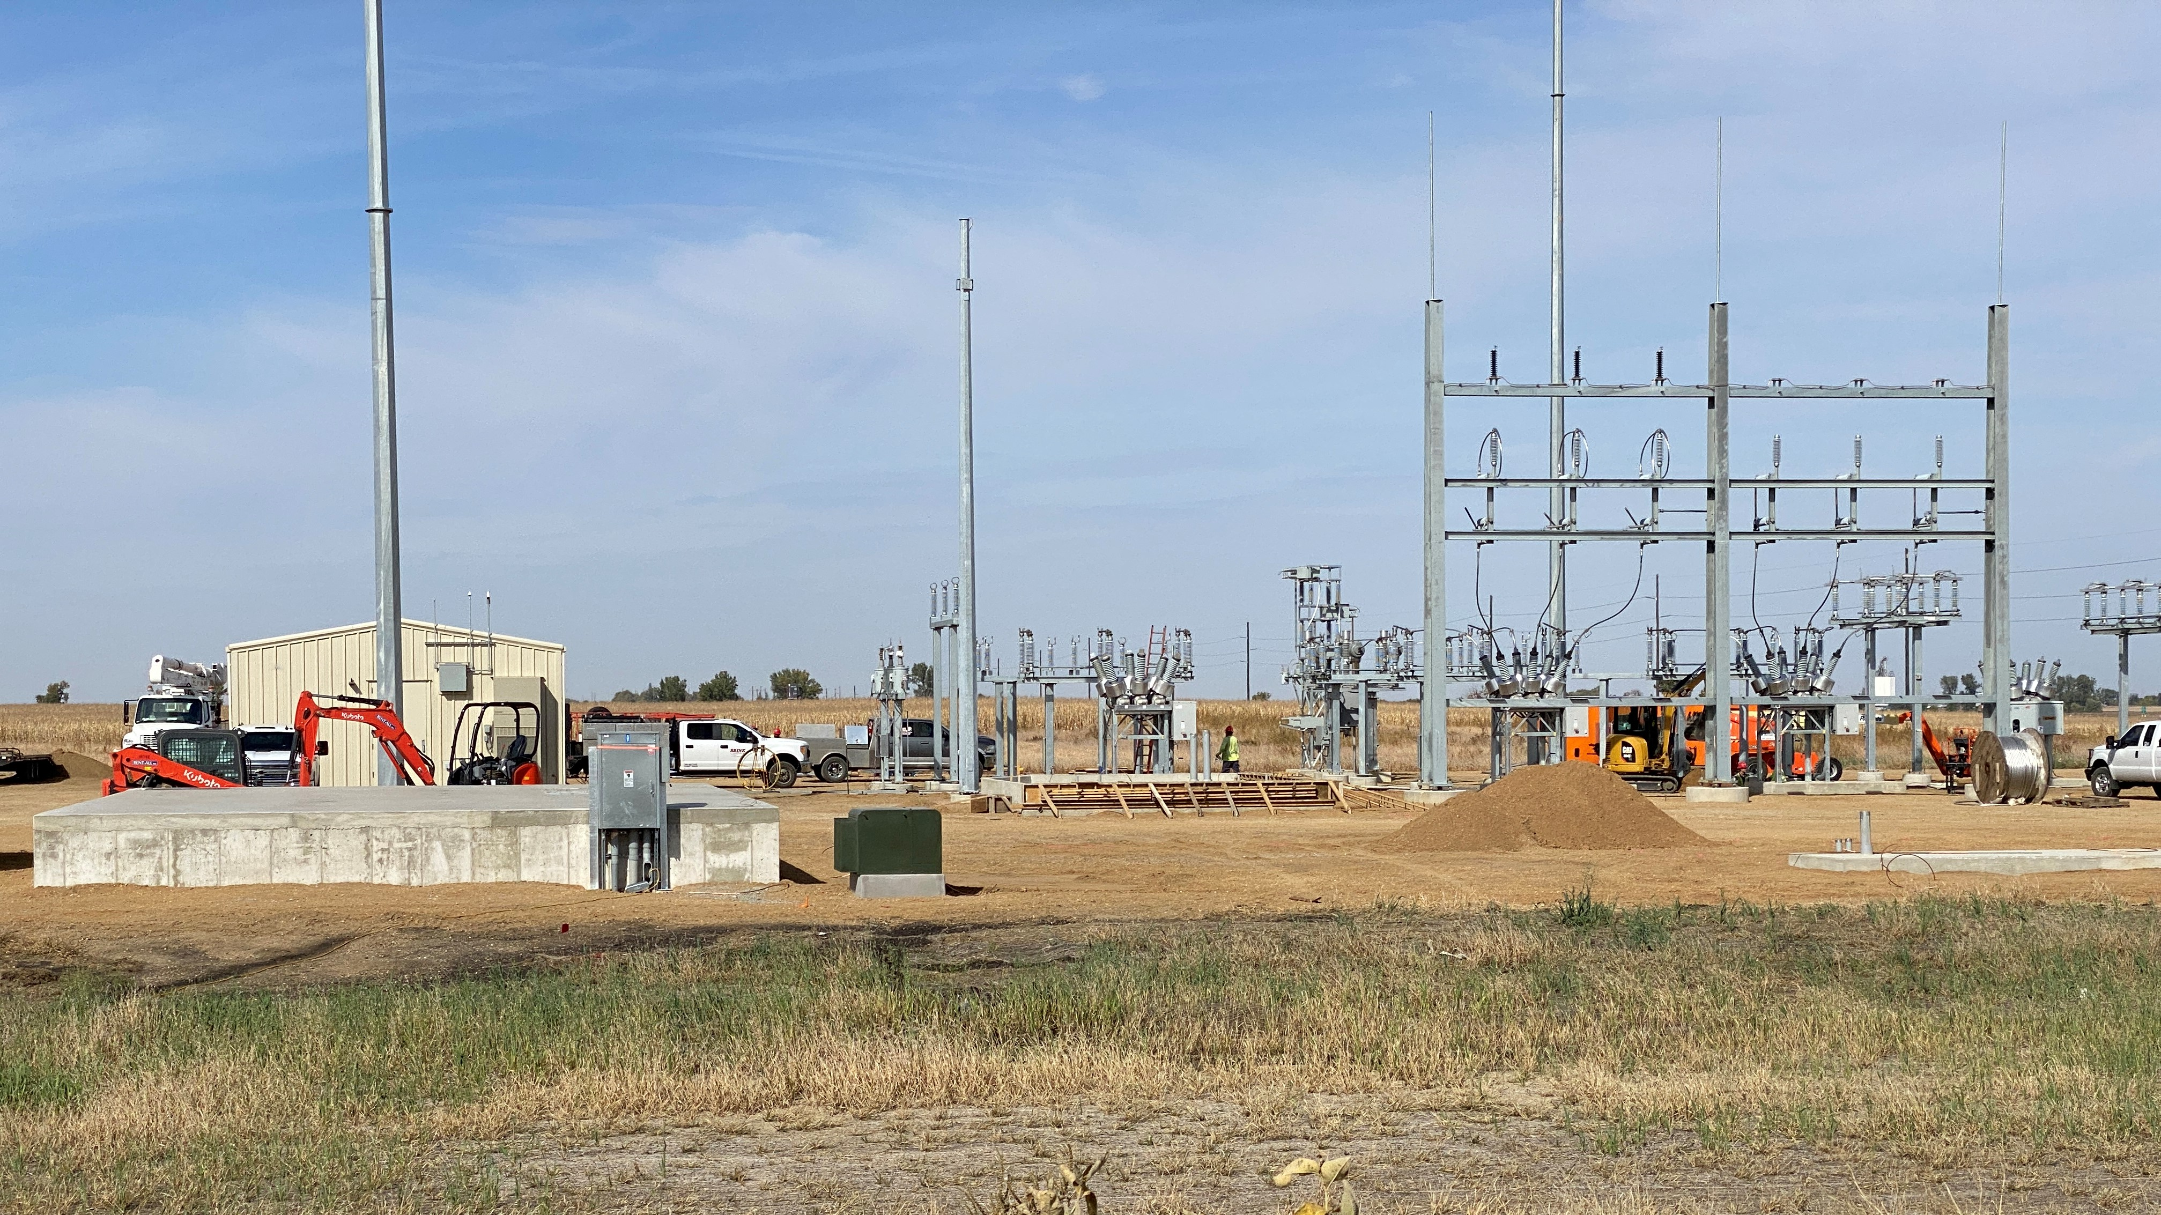
Key points
We are here to help our members:
  We work to make transmission easier for members.
  Reach out early w/ point load addition matters.
  Reach out early on transmission upgrades/ expansion/ replacement / new substations.
Notes:
Easier does not always mean “easy”.

Slide 13
Questions?
Richard Dahl
Director – Transmission Services
richard.dahl@mrenergy.com
605-338-4042

