Slide 1

2026 Program changes
Bright Energy Solutions
Kurt Hauser
December 2, 2025

Slide 2

Form revision goals

Slide 3


Slide 4
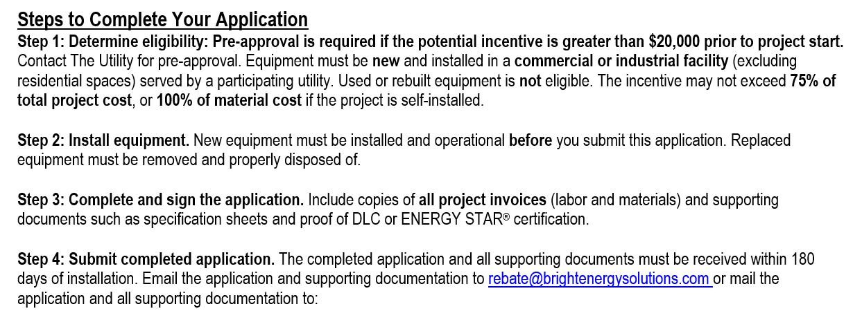
CONCISE AND NON-REPETITIVE
Notes:
180 day requirement is an extension from the previous 90 days.

Slide 5
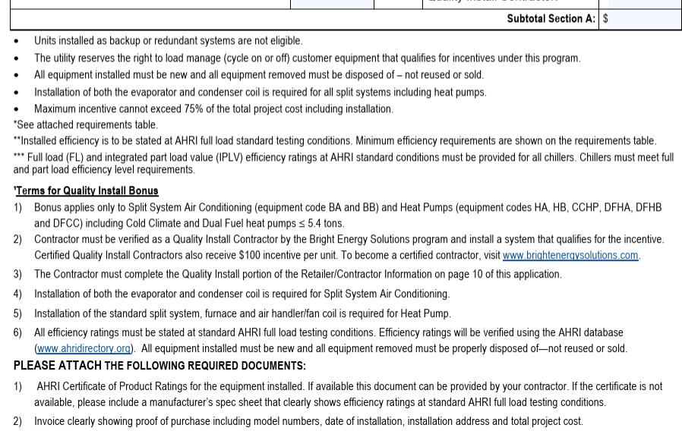
Notes:
Commercial HVAC Example – Went from this for Section A………………..

Slide 6
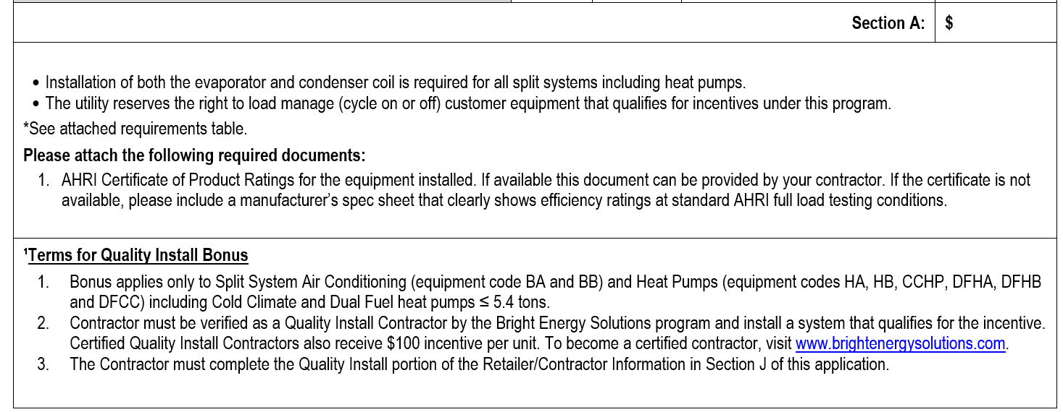
Notes:
To this.

Slide 7
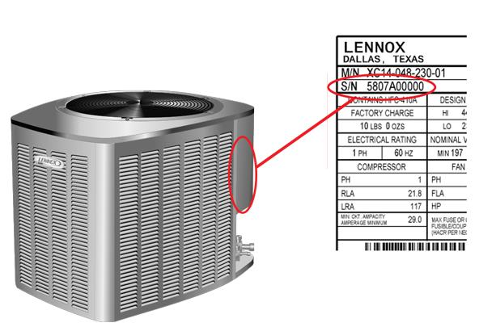
Serial numbers eliminated

Slide 8

Residential hvac
Dropped the Term ENERGY STAR from Heat Pumps and Air Conditioning
New categories – Value, Plus, and Premier

Slide 9

Residential hvac
Efficiency Requirements Unchanged
Except added heating efficiency requirement at 5 degrees to cold climate heat pumps
Same as ENERGY STAR
Dropped EER and SEER and Transitioned to EER2 and SEER2

Slide 10

Residential hvac
Reduced Categories – Examples: Geothermal Heat Pumps and ENERGY STAR Heat Pump Water Heaters

Slide 11
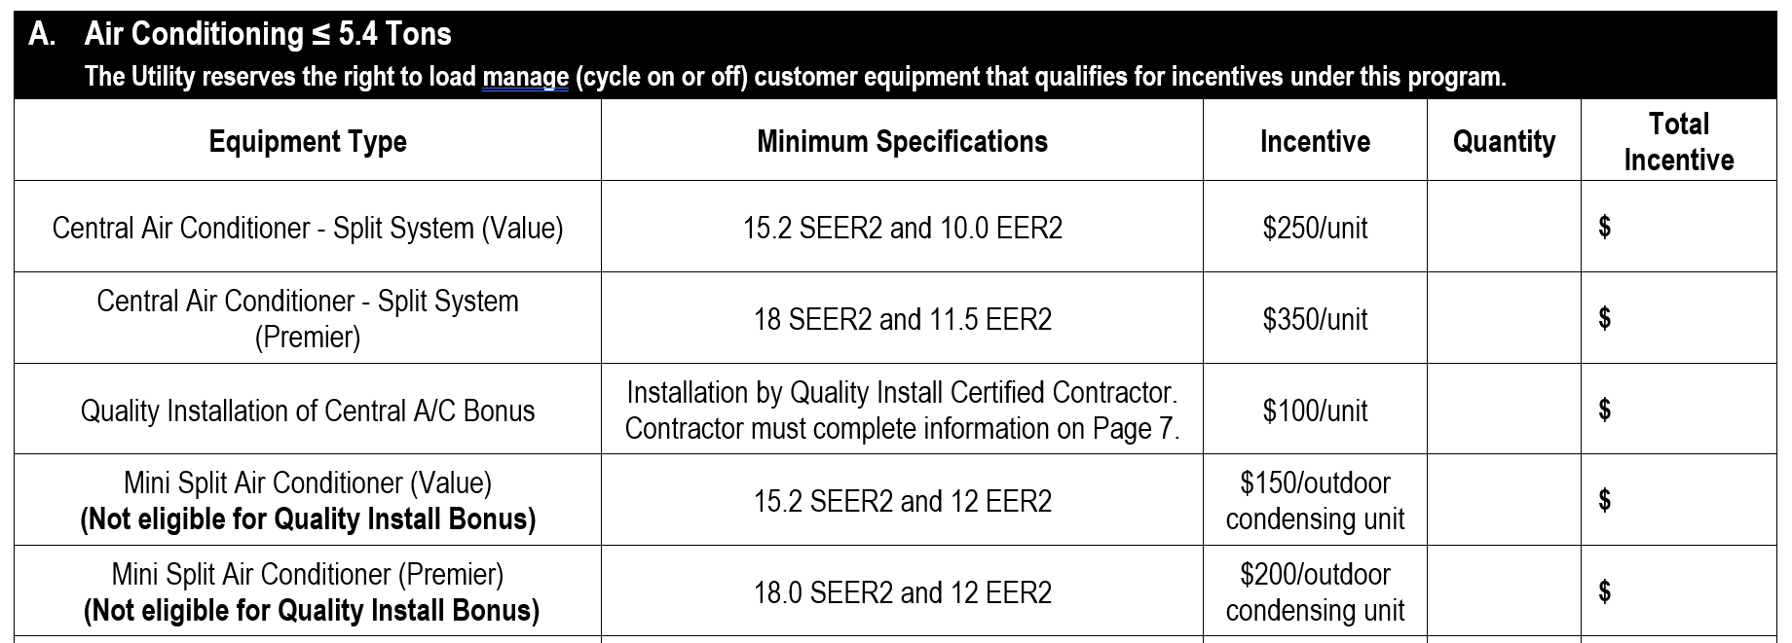
Notes:
Requirements and incentives are unchanged.

Slide 12
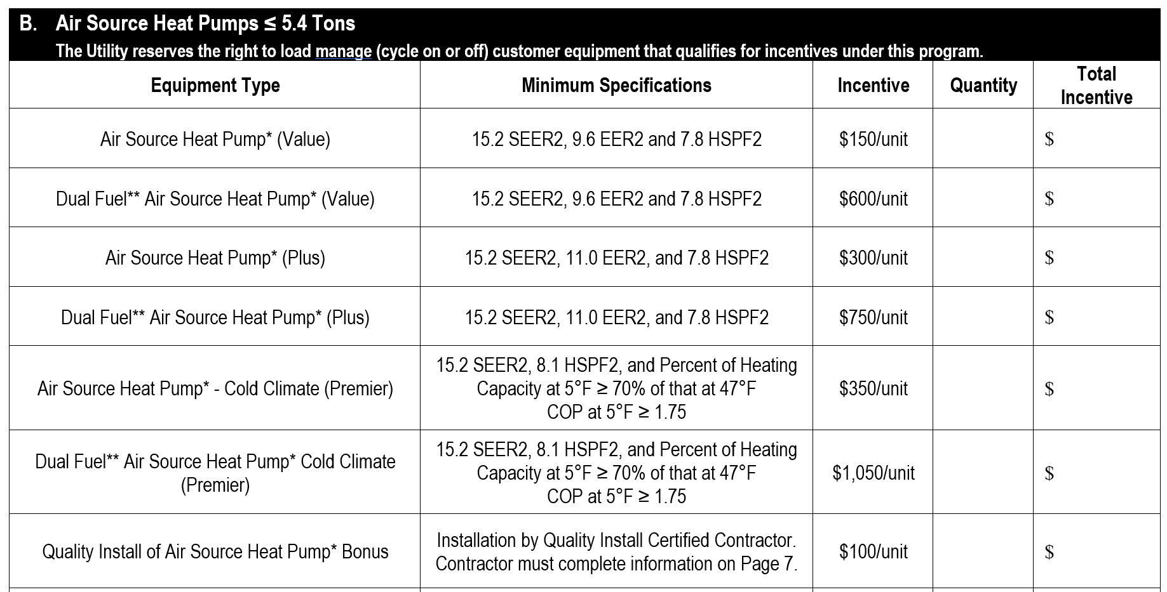

Slide 13

Lighting retrofits & New construction
LED Horticulture Lights - Lower Rebates – New Size
Example - <400 watts in air-conditioned space was $135
Now $100
Added 700 watts and greater

Slide 14
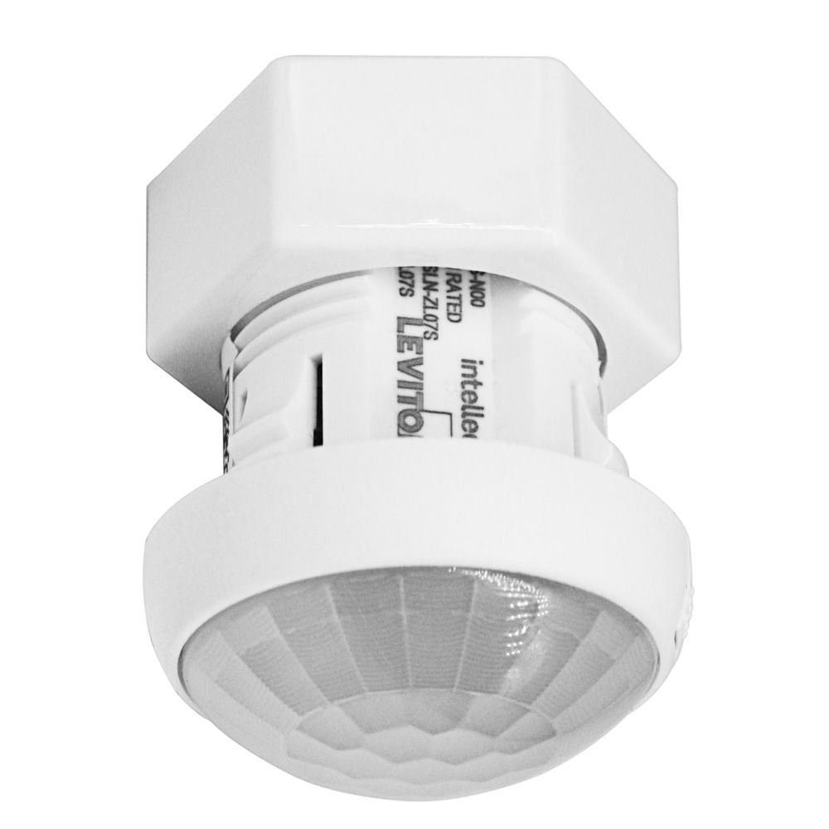
Lighting Retrofit
DLC Networked Lighting Controls
Without Luminaire Light Level Control - $0.15 per Watt Controlled
With Luminaire Light Level Control - $0.30 per Watt Controlled
Integrated sensors and controls in each fixture
Occupancy sensing, daylight harvesting, and networking capability

Slide 15
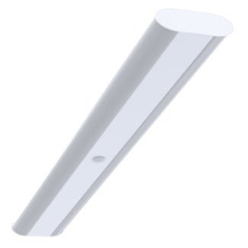
Lighting - New construction
DLC Networked Lighting Controls
Without Luminaire Light Level Control - $0.06 per Watt Controlled
With Luminaire Light Level Control - $0.20 per Watt Controlled
Integrated sensors and controls
Occupancy sensing, daylight harvesting, and networking capability

Slide 16
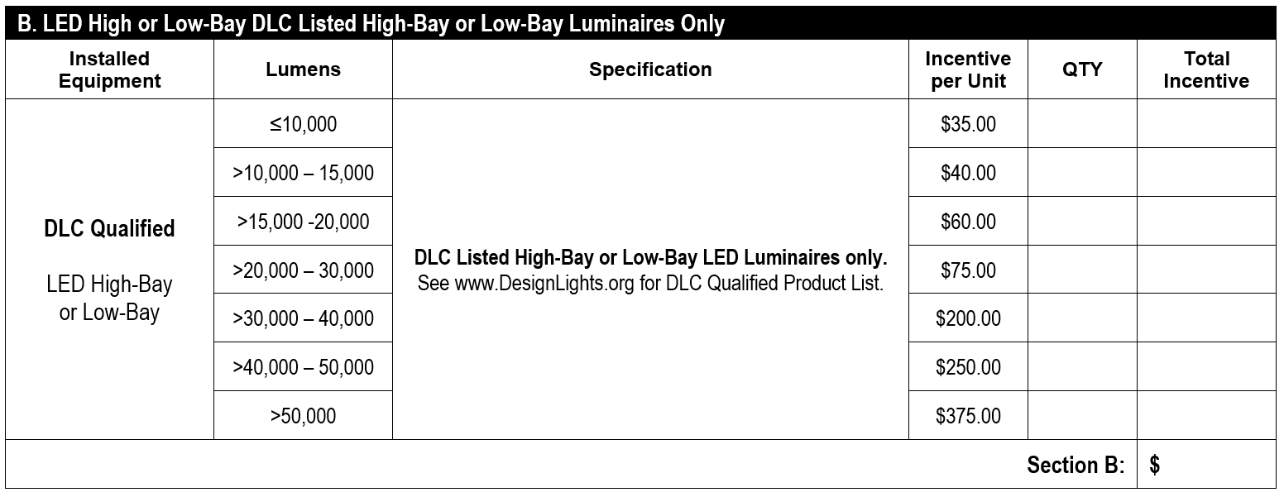

Lighting – New construction
Notes:
Sizing now based on lumen output.

Slide 17
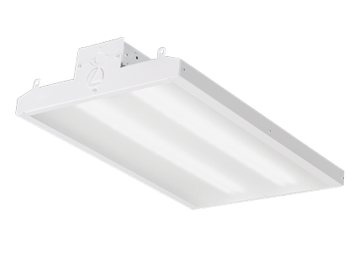

Lighting – new construction
Deleted DLC Premium High or Low Bay LED Fixtures

Slide 18
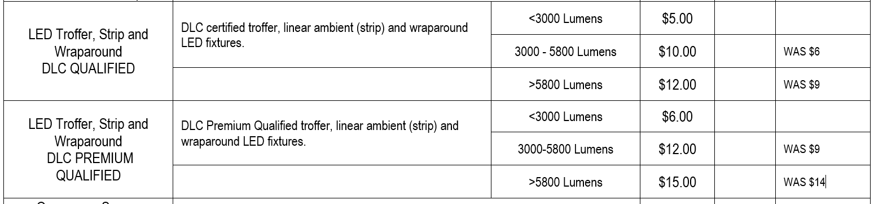

LIGHTING – NEW CONSTRUCTION
Notes:
New higher rebates.

Slide 19
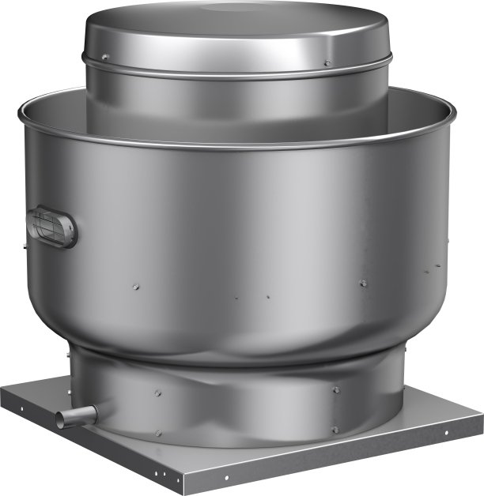
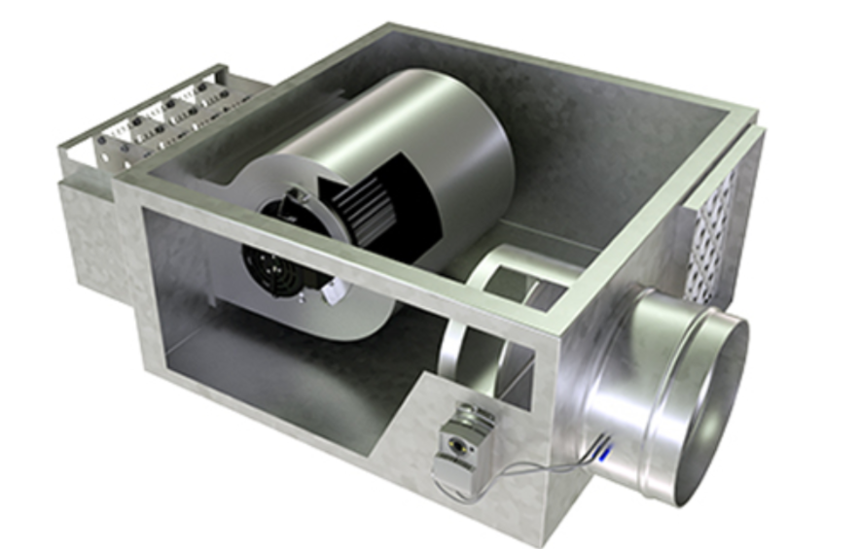
Commercial HVAC
HVAC Exhaust Fan Eliminated
HVAC Fan Powered Box - ECM
Now based on per CFM
Was per fan

Slide 20
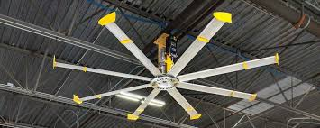
Commercial hvac
High Volume Low Speed Fan
Now the same rebate for A/C space or non-A/C space
$900

Slide 21
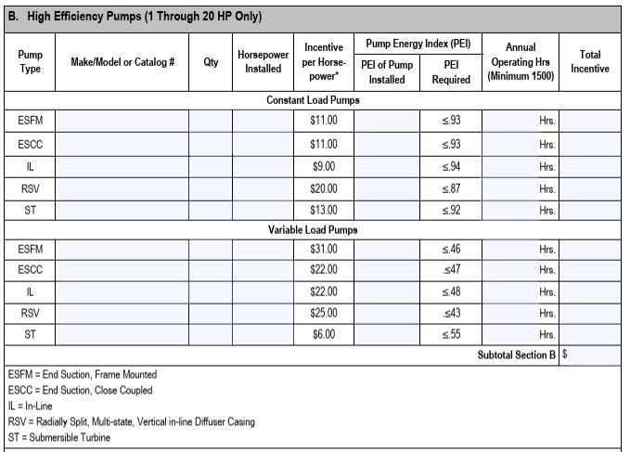

High efficiency Pumps
Notes:
Used to have 5 types of pumps with varying efficiency requirements and rebates.

Slide 22
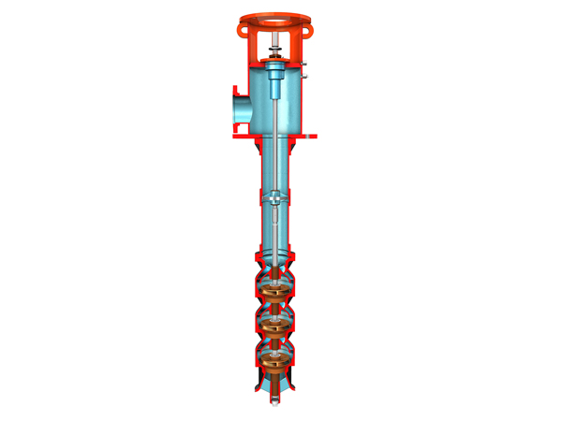
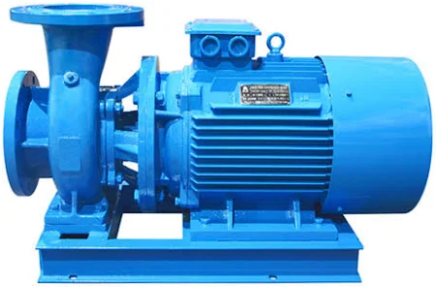
High efficiency Pumps
Constant Flow - $6 per HP
Variable Flow – Vertical Turbine $9 per HP
Variable Flow – All Other Types - $7 per HP
Applies To Pumps 200 HP and Less
Notes:
New categories.

Slide 23
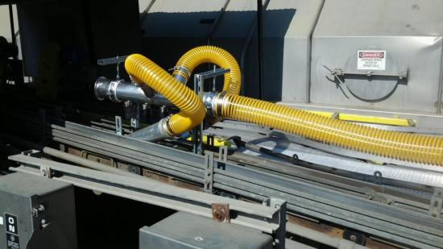
Compressed air
Dew Point Demand Controls - $4 per CFM (was $2.50)
Mist Eliminators - $5 per HP (was $6)
Low Pressure Blower Replacing Compressed Air Blow-Off - $1,800 per blower HP (was $2,000)

Slide 24
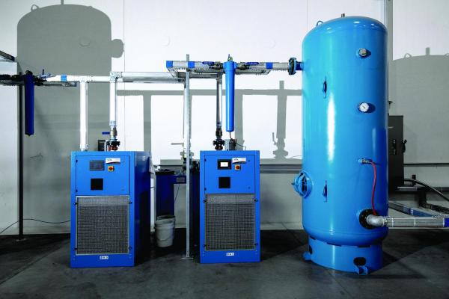
Compressed air
Adding Storage Category
Increase from ≤ 1 to ≥ 3 gal/cfm - $26 per HP
Increase from ≤ 3 to ≥ 5 gal/cfm - $13 per HP
Increase from ≤ 1 to ≥ 5 gal/cfm - $39 per HP

Slide 25
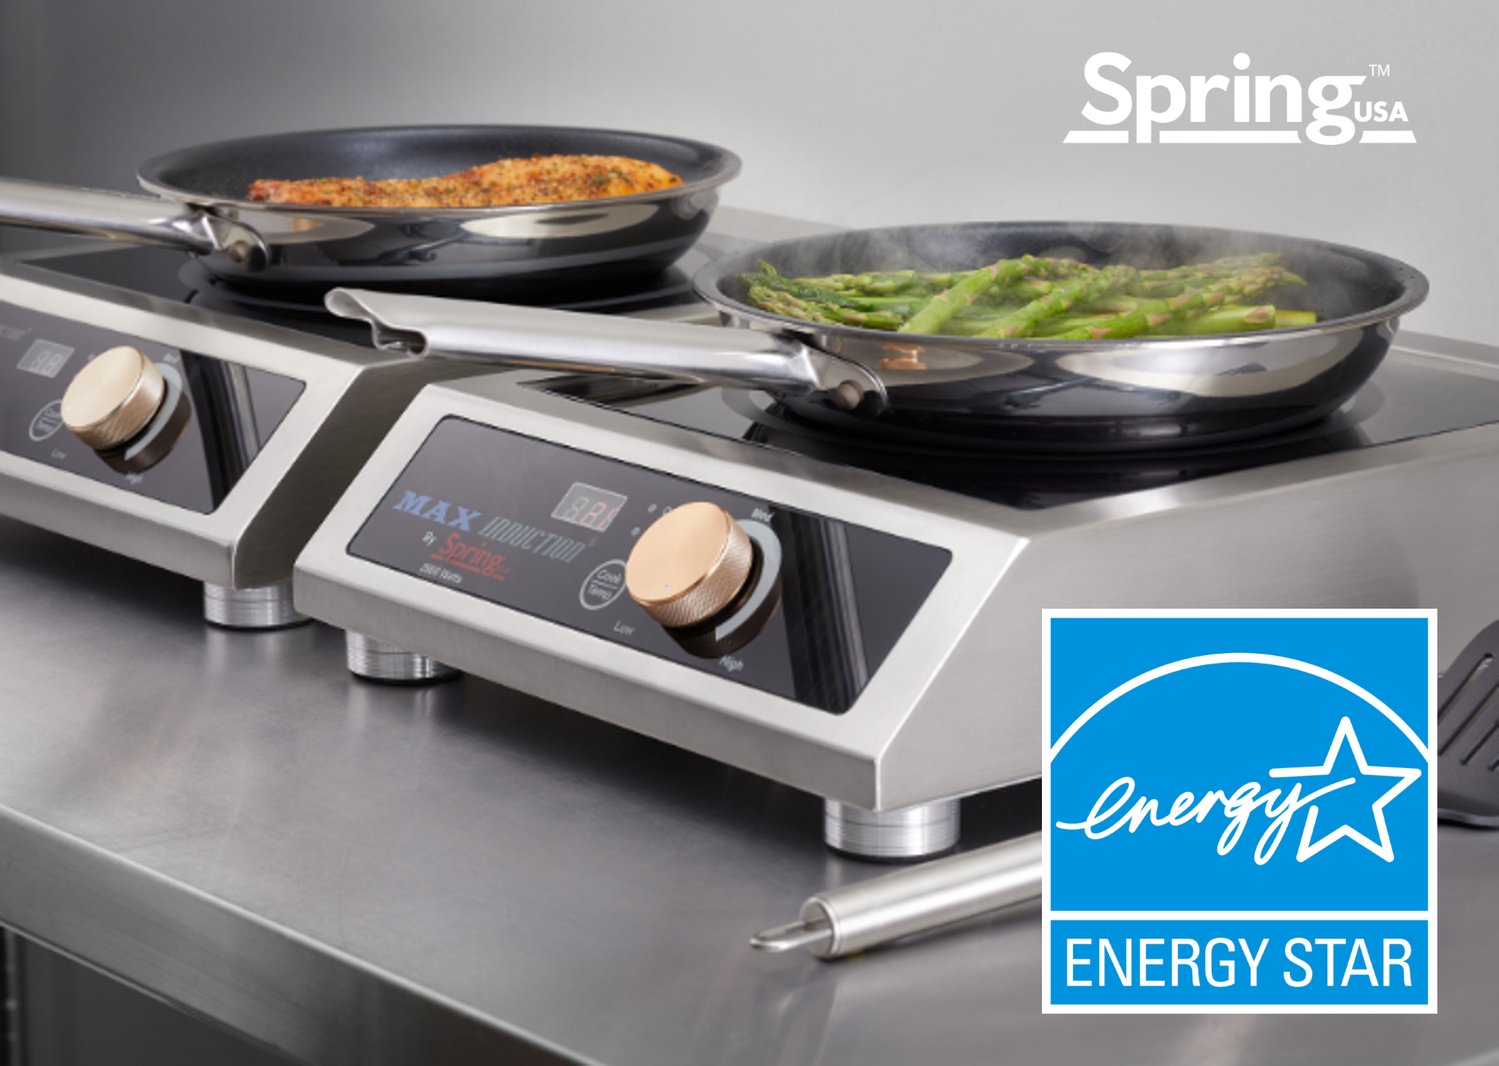

Energy star Commercial induction cooktop
$150 per Hob

Slide 26


Slide 27

Kurt Hauser
Cell: 605-660-9029
kurt.hauser@mrenergy.com

