Slide 1

Paying Public Power Employees Competitively
Tammie Krumm, VP of HR & Administration, Missouri River Energy Services
Ashley Thomalla, Senior Vice President, HUB International
October 1 , 2026

Slide 2

Session Agenda
Introductions
Compensation Study Best Practices Applied at Missouri River Energy Services
Market Trends
Discussion Items

Slide 3
Introductions

Slide 4
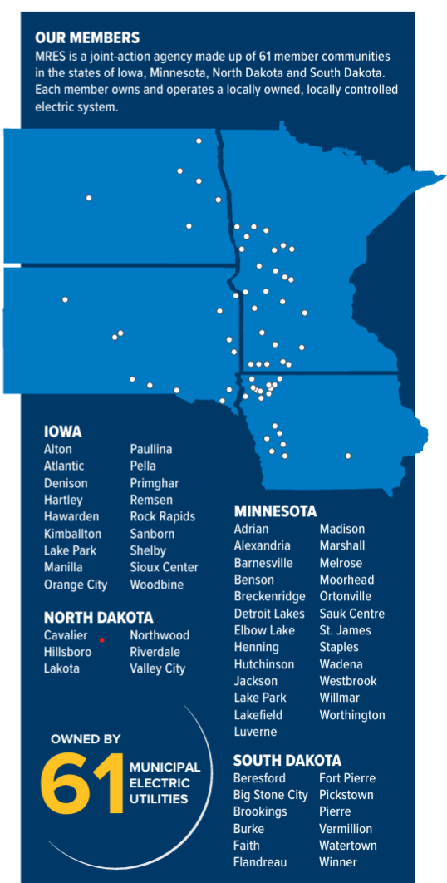
About Missouri River Energy Services

Slide 5
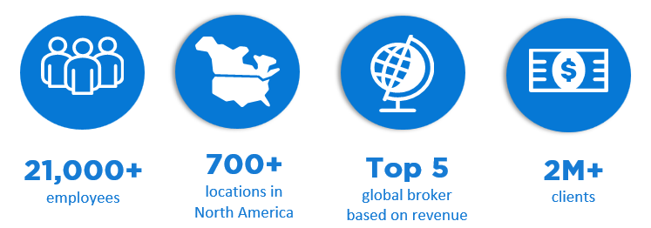
About HUB International
HUB International is a leading North American insurance brokerage that provides employee benefits, business, and personal insurance products and services.
Our Vision is to be everywhere risk exists – today and tomorrow. Helping protect what matters most.

Slide 6
Compensation Study Best Practices Applied at MRES

Slide 7
Compensation Process and Design
In 2019 MRES decided to revamp our compensation process and design.
MRES believes that it is in the best interest of both the organization and its employees to have a compensation program that supports our mission/core purpose, vision, core values and culture to fairly compensates our workforce for the value of the work provided.
Our objectives were to establish wages and salaries that will attract and retain qualified individuals, and to reward employees for their job performance.
We went from a point factor evaluation compensation philosophy to market based and pay for performance.

Slide 8
Assess the Current State of your Compensation Programs
Prep work:
  List of job titles
  Job descriptions
  Organization charts
  Pay structure
  Incumbent data
  Compensation policies
  Performance evaluation tools and process

Slide 9
Compensation Philosophy
  A formal statement documenting an organization’s employee compensation strategy
  Provides the foundation for compensation plan design and administration
  Provides an opportunity for transparency around employee compensation
  Should include:
    Mission, vision, values and organizational culture
    Compensation program goals and objectives
    Labor market matrix
    Target rate relative to the market (e.g., base pay 50th percentile)
    The role of years of service, years in position, and/or employee job performance

Slide 10
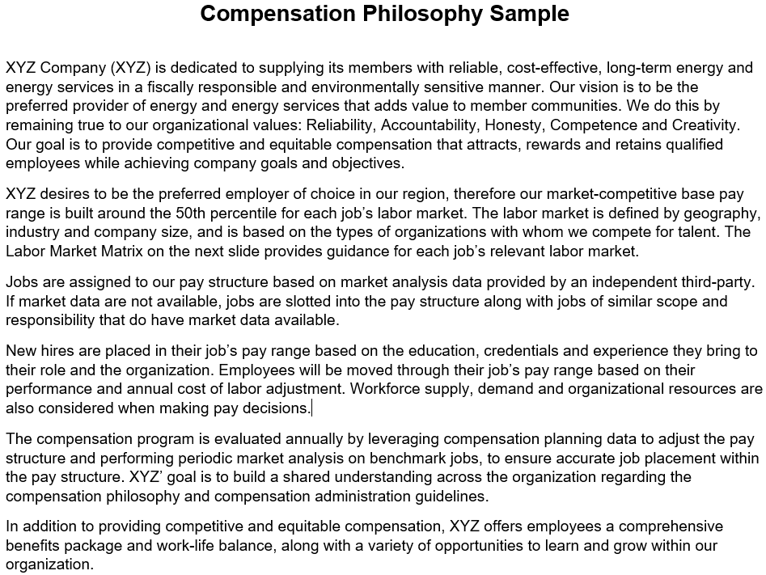

Slide 11
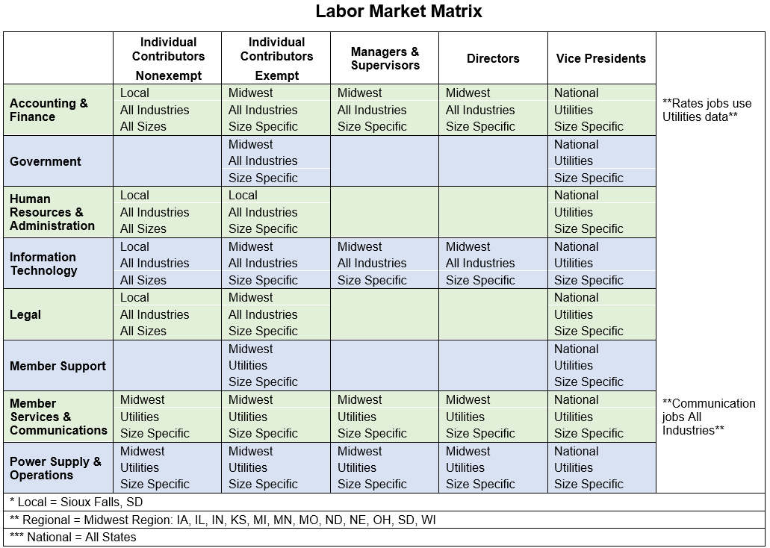

Slide 12
Market Analysis
Market Analysis:
  The process of compiling market data to determine the value of a job in its labor market
  Used by 68% of organizations to set pay (WorldatWork)
Best Practices:
  Understand the job
  Identify its labor market
  Determine data sources (consider validity, effective date, job list, available data cuts and reported statistics)
  Identify job matches that align with at least 75% of the role in your organization
  Compile the market data and survey job summaries
  Review and revise to ensure accuracy

Slide 13
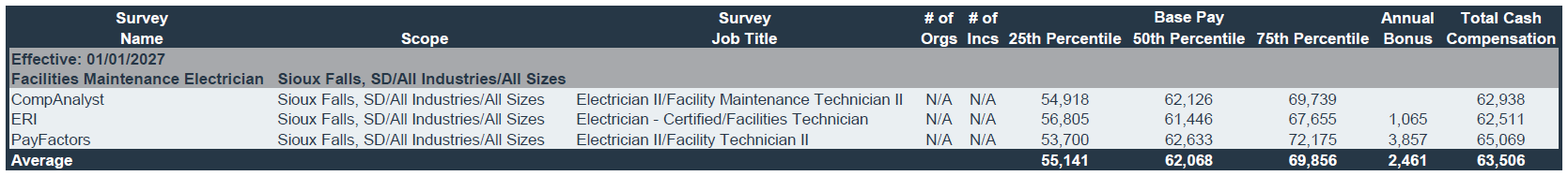
MRES Market Analysis Sample
CompAnalyst – Electrician II/Facility Maintenance Technician II
CompAnalyst – Electrician II (Weighted 50%)
Inspects, repairs, installs, and maintains electrical systems, machinery, and equipment. Ensures all work performed meets required safety codes and is properly inspected. Uses a variety of tools or equipment, such as power construction equipment, measuring devices, power tools, and testing equipment. Has at least two years of journeyman level electrical experience. Typically requires a high school diploma or equivalent. Typically requires Electrician License. Typically reports to a supervisor or manager. Works under moderate supervision. Gaining or has attained full proficiency in a specific area of discipline. Typically requires 1-3 years of related experience.
CompAnalyst – Facility Maintenance Technician II (Weighted 50%)
Performs basic and routine facilities maintenance, construction, and repair tasks according to service, quality, and safety standards. Following standard operating procedures, installs, inspects, repairs, and performs preventative maintenance to mechanical, electrical, plumbing, HVAC, safety, and waste management systems. Assists with miscellaneous facility projects, including painting, drywall, carpentry, installation of fixtures, and moving furniture or materials within the facility. Utilizes a work order system to log activities as required. Works with or assists trades contractors to complete projects or complex repairs. Requires a high school diploma or equivalent. Typically reports to a supervisor. Works under moderate supervision. Gaining or has attained full proficiency in a specific area of discipline. Typically requires 1-3 years of related experience.

Slide 14
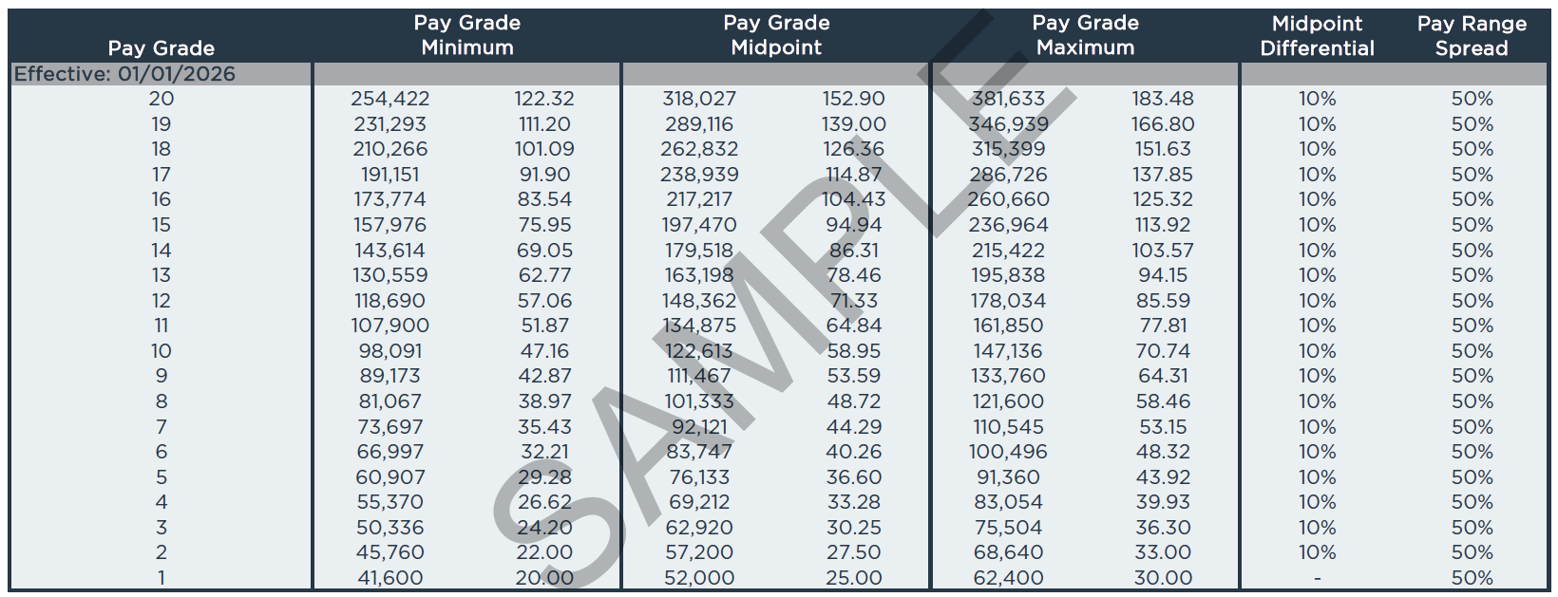
Base Pay Structure Sample

Slide 15
Implementation
Best practices:
  Use market analysis results and internal equity considerations to update your base pay structure (i.e., your pay grades, pay ranges and the pay grade assignment for each job)
  Complete employee-level financial modeling
  Develop a compensation administration guide to ensure pay practices are consistent and aligned with your strategy and the market
  Communication – What needs communicated to whom, when, and how?
MRES:
  Tied all of this into a new performance management system that led to increased employee engagement

Slide 16
Keeping Your Compensation Program Current
Best Practices:
  Annual pay structure adjustment based on your labor markets
  Annual employee pay adjustments based on your compensation philosophy
  Update compensation study around 3 years
MRES:
  Since 2019, have partnered with HUB on a regular basis to complete an organization-wide compensation study following the steps outlined
  Receive annual recommendations in non-comp study years
  Request as needed market analysis and pay grade recommendations for new or restructured jobs

Slide 17
Market Trends

Slide 18
Compensation Planning and Budgeting for 2027
 | 2026 Actual | 2027 Projected
Salary Structure Adjustment | 2.6% | 2.4%
Other Increases | 0.8% | 1.4%
General Increase/COLA | 1.4% | 2.0%
Merit Increase | 3.3% | 3.2%
Total Salary Budget Increase | 3.4% | 3.5%
WorldatWork 2026-2027 Salary Budget Survey: Central US/Utilities & Energy Production

Slide 19
The Importance of Total Rewards
MRES:
  Changing demographics
  Facing a high number of retirements
  Hard to fill industry specific positions
  Changes in employee engagement and retention
  A comprehensive benefits study/total rewards (along with the comp study)
  Separate executive compensation package

Slide 20
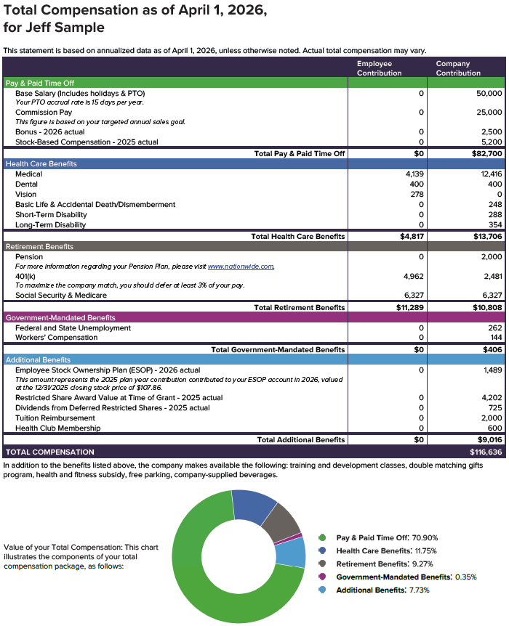
Showcasing Total Rewards through
Total Compensation
Statements
Helps employees understand the value of their total compensation (i.e., cash, health, retirement, PTO, perks, etc.)

Slide 21
Discussion Items
What is the status of your organization's compensation philosophy?
What are its strengths?
What are its areas of opportunity?

Slide 22
Discussion Items
How often do you assess base pay in your organization?
What process and data sources do you use to benchmark your organization’s jobs?
What is one helpful tip or lesson learned that others might benefit from hearing?

Slide 23
Questions?

Slide 24
Thank you!
Questions or want to connect?
Tammie Krumm
tammie.krumm@mrenergy.com
(605) 330-6973
Ashley Thomalla
ashley.thomalla@hubinternational.com
(402) 964-5409

