Slide 1
Modernizing Your Utility
Brad Lingen
Smart Grid Technical Supervisor

Slide 2
Why Invest in Technology?
  Weather events, market shortages, rolling blackouts
  Corporate renewable/clean energy demand
  Need to actively monitor system and send appropriate price signals
  Time-of-use rate structures
  Older equipment cannot accommodate modern grid technologies

Slide 3
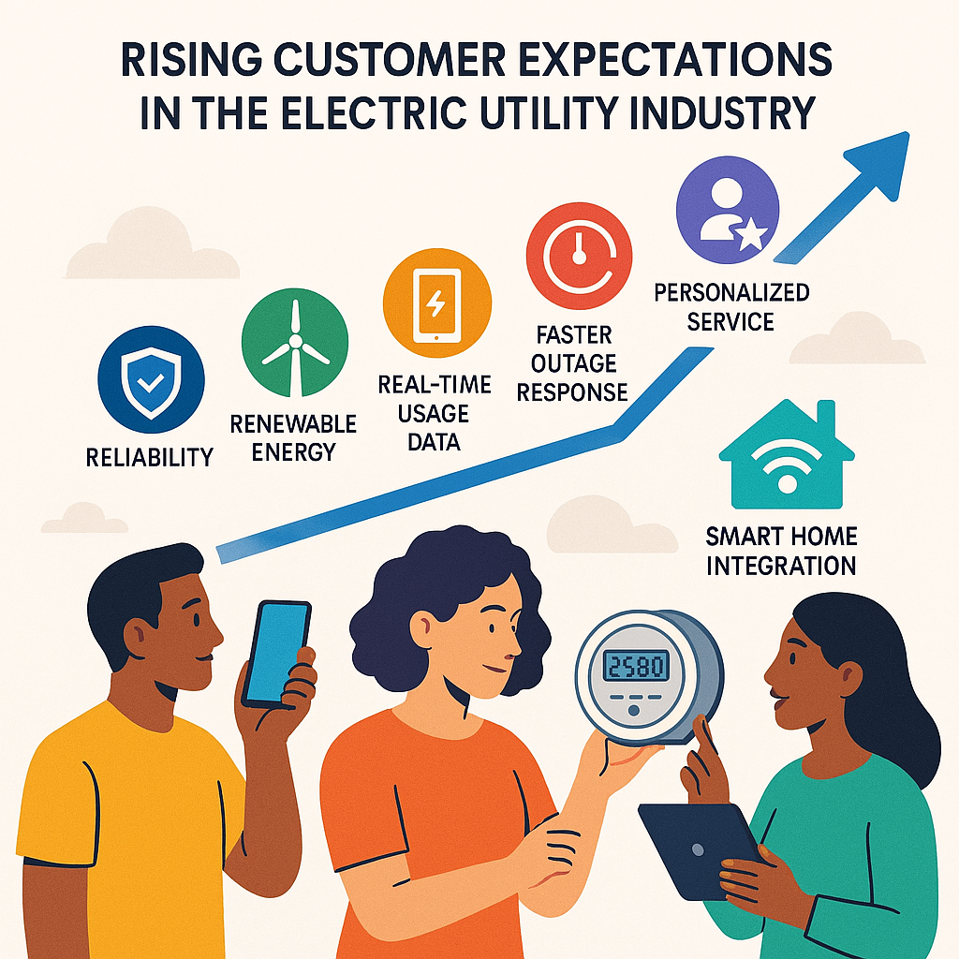
Higher Customer Expectations
  Do business 24/7/365
  Interact on multiple platforms
  Proactive notifications on outages, etc.
  Google and Amazon know more about your customers than you do:
    Data analytics
    Customer segments, values, behaviors
    Improving customer participation in utility programs — including energy efficiency
    and dynamic pricing

Slide 4
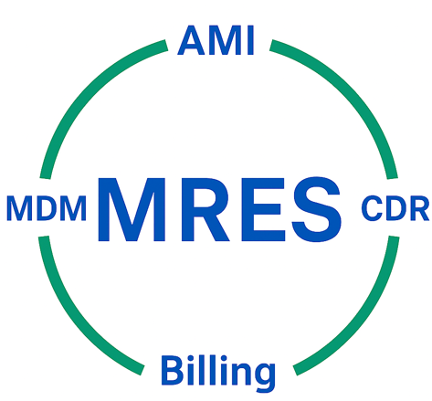
Member Technology Solutions

Slide 5
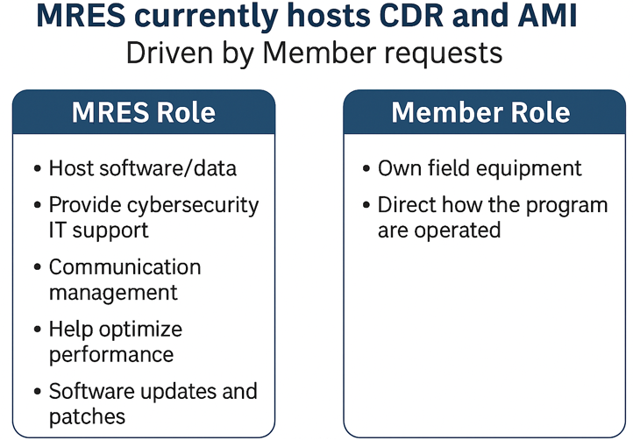
MRES Hosted Programs

Slide 6
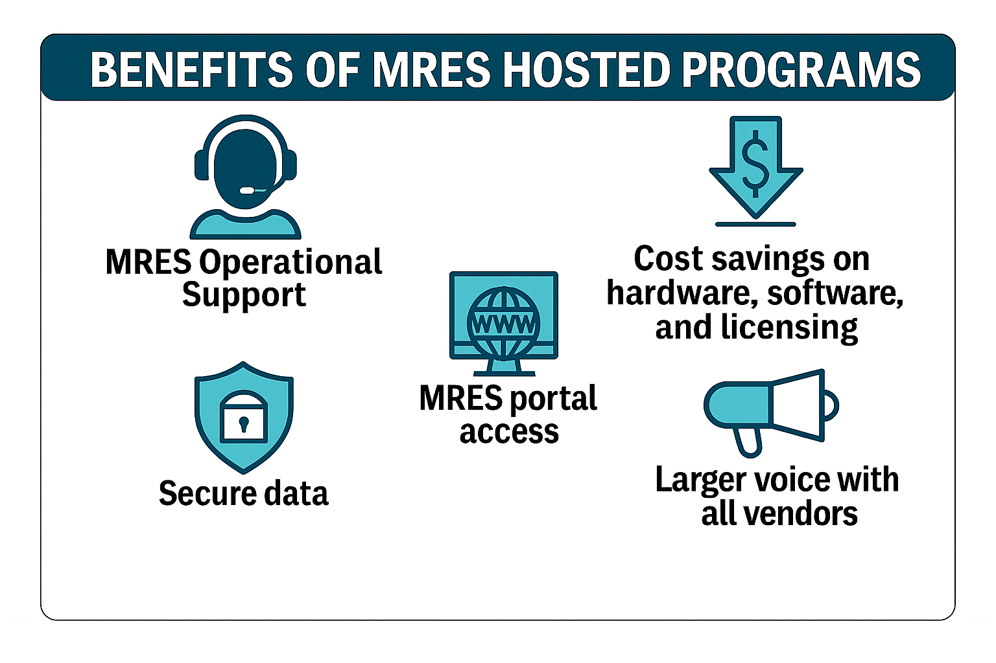

Slide 7
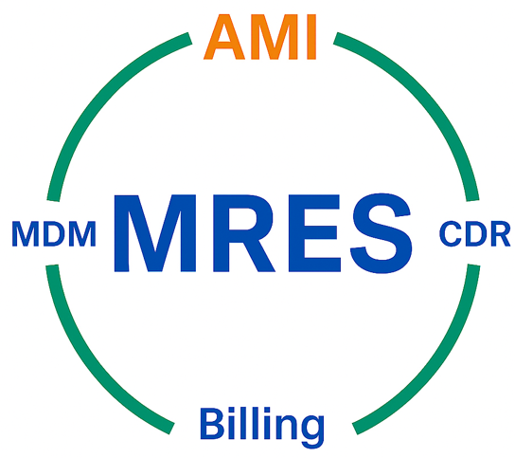
Advanced Metering Infrastructure (AMI)

Slide 8
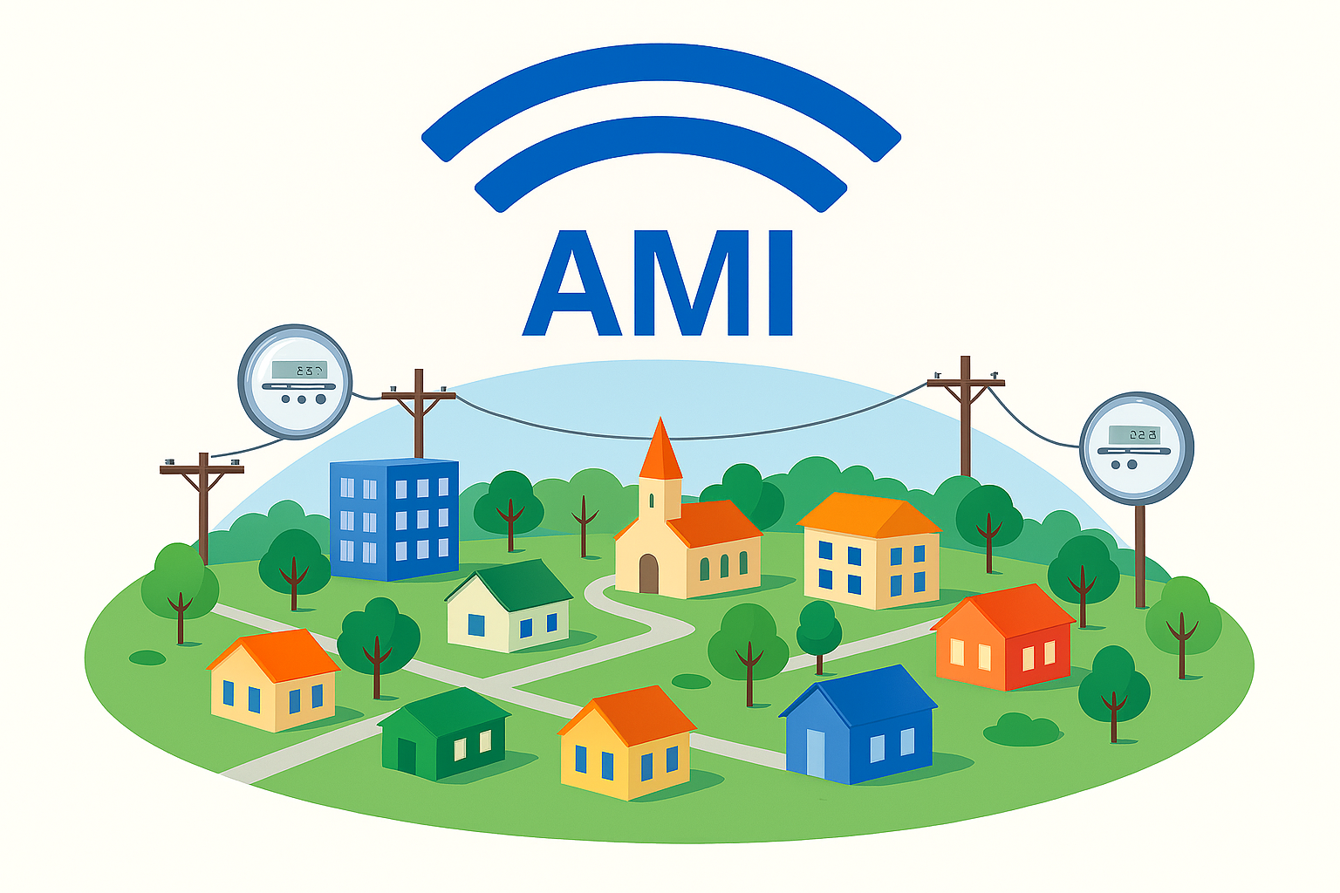
What is AMI?
  Advanced Metering Infrastructure – The integrated system of smart meters, communication networks and data management system that enable two-way communication between utilities and customers (SmartGrid.Gov)
  Considered the backbone of the Smart Grid
  MRES began hosting AMI in 2013 at the
  request of Members
  Runs on the same software and communications platform as the MRES hosted CDR program

Slide 9
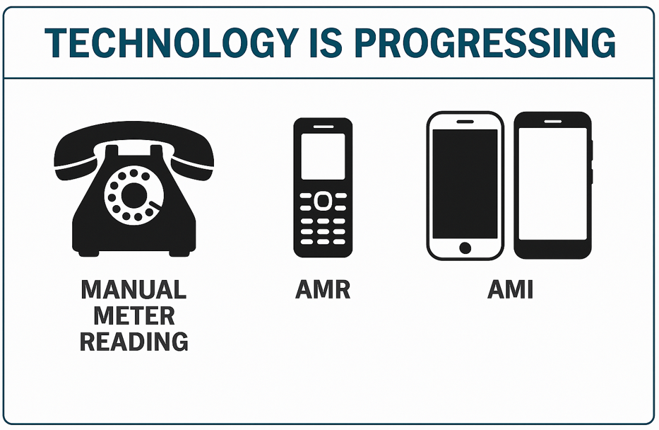

Slide 10
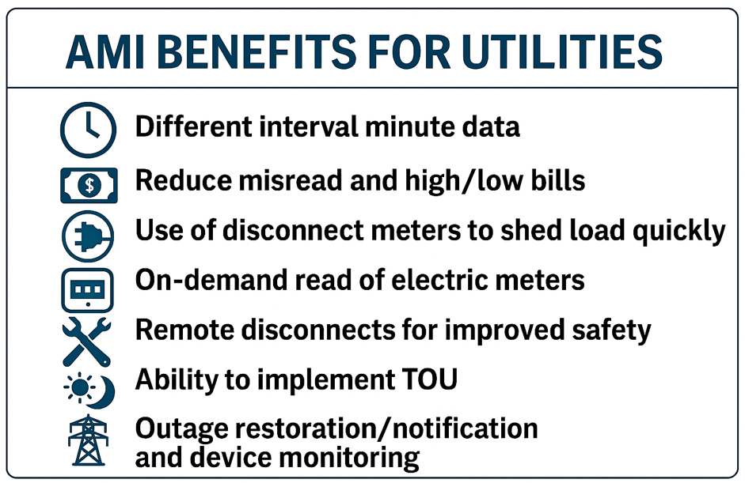

Slide 11
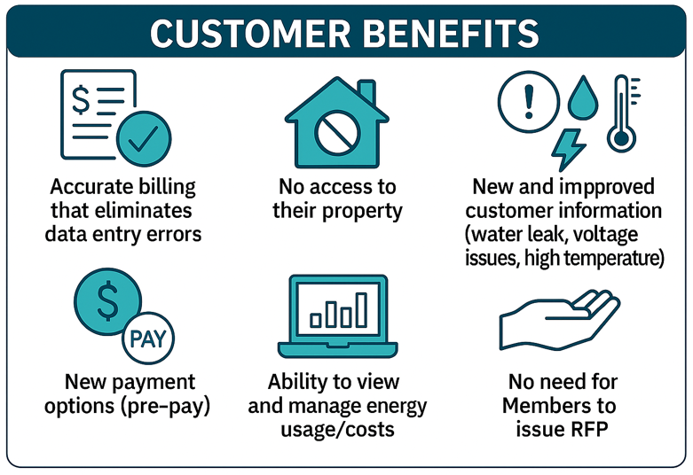
AMI Benefits for Customers

Slide 12
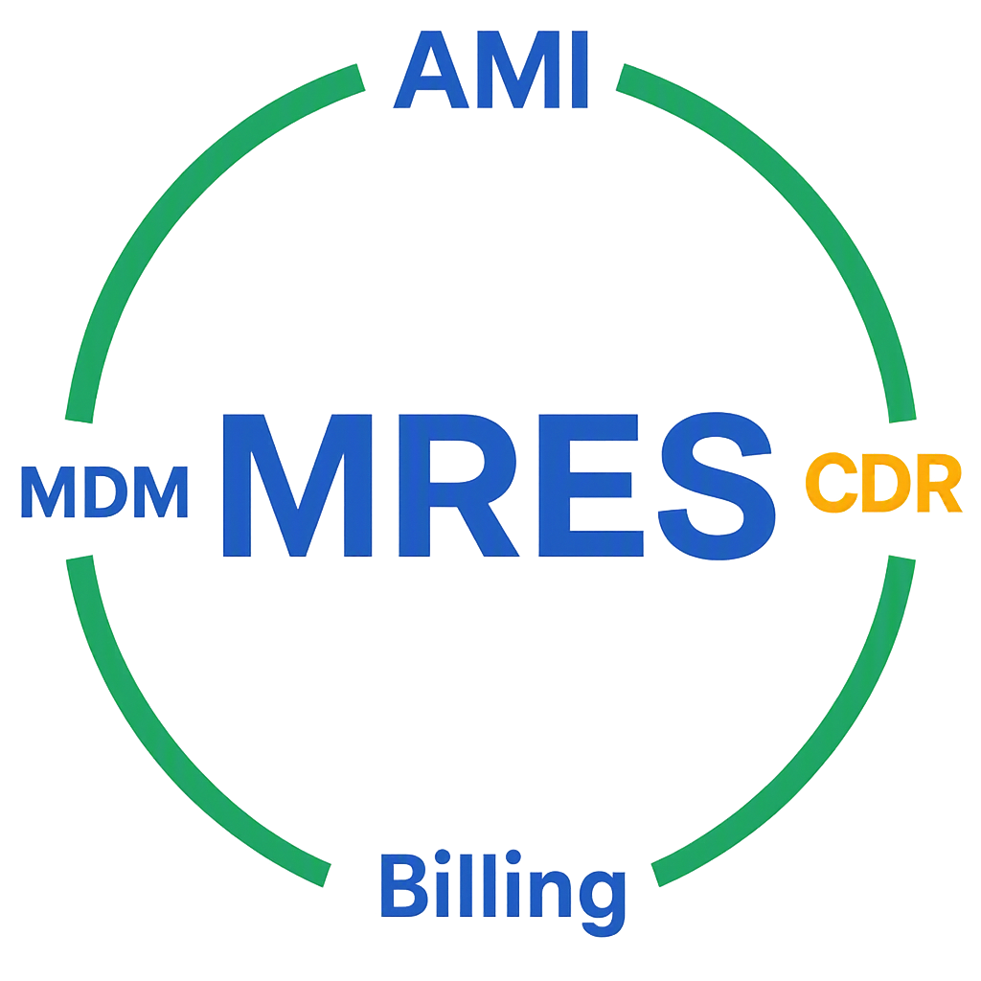
Coordinated Demand Response (CDR)

Slide 13
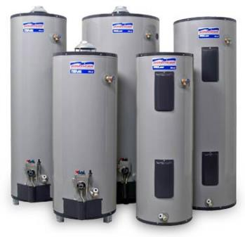
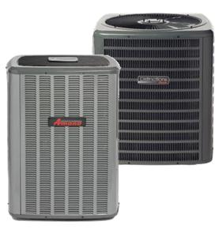
What is CDR?
  MRES began hosting in 2010 at the request of Members
  Cycles devices off and on based on
  the Member’s load
  Provides cost savings to Members –
  Lowers demand charges from MRES
  Two-way Demand Response
    Monitors load control receiver status
    Detects tampering
    Verifies participation for each event
    Allows remote configuration

Slide 14
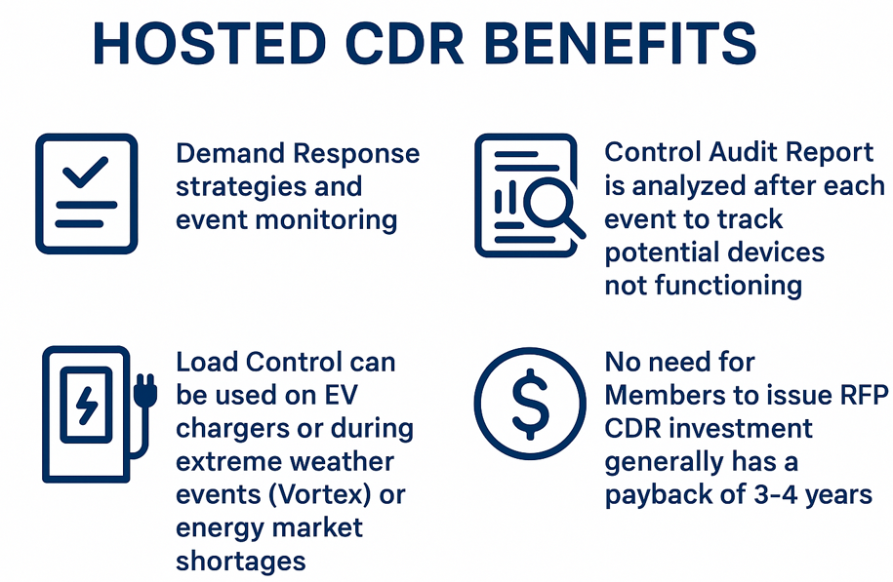

Slide 15
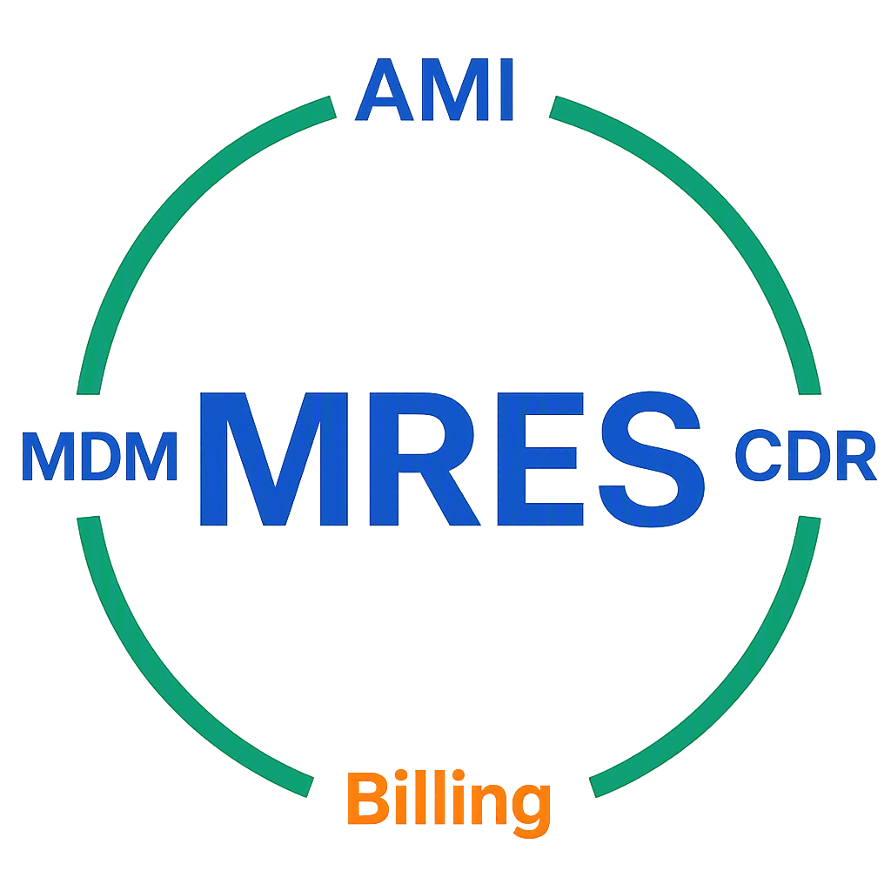
Customer Information System and Billing

Slide 16
CIS and Billing
  Approached by several Members asking MRES to explore this as the next technology “offering”
  MRES, along with the help of a Member Focus Group worked through the RFI and RFP stages and agreed Tyler Technologies was the best offering available
  At the time of the RFP, already ¼ of the membership was using Tyler
  ERP Pro 10 is now in use or in the process of being integrated to 23 members while 6 members are still using InCode 9

Slide 17

Other Offerings & Future Ideas
  AMI/CDR deployment services
  Meter Data Management (MDM)
  SmartMap
  MDM Rates Analysis Manager
  AMI/Load Control data analysis
  Geographic Information Systems (GIS)

Slide 18


Slide 19
Questions?
Brad Lingen
Smart Grid Technical Supervisor
brad.lingen@mrenergy.com
605-330-6972

