Slide 1

Top 2026 Employment Law Changes:
What Employers Need to Know Now
Ruth Horvatich
October 1, 2026

Slide 2

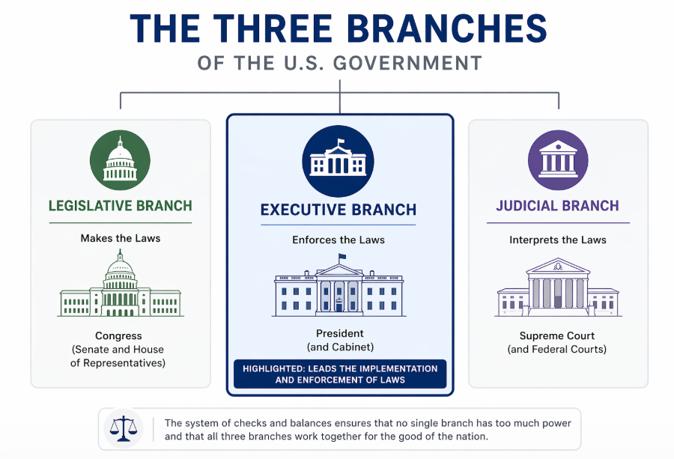

Slide 3
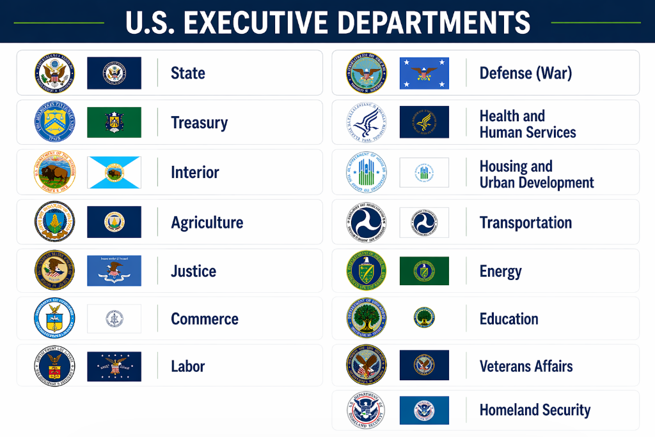

Slide 4
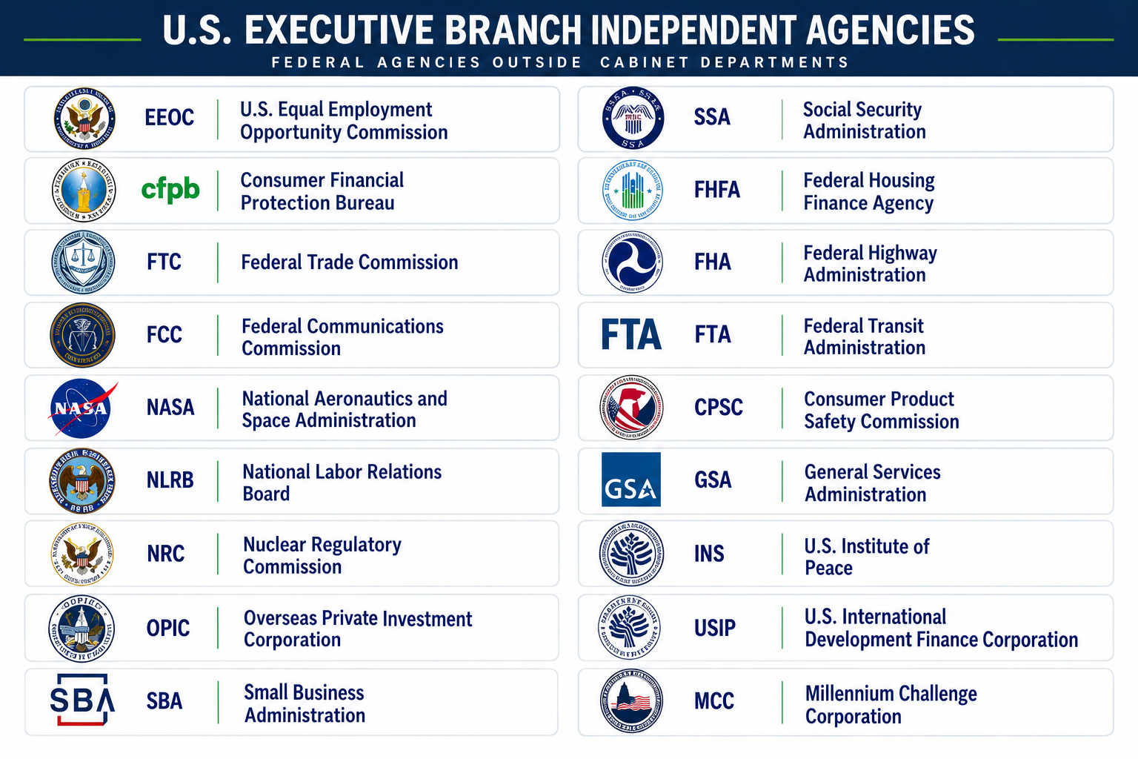
And More!

Slide 5

EEOC

Slide 6
Trump’s Swift Actions for EEOC Control
January 2025
January 2025
July 2025
October 2025
Trump terminates 2 EEOC commissioners and its General Counsel (Democrats appointed by Biden) and revokes Biden Executive Orders.
Trump names Lucas as Acting Chair and in March reappoints Lucas to another 5-year term
Commissioner Lucas confirmed as EEOC Chair
New commissioner confirmed giving Republicans a 2-1 majority and restoring full EEOC authority.

Slide 7

EEOC Chair – Andrea Lucas
Appointed by Trump to EEOC in 2020 and reappointed in March 2025
Confirmed as EEOC Chair July 31, 2025
Strongly opposed by Democrats and civil rights organizations
Republicans praise her commitment to rolling back Biden-era guidance
Actions in combating DEI-related discrimination

Slide 8

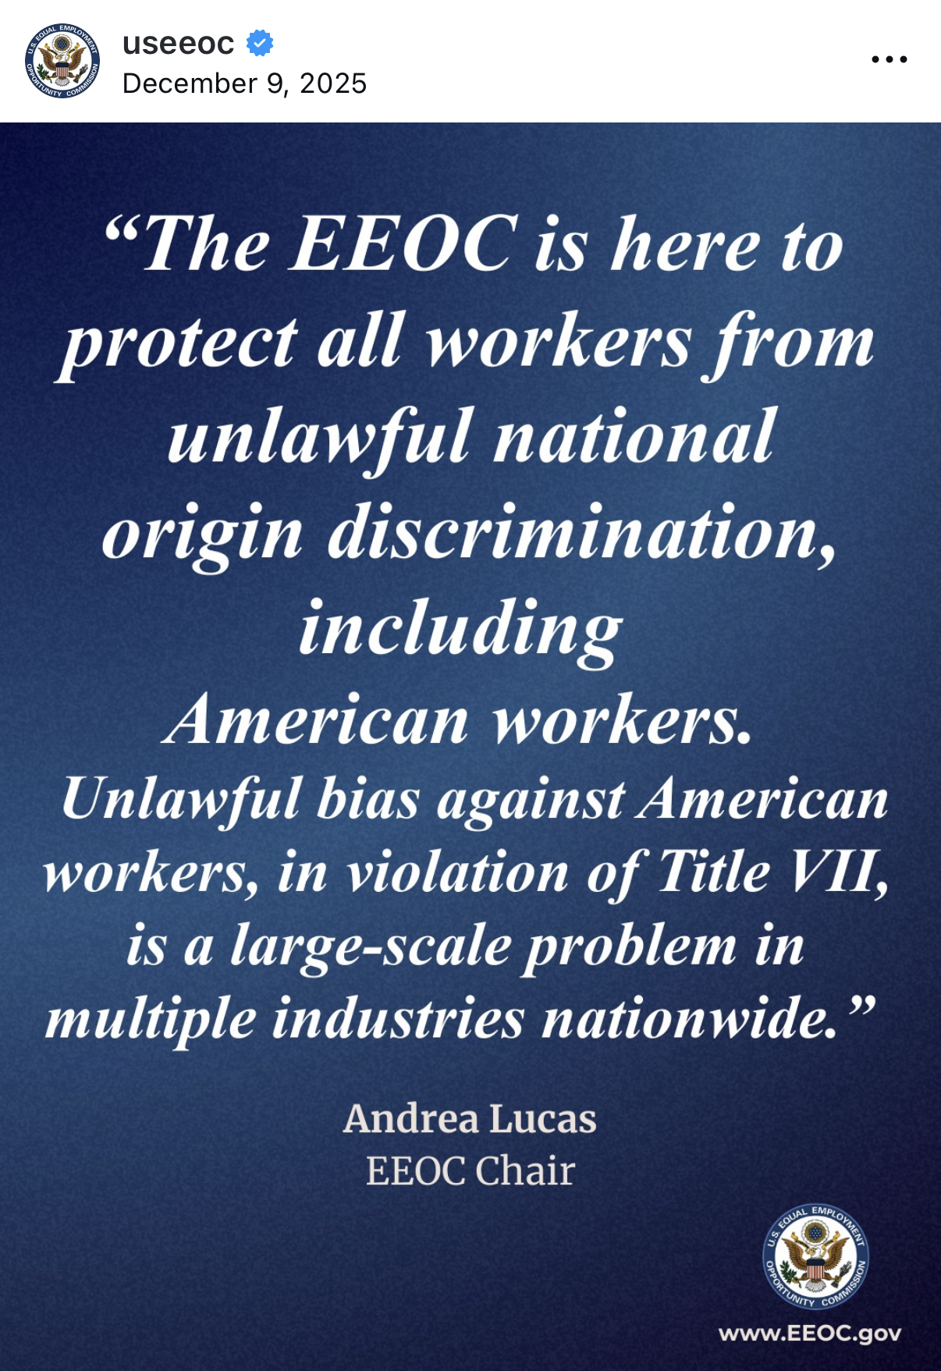

EEOC Focus & Solicitation of Charges
Discrimination against American workers (national origin)
Discrimination against white males (race and sex)
Religious discrimination

Slide 9
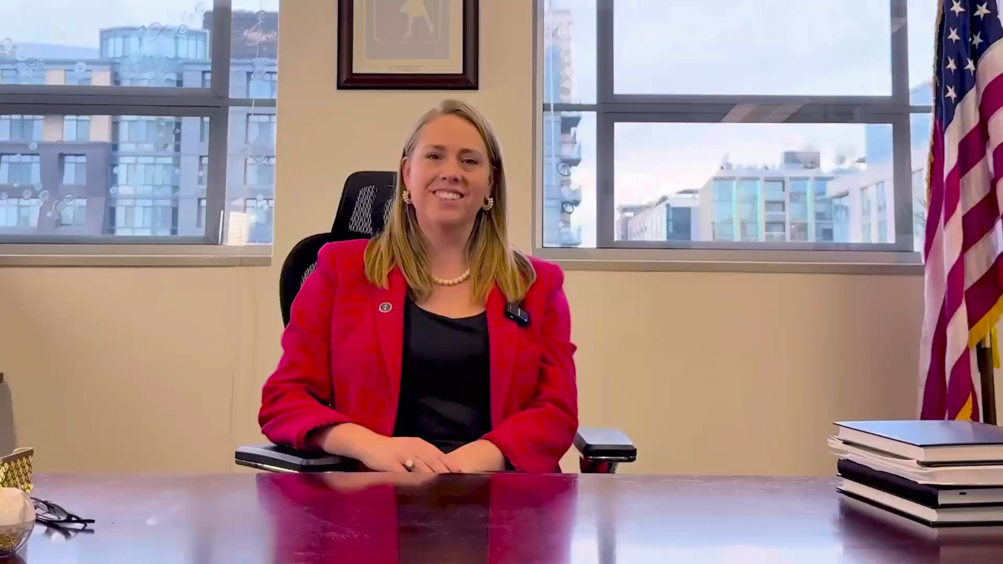
EEOC Solicitation of Charges

Slide 10
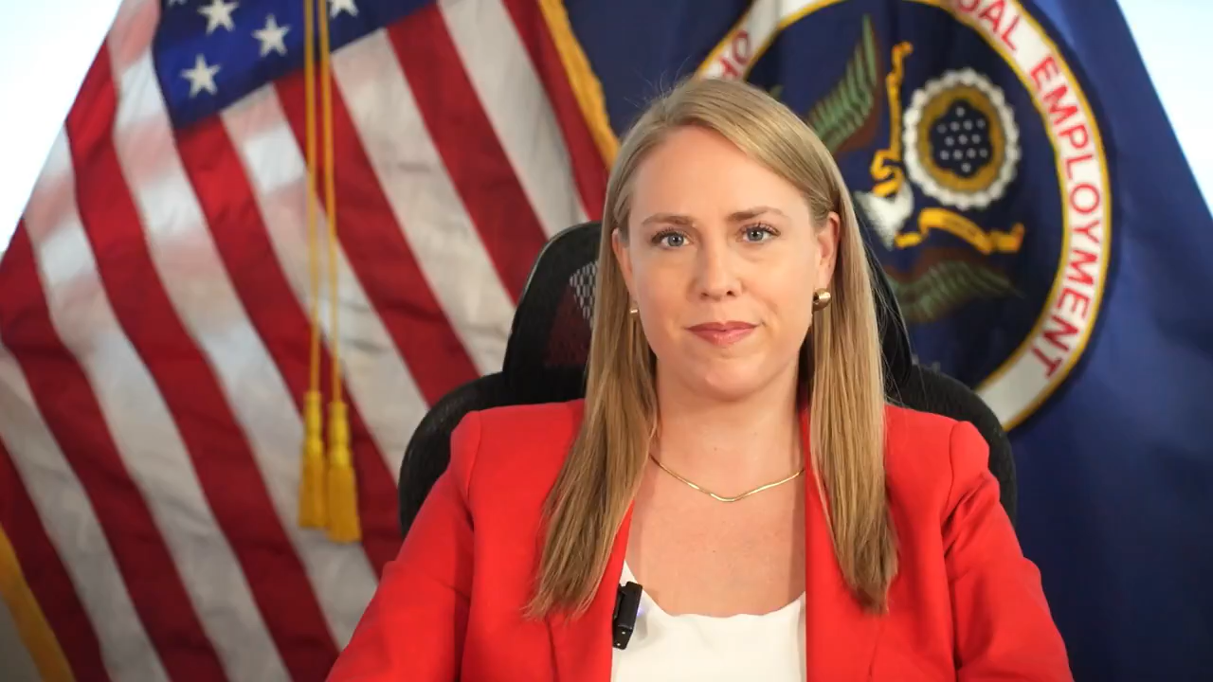
EEOC Solicitation of Charges

Slide 11
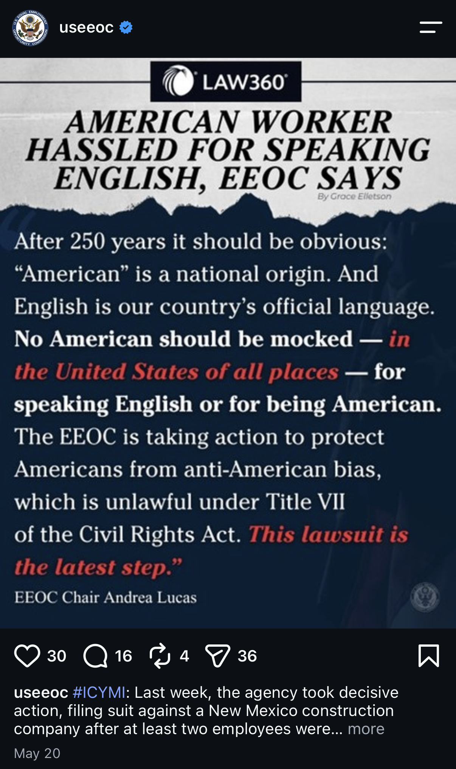

EEOC Solicitation of Charges
May 2026 – EEOC sued Advanced Technology Group, Inc. for national origin discrimination and retaliation
Allege 2 employees were subjected to anti-American slurs by their Mexican coworkers
Allege employees were terminated after complaining of harassment

Slide 12
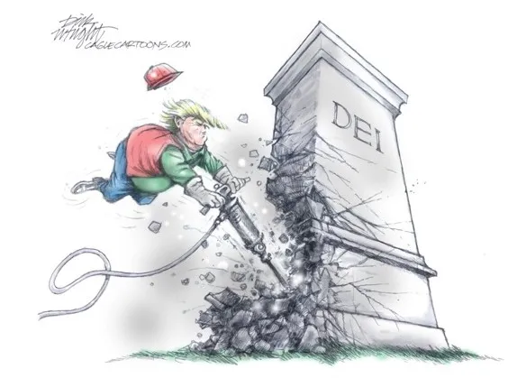
EEOC Attack on DEI
December 2025 - Lucas warned that the EEOC will use expanded searches of archived web content to identify DEI violations
Merely changing program names will not shield DEI initiatives from scrutiny
February 26, 2026 - Lucas wrote a letter to all Fortune 500 companies reminding them to comply with Title VII and warning of DEI policies

Slide 13





EEOC Attack on DEI
February 2026 EEOC sues Coca-Cola Beverages Northeast over employer-sponsored trip and networking event
February 2026 EEOC files subpoena enforcement action against Nike for DEI-related objectives
February 2026 EEOC settled lawsuit against Kickback Jack’s for $1.1M for refusing to hire male applicants
March 2026 Planned Parenthood of Illinois settled with the EEOC for $500,000 for DEI related claims including “affinity caucuses” segregated by race and DEI trainings
May 2026 EEOC sues The New York Times for engaging in DEI-related discrimination in promotion against a white male employee

Slide 14
Unlawful DEI Strategy
Making employment decisions (hiring, promotion, compensation) based on race, sex, or other protected characteristics, including quotas or preferences
Excluding or limiting opportunities (e.g., internships, leadership programs) to certain groups based on protected traits
Creating a hostile or discriminatory environment, such as mandatory trainings that single out or stereotype employees or require them to affirm particular beliefs tied to protected characteristics

Slide 15
Better DEI Strategy
Focus on expanding access and removing barriers (e.g., broad outreach, inclusive recruiting) without making decisions based on protected characteristics
Use training, mentorship, and culture initiatives that are inclusive and voluntary without stereotyping or compelling agreement with specific viewpoints
Analyze workforce data and identify gaps and improve processes without tying hiring, promotion, or pay decisions to demographic targets or quotas

Slide 16

Department of Labor (DOL)

Slide 17
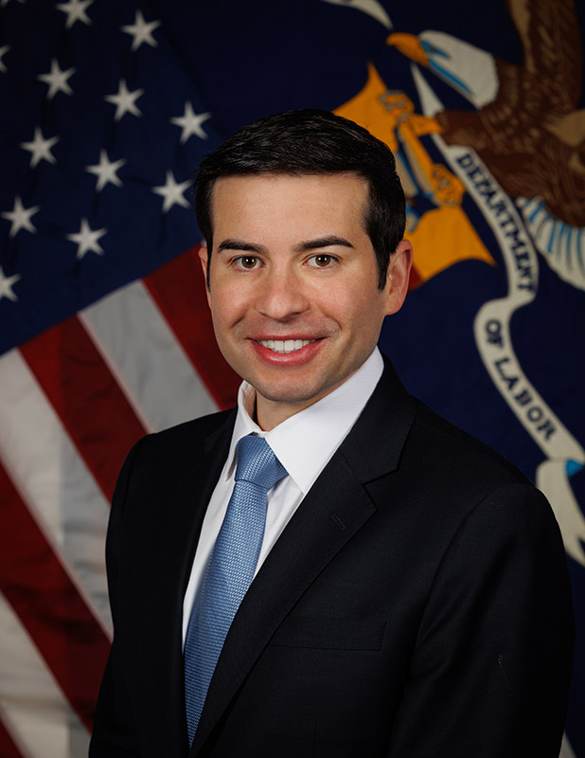

DOL Leadership
Former Labor Secretary Lori Chavez-DeRemer
(resigned on April 20, 2026)
Acting Secretary of Labor Keith E. Sonderling

Slide 18
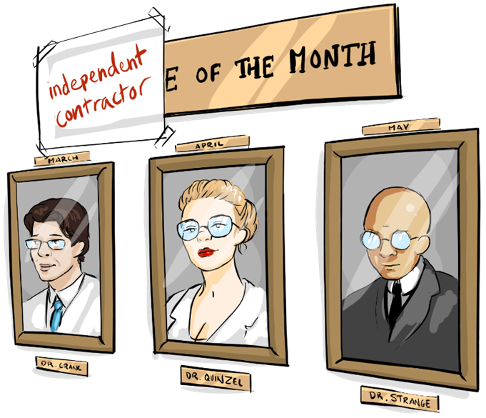
Independent Contractor Rule
February 2026 Proposed Rule
Proposed to rescind 2024 independent contractor rule and replace it with the previous 2021 Trump-era standard

Slide 19

Independent Contractor Rule
Current rule adopted in 2024 is a multi-factor analysis that requires consideration of 6 factors (totality of circumstances), each bearing equal weight:
  The individual’s opportunity to sustain a profit or loss based on his or her management skills;
  Investments by the worker and potential employer;
  How permanent the working relationship is between the worker and the potential employer;
  The nature and degree of control exercised by the potential employer over the work and the relationship;
  Whether the work is an integral part of the potential employer’s business; and
  The skill and initiative of the worker.

Slide 20

Independent Contractor Rule
New Proposed Rule (February 2026) – Economic Reality Rule
  The nature and degree of control over the relevant work; and
  Individual’s opportunity for profit or loss

Slide 21

Joint Employer Rule
New Proposed Rule Announced April 22, 2026
A single nationwide standard under:
Fair Labor Standards Act
Family and Medical Leave Act
Migrant and Seasonal Agricultural Worker Protection Act

Slide 22
Joint Employer Rule
Vertical Joint Employment
Whether the potential joint employer:
Hires or fires the employee
Horizontal Joint Employment
Two employers would be considered “sufficiently associated” if:
There is an arrangement between them to share an employee’s services
Supervises and controls the employee’s work schedule or conditions of employment to a substantial degree
Determines the employee’s rate and method of payment
Maintains the employee’s employment records
One employer is acting directly or indirectly in the interest of the other employer in relation to the employee
They share control of the employee, directly or indirectly, by reason of the fact that one employer controls, is controlled by, or is under common control with the other employer

Slide 23

Department of Homeland Security (DHS)

Slide 24

I-9 Audits
An agent of DHS ICE-Homeland Security Investigations (HSI) serves an employer a Notice of Inspection (NOI) by hand-delivery or certified mail
An employer has 3 business days to respond to the NOI
The NOI requests an employer produce:
  Forms I-9 of all current and terminated employees (usually 1-3 years from termination) and documentation
  E-Verify confirmations or other E-Verify paperwork
  A list of employees’ names
  Most recent payroll and quarterly payroll reports
  Owners’ names
  Names of contractors and staffing companies used, etc.

Slide 25

I-9 Audits - Violations
Substantive violations
  Most serious violations that cause ICE to assess a penalty
Technical violations
  Minor procedural errors that can be corrected

Slide 26

More Errors are Now Substantive Violations
In March 2026, ICE made significant changes to Form I-9 compliance and violations
These changes recategorized several technical violations as “substantive” violations
As a result, formerly correctable technical or procedural errors are now exposing employers to monetary fines

Slide 27

Technical Violations Now Categorized as “Substantive” Violations
Section 1 – Employee Information:
  Missing or incomplete legal name
  Missing date of birth
  Failure to check box attesting to immigration status in U.S. and any additionally required information (alien registration number, Form I-94 number, foreign passport number)
  Failure to sign/date Section 1
Section 2 and Supplement B - Employer Information:
  Missing required information under identity and work authorization documents
  Missing date of hire or rehire
  Missing employer/authorized representative’s complete name and title
  Missing signature or date in the Certification

Slide 28

Technical Violations Now Categorized as “Substantive” Violations
Supplement A - Preparer/Translator Certification:
  Missing full name, address, signature, or date for preparers/translators
Remote Inspection/Alternative Procedure:
  Failure to check appropriate alternative procedure (remote/virtual inspection of documents) box in Section 2 or Supplement B
  Failure to be an E-Verify participant when using alternative procedure
Electronic I‑9 Systems:
  Noncompliance with requirements for electronic completion, retention, documentation, security, reproduction, and/or signature (inadequate audit trail, security, or e‑signature functionality)
Spanish-Language Form:
  Incorrect use of the Spanish-language I-9 Form (outside of Puerto Rico)

Slide 29

Now Limited “Technical” Violations
Section 1 - Employee Information:
  Failure to use the current edition of the I-9
  Failure to provide other last names used or physical address
  Failure to ensure the Social Security number is correct when employer is enrolled in E-Verify
Section 2 - Employer Information:
  Missing employee’s complete name at the top of page 2
  Missing employer’s name or physical address
Supplement A:
  Failure to write employee’s full name at the top of Supplement A
Supplement B:
  Failure to record employee’s full name at the top of Supplement B
  Failure to record employee’s new name (if applicable) as appropriate

Slide 30
I-9 Audits - Penalties
Notice of Technical or Procedural Failures identifies technical or procedural failures found during the inspection of Forms I-9 and gives the employer at least 10 business days to correct the forms.
After this correction period ends, uncorrected technical or procedural failures will become substantive violations.
Fines range from $288 - $2,861 per I-9

Slide 31

What To Do Now
Conduct an internal I-9 audit
  Confirm all current employees have an I-9
  Complete missing I-9s
  Review and correct errors
  Discard unnecessary I-9s
Review current protocols
Conduct internal training

Slide 32

Department of Justice (DOJ)

Slide 33
DOJ & DEI
July 29, 2025 – DOJ guidance directing recipients of federal funding not to engage in “unlawful discrimination” including practices “labeled as” DEI programs.
Examples:
“Cultural competence” such as requiring job applicants to demonstrate “cross-cultural skills” or “lived experience.”
“Geographic targeting” by selecting applicants primarily because of their racial or ethnic composition rather than legitimate factors.
Race-based “diverse slate” hiring policies requiring a minimum number of candidates from specific racial groups to be included during selection process and interviewing.
Training that “promotes discrimination” with statements “stereotyping individuals based on protected characteristics” such as “all white people are inherently privileged” or “toxic masculinity, etc.”

Slide 34

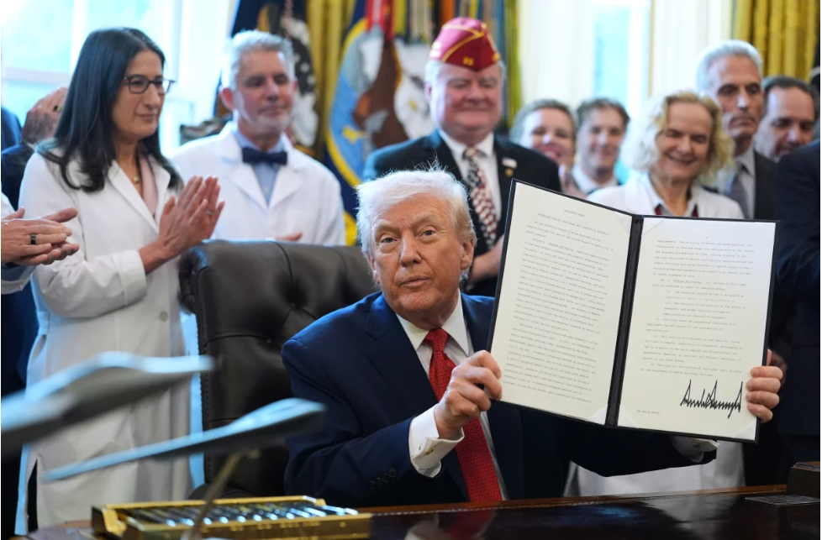
DOJ Reclassification of Marijuana
Executive Order 14370
Directed the DOJ to expedite the rescheduling of marijuana
Final Order:
“drug products containing marijuana that have been approved by the Food and Drug Administration (FDA)” and “marijuana subject to a state medical marijuana license” be immediately placed in Schedule III of the Controlled Substances Act (CSA).
ADA Reasonable Accommodation
Workplace Policies and Drug Testing

Slide 35

Artificial Intelligence & Employment Decisions

Slide 36

Executive Orders and AI
Safe, Secure, and Trustworthy Development and Use of Artificial Intelligence (published October 30, 2023)
Employment concerns:
  Displacement of human workers
  Principles and best practices –
  “equity, protected activity,
  compensation, health, and safety
  implications”
  EEOC and DOL
REVOKED

Slide 37

Executive Orders and AI
Removing Barriers to American Leadership in Artificial Intelligence (published January 23, 2025)
“Enhance America’s global AI dominance in order to promote human flourishing, economic competitiveness, and national security”
EEOC removed AI-related guidance addressing how federal anti-discrimination laws may apply to employers’ use of AI when hiring, firing, or promoting employees
DOL has noted guidance may now be outdated or not reflective of current policies and guidance not accessible in certain locations

Slide 38

Employment Discrimination Laws & AI
Mobley v. Workday, Inc.
740 F. Supp. 3d 796 (N.D. Cal. 2024)
2026 WL 1906986 (N.D. Cal. July 2, 2026)

Slide 39

State Employment AI Laws
Illinois
Colorado
New York
New York City
California
Connecticut
Maryland
Vermont
New Jersey

Slide 40

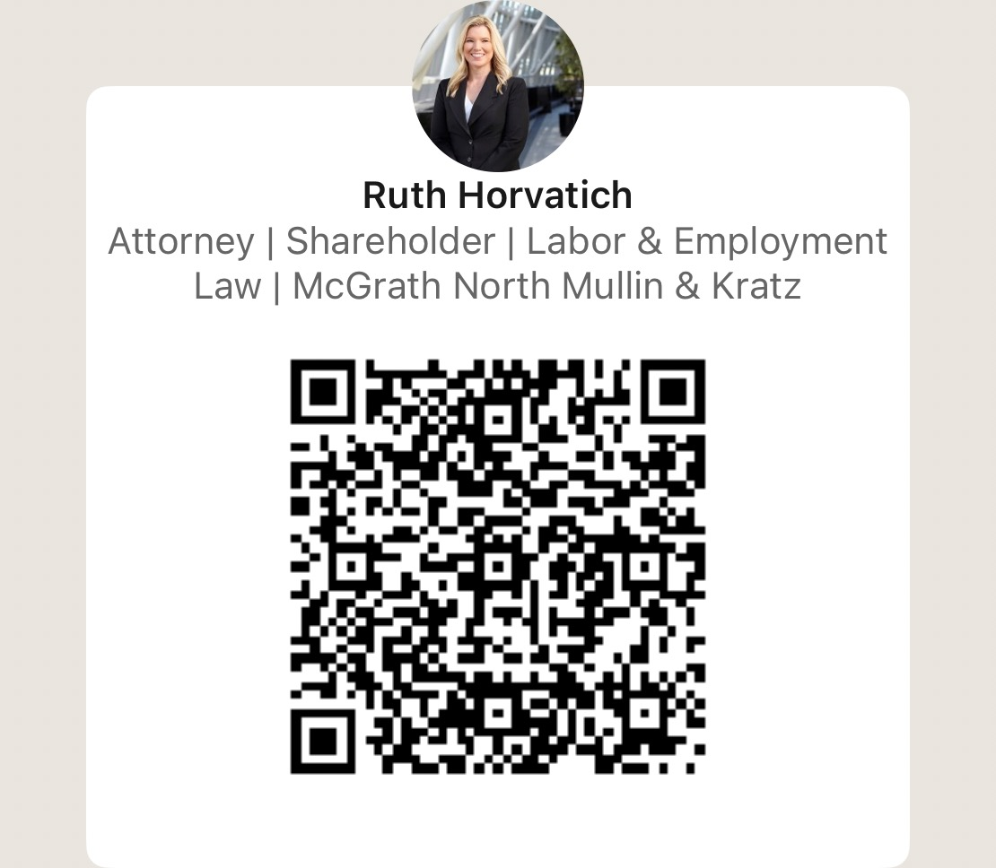

Ruth Horvatich | rhorvatich@mcgrathnorth.com | (402) 633-1521

