Slide 1
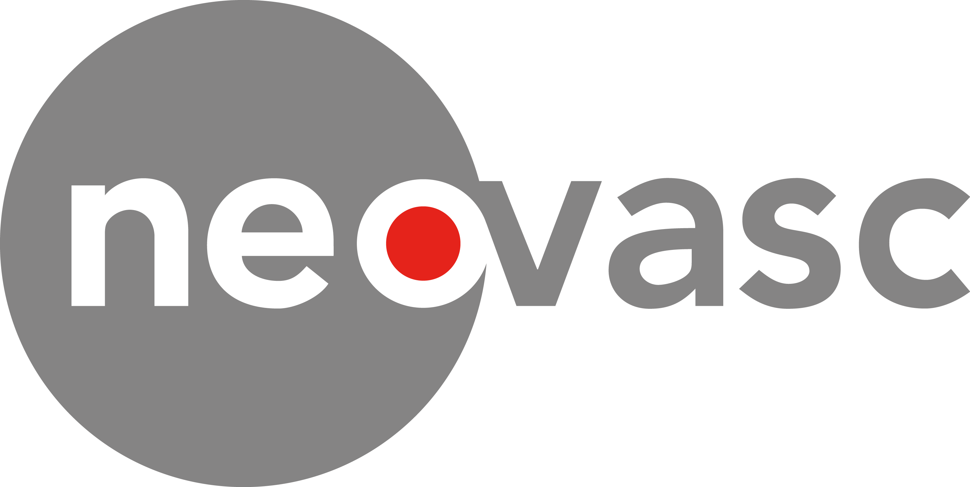
Advancing treatment of heart disease
NASDAQ, TSX: NVCN
Fred Colen, CEO
August 2020
022006-MKT Rev A (2020-08)

Slide 2
Forward-Looking Statements
This presentation contains forward-looking statements within the meaning of the U.S. Private Securities Litigation Reform Act of 1995 and applicable Canadian securities laws regarding the Company’s plans and expectations concerning: the realization of its 4 step value creation strategy, including, pursuing Reducer reimbursement in additional countries, targets as to US commercialization of Reducer and FDA approval, and anticipated first human implant of Tiara TF by late 2020; the size of the market opportunities for the Tiara and the Reducer; cash requirements in order to reach planned timing for value creation milestones; its intellectual property coverage for its products; and refractory angina and mitral regurgitation representing a large, growing market. Words and phrases that may not be based on historical fact, including without limitation statements containing the words “believe”, “may”, “plan”, “will”, “estimate”, “continue”, “anticipate”, “intend”, “expect” “revolutionize”, “strategy”, “initiate”, “path” and “re-establish”, and similar words or expressions, are intended to identify these forward-looking statements. Forward-looking statements are based on estimates and assumptions made by the Company in light of its experience and its perception of historical trends, current conditions and expected future developments, as well as other factors that the Company believes are appropriate in the circumstances. Such statements reflect management of the Company’s current views with respect to future events and are subject to risks and uncertainties and are necessarily based upon a number of estimates and assumptions that, while considered reasonable by the Company, are inherently subject to significant business, economic, competitive, political and social uncertainties and contingencies. The factors and assumptions used by management of the Company to develop such forward-looking statements include, but are not limited to: the Company’s ability to continue as going concern; the Company’s ability to raise significant additional financing on favorable terms; the Company’s regulatory and clinical strategies will continue to be successful; the Company’s current positive interactions with regulatory agencies will continue; recruitment to clinical trials and studies will continue; the time required to enroll, analyze and report the results of the Company’s clinical studies will be consistent with projected timelines; current and future clinical trials and studies will generate the supporting clinical data necessary to achieve approval of marketing authorization applications; the regulatory requirements for approval of marketing authorization applications will be maintained; the Company’s current good relationships with the Company’s suppliers and service providers will be maintained; the Company’s estimates of market size and reports reviewed by us are accurate; the Company’s efforts to develop markets and generate revenue from the Reducer will be successful; and markets for the Tiara and the Reducer will develop. Investors are cautioned that many factors and assumptions could cause the Company’s actual results, performance or achievements to differ materially from those expressed or implied by the forward-looking statements, including, without limitation: risks relating to the possibility that the Company’s common shares may be delisted from the Nasdaq Capital Market or the Toronto Stock Exchange, including Nasdaq’s discretionary public interest authority to apply more stringent criteria for continued listing or suspend or delist securities, which could affect their market price and liquidity; the substantial doubt about the Company’s ability to continue as a going concern; risks related to the recent coronavirus outbreak or other health epidemics, which could significantly impact our operations, sales or ability to raise capital; risks relating to the Company’s need for significant additional future capital and the Company’s ability to raise additional funding; risks relating to the Company’s Common Share price being volatile; risks relating to the sale of a significant number of Common Shares of the Company; risks relating to the conversion or exercise of the Company’s existing securities, which may encourage short sales by third parties; risks relating to the Company’s conclusion that it did not have effective internal control over financial reporting as at December 31, 2018 and 2019; risks relating to the Company’s Common Share price being volatile; risks relating to the influence of significant shareholders of the Company over the Company’s business operations and share price; risks relating to the Company’s significant indebtedness, and its effect on the Company’s financial condition; risks relating to claims by third parties alleging infringement of their intellectual property rights; risks relating to lawsuits that the Company is subject to, which could divert the Company’s resources and result in the payment of significant damages and other remedies; the Company’s ability to establish, maintain and defend intellectual property rights in the Company’s products; risks relating to results from clinical trials of the Company’s products, which may be unfavorable or perceived as unfavorable; the Company’s history of losses and significant accumulated deficit; risks associated with product liability claims, insurance and recalls; risks relating to use of the Company’s products in unapproved circumstances, which could expose the Company to liabilities; risks relating to competition in the medical device industry, including the risk that one or more of the Company’s competitors may develop more effective or more affordable products; risks relating to the Company’s ability to achieve or maintain expected levels of market acceptance for the Company’s products, as well as the Company’s ability to successfully build its in-house sales capabilities or secure third-party marketing or distribution partners; the Company’s ability to convince public payors and hospitals to include the Company’s products on their approved products lists; risks relating to new legislation, new regulatory requirements and the efforts of governmental and third party payors to contain or reduce the costs of healthcare; risks relating to increased regulation, enforcement and inspections of participants in the medical device industry, including frequent government investigations into marketing and other business practices; risks associated with the extensive regulation of the Company’s products and trials by governmental authorities, as well as the cost and time delays associated therewith; risks associated with post-market regulation of the Company’s products; health and safety risks associated with the Company’s products and industry; risks associated with the Company’s manufacturing operations, including the regulation of the Company’s manufacturing processes by governmental authorities and the availability of two critical components of the Reducer; risk of animal disease associated with the use of the Company’s products; risks relating to the manufacturing capacity of third-party manufacturers for the Company’s products, including risks of supply interruptions impacting the Company’s ability to manufacture its own products; risks relating to the Company’s dependence on limited products for substantially all of the Company’s current revenues; risks relating to the Company’s exposure to adverse movements in foreign currency exchange rates; risks relating to the possibility that the Company could lose its foreign private issuer status under U.S. federal securities laws; risks relating to breaches of anti-bribery laws by the Company’s employees or agents; risks associated with future changes in financial accounting standards and new accounting pronouncements; risks relating to the Company’s dependence upon key personnel to achieve its business objectives; the Company’s ability to maintain strong relationships with physicians; risks relating to the sufficiency of the Company’s management systems and resources in periods of significant growth; risks associated with consolidation in the health care industry, including the downward pressure on product pricing and the growing need to be selected by larger customers in order to make sales to their members or participants; risks relating to the Company’s ability to successfully identify and complete corporate transactions on favorable terms or achieve anticipated synergies relating to any acquisitions or alliances;; anti-takeover provisions in the Company’s constating documents which could discourage a third party from making a takeover bid beneficial to the Company’s shareholders; risks relating to conflicts of interests among the Company’s officers and directors as a result of their involvement with other issuers. These risk factors and others relating to the Company are discussed in greater detail in the “Risk Factors” section of the Company’s Annual Report on Form 20-F and in the Management’s Discussion and Analysis for the three months ended March 31, 2020 (copies of which may be obtained at www.sedar.com or www.sec.gov). The Company has no intention and undertakes no obligation to update or revise any forward-looking statements beyond required periodic filings with securities regulators, whether as a result of new information, future events or otherwise, except as required by law. All financial data mentioned is expressed in US dollars.

Slide 3
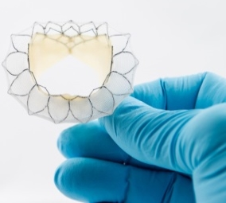
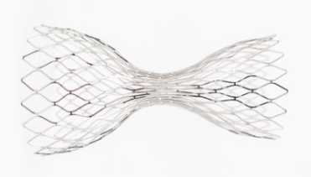
Two Key Products
Tiara™ mitral valve replacement for minimally invasive treatment of mitral valve disease (in Clinical trial phase)
- Tiara TA - CE Mark application submitted under EU Medical Device Directive
- Tiara TF - Targeting First in Human first half 2021
Neovasc Reducer™ device for minimally invasive treatment of refractory angina (CE-marked and commercial in EMEA)
- FDA Breakthrough Device designation
- Recently added to ESC Guidelines¹
- FDA Panel Meeting Oct. 27, 2020

Slide 4
4 Step Value Creation Strategy
Reducer EU revenue & therapy development
Reducer US FDA strategy
Transapical Tiara CE Mark in EU
Transfemoral/Trans-septal Tiara TF First In Human

Slide 5
Reducer Opportunity

Slide 6
Refractory Angina – an Underserved Market
Chronic, refractory angina (RA) pectoris affects millions of patients worldwide and represents a potential multi-billion-dollar opportunity¹
Over 2 Million angiograms per year in both the U.S. and E.U.¹
  Over 500,000 patients per year in each market present with Angina with Non-Obstructive Coronary Artery Disease (ANOCA)^{1,2}
Over 1.2 Million PCI/CABG procedures per year in the U.S. and E.U.¹
  Over 250,000 patients, already revascularized (PCI or CABG) continue to experience angina, even with contemporary stents or bypass surgery^{1,3}
Refractory angina is an expensive, often debilitating condition and both patients and physicians are looking for new alternatives
1. Neovasc Market Model, Data on File 2. Patel, M. N Engl J Med 2010; 362:886-895 3. Abdallah, M. Syntax Trial, J Am Coll Cardiol 2017;69:2039-50

Slide 7
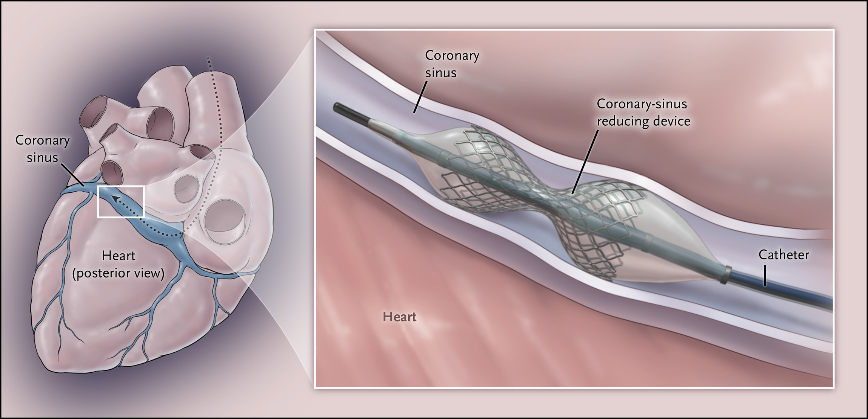
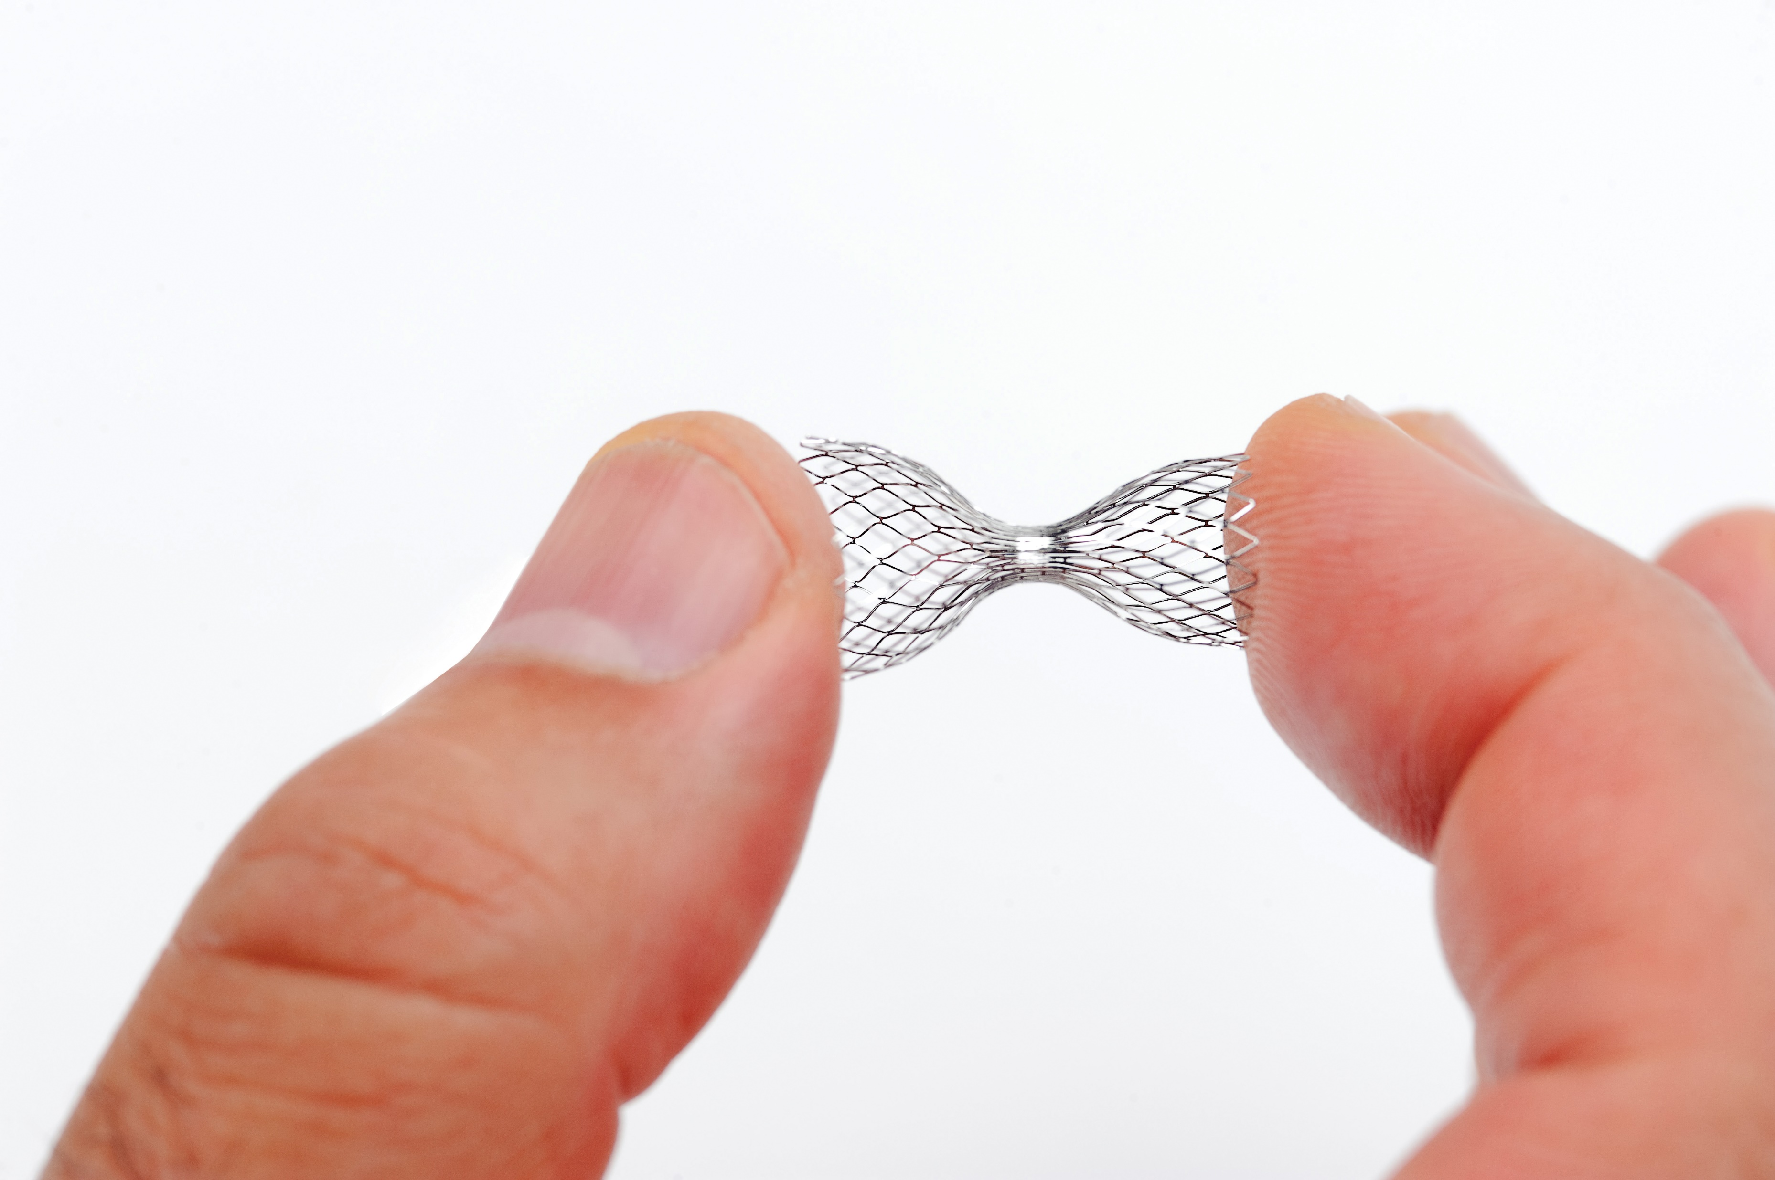
Reducer Therapy for Refractory Angina
Treats patients untreatable with CABG and PCI
Implanted in the coronary sinus (large vein in heart) in approximately 30 minutes
Increases coronary sinus pressure to redistribute blood flow to ischemic areas of the heart

Slide 8
Reducer Improves Symptoms in RA Patients
CCS: 4 Classes of Angina: I Angina only with strenuous exertion, II With moderate exertion, III With mild exertion, IV With any activity or at rest
N Engl J Med 2015; 372:519-527

Slide 9
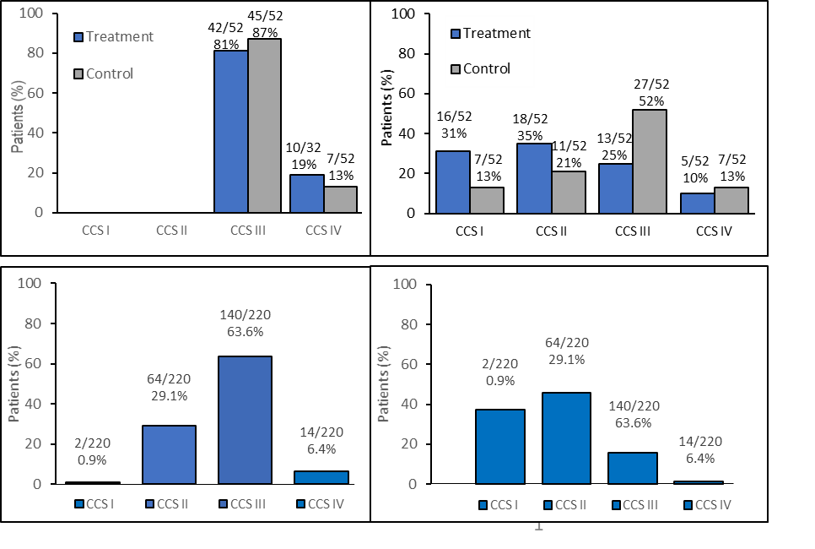
REDUCER-I Real World Study Substantiates COSIRA Results
COSIRA
Verheye S, Jolicoeur EM, Behan MW, et al.
Efficacy of a device to narrow the coronary
sinus in refractory angina. N Engl J Med
2015; 372: 519-527
REDUCER-I
Includes data through analysis lock on 12 March 2020 and 90% monitored; Data on file at Neovasc

Slide 10
REDUCER-I CCS Grade Long-Term Follow-up
Primary Endpoint: Reduction in CCS Grade
Includes data through analysis lock on 12 March 2020 and is 90% monitored; on file at Neovasc
Verheye, S. PCR e-Course, Narrowing of the Coronary Sinus for the Treatment of Refractory Angina Pectoris:
A multicentre prospective observational open-label clinical study (REDUCER-I), Analysis of the first 207 patients June 2020
Includes data through analysis lock on 12 March 2020 and is 90% monitored; on file at Neovasc

Slide 11
REDUCER-I CCS Grade Long-Term Follow-up
~70% with CCS III-IV
~16% with CCS III-IV
Verheye, S. PCR e-Course, Narrowing of the Coronary Sinus for the Treatment of Refractory Angina Pectoris:
A multicentre prospective observational open-label clinical study (REDUCER-I), Analysis of the first 207 patients June, 2020
Includes data through analysis lock on 12 March 2020 and is 90% monitored; on file at Neovasc

Slide 12
REDUCER-I Reduction in Emergency Visits
Number of Documented Emergency Department Visits Due to Angina in the Past 12 Months
ED Visits | Baseline | 12 Months
Subjects with at least 1 ED visit in the last 12 months² | 41.6% (47/113) | 13.3% (15/113)
Sum of ED visits across all subjects | 78 | 22
Average number of ED visits in the previous 12 months including subjects with 0 visits³ | 0.69 ± 1.06 (113) [0, 5] | 0.19 ± 0.60 (113) [0, 4]
P-value for change in number of visits | NA | <0.0001
Decrease in the number of ED visits or 0 visits at Baseline and 12 months | NA | 91.2% (103/113)
¹ Based on ARM 1 Subjects with Baseline and 12 Month Visits; Excluding subject with 15 ED days at baseline
² Data are presented as % (n/N)
³ Data are presented as mean ± SD (N) [min, max]
34
Verheye, S. PCR e-Course, Narrowing of the Coronary Sinus for the Treatment of Refractory Angina Pectoris:
A multicentre prospective observational open-label clinical study (REDUCER-I), Analysis of the first 207 patients June 2020
Includes data through analysis lock on 12 March 2020 and is 90% monitored; on file at Neovasc
Notes:
Key message is to show improvement and remove text

Slide 13
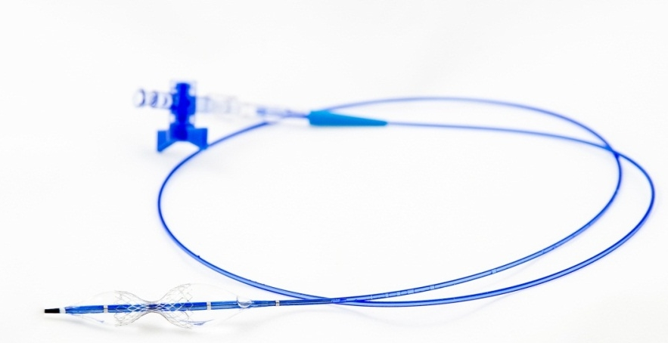
Reducer Intellectual Property
Comprehensive global patent strategy to cover Reducer
Option to extend key Reducer patent by up to 5 years based on PMA approval
Next generation Reducer patents pending
24 Granted patents
U.S. 7
Canada 6
Europe 6
Israel 3
Australia 1
India 1
9 Pending patents
U.S. 6
Other 3

Slide 14

Reducer Commercialization Status
  October 2018 - Reducer was granted FDA Breakthrough Device Designation
  August 2019 - CMS finalized inpatient proposal to create an alternative new technology add-on payment pathway for medical devices with breakthrough device designation when accompanied by FDA marketing authorization
  September 2019 - European Society of Cardiology adds Reducer to Guidelines for Treatment of Chronic Coronary Syndromes
  November 2019 – CMS finalized outpatient alternative payment pathway rule provision and grants transitional pass-through payments for breakthrough devices when accompanied by FDA marketing authorization
  December 2019 - Submitted PMA application
  October 27, 2020 – FDA Circulatory Systems Device Panel Meeting

Slide 15





Accelerating Reimbursement in Global Markets
FDA Breakthrough Medical Device designation
CMS finalized decision to offer Incremental Reimbursement for Breakthrough Devices
FDA Panel Meeting scheduled for October 27, 2020
NUB Status 1 reimbursement
Scientific Consultation Meeting with German reimbursement authorities targeted 2H 2020
Prestigious NICE in UK has selected Reducer for guidance development
Interventional Procedures Programme Review scheduled March 2021
Pursuing joint CCAM/LLPR Title III via French HAS reimbursement authority
HAS Reimbursement opinion anticipated Q4 2020
Progressing on Lombardia Regional Reimbursement
Additional regional reimbursement targeted following Lombardia

Slide 16
Reducer U.S. Milestones
2H 2019
1H 2020
2H 2020
1H 2021
FDA SUBMISSION
FDA 100-DAY MEETING
FDA PANEL MEETING
October 27, 2020
TARGETED FDA DECISION

Slide 17
Tiara Opportunity

Slide 18
Mitral Regurgitation – an Underserved Market
Over 5 Million patients in both the U.S. and E.U. suffer from mitral regurgitation^{1,2}
Anticipate $2B+ market by 2023¹
Prognosis is poor for patients with undertreated mitral regurgitation
There is no single approach that can treat all patients
Tiara targets both transapical (TA) approach and transfemoral trans-septal (TF) approach
1. Neovasc Market Model, Data on File 2. Asgar et al. Secondary Mitral Regurgitation in Heart Failure. JACC 2015;65:1231-48

Slide 19
Poor Prognosis for Patients with Functional MR
Survival rate declines about 20% per year in ischemic FMR patient population
vs.
Survival rate declines about
20% in 3 years for no FMR
patient population.
JACC Vol 65, No 12, 2015; Asgar, Mack, Stone

Slide 20

Tiara Intellectual Property
Comprehensive global patent strategy to cover Tiara and related technologies
17 Active patent families
50 Granted patents
U.S. 19
Canada 3
Australia 7
China 7
Japan 6
Germany 5 Utility models
Europe 4 (for 1 to 10 EU countries)
47 Pending patents
U.S. 17
Other 30

Slide 21
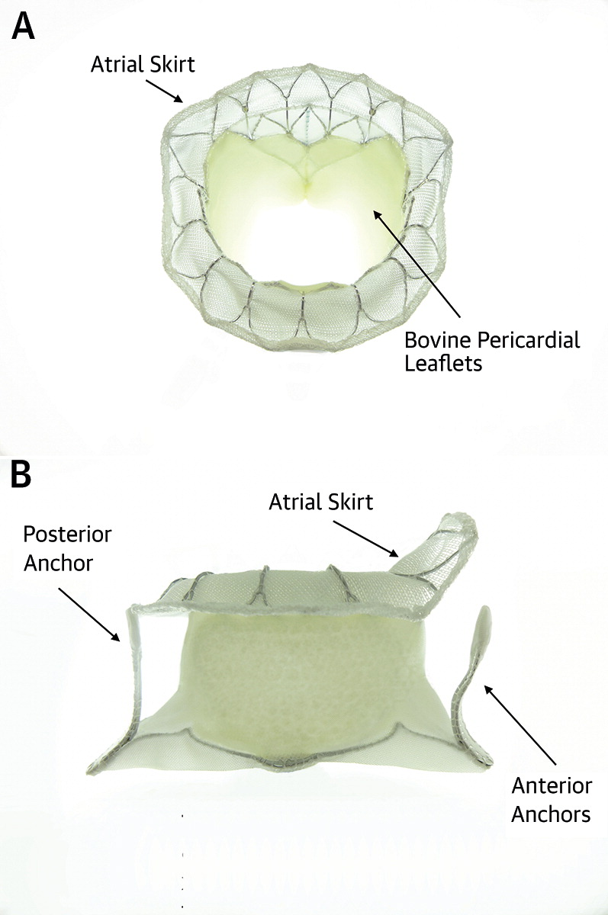
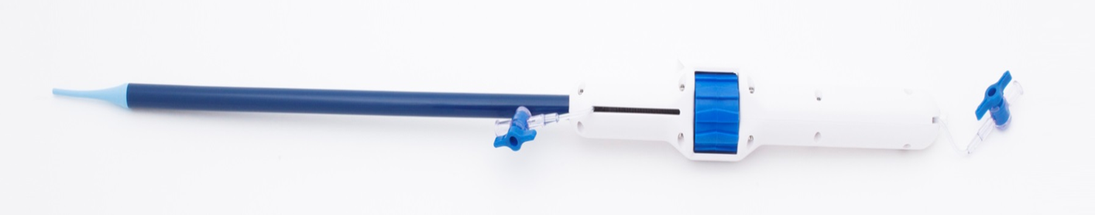
CE Mark for Tiara TA in European Union
Q2 2020 Confirmed CE Mark application to be evaluated under Medical Device Directive
Unique D Shape fits anatomical shape of native valve
Designed to minimize risk of LVOT obstruction
35 mm (32 Fr delivery system) and 40 mm (36 Fr delivery system) sizes in investigational studies

Slide 22
Tiara TA Procedural Outcomes
Study | Procedural Mortality | Successful Access, Delivery, and Retrieval of Delivery System | Successful Deployment and Correct Positioning of Valve | Freedom from Emergency Surgery/ Reintervention Related to Device or Access Procedure
Overall (N=79) | 0.0% (0/79) | 97.5% (77/79) | 92.4% (73/79) | 93.7% (74/79)
TIARA-I (N=25) | 0.0% (0/25) | 100% (25/25) | 92% (23/25) | 92% (23/25)
TIARA-II (N=32) | 0.0% (0/32) | 93.8% (30/32) | 90.6% (29/32) | 93.8% (30/32)
Compassionate Use (N=22) | 0.0% (0/22) | 100% (22/22) | 95.5% (21/22) | 95.5% (21/22)
* Data Cut-off 25Oct2019
Conradi, L. PCR e-course Transcatheter Mitral Valve Implantation with Tiara: Transapical Results and Transseptal Design. June 2020

Slide 23
MR Resolution for TIARA-I and TIARA-II
* Data Cut-off 25Oct2019
Conradi, L. PCR e-course Transcatheter Mitral Valve Implantation with Tiara: Transapical Results and Transseptal Design. June 2020

Slide 24
NYHA Improvement for TIARA-I and TIARA-II
* Data Cut-off 25Oct2019
Conradi, L. PCR e-course Transcatheter Mitral Valve Implantation with Tiara: Transapical Results and Transseptal Design. June 2020

Slide 25
NYHA Improvement for TIARA-I and TIARA-II
* Data Cut-off 25Oct2019
Conradi, L. PCR e-course Transcatheter Mitral Valve Implantation with Tiara: Transapical Results and Transseptal Design. June 2020

Slide 26
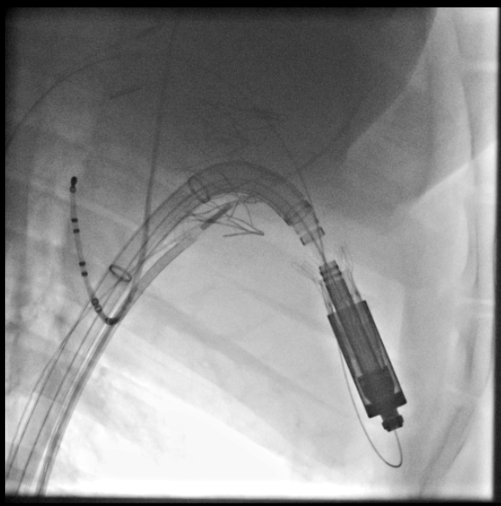
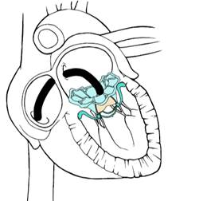
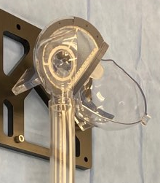
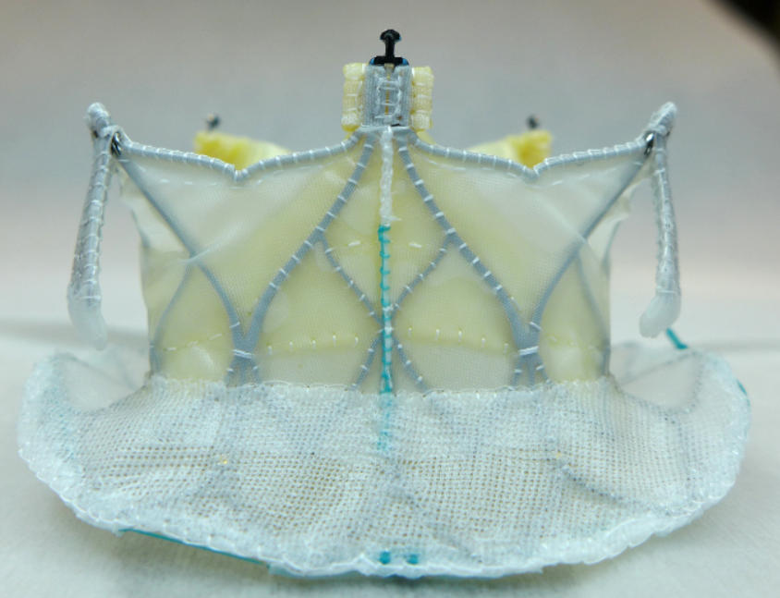
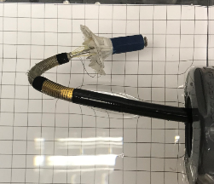
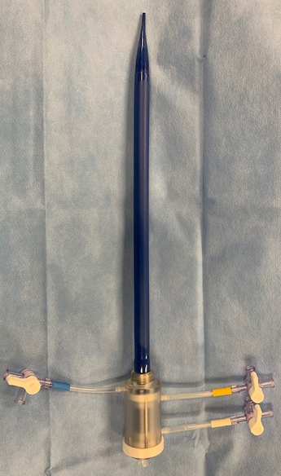
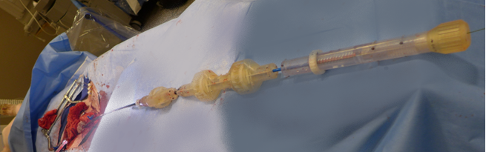
Tiara TF Development
Tiara TF design focus:
      Retrievability – until the point for final release
      D Shape – to minimize left ventricular outflow tract (LVOT) obstruction
      Low Profile valve and delivery system
      Expand the pool of treatable patients – delivery system and valve sizes
      First human implant anticipated in 1H 2021

Slide 27
Tiara Milestones
1H 2020
1H 2020
1H 2021
1H 2021
Tiara TF Design Freeze
Tiara TA CE Review Under MDD
Targeted Tiara TA CE Mark Decision
Targeted Tiara TF First-in-Human

Slide 28
In Summary

Slide 29
Neovasc Financials
Key statistics
May 2019 Note convert at $7.50 | $7.9M
May 2020 Note convert at $2.82 | $5.0M
Issued & Outstanding | 22.1M
– Fully diluted (1) | 37.3M
- Warrants | 9.5M
- Incentive SOPs and RSUs | 2.8M
Cash on hand is expected to last until at least end of Q1 2021
Outstanding notes held by a single note holder
Improved capital structure and clean balance sheet
(1) assuming all notes and warrants are fully converted and exercised and without giving effect to the PIK interest

Slide 30
Summary
Organizational Momentum Targeting Large Underserved Markets
4 Step Value Creation Strategy:
  Reducer EU revenue & therapy development
  Reducer US FDA strategy
  Tiara TA CE Mark in EU
  Tiara TF First in Human
Sufficient cash on hand to reach milestones

Slide 31
Thank you!
022006-MKT Rev A (2020-08)

