Slide 1

DSOA ​
INNER
CIRCLE
Justin Krane, CFP®​
​

Slide 2
TODAY
This presentation is for informational and educational purposes only and should not be considered as a solicitation or
offer to purchase or sell any securities. The financial strategies and guidelines discussed during this presentation may
not be appropriate for everyone, as each individual circumstance is unique.

Slide 3
Cash
TODAY
Investments
Other Assets
Real Estate
Your Business? Sellable?

Slide 4
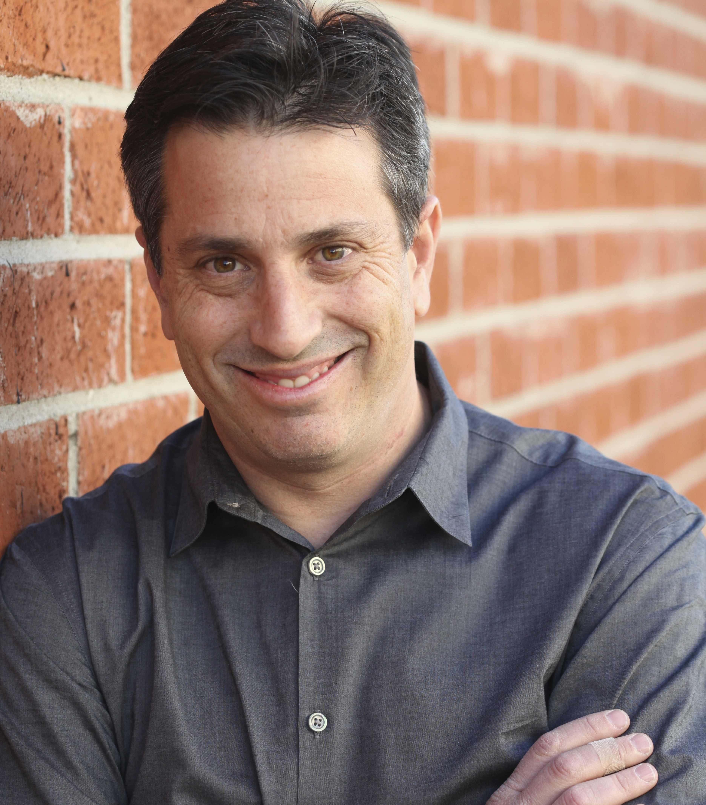

FINANCIAL ADVISOR​
CFP®️
Manage $100 million+

Slide 5
MY THREE QUESTIONS

Slide 6

FINANCIAL
LIFE PLANNING​

Slide 7
money
YOUR GOALS
life

Slide 8
Where Am I Today? ​
Where Do I Want to Be?​
What Do I Need To Do To Get There?​
Am I Willing To Do It?

Slide 9
Cash
TODAY
Investments
Other Assets
Real Estate
Your Business? Sellable?

Slide 10
Savings Account
5 YEARS OR LESS

Slide 11
Investments
OVER 5 YEARS

Slide 12
Compounding of Interest

Slide 13
Invest $10,000 NOW
& $500 a month
Make 6% Per Year

Slide 14
Wait Ten Years

Slide 15
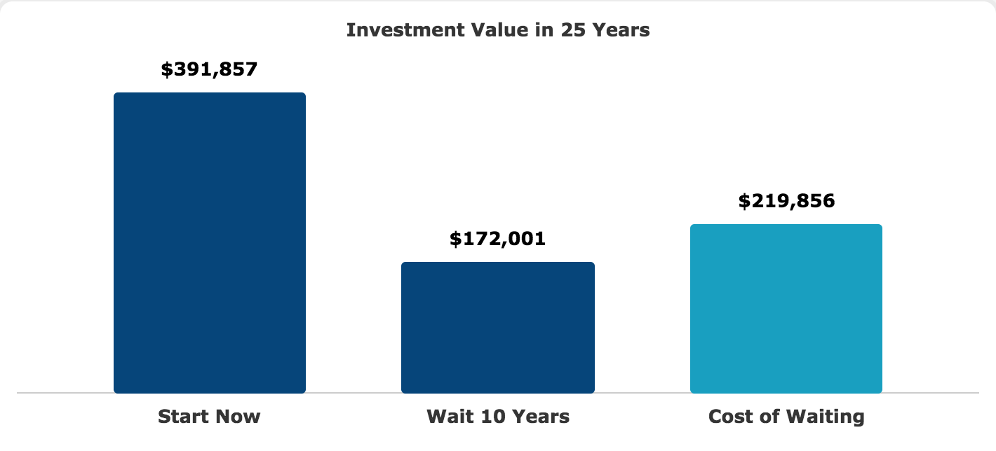

Slide 16


Slide 17


Slide 18


Slide 19
Mutual Funds
Real Estate
Your Business?

Slide 20
IRA vs. Roth IRA
RETIREMENT ACCOUNT

Slide 21
AUTOMATION​

Slide 22
Personal Checking
Automatic Transfer
from Business Checking to

Slide 23
Investment Account
Automatic Transfer
from Personal Checking to
What else?
Credit Card
Mortgage

Slide 24
RETIREMENT PLANNING​

Slide 25
TODAY
The tools presented during this presentation were presented for educational and informational purposes only and
were not intended as a solicitation to buy, sell or transact in any security. There is no guarantee of obtaining the results
discussed as each individual circumstance is different. Past performance is no indication of future results and individual
results may vary.
Please consult your attorney, tax advisor or financial professional for any of your
individual legal, tax or financial questions.

Slide 26
justin@kranefinancialsolutions.com
www.kranefinancialsolutions.com

