Slide 1

The Maryland P³ (Patients Pharmacists Partnerships) ProgramTM
A cost effective solution to patient-centered health education, medication adherence, and chronic disease management

Slide 2
The Maryland P³ (Patients Pharmacists Partnerships)TM Program
FOR MORE INFORMATION •
The P ³ Program Office
Center for Innovative Pharmacy Solutions
Department of Pharmacy Practice and Science
University of Maryland School of Pharmacy
20 N. Pine St., Fourth Floor
Baltimore, MD 21201
Telephone: 410-706-5194/Fax: 410-706-0754
The P³ Program is a collaboration of the University of Maryland School of Pharmacy, the Maryland General Assembly, the Maryland Department of Health and Mental Hygiene and the Maryland Pharmacists Association.

Slide 3
The History
This pharmacist-delivered chronic disease management initiative arose out of an effort to improve patient health and reduce employer health care costs
Began in 2006 with one employer in Western Maryland
Now serving 6 employers and over 400 employees
Over 300 Pharmacists trained

Slide 4
Maryland P³ Program
(Patients, Pharmacists, Partnerships)
Maximizes the role of the pharmacist (medication expertise)
Pharmacists serving as “coaches” to stress self-management education
Delivery system design
(aligned incentives, convenient location)
Decision support working collaborative with the patient’s physician and other health care providers
Data Collection System-MedPath
Notes:
I want to elaborate on the P3 program for just a minute, because this model addresses multiple aspects of the chronic care model. Specifically, it includes the patient self management education, which is conducted by specially trained pharmacists. As Lydia’s data presentation mentioned, only in 2006, 58% of persons with diabetes reported they had taken a class on diabetes self-management. Access to patient self management education is a challenges in many areas of the state, especially rural jurisdictions.
The delivery system design is address by providing this PSME at work sites. As other worksite wellness programs have demonstrated, providing services in worksites overcomes access issues related to transportation and time.
The decision support is re-enforced by the patient-self management education and the feedback loop to the primary care providers. Within the Asheville project model and the P3 program, there is a purposeful communication between the PCPs office and the pharmacist.
The information technology is enhanced through the software system utilized by the P3 pharmacists.

Slide 5
The P³ Pharmacist
Meets with the patient 4-7 times annually depending on the
patient’s needs
Assesses the patient’s knowledge and understanding of his/her chronic illness and medication regimen including:
  Importance of medication adherence
  Possible drug interactions, as well as adverse effects
  Importance of preventive care
Helps the patient set personal goals (therapeutic indicators)
Coordinates referrals for necessary laboratory tests and specialist visits
Provides immunizations for pneumococcal and influenza
Communicates with patient’s primary care provider in order to support continuity of care
American Diabetes Association Clinical Care Guidelines (2007)

Slide 6
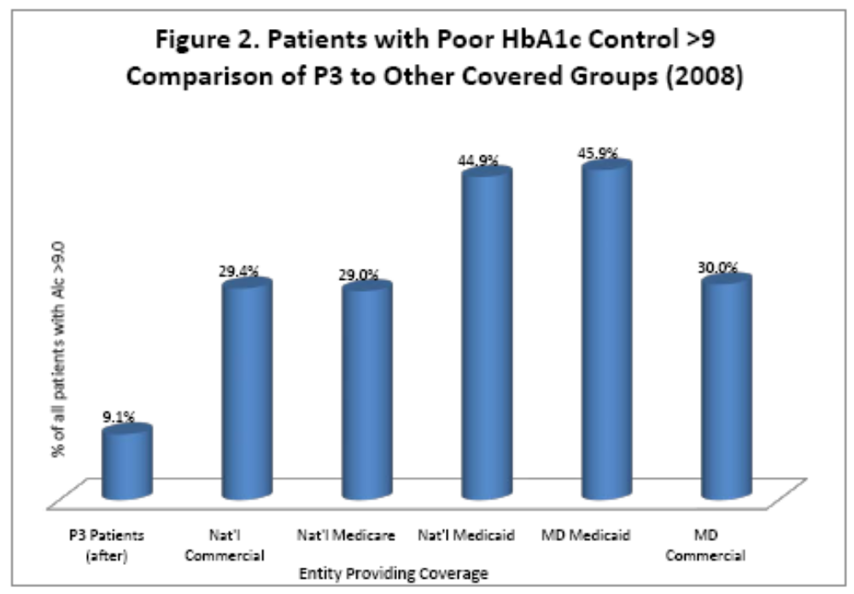

Slide 7
Results

Slide 8
Cost Savings
On average our employers are saving approximately $900 per employee per year ($495-$3,281).

Slide 9

Recipient of the APhA Foundation Pinnacle Award- 2010

