Slide 1

Society for
Maternal – Fetal
Medicine
SMFM Consult Series: Hepatitis C in pregnancy: screening, treatment, and management
Society of Maternal Fetal Medicine with the assistance of Brenna L. Hughes, MD, MSc; Charlotte M. Page, MD; Jeffrey A. Kuller, MD
Notes:
Note that slide text should stay at font size 18 or higher for presentations.

Slide 2
Introduction
Up to 8% of pregnant women are infected with
hepatitis C virus (HCV).
In the United States, the estimated prevalence of antenatal HCV infection is 1-2.5%.
Two primary concerns arise from HCV in pregnancy:
1. Maternal well-being, i.e., the effect of pregnancy on the course of chronic HCV infection.
2. Fetal well-being, namely mother-to-infant transmission of HCV and the impact of maternal infection on pregnancy outcomes.

Slide 3
Epidemiology: What is the natural course of HCV infection?
Acute:
The first 6 months after exposure to HCV.
Asymptomatic in 75% of cases; when symptoms occur, they include abdominal pain, nausea, anorexia, jaundice, or malaise.
15% of infected individuals spontaneously clear HCV within 6 months of infection.

Slide 4
Epidemiology: What is the natural course of HCV infection?
Chronic:
Those who do not clear the virus and harbor it for the rest of their lives.
It accounts for most HCV-associated morbidity and mortality.
Asymptomatic, although it can cause progressive liver damage with serious consequences.
15-30% of patients with chronic HCV infection develop cirrhosis within 20 years.
27% of those with cirrhosis develop hepatocellular carcinoma (HCC) within 10 years.
HCC is a primary cause of mortality from HCV infection.

Slide 5
Epidemiology: What is the impact of pregnancy on chronic hepatitis C?
Alanine aminotransferase (ALT) levels tend to decrease during the second and third trimesters in pregnancies complicated by HCV infection.
HCV RNA levels may increase in infected women during the second and third trimesters of pregnancy.
Hepatocellular damage caused by chronic HCV infection is thought to be immune-mediated.
Down-regulation of the maternal immune response in pregnancy → reduce the amount of hepatocellular damage caused by HCV, which would also account for the decrease in ALT levels.
Data concerning the impact of pregnancy on the progression of liver fibrosis remains controversial and unclear. (next)

Slide 6
(Continued) Epidemiology: What is the impact of HCV on pregnancy outcomes?
HCV infection is associated with adverse pregnancy outcomes.
Infants born to women infected with HCV were more likely to be small for gestational age, have low birthweight, require admission to the neonatal intensive care unit, and require assisted ventilation.
HCV-infected women were more likely to deliver infants with poor birth outcomes, including preterm birth, low birthweight, and congenital anomalies.
Meta-analysis: maternal HCV infection was significantly associated with fetal growth restriction (odds ratio, 1.53; 95% confidence interval, 1.40-1.68) and low birthweight (odds ratio, 1.97; 95% confidence interval, 1.43-2.71).
(next)

Slide 7
(Continued) Epidemiology: What is the impact of HCV on pregnancy outcomes?
Infants born to HCV-infected women were more likely to have feeding difficulties and other adverse neonatal outcomes, including cephalohematoma, brachial plexus injury, fetal distress, intraventricular hemorrhage, or neonatal seizures.
Pregnant women with HCV have a significantly higher incidence of this disease-the overall incidence of ICP in the general obstetric population is 0.2-2.5%, while the odds of developing ICP are 20-fold higher in HCV-infected pregnant women.

Slide 8
Epidemiology: What is the rate of vertical transmission of HCV?
Vertical transmission of HCV is the leading cause of HCV infection in children.
One-third to one-half of mother-to-child transmission of HCV appears to occur in utero prior to the last month of pregnancy, the remainder is thought to occur either in the last month of pregnancy or during delivery.
In HIV-negative women with chronic HCV infection the risk of vertical transmission was 5.8%.
The risk of vertical transmission in HIV-positive women was almost doubled, at 10.8%.
Whether the level of HCV viremia correlates with the risk of transmission has yet to be determined.

Slide 9
Screening: Who should be screened for HCV during pregnancy?
We recommend that obstetric care providers screen women who are at increased risk for HCV by testing for anti-HCV antibodies at their first prenatal visit.
If initial results are negative, HCV screening should be repeated later in pregnancy in women with persistent or new risk factors for HCV infection (e.g., new or ongoing use of injected or intranasal illicit drugs) (GRADE 1B).
Without data that universal screening is cost-effective and without currently approved treatments for HCV in pregnancy, we concur with ACOG and the CDC in recommending against universal screening during pregnancy at this time.
(next)

Slide 10
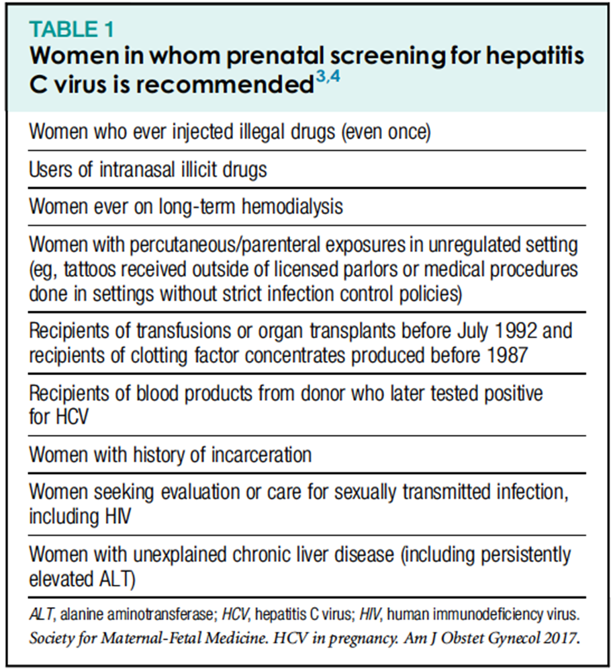
(continued)
Screening: Who should be screened for HCV during pregnancy?

Slide 11
Screening: What is the ideal screening test for HCV?
Diagnosis of HCV infection depends on detection of anti-HCV antibodies and HCV RNA.
Anti-HCV antibodies usually develop 2-6 months after exposure during the acute phase of infection and persist throughout life.
A positive antibody test: Active HCV infection (acute or chronic), or past infection that has resolved, or false positive.
If positive →a quantitative nucleic acid test for HCV RNA.
(next)

Slide 12
(continued)
Screening: What is the ideal screening test for HCV?
HCV viremia, i.e., the presence of HCV RNA in the blood, indicates active infection and can first be detected 1-3 weeks after exposure.
The recombinant immunoblot assay is no longer available or recommended.
Negative HCV RNA within the past 6 months & is newly found to be viremic, acute HCV infection is confirmed.
No previous testing for hepatitis C tests & positive for both anti-HCV antibodies and HCV RNA→ cannot distinguish acute from chronic HCV infection.
(next)

Slide 13
(continued)
Screening: What is the ideal screening test for HCV?
If the anti-HCV antibody test result is positive and the HCV RNA test result is negative → different antibody assay platform to distinguish false (+) from true infection.
Woman who may have been exposed to HCV within the last 6 months tests negative for anti-HCV antibodies, HCV RNA testing should be performed because the patient may not yet have seroconverted.
(next)

Slide 14
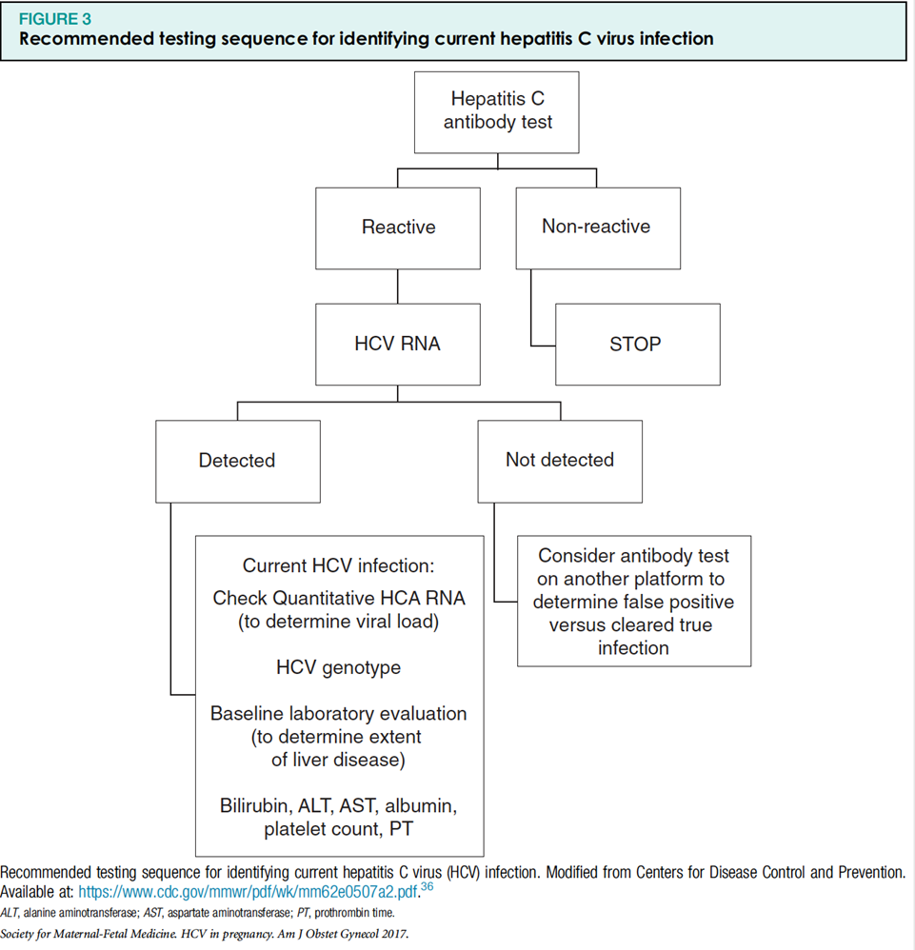
(continued)
Screening: What is the ideal screening test for HCV?

Slide 15
Treatment & Outcomes: Once hepatitis C is diagnosed, what additional evaluation should occur?
For pregnant women with confirmed active HCV infection:
A quantitative HCV RNA test should be done to determine the baseline viral load.
Basic laboratory testing to evaluate the extent of liver disease: bilirubin, ALT, and AST, albumin, platelet count, and prothrombin time and HCV genotype.
We recommend that obstetric care providers screen HCV-positive pregnant women for other sexually transmitted diseases, including HIV, syphilis, gonorrhea, chlamydia, and hepatitis B virus (HBV) (GRADE 1B).

Slide 16
Treatment & Outcomes: What are the principles of medical management of HCV ?
Referral to hepatologist or infectious disease specialist experienced in the management of hepatitis to establish long-term care.
Different genotypes→ different treatment strategies.
The goal of treatment is to achieve SVR, defined as undetectable HCV RNA 12-24 weeks after completing treatment→ Cure of HCV.
In patients who do not have cirrhosis, SVR is associated with resolution of liver disease.
We suggest that patients with HCV, including pregnant women, be counseled to abstain from alcohol (Best Practice).

Slide 17
Treatment & Outcomes: How is HCV treated in nonpregnant patients?
The standard-of-care treatment for chronic HCV until 2011 was with pegylated interferon (PegIFN)-a and ribavirin→ SVR in only 40-80% of patients despite risks of severe infection, hemolytic anemia, depression, and a flu-like syndrome.
In 2011, DAA medications were released; directly inhibit the replication cycle of HCV through 1 of 3 targets: NS3/4A protease, NS5A protein, and NS5B RNA-dependent polymerase.
Second-generation DAA medications: dasabuvir, sofosbuvir, paritaprevir, grazoprevir, simeprevir, daclatasvir, ledipasvir, elbasvir, ombitasvir, and velpatasvir.

Slide 18
Treatment & Outcomes: Should HCV be treated pharmacologically during pregnancy?
None of the antiviral therapies recommended for HCV infection are currently approved for use in pregnant women.
Ribavirin is contraindicated in pregnancy (embryocidal and/or teratogenic effects in all animal species studied).
Ribavirin can persist in nonplasma compartments for up to 6 months ( FDA recommends pregnancy should be avoided in women taking ribavirin as well as in female partners of male patients taking ribavirin until 6 months after completing therapy.
At least 2 forms of effective contraception be used during treatment (of either the male or female partner) and for 6 months afterwards to prevent pregnancy.
(next)

Slide 19
(continued) Treatment & Outcomes: Should HCV be treated pharmacologically during pregnancy?
Due to the lack of human studies, no DAA therapy has yet been approved to treat HCV infection in pregnancy.
The FDA has not categorized most of these drugs in terms of pregnancy safety.
Although limited animal data are available, sofosbuvir and ombitasvir/paritaprevir/ritonavir have not been demonstrated to confer a risk to the fetus.
Simeprevir has shown fetal toxicity in animal studies.
(next)

Slide 20
(continued) Treatment & Outcomes: Should HCV be treated pharmacologically during pregnancy?
Ribavirin free DAA regimens for use in pregnancy should be actively researched.
A phase I trial is underway to test the pharmacokinetics and safety of ledipasvir plus sofosbuvir for treatment of chronic HCV infection during pregnancy (Clinicaltrials.gov: NCT02683005). The projected completion date of this study is September 2018.
We recommend that DAA regimens only be used in the setting of a clinical trial or that antiviral treatment be deferred to the postpartum period as DAA regimens are not currently approved for use in pregnancy (GRADE 1C).
(next)

Slide 21
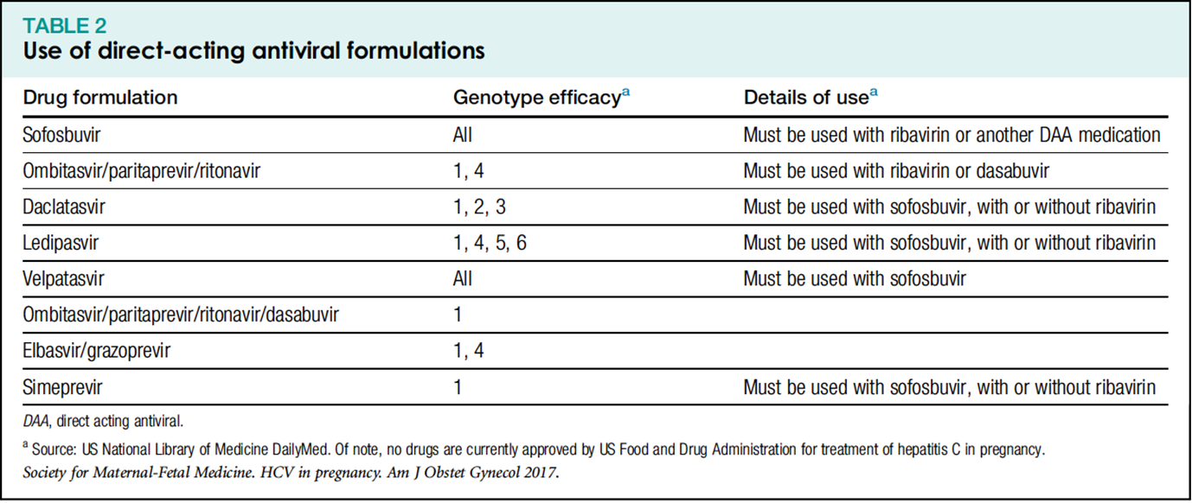
(continued) Treatment & Outcomes: Should HCV be treated pharmacologically during pregnancy?

Slide 22
Methods to reduce maternal-fetal transmission: Is invasive prenatal diagnostic testing safe in pregnant women with HCV?
We suggest that if invasive prenatal diagnostic testing is requested, women be counseled that data on the risk of vertical transmission are reassuring but limited; amniocentesis is recommended over chorionic villus sampling given the lack of data on the latter (GRADE 2C).

Slide 23
Methods to reduce maternal-fetal transmission: Does mode of delivery affect the risk of vertical transmission?
There was no statistically significant difference in the risk of vertical transmission according to mode of delivery (all observational):
Cottrell et al published a systematic review in 2013 that included 14 studies.
Two good-quality studies specifically compared elective cesarean delivery before the onset of labor with vaginal or emergent (after onset of labor) cesarean delivery.
2011 meta-analysis of studies on HCV vertical transmission by mode of delivery.
We recommend against cesarean delivery solely for the indication of HCV (GRADE 1B).

Slide 24
Does labor management affect the risk of vertical transmission?
Several factors in labor management may be associated with an increased risk of vertical transmission of HCV:
Prolonged rupture of membranes, internal fetal monitoring, and episiotomy.
One study reported that membrane rupture for >6 hours was associated with increased risk of vertical transmission.
Another study showed that median duration of ROM was longer in women who transmitted HCV to their infants (28hrs versus 16hrs).
(next)

Slide 25
(continued) Does labor management affect the risk of vertical transmission?
A retrospective study including 710 HCV-infected women and a prospective study including 242 HCV-infected women both reported that internal fetal monitoring was associated with increased risk of transmission compared with no internal monitoring.
In contrast, a retrospective study with 724 women found no association.
One of these studies also found that episiotomy was significantly associated with an increased risk of vertical transmission.
(next)

Slide 26
(continued) Does labor management affect the risk of vertical transmission?
(next)
We recommend that obstetric care providers avoid internal fetal monitoring, prolonged rupture of membranes, and episiotomy in managing labor in HCV-positive women (GRADE 1B)*.
We also recommend that obstetric care providers avoid early amniotomy and episiotomy in managing labor in HCV-positive women.
Expectant management of ruptured membranes should be avoided at term and patients with ruptured membranes at term should be actively managed in labor.
*Unless it is unavoidable in the course of management (e.g., when unable to trace the fetal heart rate with Doppler and the alternative is proceeding with cesarean delivery).

Slide 27
Postnatal issues related to HCV: Is breastfeeding safe in HCV-positive mothers?
The Cottrell et al systematic review included 14 cohort studies examining breast-feeding and HCV transmission, and none found a significant association.
CDC recommends that women abstain from breastfeeding if their nipples are bleeding or cracked.
We recommend that obstetric care providers not discourage breastfeeding based on a positive HCV infection status (GRADE 1A).

Slide 28
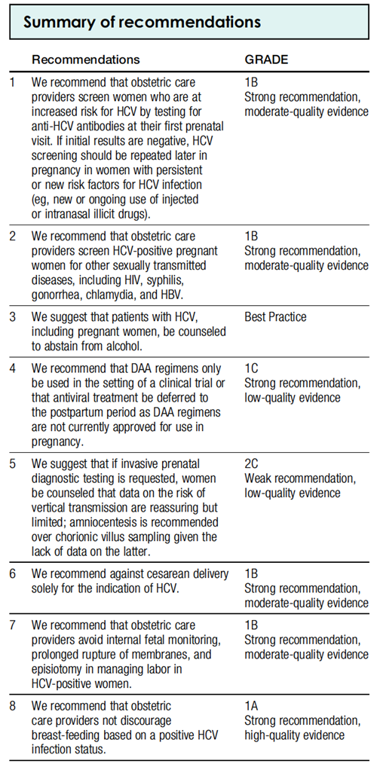
SMFM Recommendations

Slide 29
Disclaimer
The practice of medicine continues to evolve, and individual circumstances will vary. This opinion reflects information available at the time of its submission for publication and is neither designed nor intended to establish an exclusive standard of perinatal care. This presentation is not expected to reflect the opinions of all members of the Society for Maternal-Fetal Medicine.
These slides are for personal, non-commercial and educational use only

