Slide 1
SMFM Consult Series #40
The role of routine cervical length screening in selected high- and low-risk women for preterm birth prevention
Society of Maternal Fetal Medicine with the assistance of Jennifer McIntosh, MD; Helen Feltovich, MD;
Vincenzo Berghella, MD; Tracy Manuck, MD
Published in AJOG/ 09/2016

Slide 2
Introduction
Worldwide 15 million babies are born too early causing 1.1 million deaths.
The majority (two thirds) of preterm births (PTB) are spontaneous, and recurrence risks are high
History of a prior spontaneous PTB is historically the strongest risk factor for spontaneous PTB
Transvaginal cervical length (CL) measurement is an important clinical tool to identify women at high risk for preterm birth in order to allow for interventions to prevent, delay, or prepare for PTB

Slide 3
What is the clinical significance of a sonographically short cervix?
History of preterm birth accounts for only 10% of all birth before 34 weeks of gestation
Mid-trimester CL assessment by transvaginal ultrasound is the best clinical predictor of spontaneous PTB
The threshold chosen in clinical practice as “short” ranges from 20 to 30mm
Women with the shortest CL have the highest risk of prematurity
The finding of a short CL, irrespective of prior pregnancy history, has been consistently and reproducibly associated with an elevated risk of spontaneous PTB across different gestational age cutoffs and multiple patient populations.
Women with a history of a prior spontaneous PTB and a short CL are at the highest risk

Slide 4
Should the cervical length be evaluated by transabdominal or transvaginal ultrasound?
Transvaginal ultrasound is considered the ‘gold standard’
Transvaginal ultrasound measurements are highly reproducible, and measurements are unaffected by maternal obesity, cervical position, and shadowing from fetal parts
Transvaginal ultrasound is also more sensitive
Transvaginal ultrasound is safe, and when performed by trained operators results are reproducible with a relatively low inter-observer variation rate of 5-10%

Slide 5
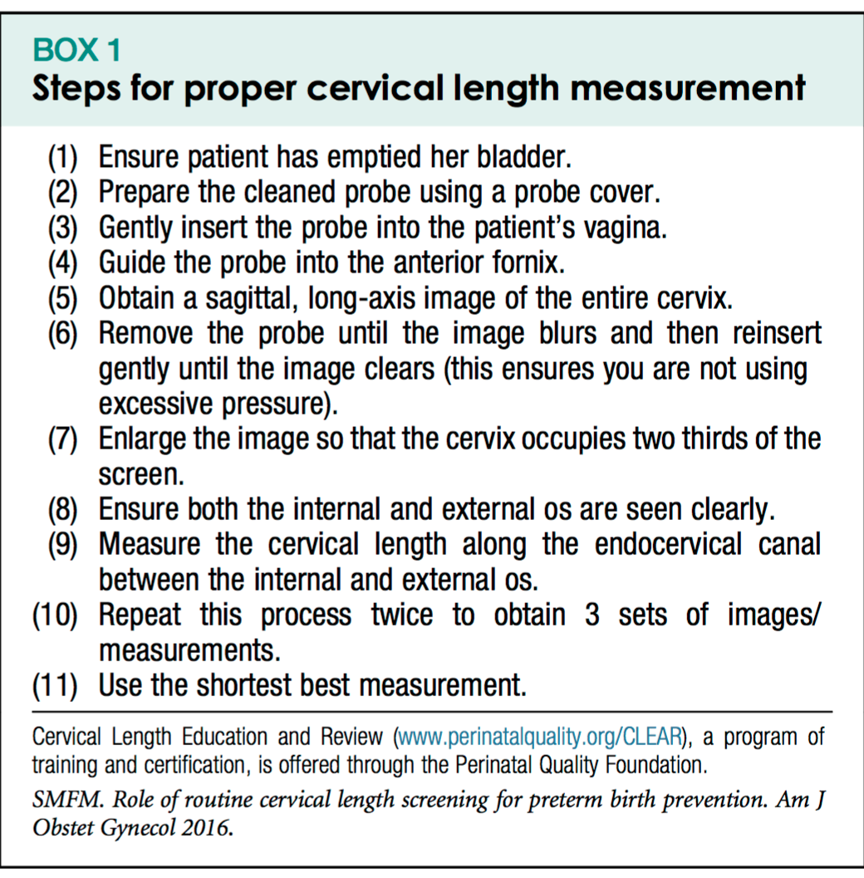
What steps should be performed to accurately evaluate the cervical length?

Slide 6
What steps should be performed to accurately evaluate the cervical length?
SMFM recomends that sonographers and/or prac titioners receive specific training in the acquisition and interpretation of cervical imaging during pregnancy. GRADE 2B
Several training programs are available online, including the Cervical Length Education and Review (CLEAR) program (sponsored by SMFM and its Perinatal Quality Foundation, available at https://clear.perinatalquality.org), and the Fetal Medicine Foundation’s Certificate of Competence in cervical assessment (available at https:// fetalmedicine.org).

Slide 7
If the cervical length is assessed by ultrasound, when during pregnancy should it be evaluated?
The cervix should be assessed between 16 and 24 weeks of gestation
Before 16 weeks of gestation: the lower uterine segment is underdeveloped, making it challenging to distinguish this area from the endocervical canal.
  Not predictive of preterm birth
Routine CL screening is also not advised beyond 24 weeks of gestation, because studies of interventions (e.g., cerclage, vaginal progesterone) have most often used 24 weeks of gestation as the upper gestational age limit for screening and initiation of therapies or interventions

Slide 8
How should the approach to cervical length screening differ for women with and without a prior preterm birth?
Current SMFM and ACOG guidelines recommend women with a prior spontaneous PTB undergo CL screening with transvaginal ultrasound
Serial assessment of CL (every 1-2 weeks as determined by the clinical situation) from 16 until 24 weeks of gestation
SMFM recommends routine transvaginal CL screening for women with singleton pregnancy and history of prior spontaneous PTB. (GRADE 1A)

Slide 9
How should the approach to cervical length screening differ for women with and without a prior preterm birth?
Universal transvaginal ultrasound CL screening of singleton gestations without prior PTB for the prevention of PTB remains an object of debate
CL screening in singleton gestations without prior PTB cannot yet be universally mandated
It can be viewed as reasonable, and can be considered by individual practitioners.
Stretching the criteria and management beyond those tested in RCTs should be prevented
Practitioners who decide to implement universal CL screening should follow strict guidelines (GRADE 2B)

Slide 10
Other Special Situations: Should women with a history of treatment for cervical dysplasia (in the absence of a prior preterm birth) undergo routine serial cervical length screening?
Insufficient evidence to support additional screening for women with a previous electrosurgical procedure (loop electrical excision procedure, LEEP) or cold knife cone for cervical dysplasia.
The increased risk of spontaneous PTB in this population appears related to the history of cervical dysplasia, not the procedure itself
Low-risk women who have undergone treatment for cervical dysplasia or have a history of dysplasia do not require additional evaluation beyond that which would routinely be offered to women without a history of a prior PTB

Slide 11
Other Special Situations: Should women undergo routine cervical length screening after cerclage placement?
Progressive cervical shortening after cerclage increases the risk of PTB, particularly if CL is <10mm; but neither overall CL nor length below the stitch correlate well with outcomes
Importantly, there are currently no additional treatment options for a short cervix after cerclage (e.g. reinforcement suture does not improve outcomes)
Hence, insufficient data to suggest a clinical benefit of routine postcerclage CL measurement or surveillance

Slide 12
Other Special Situations: Should women with multiple gestations undergo routine cervical length screening?
In women with multiple pregnancies, the cervix is shorter and associated with an increased risk of PTB
Various interventions (e.g. progesterone, pessary) are currently being tested in RCT’s for women with multiple gestation and shortened cervix
Routine CL screening in multiple pregnancies is not currently recommended by SMFM

Slide 13
What is the role of cervical length screening to predict preterm birth for women in other clinical scenarios? Threatened preterm labor
FFN does not add to PTB prediction in women with a very short (<20 mm) or long (>30 mm) CL. In these situations FFN may be discarded
In combination with CL screening, FFN may be most useful in women with CL is 20-29 mm (e.g. the “grey zone”); in this situation a “negative test” (~80% of cases) may allow for no treatment while a positive test would suggest the need for intervention (antenatal corticosteroids, transfer to tertiary center, etc)
The routine use of FFN with or without CL screening to detect true PTL in symptomatic women remains controversial (two Level 1 studies showing opposite results)

Slide 14
What is the role of cervical length screening to predict preterm birth for women in other clinical scenarios? Preterm premature rupture of membranes
Conflicting:
  4 studies found shorter CLs to be associated with shorter latencies
  fifth study did not but was powered to assess safety (risk of chorioamnionitis/endometritis, neonatal infection)
CL measurement does not appear to cause harm with PPROM and a shortened cervix is associated with shorter latency, there are insufficient data to suggest a clinical benefit to CL measurement or surveillance

Slide 15
What is the role of cervical length screening to predict preterm birth for women in other clinical scenarios? Placenta Previa
Three studies
All studies used a CL cutoff of 30mm to define the cervix as ‘short,’ and reported that those with a short CL were more likely to have hemorrhage and emergent delivery
Despite the available data, there are no prospective studies testing a management strategy based on CL, and there are insufficient data to suggest a proven clinical benefit of routine CL measurement or surveillance.
We recommend routine transvaginal CL screening not be performed for women with cervical cerclage, multiple gestation, PPROM, or placenta previa. (GRADE 2B)

Slide 16
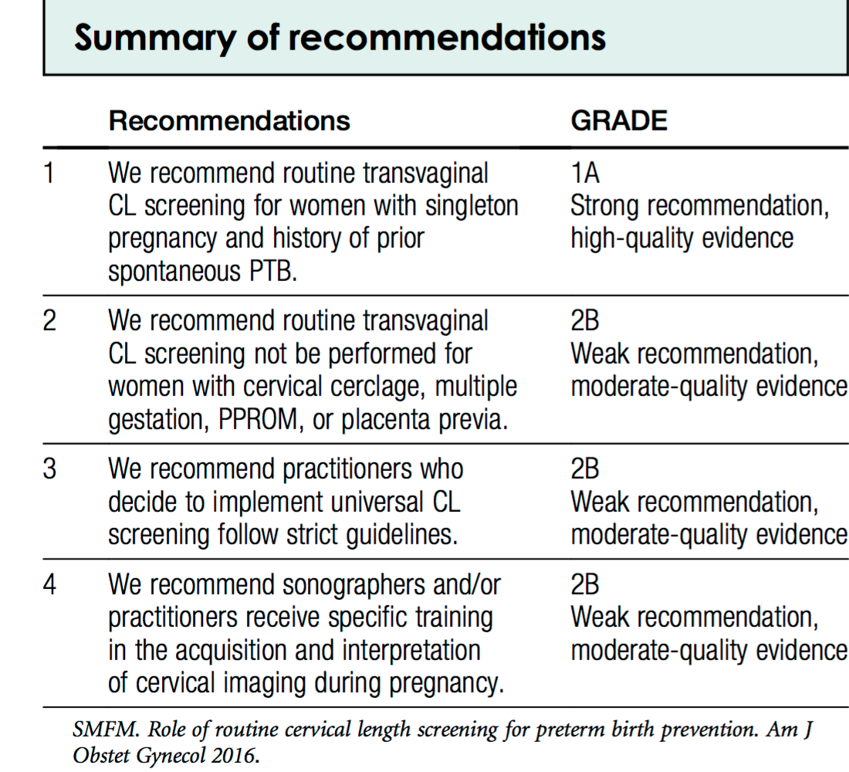
Summary of Recommendations

Slide 17
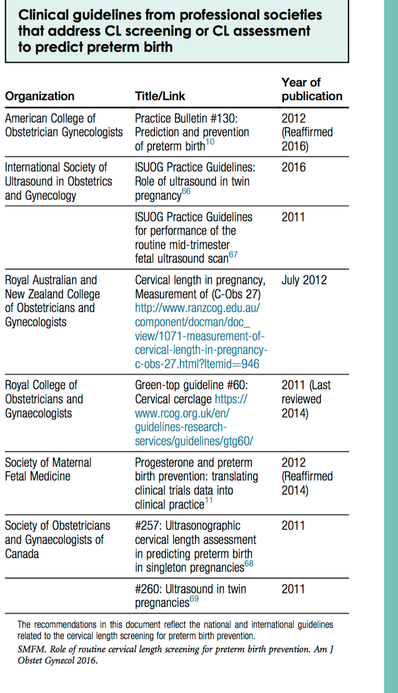

Slide 18
Disclaimer
The practice of medicine continues to evolve, and individual circumstances will vary. This opinion reflects information available at the time of its submission for publication and is neither designed nor intended to establish an exclusive standard of perinatal care. This presentation is not expected to reflect the opinions of all members of the Society for Maternal-Fetal Medicine.
These slides are for personal, non-commercial and educational use only

Slide 19
Disclosures
All authors and Committee members have filed a conflict of interest disclosure delineating personal, professional, and/or business interests that might be perceived as a real or potential conflict of interest in relation to this publication. Any conflicts have been resolved through a process approved by the Executive Board. The Society for Maternal-Fetal Medicine has neither solicited nor accepted any commercial involvement in the development of the content of this publication.

