Slide 1

Teaching the Truth
Implementing the Work of the AAHEC in the Classroom
March 13, 2021
Ed Ayers & Annie Evans
New American History
Follow along: bit.ly/3l3jLpH Curiosity & Innovation Plan: bit.ly/3qDs5gV
Notes:
Post these links in chat:
Slides: https://bit.ly/3l3jLpH
Curiosity Innovation Plan: https://bit.ly/3qDs5gV
Teaching The Truth: Implementing the Work of The African American History Education Commission” in the Classroom

Slide 2

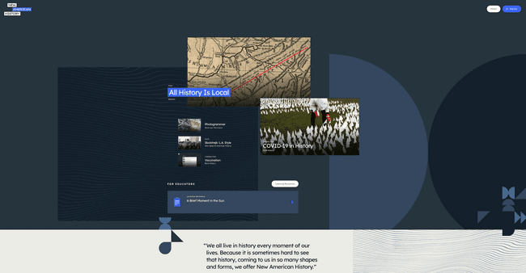
New American History
Notes:
Ed - slides 2-6
Annie will navigate - share screen, please make a co-host

Slide 3
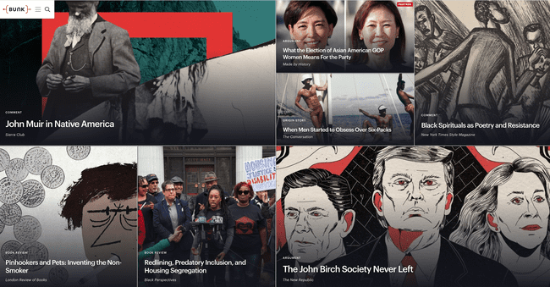
Bunk
Notes:
Bunk

Slide 4
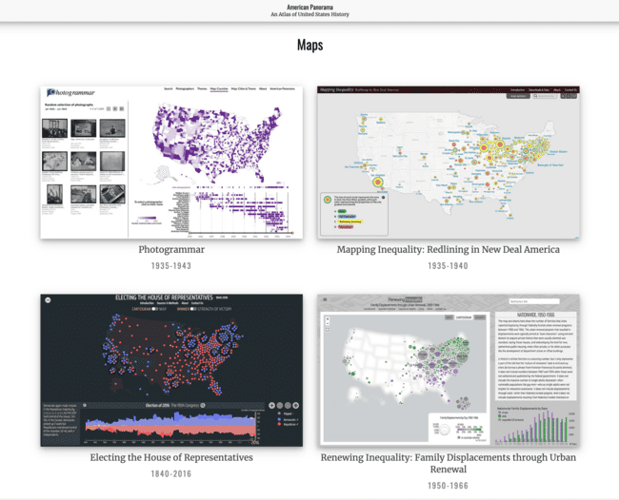
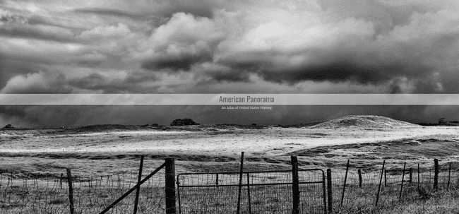
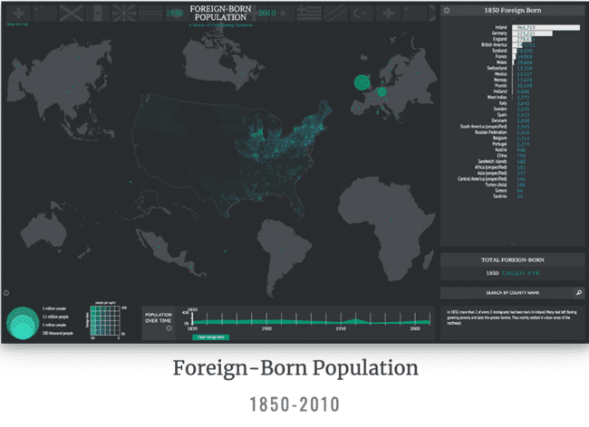
American Panorama
Notes:
American Panorama

Slide 5
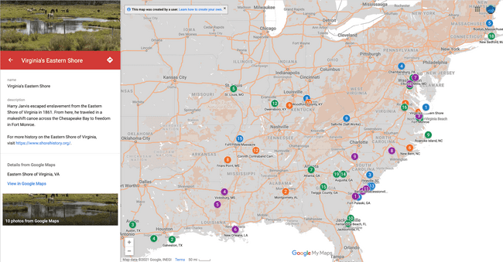
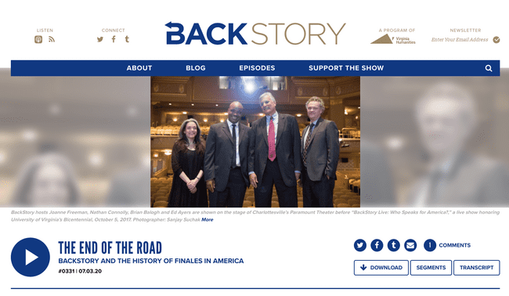

Now playing...
Seizing Freedom
BackStory
Notes:
BackStory
Seizing Freedom

Slide 6


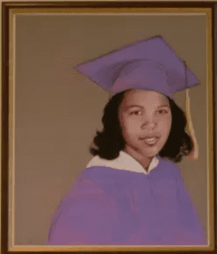
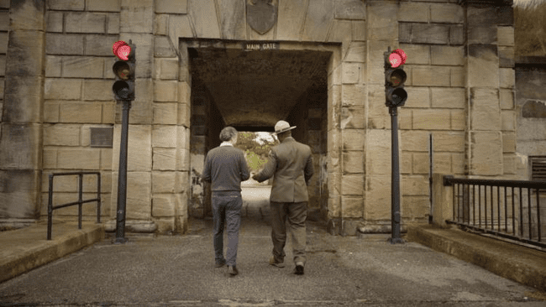
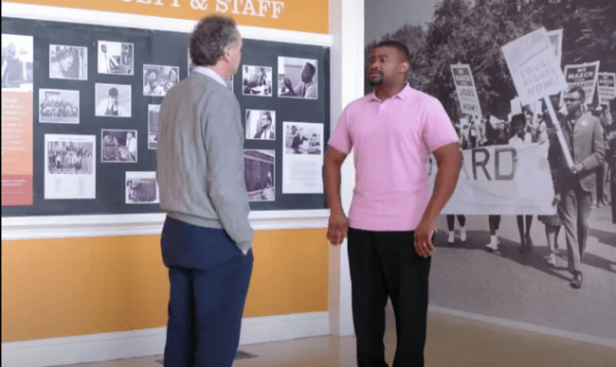
A Public Calamity
The Future of America’s Past
School Interrupted
Freedom’s Fortress
Notes:
The Future of America’s Past

Slide 7
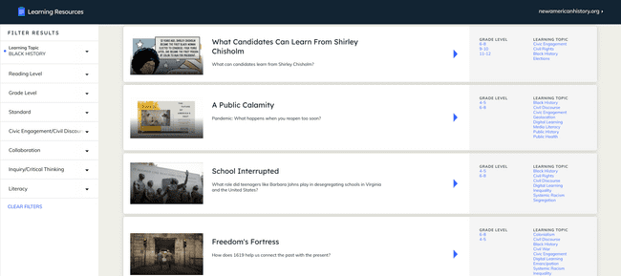
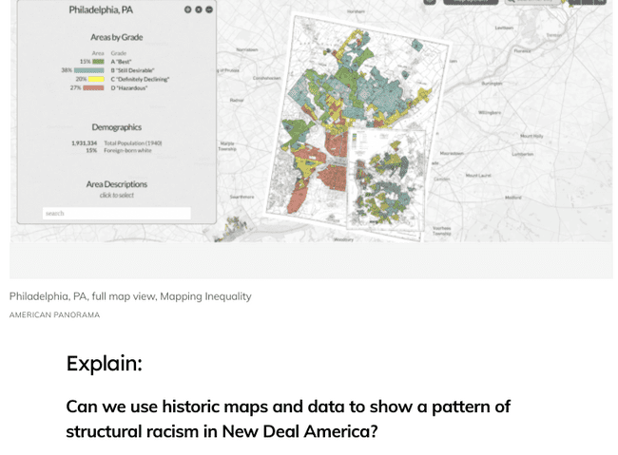
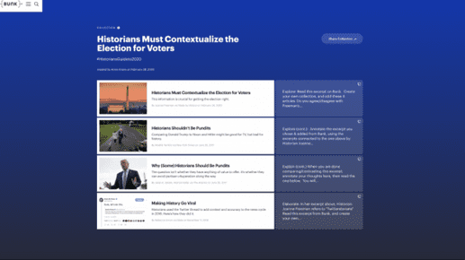
Learning Resources
Notes:
Learning Resources - Annie

Slide 8

Time for a quick poll!
Notes:
Poll Question #1
Which of these topics do you find most challenging to explain to students in the current moment?
cancel culture
fake news
civil discourse
systemic racism
social justice movements

Slide 9
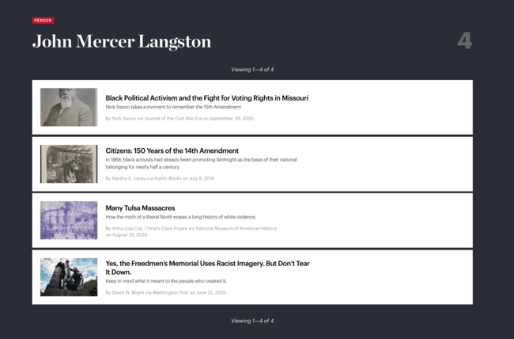
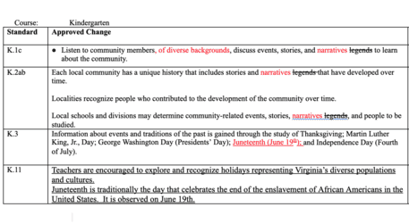
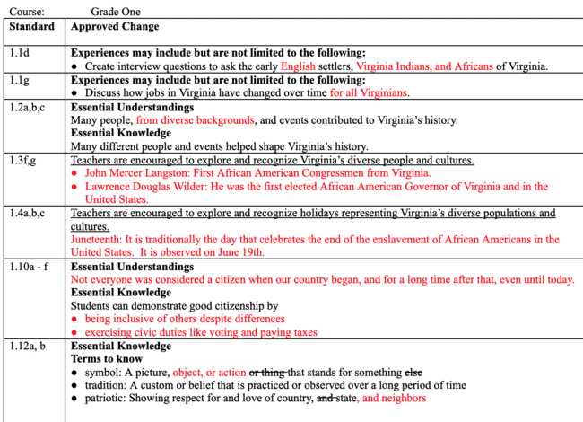
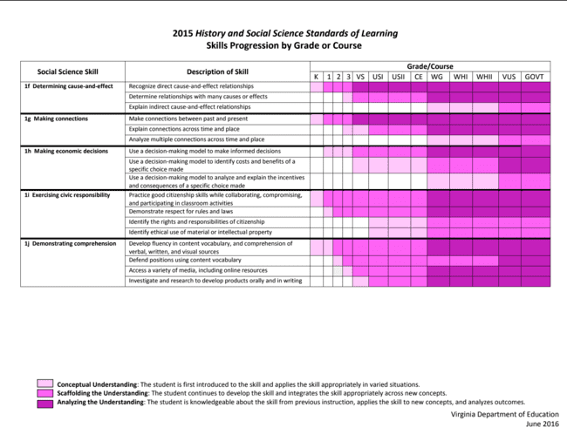
AAHEC Technical Edits
Notes:
Annie - “Littles” set the foundation for K12 H/SS - skills progression chart, other states’ versions, NAH tools / resources help teachers build background knowledge K-3
AAHEC technical edits: VA BOE docs showing changes as adopted - https://www.doe.virginia.gov/boe/meetings/2020/10-oct/agenda-101520.shtml
Updated on VDOE Curriculum frameworks K-12 - https://www.doe.virginia.gov/testing/sol/standards_docs/history_socialscience/index.shtml
Skills Progression: https://drive.google.com/file/d/1SHL37sBUZwpmQKfukxX3DmcaWm0ayQPS/view?usp=sharing
VDOE Culturally Relevant and Inclusive Education Practices Advisory Committee: https://www.virginiaisforlearners.virginia.gov/culturally-relevant-and-inclusive-education-practices-advisory-committee/
https://www.bunkhistory.org/tags/persons/10698
https://www.bunkhistory.org/tags/ideas/2698

Slide 10
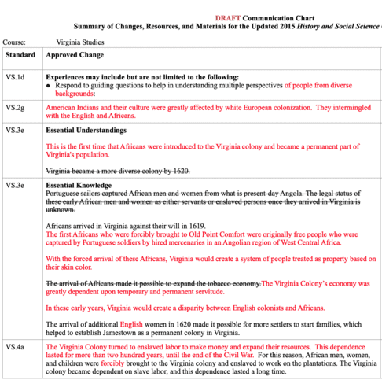
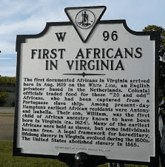
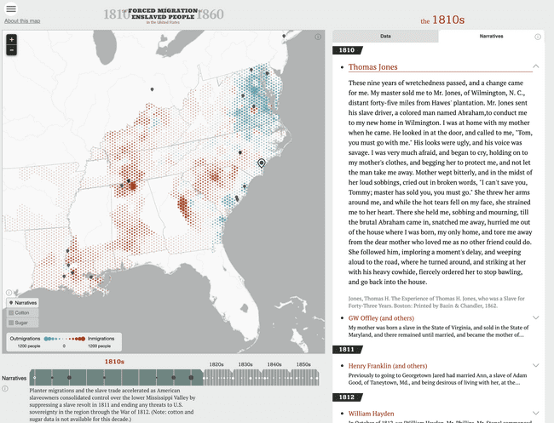
AAHEC Technical Edits
Notes:
Ed, slides 10,11,12,13 -role of historians in the AAHEC and SOL revisions and how our NAH tools/resources support, Annie - skills progression and age appropriateness VS - 4 / 5
https://www.education.virginia.gov/initiatives/aahec/
Updated changes approved and added to the 2015 Curriculum Frameworks
https://resources.newamericanhistory.org/freedom-s-fortress
https://dsl.richmond.edu/panorama/forcedmigration

Slide 11
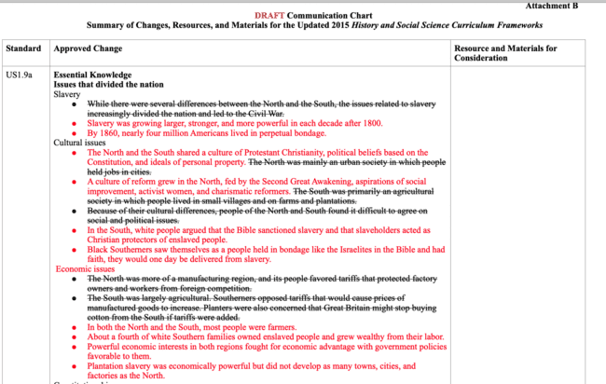
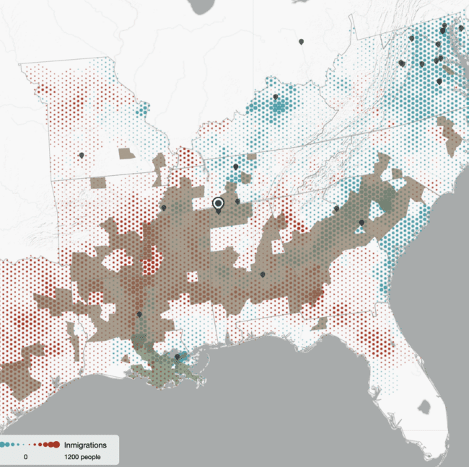
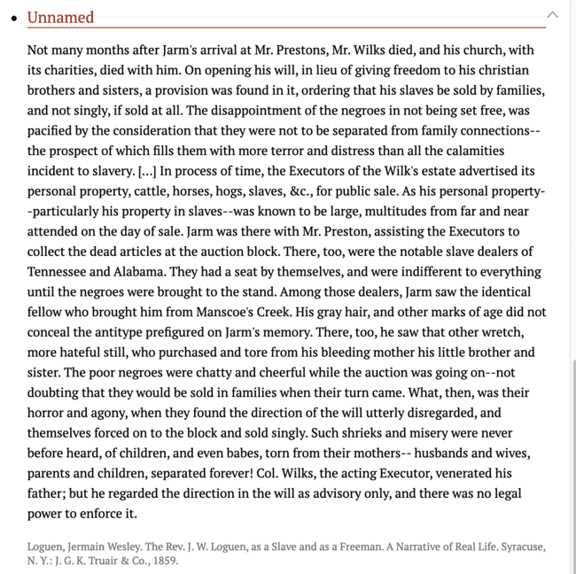

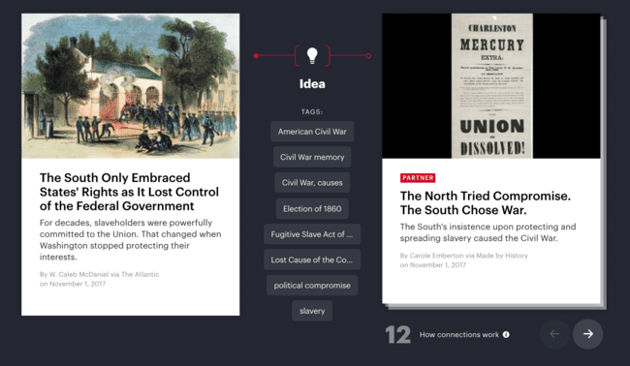
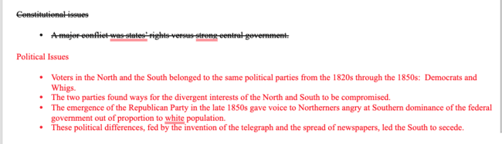
AAHEC Technical Edits
Notes:
Ed
Bunk connection: https://www.bunkhistory.org/resources/1297/connections?type=idea&res=1291 5 /6
Forced Migration, narratives/map:
https://dsl.richmond.edu/panorama/forcedmigration/#tab=2&narratives=true&cotton=true&sugar=true&labels=false&decade=1850&narrative=144&loc=6/-9.601/12.775

Slide 12
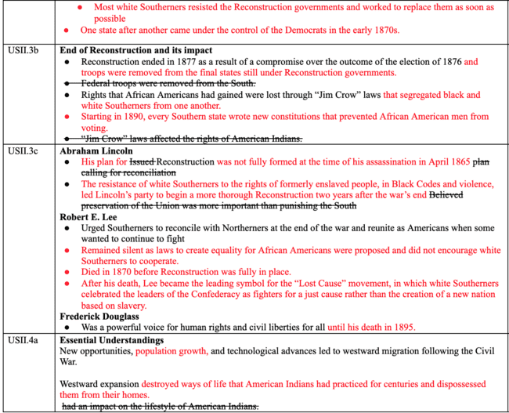

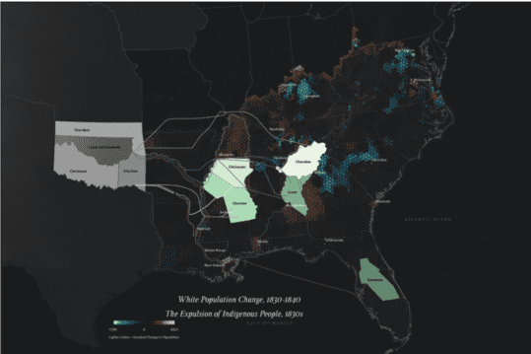
AAHEC Technical Edits
Notes:
Ed 6 /7 /
https://dsl.richmond.edu/southernjourney/
https://www.seizingfreedom.com/

Slide 13
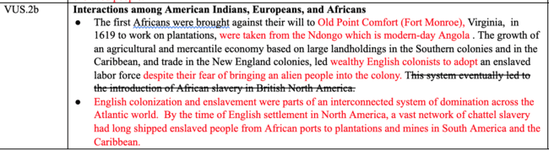
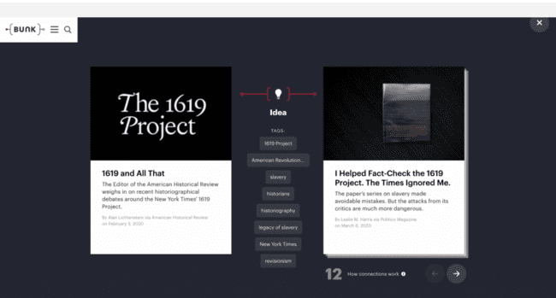
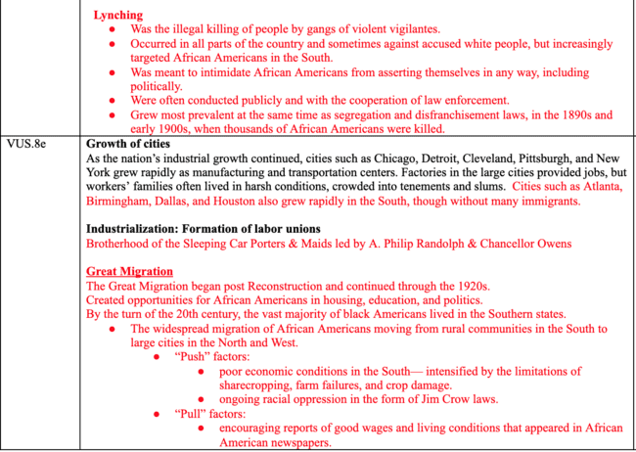
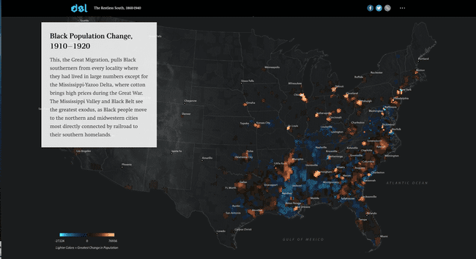
AAHEC Technical Edits
Notes:
https://storymaps.arcgis.com/stories/3623b54371434be0b7612c87b8cc3f1f HS 11
https://www.bunkhistory.org/tags/ideas/4946

Slide 14
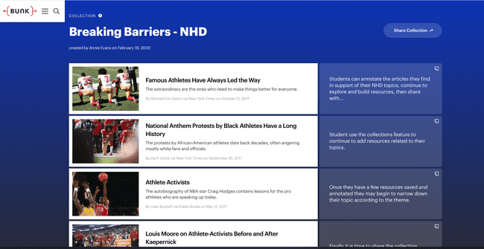
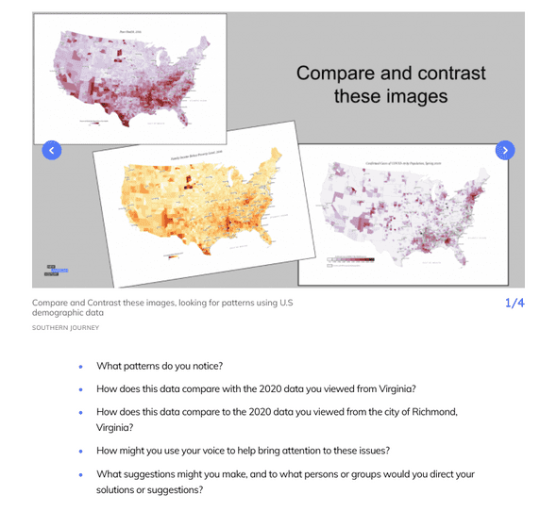
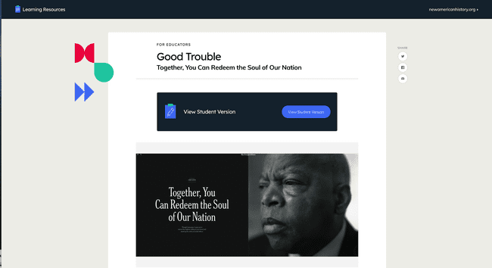
Bunk Collections / Assignments
AAHEC Technical Edits
Inquiry / Take Action step /Good Trouble
Notes:
Annie - using NAH tools/resources - flexibility, options, 5 Es, inquiry
Bunk Collections / Assignments : https://www.bunkhistory.org/collections
Learning Resources: https://learn.newamericanhistory.org/

Slide 15
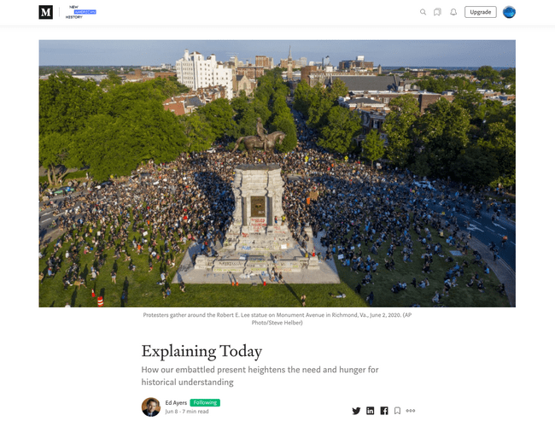
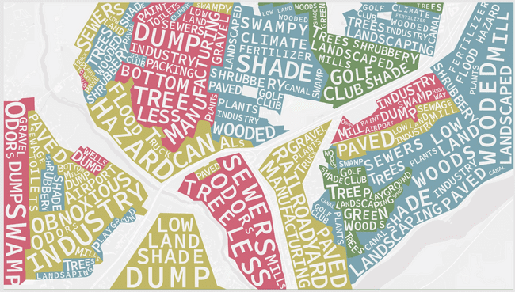
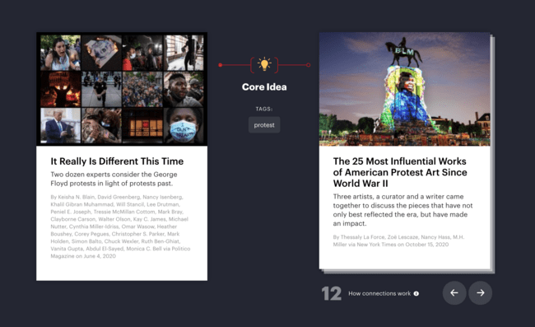
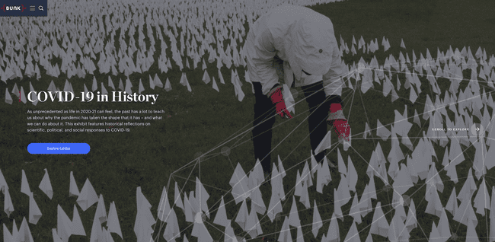
AAHEC Technical Edits
Notes:
Ed -Explaining Today …. Removal of Confederate monuments, BLM protests, Jan. 6, there will always be controversy as we relate past/present
Explaining Today - follow us on Medium
Bunk connection: https://www.bunkhistory.org/resources/6124/connections?type=idea&res=6939
Not even past … : https://dsl.richmond.edu/socialvulnerability/
The lines that shape our cities - climate justice map: /ow.ly/dkGa50CRkPS
Bunk exhibit - COVID-19 in History: https://www.bunkhistory.org/exhibits/36

Slide 16
What are your ideas for using New American History tools/resources in your teaching?
What potential challenges/barriers do you anticipate will need to be tackled as you begin this work in your classroom, school, community?
How could New American History resources support integration of the AAHEC tech edits as a way to deepen students' understandings? What’s possible?
Add your answers to the chat and use your copy of the Anti-Racist Teacher Curiosity and Innovation Plan
Notes:
Annie facilitates whole group discussion -

Slide 17

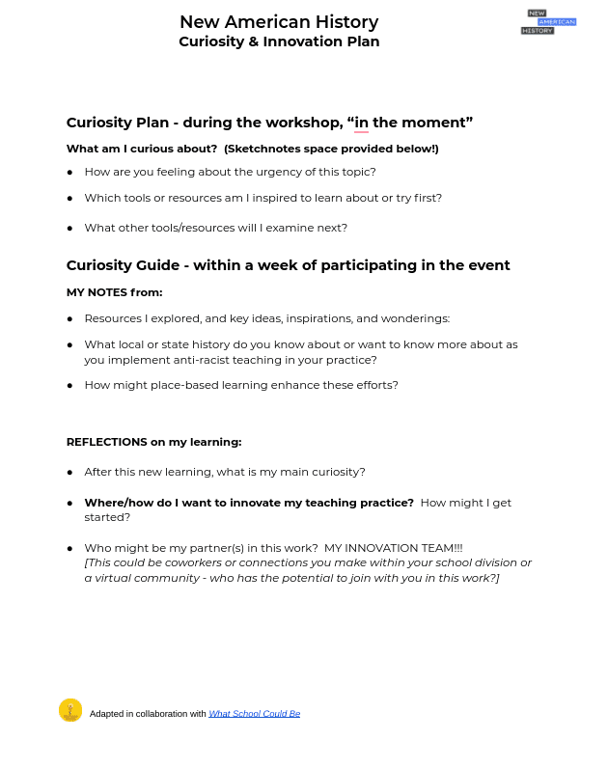
Next Steps for Our Work Together...
Notes:
Annie - how to use the Curiosity and Innovation plan moving forward - build you innovation team !!
Add calendar invites to yourself for reminders to revisit your Curiosity & Innovation Plans!
Keep in touch and let us know how you are implementing your plan @newamericanhist
Schedule professional learning or join an upcoming event, become a member of our online educator community via our Facebook Group
How do anti-racist teaching practices, policies and attitudes promote unity within a community?

Slide 18
Final thoughts/questions ...
&
Thank you!
Ed Ayers, Executive Director
eayers@richmond.edu
Annie Evans, Director of Education & Outreach
Anne.Evans@richmond.edu
Notes:
Ed closing thoughts, questions...

Slide 19


Subscribe / Follow us:
Annie Evans
Director of Education & Outreach
New American History
University of Richmond
Anne.Evans@richmond.edu
@MapM8ker
newamericanhistory.org
@newamericanhist
New American History
New American History
newamericanhistory
Notes:
Annie - How to find us … stay in touch
Reminder to subscribe to NAH and Learning Resources newsletters! https://newamericanhistory.us4.list-manage.com/subscribe/post?u=2c855ac528983a63be4e7bd00&id=2a398453ce

