Slide 1
Johari Harris, Ph.D.
jh9zn@Virginia.edu
UVA School of Education and Human Development

Slide 2
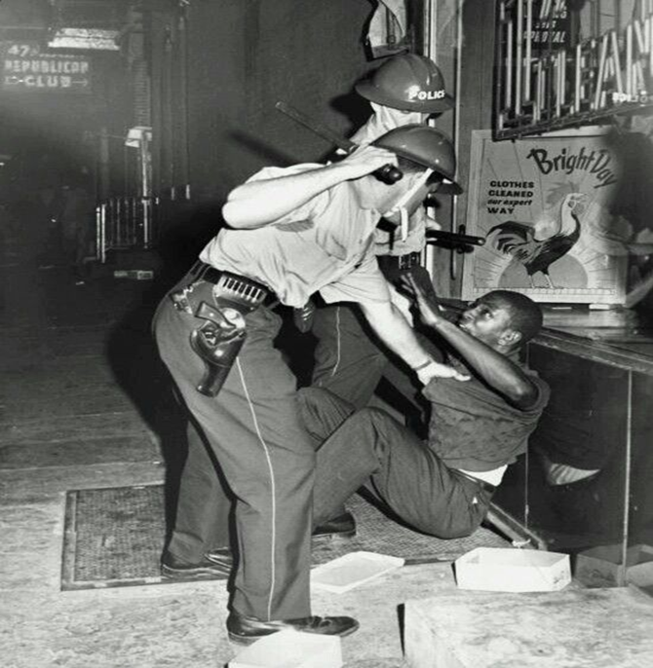
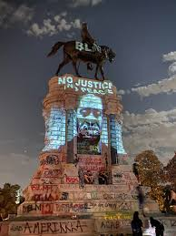
Race and America

Slide 3
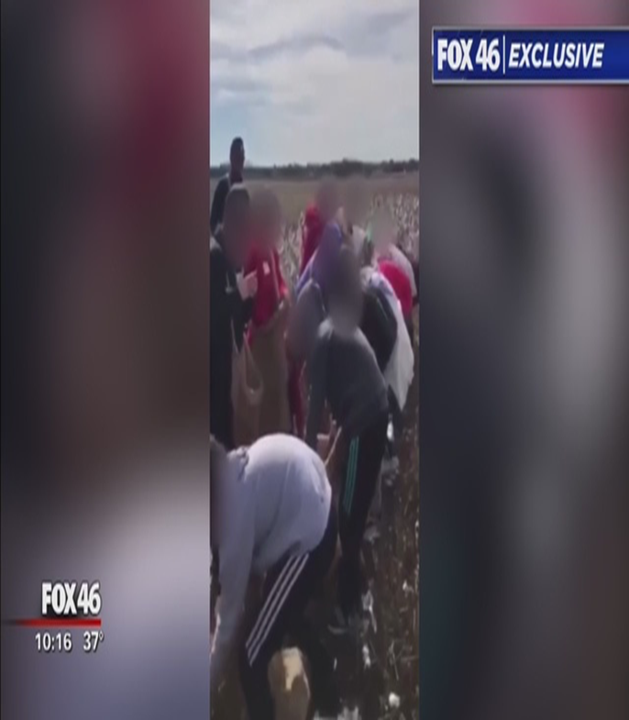
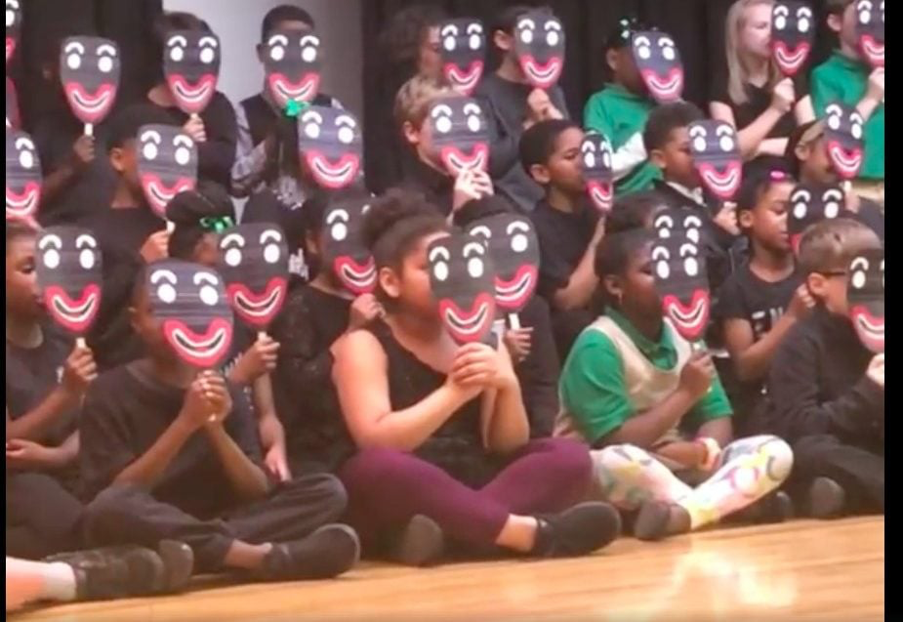
Conversations about Race and Justice Schools

Slide 4

Social-Cognitive Domain Theory
All children and adolescents actively construct meaning from the world.
According to Social-Cognitive Domain Theory, this meaning is informed by cognitive growths and developed through peer-to peer interaction.

Slide 5
Social-Cognitive Domains
Moral | Social Conventional | Personal
Issues of human welfare, rights, and justice Inherent features of interpersonal relationship. e.g. hitting, stealing | Social norms and expectations Arbitrary in nature Determined by social consensus and authority. e.g. Mr./Ms. | Matters of preference or choice e.g. hairstyle, music, friends

Slide 6

Social Convention: Elementary School
K-2 | 3-4 | 5-6
Students view the world in Black and White terms. Conventions are tied to the daily interactions they experience. e.g. Strict gender roles | Students see the inconsistency in norms/ interactions and less inclined to follow them.. e.g. Flexible gender expectations. | Students realize conventions maintain order and people in charge make rules. e.g. Mr./Ms.

Slide 7

Social Convention:
Middle School
6-8
“Nothing but” social expectations. Students are unable to view society as systems therefore rules are norms are arbitrary and acts are evaluated independently of expectations. e.g. Avoidance of trouble

Slide 8

Social Conventional:
High School
9-12
Students realize social norms maintaining social structures. They also realize norms are fluid and reflective of social positioning. e.g. Titles denote respect to marinating relationship status.

Slide 9
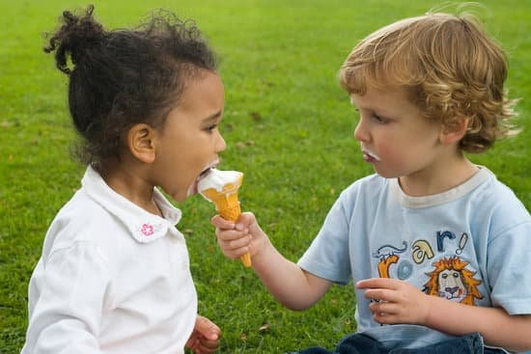
Moral Reasoning: Elementary School
Distributive Justice
K-2 | 2-5
Students understand certain behaviors are wrong but can only consider one person’s need at a time. Students will often prioritize their own self-interest as it relates to fairness and justice. e.g. Sharing does not have to mean 50/50 to the benefit of the child. | Students take fellow students feelings into consideration but though the lens of strict equality. E.g. Sharing must be 50/50.

Slide 10
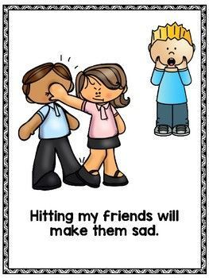
Moral Reasoning:
Elementary School
Harm and Welfare
K-5
Students view events as harmful as the harm inflicted. Context matters little in how they make sense of harm and welfare. e.g. Hitting is wrong because hitting hurts. Someone should help only if the other person asks for help. -Moral ledger-

Slide 11

Moral Reasoning:
Middle School
Middle School
Distributive Justice | Harm and Welfare
Fairness is more nuanced: Equity matters more e.g. Special accommodations for those with special needs. | Students recognize grey areas in moral harm such as indirect harm. May conflate personal rights with moral rights. i.e. One may have a right to act in ways that are morally wrong. e.g. Bystander Effect

Slide 12
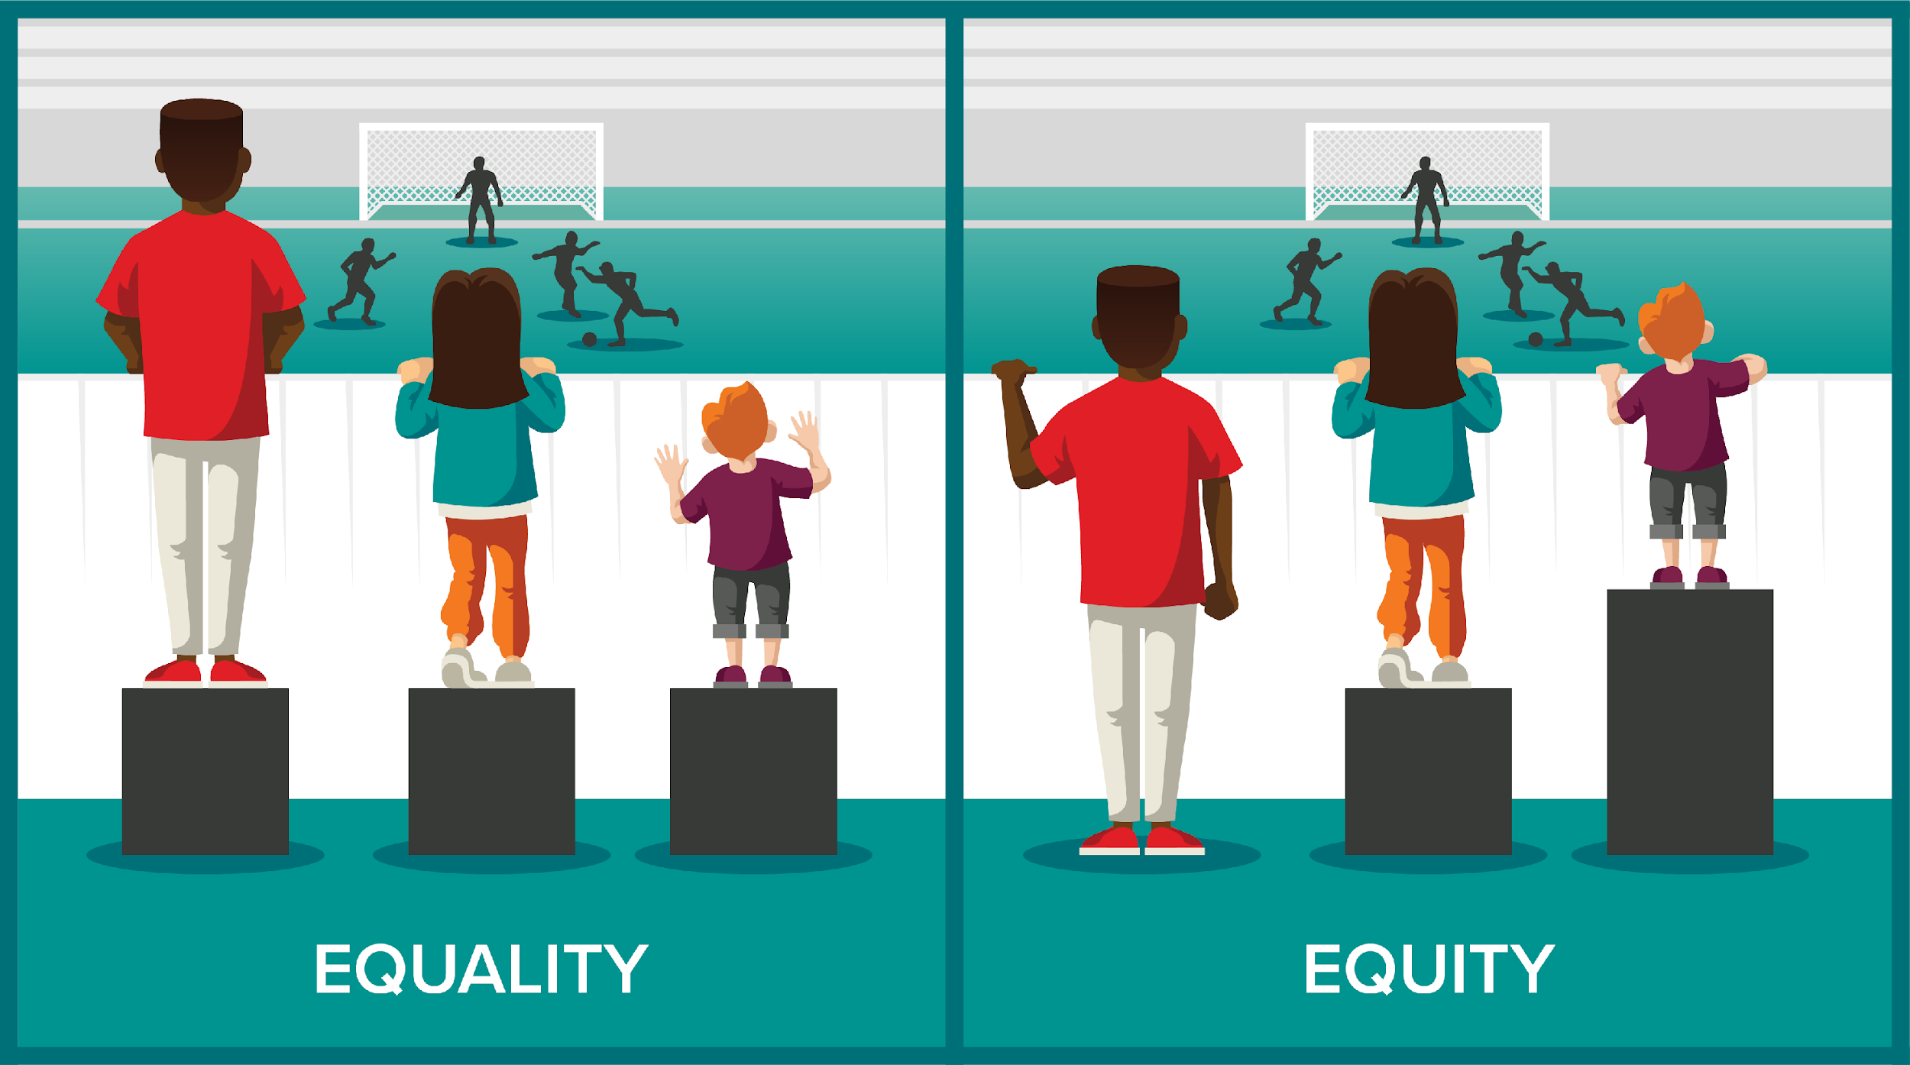
Moral Reasoning:
High School
High School
Distributive Justice | Harm and Welfare
Students are able to coordinate contradictions in equity and equality. They can also begin to apply this to social systems. e.g. Student Nonviolent Coordinating Committee | Students continue to recognize grey areas but give priority to moral issues. Issues of choice are separated from rights “Having choice does not relieve someone of moral obligations in helping situations”

Slide 13

Transactive Discussions
Research has shown the most effective discussions are ones where students are actively working to transform the arguments they hear others making. These statements are referred to as transacts and do one of three things:
Extend the logic of the argument
Refute the assumptions in the argument
Find a place of commonality between two conflicting positions

Slide 14

Domain-Concordant
Instruction
Dilemmas are central to this process. Children and adolescents’ moral and conventional reasoning develops when discussions and assignments around dilemmas reflect the domain being discussed.
Hitting vs. Chewing gum in school
You should not hit someone because its against the rules.
You should not chew gum because it will make Anthony feel bad.

Slide 15
Concerns of each Domain
Moral Reasoning : Does it affect the welfare of others? Would the transgression still be wrong if there was no rule about it?
Social Convention: If there was no rule would the action still be wrong? Is its primary purpose to organize system/ interactions between people?
Overlapping Domains:
Many issues overlap between
Moral and Social Convention domains

Slide 16
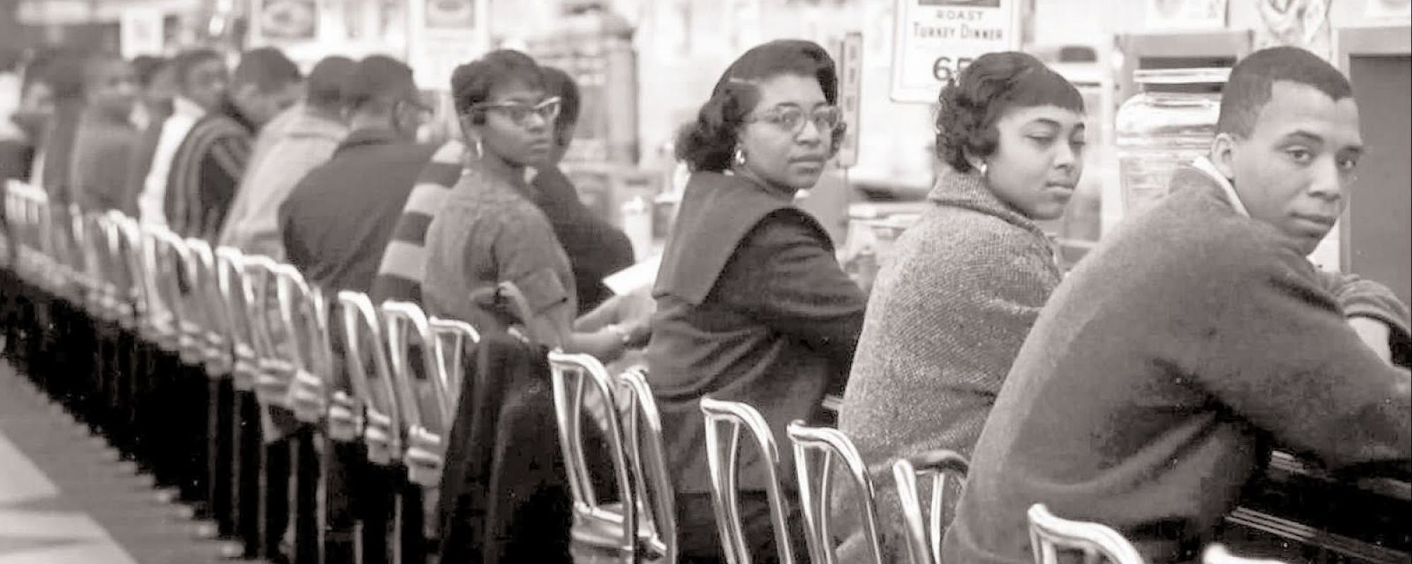
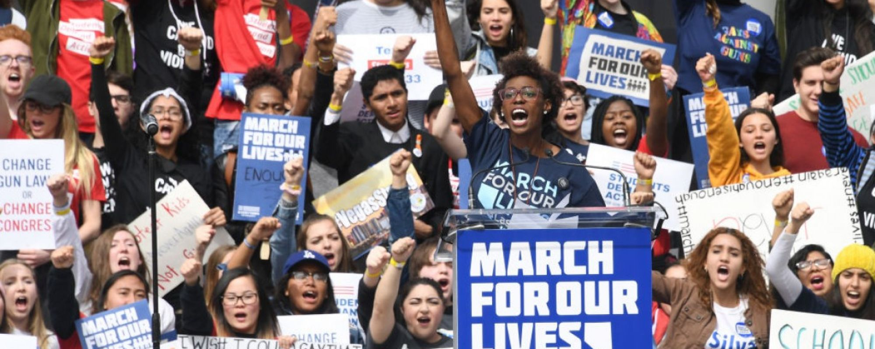
Educating for Democracy
Teacher Training
Curriculum Materials
Home | Educating for Democracy (virginia.edu)

Slide 17
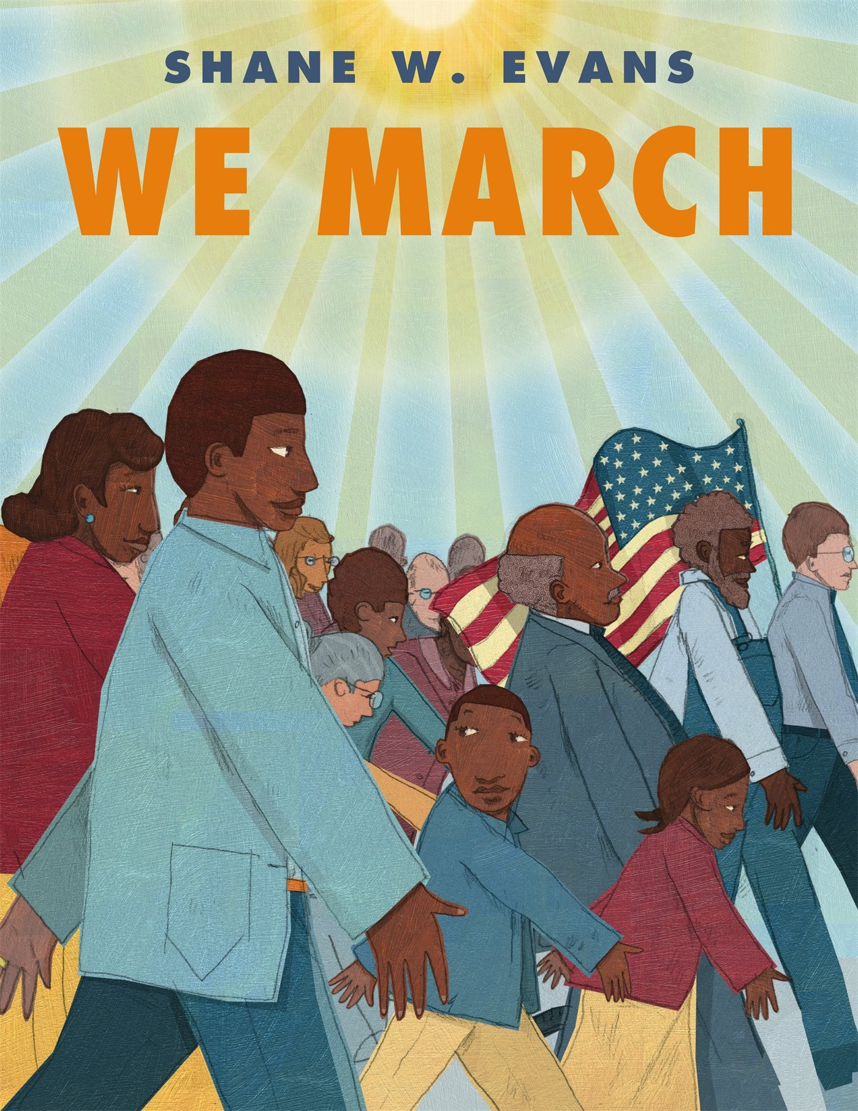
Elementary School Questions
We March (K-2)
Do you think it was fair that Black people were treated unkindly because they were Black? (The answer will likely be no)
  How do you think the little boy and girl in the story feel about being treated unfairly because they are Black?
  Have you ever been treated unfairly?
    How did that make you feel?

Slide 18
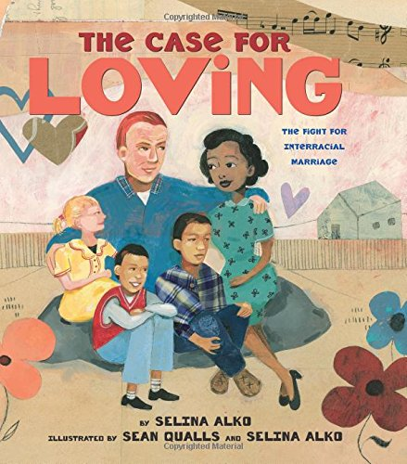
Elementary School Questions
The Case Against Loving (3-5)
Were the Virginia police officers right to arrest them? The Lovings were breaking the rules/laws in Virginia at the time. a. Why or Why not?
Do you think that Richard and Mildred should have stayed in Virginia because that is where they wanted to live? Or should they move to Washington, D.C., where they would not be breaking the law?
  Why or why not?

Slide 19
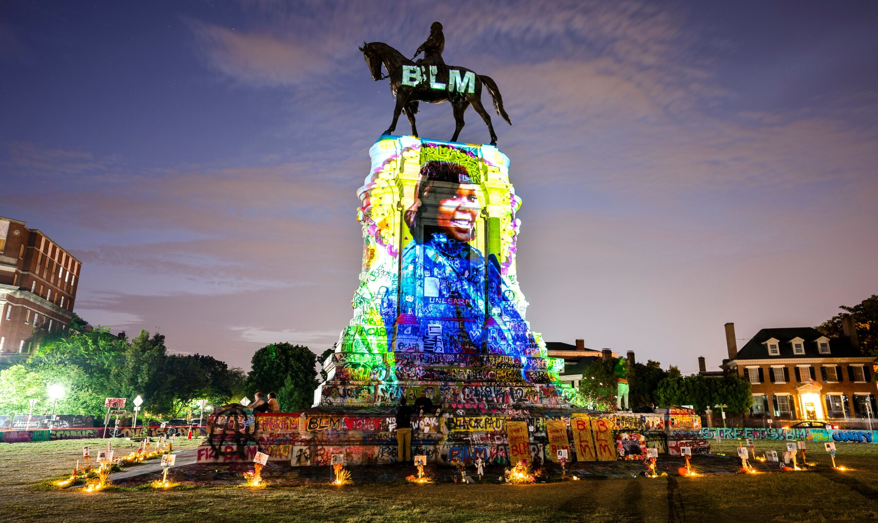
Middle School Questions
Confederate Monuments
Before the Civil War, the federal government passed laws (The Fugitive Slave Acts) that required Northerners to return enslaved people who had tried to escape to freedom.
  What do you think a Northerner should have done if that person was against slavery? (M,C)
Some White Northerners did not seem to care much that many Black people were treated unjustly in the South.
a. Does that matter if they were
fighting on the side of the North? (M)
  a. Why or why not?

Slide 20
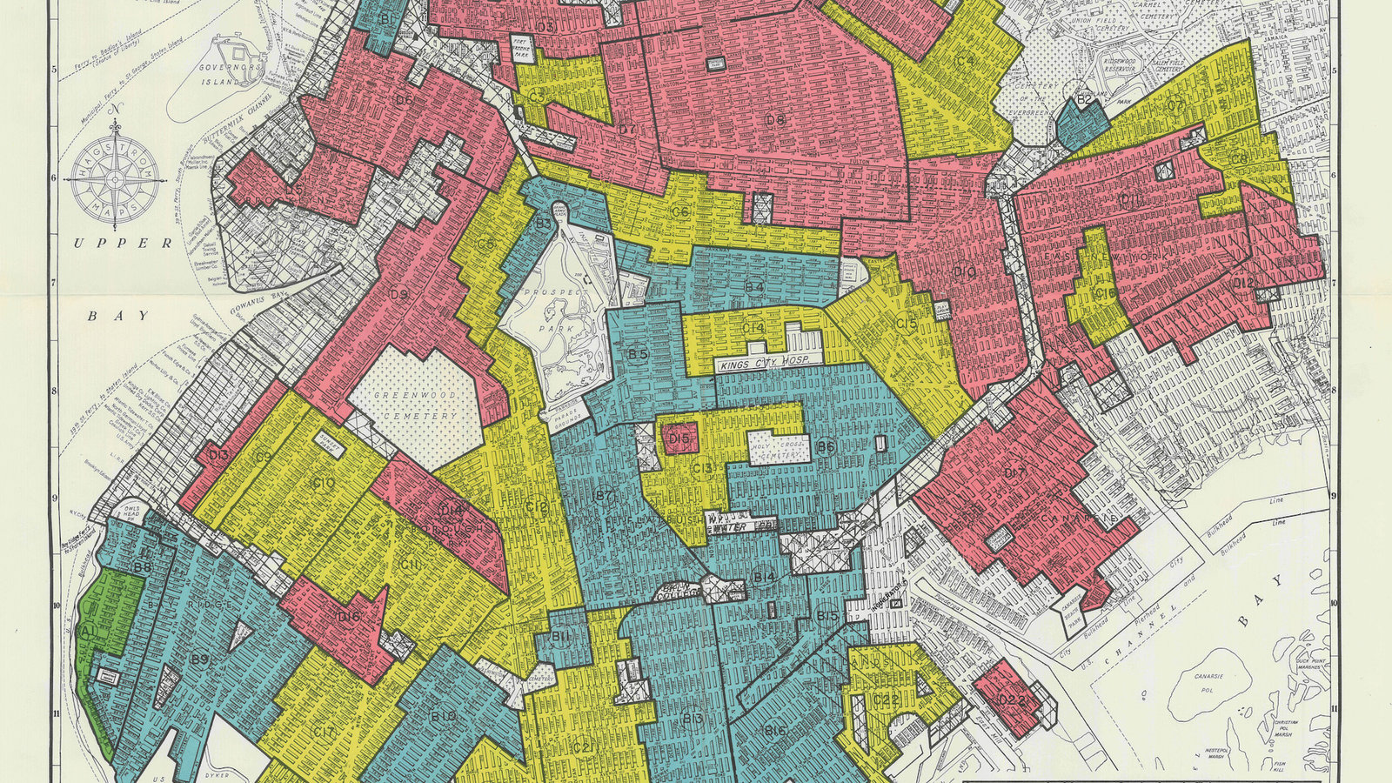
High School Questions: Reparations
Mainly White legislatures at the local and state level created racist housing policies that forced African Americans to live in poorer, unequal communities than White peers.
Consider the possibility that the neighborhoods African Americans lived in were equal to White peers. Would it be ok for local and state policies to maintain segregated neighborhoods?
  a. Why or Why not? (M) (C)

Slide 21
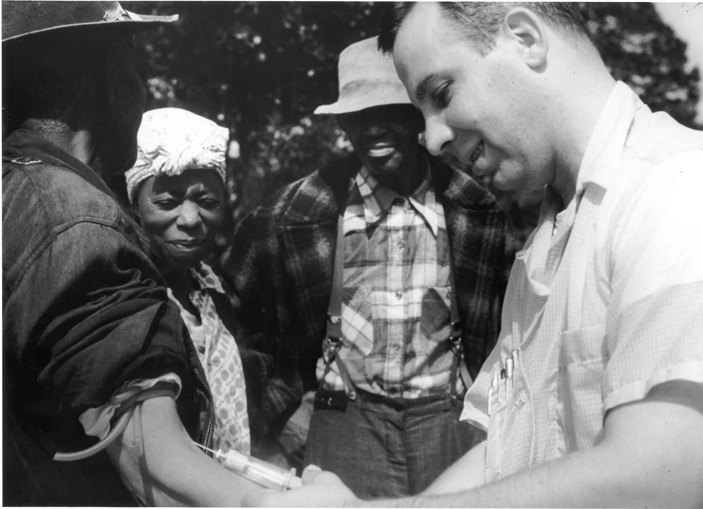
High School Questions: Tuskegee Experiment
Should Informed Consent always be required? Why or Why not?( C) (M)
How about if a study does not involve an experiment, such as observing how people act or giving a survey. Should researchers have to get informed consent? (C ) (M)
Should researchers be allowed to study people (e.g. children) who can’t give consent on their own? Why? How would you handle that? (M) (C)

Slide 22
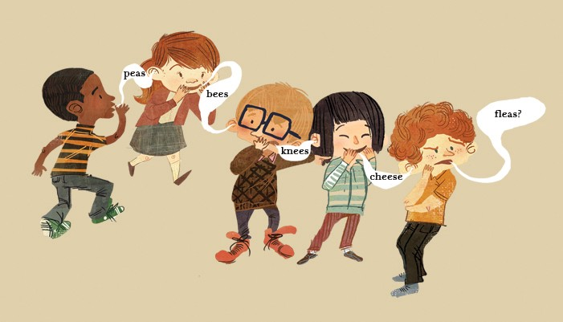
Transactive Discussions Techniques
Telephone (ES)
Elaboration game
  Student must paraphrase elaborates on what previous student says
Rebuttal Game
  Student must paraphrase and offer rebuttal
Integrative Resolution (HS)
  Player 1 states position
  Player 2 paraphrases and refutes
  Player 3 paraphrases and integrates both positions

Slide 23

"Knowledge emerges only through invention and re-invention, through the restless, impatient, continuing, hopeful inquiry human beings pursue in the world, with the world, and with each other."
Paulo Freire

Slide 24
Thank You!
Questions & Comments

