Slide 1

2026-2030 Consolidated Plan
2026 Annual Action Plan
Presented by Civitas, LLC

Slide 2
HUD Consolidated Plan Process
Needs Assessment & Market Analysis
Priority Needs Identification
Strategic goals for funds
COG Planning Sessions
Annual Action Plan (one-year funding)
Opportunities for Citizen Participation
S.C. Commerce Dept develops statewide Consolidated Plan.
(non-entitlement communities)
ConPlan is approved & submitted to HUD.
HUD awards grant funds to the state to fund activities in ConPlan and AAP.
2

Slide 3
HUD Programs – Eligible Activities
Community Development Block Grant (CDBG)
2025 Statewide Allocation: $20,158,365
Public Improvements
Public Facilities
Housing Rehabilitation
Economic Development
Public Services
Emergency Solutions Grants (ESG)
2025 Statewide Allocation: $2,502,598
Engage unsheltered homeless through street outreach
Rehab and renovate emergency shelters
Provide funding for emergency shelter operations
Provide essential services to shelter residents
Rapidly re-house homeless individuals & families
Homeless prevention efforts for the at-risk of homeless
HOME Investment Partnerships Program (HOME)
2025 Statewide Allocation: $6,371,372
Multi-family apartment buildings
Housing for people with special needs
First-time Homebuyer assistance
Housing Rehabilitation
Rental Assistance (vouchers)
Housing Opportunities For Persons With AIDS (HOPWA)
2025 Statewide Allocation: $3,034,345
• Housing & temporary lodging assistance
• Necessary supportive services
HUD Programs With Separate Planning/Reporting
• Recovery Housing Program (RHP)
• CDBG Mitigation (CDBG-MIT)
• HOME American Rescue Plan (HOME-ARP)
National Housing Trust Fund (HTF)
2025 Statewide Allocation: $3,134,373
• Production and preservation of affordable housing
• Rental housing focused on extremely low-income households
(30% AMI)
Notes:
Recovery Housing Program (RHP)
Temporary housing for people recovering from substance use disorder
Public facility improvements and rehabilitation
Acquisition or lease of housing
Payment of rent and utilities
Relocation and supportive services
Administration and technical assistance.
Housing Trust Fund (HTF)
Production and preservation of affordable housing
New construction and rehabilitation of non-luxury housing
Rental housing for extremely low- and very low-income households
Real property acquisition and site improvements
Operating cost assistance for rental housing
Reasonable administrative and planning costs.

Slide 4
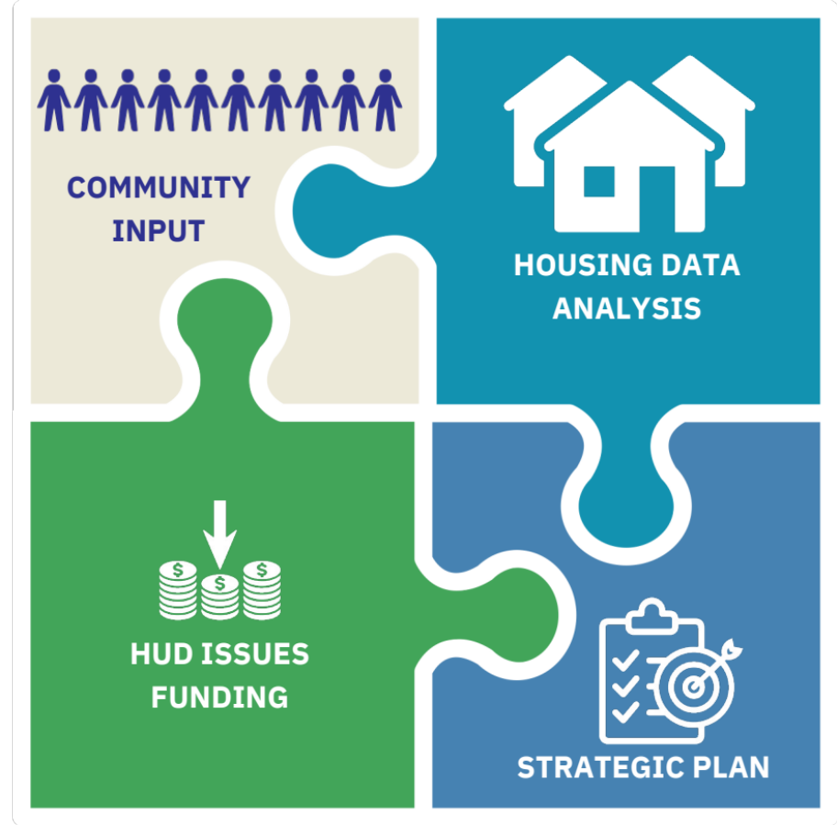
ConPlan - Major Components & Allocations
HUD 2025 Fund Allocation
Source | Amount
CDBG | $20,158,365
HOME | $6,371,372
ESG | $2,502,598
HTF | $3,134,373
HOPWA | $3,034,345
4

Slide 5
Outreach Efforts
Online Surveys – September 2025 – January 2026
  Community/Resident Survey
  Stakeholders (Agencies/Service Providers)
  Government Staff and Officials
Partner Agencies
  SC Housing (HOME and HNTF)
  Office of Economic Opportunity (ESG)
  S.C. Department of Public Health (HOPWA)
Council of Governments Outreach
  Waccamaw Regional Council of Governments 9/26/25
  Pee Dee Regional COG (10/23/2025)
  Upper Savannah COG (10/27/2025)
  Catawba Regional COG (11/5/2025)
  Lower Savannah COG11/13/2025
  Lowcountry COG11/19/2025
  Santee-Lynches Regional COG (12/1/2025)
  Phone/Email: Central Midlands COG and Appalachian COG
5

Slide 6
Community Survey Priority Needs
Top 3 Community Needs Priorities
Affordable Housing
Public Improvements
Public Services
Public Improvement Priorities
Water/Sewer Improvements
Sidewalks
Street Improvement
Affordable Housing Priorities
New Affordable Housing
Senior or Transitional Housing
Other (suggestions included housing for people with disabilities/special needs, housing waivers, and permanent supportive housing)
Public Services Priorities
Homeless Services
Mental Health Services
Transportation Services
Ranked by highest need identified

Slide 7
Service Providers & Local Government
Service Provider – Top Needs
Safe, decent, affordable housing
Housing for special needs populations
Helping the homeless and homelessness prevention
Service Provider – Top Funding Priorities
Creation of affordable housing and/or homebuyer assistance
Owner/renter housing rehabilitation
Public services
Local Government – Project Priority
Public infrastructure improvements
Economic development/job creation
Affordable rental housing development
Public facilities (community centers, parks, etc.)
7

Slide 8




Data Highlights: State Population
Population: 5,212,774
+11.4% over last 10 years
Total Households: 2,070,390
16.3% Increase
Median Income: $66,818
49.2% Increase
Data Source: 2023, 2013 ACS Five-Year Estimates Data Profiles; Median Income in Nominal Dollars

Slide 9
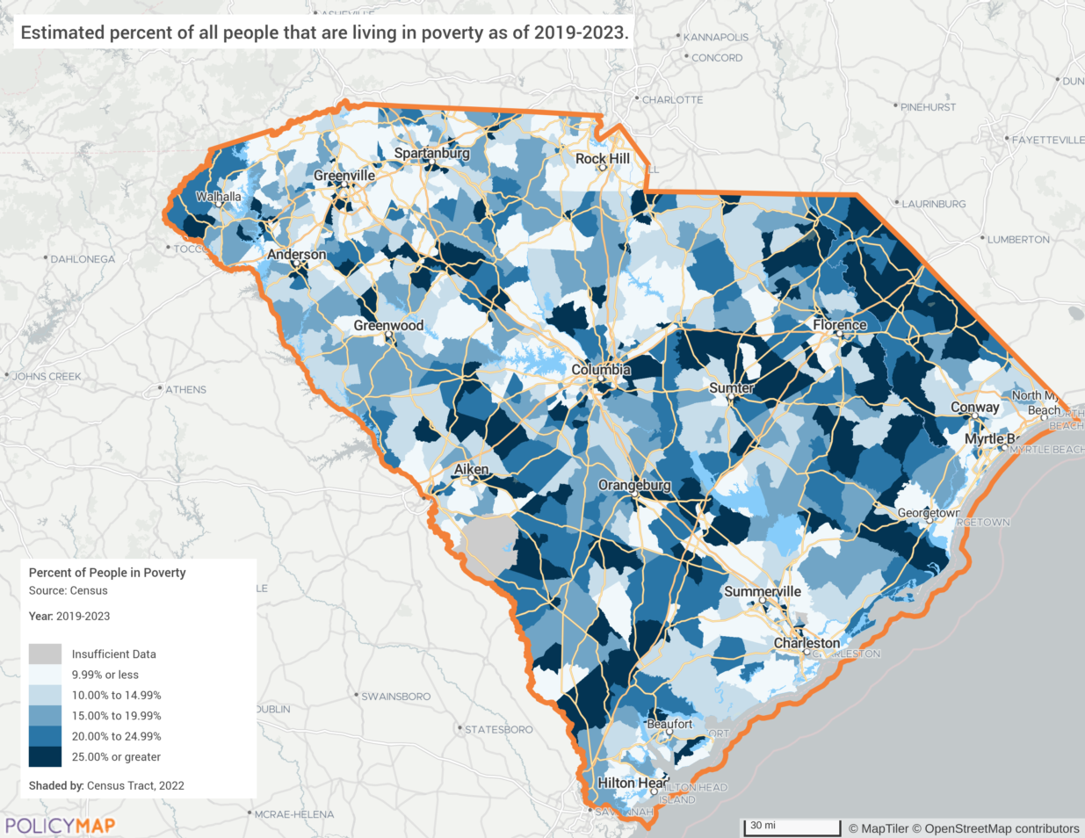
Needs Assessment
Table: Poverty Rate – 2013 to 2023
 | 2013 | 2023
South Carolina (statewide) | 18.1% | 14.2%
Source: 2013 and 2023 American Community Survey Data
Low to Moderate Income (LMI)
  LMI = Less than 80% of Area Median Income (AMI)
    Based on 2025 HUD income limits for the State of South Carolina
  Household of 1: $50,700
  Household of 2: $57,950
  Household of 3: $65,200
  Household of 4: $72,400
  Household of 5: $78,200
Poverty Rates by Census Tract
Source: 2019-2023 ACS via PolicyMap
9

Slide 10
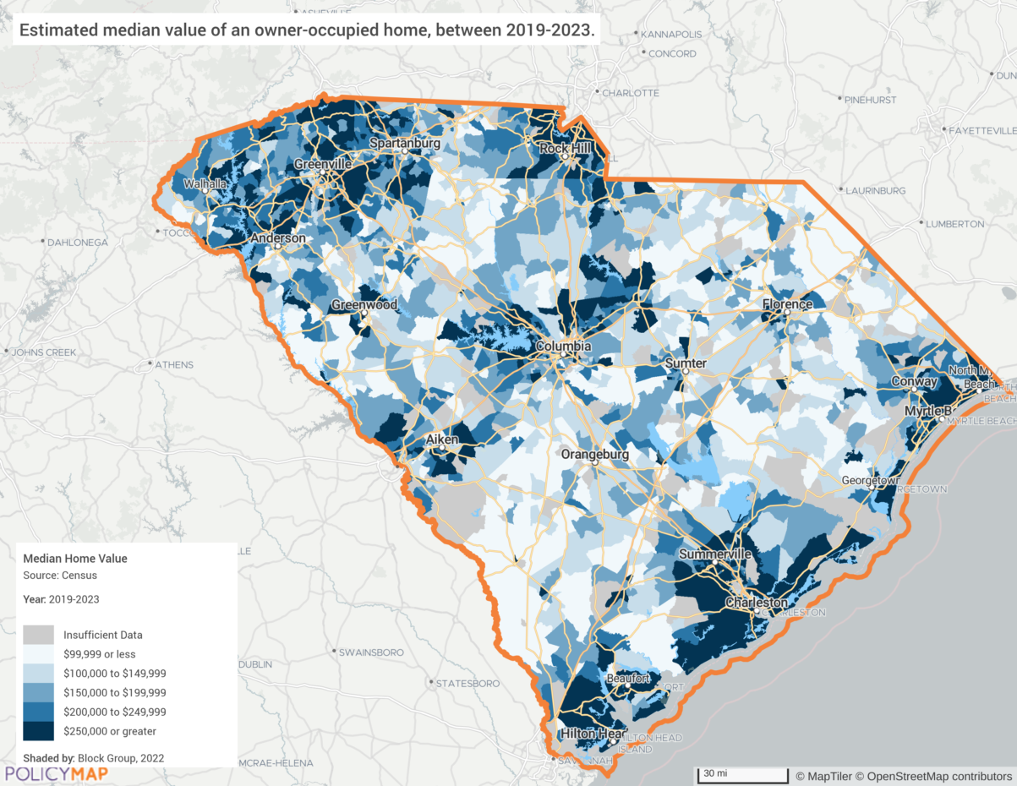
Housing Profile Snapshot
Table: Cost of Housing 2013 to 2023
 | 2013 | 2023 | Rate
Median Home Value | $137,400 | $236,700 | +72.3%
Median Contract Rent | $582 | $904 | +55.3%
Median Income | $44,779 | $66,818 | +49.2%
Source: 2013 and 2023 American Community Survey Data
Home Values by Census Block Group
Source: 2019-2023 ACS via PolicyMap
10

Slide 11
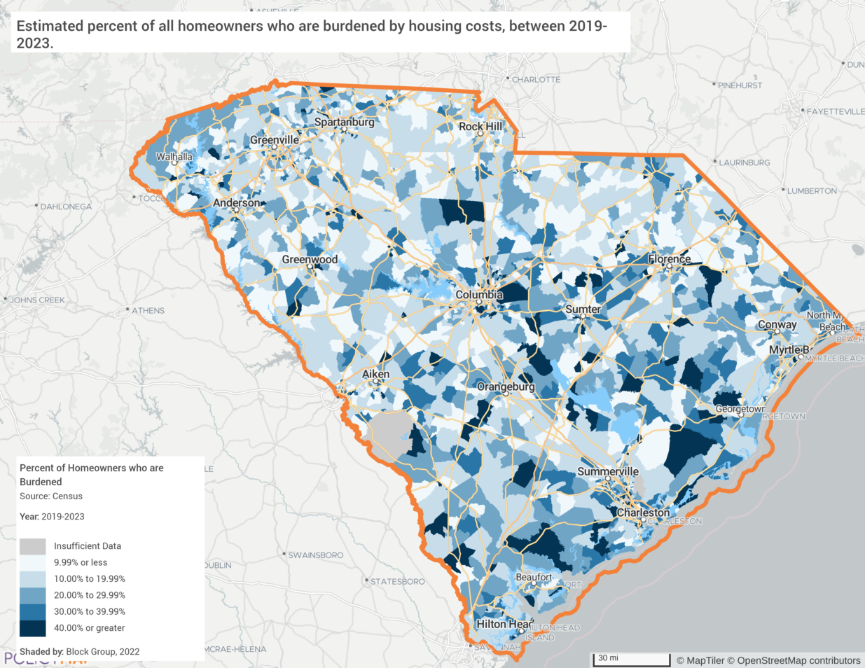
Homeowner Housing Cost Burden
Median Home Value: 72.3% increase in last decade
17.8% Cost burdened* homeowners
7.7% Severe cost burdened**
Impacts of Housing Cost Burden
Financial Strain: reduced available income for essentials such as food, healthcare, & transportation.
Risk of Foreclosure: Homeowners facing a housing cost burden are at an increased risk of foreclosure
Reduced Savings and Investments: limit the ability to save for retirement
*Cost Burdened: Spending over 30% of income on housing expenses
**Severe Cost Burdened: Spending over 50% of income on housing expenses
11

Slide 12
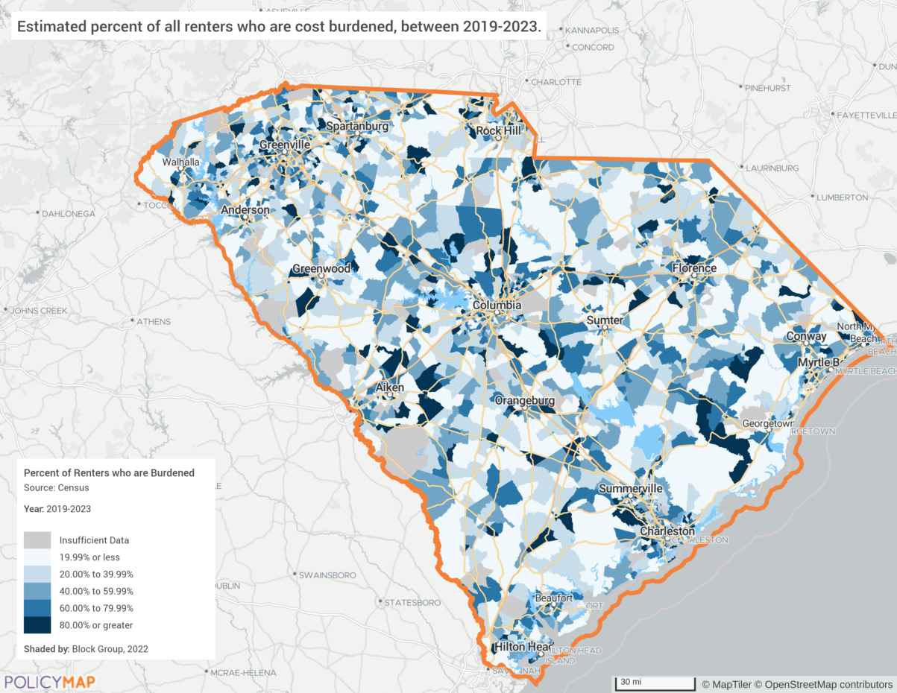
Rental Housing Cost Burden
Median Rent Contract increased 55.3%
42.9% Cost burdened* renters
22.0% Severe cost burdened*
Impacts of Housing Cost Burden
Financial Strain: Reduced available income for essentials such as food, healthcare, & transportation.
Risk of Eviction: Higher risk of eviction and displacement.
Inability to Save for Homeownership: Limits the ability to save for downpayment.
*Cost Burdened: Spending over 30% of income on housing expenses
**Severe Cost Burdened: Spending over 50% of income on housing expenses
12
Notes:
Overlap and Common Impacts
Limited Mobility and Economic Opportunities: Both homeowners and renters may find it difficult to relocate for better job opportunities, schools, or amenities due to high housing costs, limiting economic advancement.
Reduced Quality of Life: Financial strain from high housing costs can reduce the quality of life for both groups, affecting their ability to afford recreational and social activities.
Health Implications: The stress associated with housing cost burden can negatively impact the physical and mental health of both homeowners and renters, leading to stress-related illnesses and delayed or foregone medical care.
Community Impacts: Housing cost burden can contribute to neighborhood decline, as both homeowners and renters may cut back on property maintenance and investments, leading to broader social and economic impacts on communities, including reduced property values and increased crime rates.

Slide 13
2026-2030 ConPlan – Priority Needs & Goals
Priority Needs | Goals
Preserve & Develop Affordable Housing | 1A New Affordable Rental Housing 1B Preservation of Existing Affordable Housing 1C Tenant-Based Rental Assistance
Improve Public Facilities & Infrastructure | 2A Improve Public Facilities & Infrastructure
Economic Development & Sustainability | 3A Economic Development & Sustainability
Community & Regional Planning | 4A Community & Regional Planning
Homeless Housing & Services | 5A Homeless Housing & Services
Housing & Supportive Services for HIV/AIDS | 6A Housing & Supportive Services for HIV/AIDS
Effective Program Administration | 7A Effective Program Administration
Order of goals do not necessarily reflect ranking.
13

Slide 14
2026 Action Plan Projects – CDBG
Project Name | Funding
Improve Public Facilities & Infrastructure | $15,376,692.00
Economic Development & Sustainability | $250,000.00
Community & Regional Planning | $500,000.00
CDBG Administration | $4,031,673.00
TOTAL 2026 Program Year Funds | $20,158,365.00
Estimated budget based on 2025 allocation
14

Slide 15
2026 Action Plan Projects – HOME
Project Name | Funding
New Affordable Rental Housing | $15,798,714.55
Preservation of Existing Affordable Housing | $9,63,083.11
HOME Administration | $637,137.21
TOTAL 2026 Program Year Funds | $26,118,934.87*
Estimated budget based on 2025 allocation
*Amount includes Prior Year and Program Income funding
15

Slide 16
2026 Action Plan Projects – HTF
Project Name | Funding
New Affordable Rental Housing | $1,810,284.84
Preservation of Existing Affordable Housing | $1,109,529.43
HTF Administration | $313,437.32
TOTAL 2026 Program Year Funds | $3,233,251.59*
Estimated budget based on 2025 allocation
*Amount includes Prior Year and Program Income funding
16

Slide 17
2026 Action Plan Projects – ESG
Project Name | Funding
Homeless Housing & Services | $2,314,903.15
ESG Administration | $187,694.85
TOTAL 2026 Program Year Funds | $2,502,598.00
Estimated budget based on 2025 allocation
17

Slide 18
2026 Action Plan Projects – HOPWA
Project Name | Funding
Housing & Supportive Services for HIV/AIDS | $2,943,314.65
HOPWA Administration | $91,030.35
TOTAL 2026 Program Year Funds | $3,034,345.00
Estimated budget based on 2025 allocation
18

Slide 19

Community
Development
Block Grant
Program
(CDBG)

Slide 20
Community Development Block
Grant (CDBG) Program
Three national objectives:
  Benefit low- and moderate-income (LMI) persons (80 percent or less of median income).
  Address slum and blighting conditions.
  Address urgent needs that pose general health and safety hazards or imminent threats to the public health and safety.
20
Notes:
I’ve covered some of the program background, but for the rest of this session and this afternoon’s session, we will focus on TYPES of eligible projects, their requirements, and the application process. MARTHA is up next to talk about infrastructure and community enrichment

Slide 21
Primary Focus/National Objective for CDBG
Primary focus is benefit to low- and moderate-income persons.
For 2026, at least 70 percent of CDBG funds will benefit low- and moderate-income persons.
21
Notes:
I’ve covered some of the program background, but for the rest of this session and this afternoon’s session, we will focus on TYPES of eligible projects, their requirements, and the application process. MARTHA is up next to talk about infrastructure and community enrichment

Slide 22
Eligibility for CDBG
Only units of local government are eligible to apply/receive funds.
Many eligible activities:
  Infrastructure (water, sewer, drainage)
  Public facilities
  Downtown and Community Revitalization
  Economic Development
  Regional Planning
22
Notes:
I’ve covered some of the program background, but for the rest of this session and this afternoon’s session, we will focus on TYPES of eligible projects, their requirements, and the application process. MARTHA is up next to talk about infrastructure and community enrichment

Slide 23
Minimize Displacement
State CDBG Program grants are not expected to displace any individuals as a result of funded activities.
State typically does not fund any projects that would require displacement.
23
Notes:
I’ve covered some of the program background, but for the rest of this session and this afternoon’s session, we will focus on TYPES of eligible projects, their requirements, and the application process. MARTHA is up next to talk about infrastructure and community enrichment

Slide 24
Categories/Estimated Funds Available
Community Development $18.7 million
  Community Infrastructure * $8.0 million
  Community Enrichment * $7.9 million
  Local Priorities * $2.0 million
  Ready to Go $0.75 million
Business Development $0.25 million
Regional Planning $0.5 million
* When the actual 2026 allocation is announced, any increase will be used to increase funding for the Community Infrastructure, Community Enrichment and Local Priorities Programs on a pro rata basis. Any decrease will reduce funding for Community Infrastructure and Community Enrichment on a pro rata basis.
24
Notes:
I’ve covered some of the program background, but for the rest of this session and this afternoon’s session, we will focus on TYPES of eligible projects, their requirements, and the application process. MARTHA is up next to talk about infrastructure and community enrichment

Slide 25
Regional Planning Program
$50,000 grants
Available to Regional Councils of Government (COGs) to assist local governments in developing plans and building local development capacity.
25
Notes:
I’ve covered some of the program background, but for the rest of this session and this afternoon’s session, we will focus on TYPES of eligible projects, their requirements, and the application process. MARTHA is up next to talk about infrastructure and community enrichment

Slide 26
Business Development Program
Assist new or expanding businesses who are creating jobs for LMI persons.
Typically, business is working with an S.C. Commerce project manager for these projects.
26
Notes:
I’ve covered some of the program background, but for the rest of this session and this afternoon’s session, we will focus on TYPES of eligible projects, their requirements, and the application process. MARTHA is up next to talk about infrastructure and community enrichment

Slide 27
Community Development –
Community Infrastructure
Water & Sewer
  Upgrades to existing infrastructure
  New services where there are health concerns and where it is cost effective
Drainage
27
Notes:
I’ve covered some of the program background, but for the rest of this session and this afternoon’s session, we will focus on TYPES of eligible projects, their requirements, and the application process. MARTHA is up next to talk about infrastructure and community enrichment

Slide 28
Community Development –
Community Enrichment
Projects should improve quality of life, sustainability or economic competitiveness through:​
    Community Revitalization​
    Planning​
    Workforce/public health related projects​
    Activities addressing public safety
Examples: Demolition, streetscape, sidewalks & public facilities
Notes:
I’ve covered some of the program background, but for the rest of this session and this afternoon’s session, we will focus on TYPES of eligible projects, their requirements, and the application process. MARTHA is up next to talk about infrastructure and community enrichment

Slide 29
Community Development –
Local Priorities
Projects that address unique local needs/priorities not typically funded through other CDBG/HUD partner programs.
Must meet a National Objective and all other requirements.
Examples: Parks/trails, historic preservation, innovation and energy conservation.
29
Notes:
I’ve covered some of the program background, but for the rest of this session and this afternoon’s session, we will focus on TYPES of eligible projects, their requirements, and the application process. MARTHA is up next to talk about infrastructure and community enrichment

Slide 30
Community Development –
Ready to Go
Stimulate local economy or address urgent or compelling community needs
  Must be eligible public facility improvement (under Community Infrastructure, Community Enrichment or Local Priorities)
CDBG grant for construction costs only
  Requires locality pay upfront costs for design, permitting and environmental review
  Ready to go to construction within 60 days
30
Notes:
I’ve covered some of the program background, but for the rest of this session and this afternoon’s session, we will focus on TYPES of eligible projects, their requirements, and the application process. MARTHA is up next to talk about infrastructure and community enrichment

Slide 31
Community Development –
Ready to Go
In the event of state or federally declared disaster, the Ready to Go requirement may be waived for eligible public facilities and infrastructure.
Eligible local governments will be notified of availability of funds.
31
Notes:
I’ve covered some of the program background, but for the rest of this session and this afternoon’s session, we will focus on TYPES of eligible projects, their requirements, and the application process. MARTHA is up next to talk about infrastructure and community enrichment

Slide 32
Maximum Grants & Match
Community Infrastructure $1,000,000
Community Enrichment $750,000
Local Priorities $300,000
Ready To Go $500,000
Match for all projects 10%
32
Notes:
I’ve covered some of the program background, but for the rest of this session and this afternoon’s session, we will focus on TYPES of eligible projects, their requirements, and the application process. MARTHA is up next to talk about infrastructure and community enrichment

Slide 33
Community Development Selection Criteria
Community Distress 5%
Severity of Problem 10%
Citizen Participation 5%
Level of Effort/ROI 5%
Feasibility 15%
Readiness 5%
Cost/Benefit 5%
Beneficiaries 5%
Outcome 20%
Sustainability 5%
State Priorities 10%
Capacity 10%
Bonus Points for project location in an Opportunity Zone – 10 Points
33
Notes:
I’ve covered some of the program background, but for the rest of this session and this afternoon’s session, we will focus on TYPES of eligible projects, their requirements, and the application process. MARTHA is up next to talk about infrastructure and community enrichment

Slide 34
Program Deadlines
Program | Application Requests Due | Applications Due
Community Infrastructure | March 20, 2026 | April 20, 2026
Community Enrichment & Local Priorities | August 21, 2026 | September 21, 2026
Regional Planning | N/A | May 5, 2026
Ready to Go & Business Development | Accepted at any time | Within 30 days of request approval
34
Notes:
I’ve covered some of the program background, but for the rest of this session and this afternoon’s session, we will focus on TYPES of eligible projects, their requirements, and the application process. MARTHA is up next to talk about infrastructure and community enrichment

Slide 35
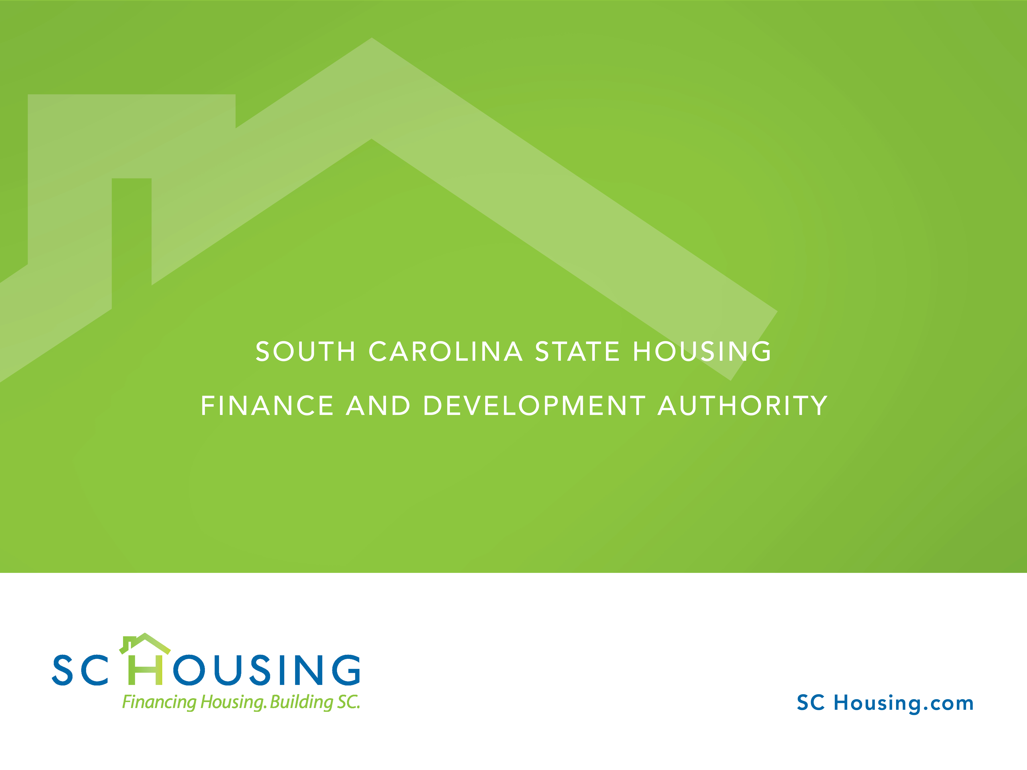
2026 HOME and National Housing Trust Fund (NHTF) Consolidated/Action Plan

Slide 36


2026 HOME Funds
Anticipated 2026 HOME Allocation is yet TBD by Legislative Branch
Small Rental Development Program
(Cumulative total of anticipated award, carryover, and
program income)
HOME $25,481,797.66
CHDO $955,705.81
36

Slide 37

2026 NHTF Funds
Anticipated 2026 NHTF $3,134,373.20
10% Administrative = $313,437.32
Small Rental Development Program
(Cumulative total of anticipated award, carryover, and
program income)
NHTF $2,919,814.27
37

Slide 38

Small Rental Development Program (SRDP)
HOME $ 25.4 Million
NHTF $ 2.9 Million
SC HTF $ 12 Million
Total Funding Available:
Approximately $40.3 Million
New Construction, Conversion, and Rehabilitation
4-39 Units Single & Multi-Family Rentals
Single Sites and Scattered Sites
38

Slide 39

SRDP Set Asides
25% Micro-Developments
  Limited to (4) units
  New for 2026: No longer limited to new construction
50% General New Construction/Conversion
  5-39 units
25% General Rehabilitation
  5-39 units
39

Slide 40

2026 HOME & NHTF Funding Rounds
Small Rental Development Program
Application Workshop – February 25, 2026
  The workshop will be held in a two sessions.
    Session 1 will be from 10am-12pm and will cover program requirements, threshold, scoring, federal requirements, etc. and application submission instructions.
    Session 2 will be from 2pm-4pm and will cover the Construction Requirements for the submission of SRDP Applications. Both Applicants and their Architects are highly encouraged to attend.
40

Slide 41
2025 HOME & NHTF Funding Rounds
Small Rental Development Program
        Application Submissions Deadlines:
  SRDP Exhibit 7 - Previous Participation Certification: April 1, 2026
  SRDP Exhibit 24- Site Screen (Optional): April 1, 2026
  Application Deadline: July 7, 2026
  Missing Documents Notification/Final Point Scores: August 2026
  Conditional Commitment Letters Issued: October 2026
  Submission of Final Plans/Specs and NEPA: January 2027
  Award Agreements Issued & Implementation Trainings: Summer 2027
41

Slide 42

Application Manual and Documents
Application manuals and documents are posted on SC Housing’s website:
www.SCHousing.com

Slide 43
SRDP Eligible Applicants
For-profits
Nonprofits
CHDOs
Local Governments
Public Housing Authorities
43

Slide 44
Threshold Requirements
Previous Participation Certifications are Due April 1, 2026. The SRDP Exhibit 7 – Previous Participation Certification must be approved by SC Housing in order to be eligible to submit an application.
Application submissions are Due July 7, 2026.
Financial Capacity requirements must be met for the total number of units.
  4 – 8 total units – Minimum net worth of $500,000 and a minimum of $75,000 in unrestricted liquid assets.
  9 – 16 total units – Minimum net worth of $1 million and a minimum of $150,000 in unrestricted liquid assets.
  17-24 total units – Minimum net worth of $1.5 million and a minimum of $200,000 in unrestricted liquid assets.
  25-39 total units – Minimum net worth of $2 million and a minimum of $250,000 in unrestricted liquid assets.
Good Standing/Previous Participation – Existing projects must be in compliance
Program Income/CHDO Proceeds – Must be spent or returned
Applicant Experience – Tiered based on scope of the proposed project
Status of Open Projects – No more than 2 open projects allowed. All open projects must meet completion benchmarks.

Slide 45
Threshold Requirements
Phase I – No projects requiring lengthy environmental mitigation.
Site Control – Required at Application.
Zoning – Site must be zoned for proposed project at time of Application.
Uniform Relocation Act – Must be in compliance.
Geotechnical Reports – Must meet all specified criteria.
Rehabilitation – Physical Needs Assessment, Lead Based Paint/Asbestos test results must be provided with the Application.
Financial Commitments- Required for ALL funding sources.

Slide 46
Scoring Criteria
Previous Performance Issues
NEGATIVE POINTS –
  -20 Points - Applicants who were previously suspended from participating in any SC Housing program, at any point in time, and the suspension has been lifted.
  -20 Points – Applicants proposing a project that includes the permanent relocation of existing tenants.
  -15 Points - Applicants who have had funds de-obligated or rescinded by SC Housing for lack of progress or an inability to complete the project. Negative points will not be assessed for de-obligated/rescinded funds when issues regarding a project progressing were beyond an awardee’s control as determined by SC Housing
  -10 Points - Applicants who received a HOME or NHTF award within the last five years that took more that 42 months to complete.

Slide 47
New Construction Projects Scoring Criteria
POSITIVE SITE CHARACTERISTICS
  Up to 64 Points for the site’s distance to amenities
  Up to 10 Points based number of jobs paying between $1,251 and $3,333 per month in a two-mile or four-mile radius depending on the county, as displayed on the US Census Bureau’s OnTheMap tool for the Longitudinal Employment Household Dynamics database
  5 Points for not being located in a Racially or Ethnically Concentrated Area of Poverty (R/ECAP) as defined by the US Department of Housing and Urban Development

Slide 48
New Construction Projects Scoring Criteria
NEGATIVE SITE CHARACTERISTICS
1 Point deducted for each instance of a site within:
  five hundred (500) feet of an easement containing an electric substation, whether it is active or inactive
  one-half (1/2) mile of an operating commercial beef/hog/chicken/turkey farm or processing plant
  one-half (1/2) mile of a treatment, storage, or disposal facility for hazardous wastes, an active or inactive solid waste disposal facility and/or solid waste transfer facility
  one-half (1/2) mile of a sewage treatment plant
  one-quarter (1/4) mile of any jail, prison, detention center or correctional facility (not including a temporary holding facility).
  2 Points deducted where any portion of the site contains for permits easements for overhead electric power lines and/or such electric power lines which encumber the site.
  3 Points deducted for each instance of a site within:
  Five hundred (500) feet of a commercial junkyard or salvage yard; trash heap, landfill, dump pile or other eyesore.
  One-half (1/2) mile of an operating industrial facility including but not limited to steel manufacturers, oil refineries, ports, chemical plants, plastic manufacturers, automotive and engine parts manufacturers, and food processing plants.

Slide 49
New Construction Projects Scoring Criteria
Other Points Awarded
Affordable Housing Shortage – Up to 10 Points
10 points to a project that is located in a county that did not receive an SRDP award in 2021, 2022, 2023, 2024 or 2025.
5 points to a project that is located in a county that did not receive an SRDP award in 2023, 2024 or 2025.

Slide 50
New Construction Projects Scoring Criteria
Other Points Awarded (continued)
Leveraging – Up to 20 Points
Up to 10 Points for financial support from a municipality, non-profit, or local housing trust fund. Points are tiered by amount of funding being leveraged.
Up to 10 Points for having written conditional commitment for PBRA. Points are tiered based on amount of PBRA being provided for the SRDP Project.
Site & Neighborhood Standards – 5 Points
Project is not located in an area of minority concentration
Supportive Housing – 10 Points
For projects setting aside at least 20% of the units for permanent supportive housing.

Slide 51
New Construction Projects Scoring Criteria
Other Points Awarded (continued)
Section 3 Benchmarks – Up to 15 Points
10 Points if 25% or more of the total number of labor hours worked by all workers on a Section 3 project are Section 3 workers
15 Points if both the 25% benchmark is met AND 5%or more of the total number of labor hours worked by all workers on a Section 3 project are Targeted Section 3 workers
In total, New Construction projects are eligible to receive a total of 139 points

Slide 52
Evaluation of Rehabilitation Applications
SC Housing will evaluate rehabilitation projects based on the following criteria:
  Preventing the conversion of affordable units to market rate
  Extent of physical distress
  If the project is covered by a Concerted Community Revitalization Plan
  The degree to which the project site and its surrounding support the economic empowerment of low-income households.
  In total rehab projects are eligible to receive up to 120 points.
Tie Breaker Criteria – Preference will be given to:
  Supportive or Transitional Housing projects
  Counties that have not received SRDP awards
  Projects with highest share of TDC funded from non-SC Housing sources
  Lottery

Slide 53
Tenant Based Rental Assistance (TBRA)
Security Deposits Assistance:
SC Housing will continue to administer Tenant Based Rental Assistance through program year 2030, no funds for program year 2026 were set aside for TBRA.

Slide 54

Questions

Slide 55



2026 Public Hearing
South Carolina Office of Economic Opportunity
Emergency Solutions Grant Program

Slide 56



Discussion Points
HEARTH revision to McKinney Vento Act
ESG Eligible Participants
ESG Eligible Entities
Available funding
Request for application release and due dates
Area-wide system coordination
Eligible Activities
Admin_Stacked_onBlue.gif, gif File, Private, Modified 8/18/2020, 3.06 KB 
Admin_Stacked_onBlue.gif
August 18, 2020

Slide 57

HEARTH/McKinney-Vento
The Emergency Solutions Grant (ESG) program is authorized by subtitle IV of the McKinney-Vento Homeless Assistance Act (42 U.S.C 11371-11378) as amended by the HEARTH Act.
The program authorizes the U.S. Department of Housing and Urban Development (HUD) to make grants to states, units of general purpose, local government, and territories.
OEO received approximately 2.5 million dollars for the 2025 program year to assist in meeting the needs of our state to reduce homelessness and those at risk of homelessness.

Slide 58
Individuals assisted utilizing ESG funds
According to the HUD CAPER for the reporting period of April 1, 2024 through March 31, 2025, the State of South Carolina subrecipients assisted:
5,010 individuals under the Emergency Shelter component
2049 individuals under the Street Outreach component
215 individuals under the Rapid Re-housing component
237 individuals under the Homeless Prevention component
This makes a total of 7,511 individuals in the State of South Carolina assisted under the ESG program.

Slide 59
ESG Eligible Participants
Literally homeless individuals/families are those who lack a fixed, regular, and adequate nighttime residence.
At risk individuals/families are those who will imminently (within 21 days) lose their primary nighttime residence with no subsequent residence, resources or support network.
Unaccompanied youth under 25 years of age or families with children/youth who do not otherwise meet the homeless definition (see 24 CFR 576.2 for all details).
Individuals/families fleeing or attempting to flee domestic violence with no subsequent residence, resources or support networks.

Slide 60

ESG Eligible Entities
Public and private non-profit organizations that currently provide services to the homeless and/or individuals and families at-risk of becoming homeless. With the support of their local government and a recommendation of their area Continuums of Care (COC).

Slide 61

Available funding
Funds will be awarded by the OEO on a competitive basis. OEO should publish the Notice of Available Funding (NOFA) sometime in March 2026, on the OEO website.* The NOFA will provide the public details about the application process from beginning to completion.
*Dates are based on HUD allocation of FY 26 ESG grant.
oeo.sc.gov

Slide 62

Available Funding
(continued)
ESG funds are submitted on a reimbursable basis. Once an applicant receives the award, in order to be reimbursed the agency must submit:
ESG eligible expenses
Support documentation
100% matching dollars

Slide 63

Area-wide System Coordination
Coordination with other targeted homeless services.
The subrecipient must coordinate and integrate, to the maximum extent practicable, ESG-funded activities with other programs targeted to homeless people in the area covered by the Continuum of Care (COC) or the area over which the services are coordinated. This is to provide a strategic, community-wide system to prevent and end homelessness for that area.

Slide 64

Area-wide System Coordination
Continued
Coordinated Entry System (CES)
The subrecipients must participate in the Coordinated Entry System, which allows homeless participant data to be utilized to provide a shared and standardized method for connecting people experiencing homelessness to the resources available in a given community. This system assesses people’s housing-related needs, prioritizes them for resources, and links those in need to a range of types of assistance, including immediate shelter and/or longer-term housing focused programs.

Slide 65
Eligible activities
Street Outreach
Engage and share resources with homeless persons in their environment.
EMERGENCY SHELTER
The costs to provide shelter, case management, operation of facilities, and essential services to transition homeless persons back into the community.
Homeless Prevention
The cost to provide case management and/or financial services to prevent participants “at risk” of losing their rental property to remain in their home or move into safe and more sustainable housing.
Rapid Re-Housing
The cost to provide case management and/or financial services to transition homeless persons into affordable and sustainable housing.
HMIS
The costs to ensure that data and all activities assisted under ESG are entered into the applicable community-wide HMIS or a comparable database, in accordance with HUD standards on participation, data collection, and reporting under local HMIS.

Slide 66

Contact information
Michele Dowlen, Program Manager I
803-734-2454; Michele.Dowlen@admin.sc.gov
Tiffany Howard, Program Coordinator I
803-734-1300; Tiffany.Howard@admin.sc.gov

Slide 67


Housing Opportunities for Persons with AIDS (HOPWA)
T. Veta Mills- SC DPH
EHE & HOPWA Program Coordinator

Slide 68

HOPWA
Housing remains a vital piece of ending the HIV epidemic and the HOPWA program plays a crucial role in these efforts.
HOPWA- Housing Opportunities for Persons With AIDS is the only federally funded program by HUD, dedicated to provide housing and supportive services for people with HIV.
As a Grantee, DPH holds an immense responsibility in ensuring that the HOPWA program in South Carolina is responsive, inclusive, and reflective of the current needs of people in our state living with HIV.

Slide 69

HIV/AIDS Epi Data in South Carolina
Viral suppression through consistent antiretroviral medication has been found to reduce the risk of transmitting HIV to others by 96%

Slide 70
HIV Care Continuum , the Connection Between Housing and Improved HIV Health Outcomes
The HIV Care Continuum Initiative was established in 2013 by President Obama to mobilize and coordinate federal efforts to meet National HIV/AIDS Strategy goals and reduce new HIV infections in the US.
Data gathered by the initiative showed significant gaps in the engagement of HIV care in the United States and illustrated that only 1/4 of all HIV-positive persons had the virus controlled through adherence to antiretroviral medications.
Data also showed housing instability as linked to delayed HIV diagnosis and to an increased risk of acquiring and transmitting HIV infections, with at least half of Americans living with HIV experiencing homelessness or housing instability following diagnosis.
Thus, to maximize viral suppression, HIV service and housing providers were urged to fill gaps in the HIV Care Continuum with housing as an intervention strategy.

Slide 71

HOPWA Funding
Formula based funding.
State of South Carolina, Department of Public Health (DPH) receives a direct allocation from the Department of Housing and Urban Development (HUD).
For Fiscal Year 2025, DPH HOPWA was awarded $3,034,345.
DPH HOPWA Program serves all areas of South Carolina with the exception of the Columbia, Greenville and Charleston Eligible Metropolitan Areas (EMAs) which receive HOPWA funding directly from HUD and Aiken, Chester, Lancaster, and York counties which are part of neighboring states’ EMAs (Georgia and North Carolina).​

Slide 72
HOPWA Funds Allocation
The HOPWA funds received by DPH are awarded through a competitive Request for Grant Application (RFGA) process to project sponsors.
DPH allocates funds to the awarded Project Sponsors based on HIV prevalence in the counties served to develop resources and long-term strategies for low-income people with HIV and their families to overcome barriers to stable housing such as affordability and discrimination.
Most of the sponsors are also Ryan White HIV care providers.
Project Sponsors allocate funds for HOPWA activities based on projected local needs.
Notes:
We expect to provide approximately 1500 eligible persons with emergency housing assistance and supportive services.

Slide 73

HOPWA Activities
DPH’s Ryan White Program, through HOPWA funding, partners with project sponsors to elevate and utilize housing as an effective structural intervention in ending the HIV epidemic.
DPH allocates funds to Project Sponsors based on HIV prevalence in the counties served to develop resources and long-term housing strategies. HOPWA funded services include:
Short-term rent, mortgage and utility payments (STRMU)
Supportive services including permanent housing placement
Tenant-based rental assistance
Short –term transitional housing (hotel and motel leasing)
Supportive long-term housing

Slide 74
Goals and success for DPH HOPWA
During PY 2024, DPH HOPWA met or exceeded performance goals across all major activity categories. These outcomes demonstrate continued progress toward improving housing stability and health outcomes for persons living with HIV or AIDS.
One-year goals for the number of households to be provided housing using DPH HOPWA funds for 2025-2026:
Short-term rent, mortgage, and utility assistance to prevent homelessness of the individual or family | 250
Tenant-based rental assistance | 125
Units provided in permanent housing facilities developed, leased, or operated with HOPWA funds | 10
Transitional Housing, Hotel/Motel Leasing to prevent homelessness of the individual or household | 30
Support Services (Includes Case Management) | 1400
Total | 1,815

Slide 75

Conclusion
DPH is committed to sustaining efforts to increase access to stable housing and improved health outcomes for people with HIV in South Carolina.
Stable housing is closely linked to successful HIV outcomes. With safe, decent, and affordable housing, people with HIV are better able to access medical care and supportive services, get on HIV treatment, take their HIV medication consistently, and see their health care provider regularly.
In short: the more stable your living situation, the better you do in care.

Slide 76
Contact Us
T. Veta Mills
Bureau of Communicable Disease Prevention & Control (BCDPC)
SC Department of Public Health (SCDPH)
EHE/ HOPWA Program Coordinator
millstv@dhec.sc.gov
Office: (803)898-3877

