Slide 1

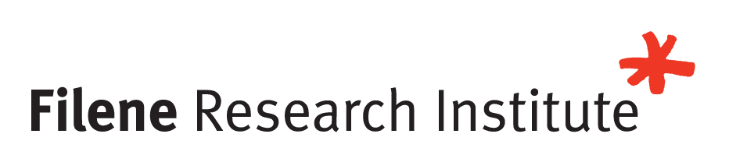
i3 wave 20
graduation celebration!
March 19, 2026

Slide 2

Welcome
Graduate Recognition
Closing Remarks
Notes:
McKaye to kick off and hand off to Christie
Wave 19 is awesome – curious, collaborative, care about each other and their members, change the world. Leaders of the highest caliber.
Thank you to the participants, their managers/teams, and their organizations - investment
Chat – Feel free to congratulate them and share memories
Introduce Amanda

Slide 3

WHAT WILL YOU TAKE FROM i3?
Filene has reminded me how important it is to keep learning through a process where you are trying to solve a problem. Those learnings can help you better understand the problem or pivot and redefine the goal entirely.
PROJECTS
Plentitude: An innovative digital platform that connects millennials with wealth advisors through their credit unions, offer affordable, personalized financial guidance.
FutureFunds: An AI-powered, investment assistant designed specifically for young adults coming of age between 2030 and 2035. The solution is a personalized, proactive financial companion integrated directly into digital banking platforms.
Notes:
Congratulations Amanda
- Focused her innovation efforts on youth and young adults through gamification and immersive experiences through her learn2earn and Moneyverse teams

Slide 4

WHAT WILL YOU TAKE FROM i3?
There are so many takeaways from being in the i3 program for the past 2 years! I learned how to innovate effectively and with purpose- when to be bold, when to take chances, and when to question the status quo. Even better, I have made lifelong friendships with some of the most impactful, intelligent and inspiring people I've met in the industry, and for those I'll be forever grateful!
PROJECTS
Student Assist: An innovative application designed to support college students seeking to build essential life skills, manage their finances, and maintain well-being.
Wayfinder: A platform that leverages behavioral science, technology, and community, so that credit unions can reclaim their role as indispensable partners in their members’ financial journeys.
Notes:
Maddie

Slide 5

WHAT WILL YOU TAKE FROM i3?
After three years in this program, it’s difficult to identify just one key takeaway. However, the most meaningful and impactful aspect has undoubtedly been the lifelong relationships I’ve built. I’ve formed connections with individuals across many areas of the credit union industry—people I can rely on, learn from, and collaborate with. We’ve stayed connected with past i3 participants and continue to expand our network each year. The breadth of knowledge and insight I’ve gained from these relationships is truly invaluable.
PROJECTS
Thrive (i2 project): Connecting users, from Generation A to Generation Z and all in between, with personalized guidance to help them financially thrive.
Plentitude: An innovative digital platform that connects millennials with wealth advisors through their credit unions, offer affordable, personalized financial guidance.
Golden Glide: A retirement planning tool that offers members a personalized "glide path" that connects today's finances to future lifestyle goals. Golden Glide goes beyond planning by embedding exclusive credit union offers.
Notes:
Ayuz B HH EY AY AH T
- Focused on advancing financial education and personalized guidance for young adults and millennials- Learn2Earn & Plentitude

Slide 6

WHAT WILL YOU TAKE FROM i3?
The i3 program reinforced for me that the greatest innovations come from collaboration among people with diverse perspectives and strengths. The best ideas are rarely created in isolation; instead, they are built by learning from one another through shared curiosity and mutual respect for ideas big and small. i3 created the space for us to learn and innovate together, encouraging open-mindedness, adaptability, and the confidence to leverage our strengths to turn individual inspiration into something greater, together.
PROJECTS
Rapid Response: A community impact fund facilitated by credit unions, empowering communities through member donations.
FutureFunds: An AI-powered, investment assistant designed specifically for young adults coming of age between 2030 and 2035. The solution is a personalized, proactive financial companion integrated directly into digital banking platforms.

Slide 7

WHAT WILL YOU TAKE FROM i3?
i3 gave me two things I didn't anticipate: a network of leaders I'll lean on for the rest of my career, and a fundamental shift in how I approach innovation. What surprised me most wasn't a framework or a tool — it was discovering that the most powerful thing you can bring to a problem is genuine curiosity about the person on the other side of it. Being immersed in a cohort of people from across the credit union movement — all wrestling with the same tensions, all committed to doing better by their members — reshaped how I see my own work and my place in this industry. I leave with the relationships, the tools, and the conviction to turn what's possible into what's real
PROJECTS
GigStability: A tool that helps gig workers achieve greater financial stability by smoothing income variability, automating savings, streamlining tax planning, and providing access to affordable benefits and a supportive community.
Nexura: A solution that reimagines the checking relationship as a dynamic financial wellness platform. Nexura provides a consolidated dashboard that forecasts income, organize expenses, and enables customizable rules and alerts.
Notes:
Dana Jones – Focused on increasing collaboration between credit unions and fintechs, and supporting college students and their financial wellbeing

Slide 8

WHAT WILL YOU TAKE FROM i3?
I enjoyed my time with the two-year Filene i3 program. It was meaningful and impactful. Collaborating with peers in different roles from across the credit union industry deepened my understanding. We worked together to generate innovative business ideas that I'd love to see become a reality. Of course, I also appreciated learning from experts at Filene conferences and events. I'm glad I had the opportunity to be part of i3 wave 20.
PROJECTS
Teach2Finance: Teach2Finance enables educators to earn supplemental income and build financial expertise through a certification program designed around school breaks.
Golden Glide: A retirement planning tool that offers members a personalized "glide path" that connects today's finances to future lifestyle goals. Golden Glide goes beyond planning by embedding exclusive credit union offers.

Slide 9

WHAT WILL YOU TAKE FROM i3?
One of my key take aways is deepening an ever growing network of credit union leaders and friends, and with them building an innovative ecosystem where we can excel together in serving our organizations and our members, finding unique ways to solve issues that affect both.
PROJECTS
Building Blocks Financial Wellness: A solution that helps credit union's deepen relationships with small business owners by offering a "Just-in-Time" solution that focus on financial guidance, knowledge, and best practices to cultivate the wll0being of the member and their business.
Wayfinder: A platform that leverages behavioral science, technology, and community, so that credit unions can reclaim their role as indispensable partners in their members’ financial journeys.
Notes:
Projects focused on people helping people - designing solutions for business owners and for first responders

Slide 10

WHAT WILL YOU TAKE FROM i3?
i3 showed me that innovation isn’t about big ideas, it’s about testing fast, learning quickly, and delivering what actually matters. My key takeaway from i3 was learning to turn ideas into impact through rapid experimentation and member‑focused thinking. i3 reinforced that real innovation happens when curiosity meets action, prototype, learn, iterate.
PROJECTS
Unity Service Opportunity (U.S.O): A CUSO that combines powerful partners, translation services, and financial education specialists to assist credit unions nationally in helping immigrant and refugee community members overcome financial barriers.
CU Talent Share: An AI-powered platform where credit unions instantly find programmers, developers, and IT professionals to help on projects across the credit union network.

Slide 11

WHAT WILL YOU TAKE FROM i3?
Throughout the i3 program, I gained new perspectives, fresh ideas, and a deeper appreciation for the power of collaboration and ideation. Seeing how diverse viewpoints, paired with a thoughtful methodology, can elevate and refine ideas was incredibly impactful. Just as valuable, though, is the network I built along the way. This remarkable group of innovators is one I look forward to learning from, leaning on, and collaborating with for years to come.
PROJECTS
Rapid Response: A community impact fund facilitated by credit unions, empowering communities through member donations.
Frankly: An AI-powered behavioral financial education platform that leverages interactive financial literacy, trusted contextual guidance, and value-aligned institutional engagement to ensure credit unions are delivering value to future members.
Notes:
- Blending technology like AI and gaming with financial needs through her projects SideKik and CU Gainzz

Slide 12

WHAT WILL YOU TAKE FROM i3?
My biggest takeaway is that innovation gets real when you build relationships and solve problems together, not when you brainstorm alone. i3 is built to grow an innovation mindset, tools, and network, and it pushes you into cross‑functional teams to work on the most pressing challenges credit unions are facing right now. What I’ll carry forward is a simple, repeatable way of working: start with what members need today, bring in diverse perspectives to co‑create, and test ideas quickly so we learn fast and reduce risk.
PROJECTS
Student Assist: An innovative application designed to support college students seeking to build essential life skills, manage their finances, and maintain well-being.
BranchVerse: A scalable, future-ready platform that unifies AI, AR/VR, and biometric technologies to deliver personalized, engaging financial experiences for younger, tech-savvy members.
Notes:
Fernando m aa n d uu h aa n oh
not joining

Slide 13

WHAT WILL YOU TAKE FROM i3?
I genuinely feel fortunate to have the support of my orsa leadership in participating in the i3! Program. This experience has instilled in me a commitment to continuous learning and professional development. Working alongside industry leaders has been incredible and has significantly expanded my professional network. This collaborative effort is crucial for us in the credit union industry as we strive to achieve similar goals and fostering innovation.
PROJECTS
GigStability: A tool that helps gig workers achieve greater financial stability by smoothing income variability, automating savings, streamlining tax planning, and providing access to affordable benefits and a supportive community.
BranchVerse: A scalable, future-ready platform that unifies AI, AR/VR, and biometric technologies to deliver personalized, engaging financial experiences for younger, tech-savvy members.
Notes:
- Jason – Focused on creating smooth member experiences during onboarding and wealth advising

Slide 14

WHAT WILL YOU TAKE FROM i3?
The biggest takeaway from the Filene i3 program is the ability to think differently—challenging norms and finding innovative solutions to industry problems. The relationships built over the past two years have been instrumental in my growth as a leader and innovator, with impact that extends far beyond financial services.
PROJECTS
GigStability: A tool that helps gig workers achieve greater financial stability by smoothing income variability, automating savings, streamlining tax planning, and providing access to affordable benefits and a supportive community.
CU Talent Share: An AI-powered platform where credit unions instantly find programmers, developers, and IT professionals to help on projects across the credit union network.
Notes:
TBD on attendance
Top-Sand

Slide 15

WHAT WILL YOU TAKE FROM i3?
My key takeaway from the i3 experience is the importance of challenging assumptions and approaching problems with an innovative, member focused mindset. As a project management professional, it strengthened my ability to lead change by asking better questions, bringing structure to new ideas, and helping teams move from concept to execution. It also reinforced the value of leveraging a unique perspective to push thinking forward and drive outcomes.
PROJECTS
Unity Service Opportunity (U.S.O): A CUSO that combines powerful partners, translation services, and financial education specialists to assist credit unions nationally in helping immigrant and refugee community members overcome financial barriers.
EquityNow HELOC: A platform that modernizes home equity lending by transforming the HELOC into real-time, mobile-first liquidity platform. The tool is powered by AI-driven underwriting, automated valuation models, and open APIs.
Notes:
Not in attendance – On spring break with his family
Worked on Elevate Innovation AI, using AI as an innovation assessment tools for midsize credit unions, and Gig stability, looking at financial services designed for gig workers
Mindset shift: Thinking deeper about the problem, rather than just the solution, moving beyond traditional solutions, and leveraging emerging trends and technologies.
- I also want to take a moment to thank you and the team for an incredible learning experience over the last two years. The program has challenged me to think differently, explore new approaches to problem-solving, and connect with so many great people across the industry. I truly appreciate all the effort that has gone into making this such a valuable experience.

Slide 16

WHAT WILL YOU TAKE FROM i3?
The i3 experience taught me to trust my ability to think boldly and contribute to innovation across the credit union movement. It deepened my understanding of the cooperative foundation that makes our industry special and connected me with passionate leaders committed to shaping what comes next. That confidence-and those relationships-will stay with me long after the program ends! Imagine bigger. Collaborate boldly. Build what's next.
PROJECTS
LaunchPad: A CUSO that empowers credit unions to grow while driving meaningful change through expert consulting and strategic partnerships.
CU Talent Share: An AI-powered platform where credit unions instantly find programmers, developers, and IT professionals to help on projects across the credit union network.

Slide 17

WHAT WILL YOU TAKE FROM i3?
Innovation is vital to the future of credit unions. Our ability to ideate, iterate, and remain agile will be key to meeting and exceeding consumer expectations One of the most important learnings I had from i3 was that it's ok to launch with a minimal viable solution. That speed to market allows for crucial feedback and insights that lead to iteration.
PROJECTS
CU Gainzzz: Helps credit unions drive meaningful interactions to foster long-term loyalty among Gen Z members by developing essential financial skills in a way that resonates with their lifestyle.
CU Talent Share: An AI-powered platform where credit unions instantly find programmers, developers, and IT professionals to help on projects across the credit union network.
Notes:
Josh Stoltz-foos
Focused on using AI and other technology to provide relevant and just in time financial resources to individuals and small businesses
- Be empathetic with the member and critical of the design

Slide 18

WHAT WILL YOU TAKE FROM i3?
One of the most valuable skills I've acquired during the i3 experience is how to effectively develop and test lean prototypes at different stages of product development. Examples ranged from creating a one-page mock-up of a potential product as an early gauge of product-market fit with potential buyers, to developing a workable prototype to determine if we're pilot-ready.
PROJECTS
CU Gainzzz: Helps credit unions drive meaningful interactions to foster long-term loyalty among Gen Z members by developing essential financial skills in a way that resonates with their lifestyle.
Frankly: An AI-powered behavioral financial education platform that leverages interactive financial literacy, trusted contextual guidance, and value-aligned institutional engagement to ensure credit unions are delivering value to future members.

Slide 19

WHAT WILL YOU TAKE FROM i3?
Being part of i3 has taught me how to better engage others on our team to innovate solutions for current challenges and lead meaningful change. The network of peers and the long-term professional relationships created within the i3 community is so valuable and allows for diverse perspective across institutions and roles as we are all tackling similar real-world challenges.
PROJECTS
Building Blocks Financial Wellness: A solution that helps credit union's deepen relationships with small business owners by offering a "Just-in-Time" solution that focus on financial guidance, knowledge, and best practices to cultivate the wll0being of the member and their business.
FutureFunds: An AI-powered, investment assistant designed specifically for young adults coming of age between 2030 and 2035. The solution is a personalized, proactive financial companion integrated directly into digital banking platforms.
Notes:
Missing the first half hour –
- Member engagement and growth - Making it easy to onboard members, metaverse-powered financial education platform for Gen Alpha

Slide 20

WHAT WILL YOU TAKE FROM i3?
What I will take away most from being part of the i3 program is that we each enter with a unique lens — but innovation begins when we learn to widen it: to notice deeper, question differently, and design beyond the familiar.
PROJECTS
Building Blocks Financial Wellness: A solution that helps credit union's deepen relationships with small business owners by offering a "Just-in-Time" solution that focus on financial guidance, knowledge, and best practices to cultivate the wll0being of the member and their business.
Nexura: A solution that reimagines the checking relationship as a dynamic financial wellness platform. Nexura provides a consolidated dashboard that forecasts income, organize expenses, and enables customizable rules and alerts.

Slide 21

WHAT WILL YOU TAKE FROM i3?
It's been an incredible opportunity to participate in the i3 program. The experience of learning
alongside credit union innovators—while exploring trends, shaping meaningful research, and
building stronger partnerships—has been truly inspiring. I’m grateful for the chance to deepen
my skills in strategic foresight, inclusive solution design, and evidence-based innovation, as
well as developing strong pitch and presentation skills. I look forward to applying these insights
to lead change and create lasting impact for our members and the broader credit union
community.
PROJECTS
Student Assist: An innovative application designed to support college students seeking to build essential life skills, manage their finances, and maintain well-being.
Virtually Yours: A credit union-owned AI personal assistant embedded directly within online and mobile banking. Virtually Yours proactively surfaces next steps such as identifying potential overdrafts, recommending adjustments aligned to savings goals, and executing approved actions with confirmation and auditability.
Notes:
Not in attendance
Member engagement and onboarding tool, services through immigrants
Michele – biggest takeaway was the community – sharing the last two years with teams of i3 has been an impactful experience that will continue to benefit her throughout her career

Slide 22

WHAT WILL YOU TAKE FROM i3?
One of my biggest takeaways from the Filene i3 program has been learning a structured approach to turning ideas into real solutions. The program reinforced that innovation is not just about creativity, but about applying a clear methodology to identify opportunities, test ideas, and implement solutions that create value for members. I had the opportunity to collaborate with talented peers, mentors, and facilitators from across the credit union movement was incredibly valuable. Attending the i3 conferences and learning about emerging topics such as technology transformation, AI, and data and analytics further expanded my perspective on how credit unions can continue to evolve and serve their members in new ways.
PROJECTS
MoneyVerse: A metaverse-powered financial education platform designed to engage Gen Alpha (ages 10-14) through immersive, gamified learning experiences.
EquityNow HELOC: A platform that modernizes home equity lending by transforming the HELOC into real-time, mobile-first liquidity platform. The tool is powered by AI-driven underwriting, automated valuation models, and open APIs.
Notes:
Not in attendance

Slide 23

WHAT WILL YOU TAKE FROM i3?
i3 helped me develop a futurist mindset with learning to recognize early signals of change and translate them into meaningful opportunities for credit unions. The experience reinforced that the future isn’t something we wait for, it’s something we actively design through collaboration, curiosity, and creative thinking.
PROJECTS
MoneyVerse: A metaverse-powered financial education platform designed to engage Gen Alpha (ages 10-14) through immersive, gamified learning experiences.
Nexura: A solution that reimagines the checking relationship as a dynamic financial wellness platform. Nexura provides a consolidated dashboard that forecasts income, organize expenses, and enables customizable rules and alerts.
Notes:
Woo in tran on
Thrive – mobile app that bridges the gap between Gen Z and CUs through personalized financial guidance, and LaunchPad- platform to empower credit union growth through consulting and partnerships

Slide 24

WHAT WILL YOU TAKE FROM i3?
Completing Filene’s i3 program has been an impactful experience. A key takeaway for me was the ability to apply the innovation frameworks in real time at my credit union, helping move several initiatives forward with greater clarity and confidence. I’m leaving the program with a refreshed perspective, practical tools to support continued innovation, and a network of connections that will remain invaluable. Thank you to the Filene team and my fellow Wave 20 participants for the support, collaboration, and encouragement throughout the experience. I’m also grateful to my credit union, Tucson Federal Credit Union, for supporting my participation and investing in my professional development.
PROJECTS
Teach2Finance: Teach2Finance enables educators to earn supplemental income and build financial expertise through a certification program designed around school breaks.
BranchVerse: A scalable, future-ready platform that unifies AI, AR/VR, and biometric technologies to deliver personalized, engaging financial experiences for younger, tech-savvy members.

Slide 25

WHAT WILL YOU TAKE FROM i3?
My time i3 has been an amazing opportunity. It pushed me outside my comfort zone even more than I expected and gave me a deeper appreciation for innovation and the importance of collaboration. The connections made throughout this experience were incredibly valuable and will continue well beyond the program. I’m grateful for the opportunity to learn, grow, and build relationships with such talented people across the credit union industry.
PROJECTS
Teach2Finance: Teach2Finance enables educators to earn supplemental income and build financial expertise through a certification program designed around school breaks.
Virtually Yours: A credit union-owned AI personal assistant embedded directly within online and mobile banking. Virtually Yours proactively surfaces next steps such as identifying potential overdrafts, recommending adjustments aligned to savings goals, and executing approved actions with confirmation and auditability.
Notes:
Moh ron ic
- Charlie AI – search engine for car buying, using AI tech in CU websites; Teach2Finance – Unlocking critical CU talent need by engaging teachers and providing a specialized certification program

Slide 26

WHAT WILL YOU TAKE FROM i3?
Filene i³ reinforced innovation as a mindset and gave me practical tools to approach challenges more creatively and strategically. The program’s greatest value came from collaborating with like‑minded, forward‑thinking professionals whose insights and passion elevated every project. The relationships, skills, and perspectives I gained through i³ will stay with me throughout my career and continue to shape how I lead, solve problems, and drive meaningful change.
PROJECTS
CU Gainzzz: Helps credit unions drive meaningful interactions to foster long-term loyalty among Gen Z members by developing essential financial skills in a way that resonates with their lifestyle.
BranchVerse: A scalable, future-ready platform that unifies AI, AR/VR, and biometric technologies to deliver personalized, engaging financial experiences for younger, tech-savvy members.

Slide 27

WHAT WILL YOU TAKE FROM i3?
I would describe my experience in i3 as a white board experience. It positioned me to think about what’s possible and removed the guardrails for me to find ways to think creatively. While the tools were helpful and are apart of my toolbox, the true change is relative to my mindset. My mindset has shifted from expecting perfection to embracing the MVP. From there, the test and learn philosophy is utilized to enhance the MVP. The relationships that I’ve built will carry on beyond my graduation. I’m grateful to have been apart of i2 & i3!
PROJECTS
Plentitude: An innovative digital platform that connects millennials with wealth advisors through their credit unions, offer affordable, personalized financial guidance.
Virtually Yours: A credit union-owned AI personal assistant embedded directly within online and mobile banking. Virtually Yours proactively surfaces next steps such as identifying potential overdrafts, recommending adjustments aligned to savings goals, and executing approved actions with confirmation and auditability.
Notes:
Wallet Wise – age-specific financial education
Power of collaboration, people helping people, and getting beyond what feels comfortable to drive innovation

Slide 28


Please join us in a virtual round of applause for Wave 20!
Congrats, Grads!
Notes:
Please join me in a virtual round of applause for our Wave 19!!!
We are so incredibly proud of them and it’s been a true honor to work with them.
As we look to the future, we have high expectations for them to transform their teams, credit unions, and the industry overall. They’ve been trained to look at challenges in new ways, explore innovative solutions, and to build culture and excitement as they drive to the future.
Each month, our i3ers are left with an assignment to help them grow. At the end of this program, we kindly ask for one more assignment (you don’t have to turn it in) – using these skills you’ve built, challenge yourself to apply them to your CUs in new ways. It’s by innovating that we make the future of the credit union industry that we want to participate in. And to the managers on this call – hold them to it! Lean on them to help you grow. It’s truly inspiring to see what these innovators can do.

Slide 29
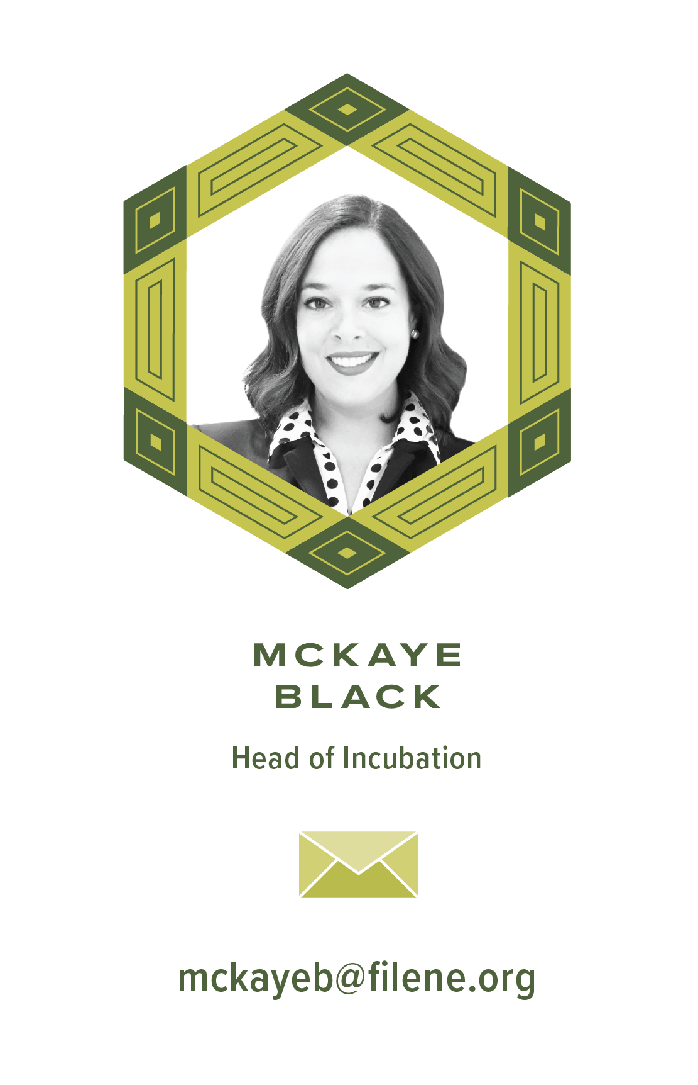
DIVE DEEPER
WANT MORE?
Visit filene.org/i3 to keep up with the i3 program and
see how the next waves of credit union professionals
explore complex problems, see with new perspective
and discover breakout solutions.
Filene's next event, EDGE!
May 12–14 | Dallas, Texas | Register at filene.org/events
Notes:
Concept docs and webinars have been posted on Filene’s website
Graduation gifts mailed – if you haven’t received it, reach out
Recording of this webinar will be posted
Graduation Diploma – Print and Social Media Want to stay connected
EDGE
BBM
LinkedIn Group
Kicking off Wave 21 next week

