Slide 1
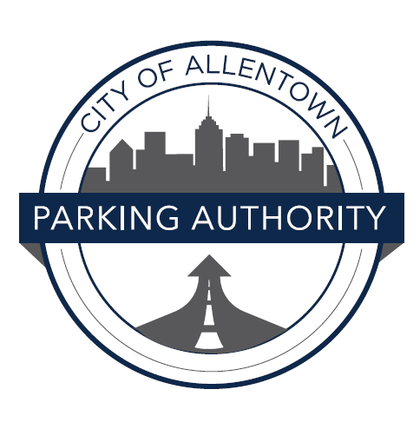
Allentown Parking Authority’s
Community Parking
Workshop
WELCOME!

Slide 2
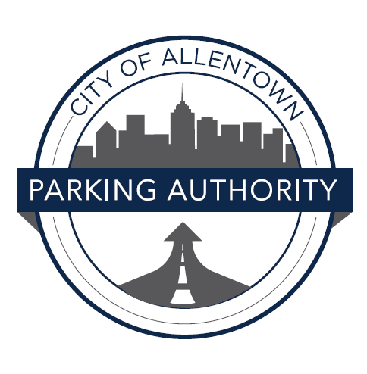
What does the Allentown Parking Authority do?

Slide 3
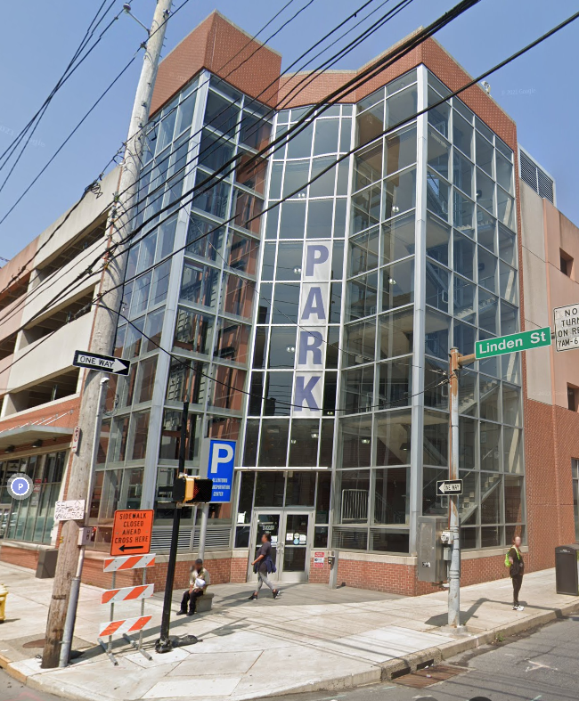
Our Mission
The mission of the Allentown Parking Authority is to operate, monitor, and maintain convenient and accessible parking facilities and on-street parking opportunities within the City of Allentown. The Allentown Parking Authority works to balance the parking needs of residents, employees, business and property owners, and visitors while enforcing parking ordinances and providing appropriate access to parking. We believe that the safety of our visitors and our residents is the number one concern, so we maintain our integrity with our officers keeping you and your vehicle safe while in the City of Allentown.

Slide 4
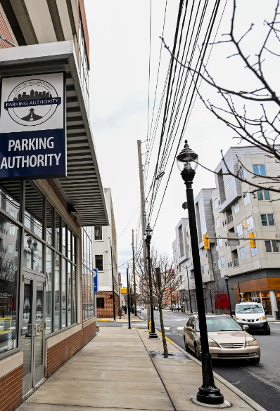
Our Purpose
The purpose of the Allentown Parking Authority is to establish guidelines for enforcing parking law violators that ensures the safety of both the violator and the Parking Enforcement Officer. The purpose of this standard operating procedure is to establish uniform guidelines for officers to follow regarding control and enforcement action(s) incidental to a violation.

Slide 5
Our Policy
It is the policy of the Allentown Parking Authority to enforce parking laws for the purpose of easing the prompt and safe movement of vehicular and pedestrian traffic. Therefore, officer’s enforcement actions, and their decisions about the type of enforcement action to take in any given situation, shall include careful consideration of the nature and seriousness of the violation, the intent of the driver, and the effect of the violation on the violator, other motorists and/or pedestrians.
Officers shall initiate enforcement action based on a combination of training, experience, and common sense. In the absence of specific direction elsewhere, officers shall operate on the premise that deliberate violations of parking laws, and hazardous violators, deserve a more vigorous enforcement effort than do inadvertent violations or non-hazardous violations.
Further, the Allentown Parking Authority places greater emphasis on the quality of an officer’s parking enforcement efforts, rather than the quantity. All parking officers share responsibility for parking enforcement. Supervisors shall consider these factors in evaluating the parking enforcement work of subordinates. The authority expects all uniformed officers to contribute to the parking enforcement effort but does not establish quantitative objectives for individual officers, such as ticket quotas.

Slide 6
City Ordinances
The parking authority enforces the City Ordinances enacted by city council.
The Parking Authority does not make the laws they only enforce them.

Slide 7
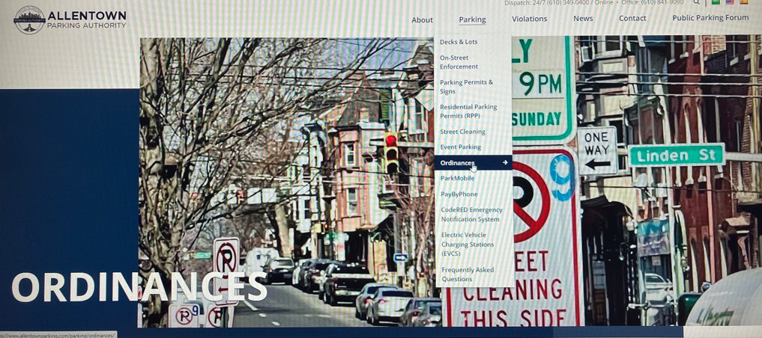
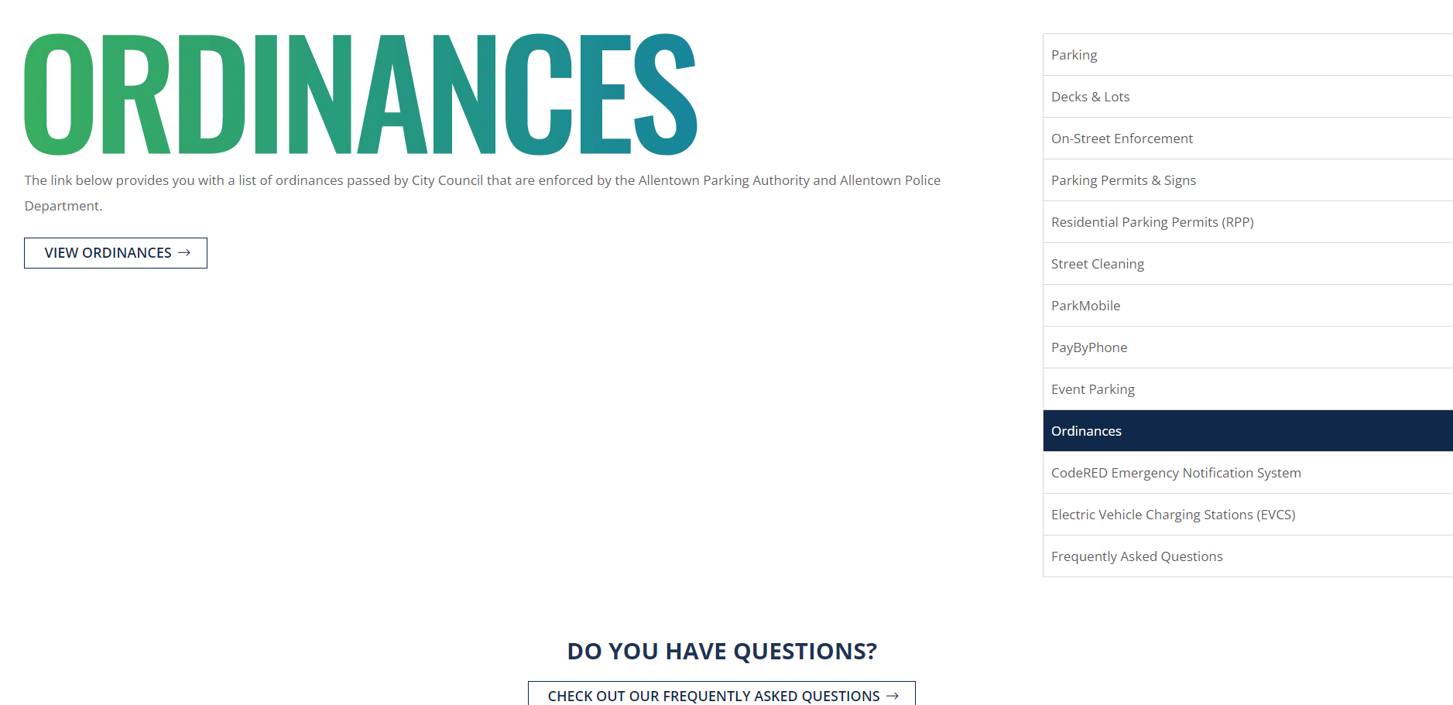
How can I familiarize myself with the Laws?
The parking authority's website provides a link to all city ordinances that are enforced. You can also use google.

Slide 8

What are the Parking Violations?

Slide 9
Most Common Parking Safety Violations
2E: No Parking Anytime
5C: NP within 15ft of Fire Hydrant
2C: No Parking This Street
9A: Double Parking
10A: Lazy Double Parking
2F: Loading Zone
2G: Too Close to Corner
5B: No Repair Work
2V: No Parking on Sidewalk
5A: NP in posted Handicap Area
2W: Parked Opposing the Flow of Traffic
4I: Blocking Street or Lane
4H: Unhitched Trailer

Slide 10
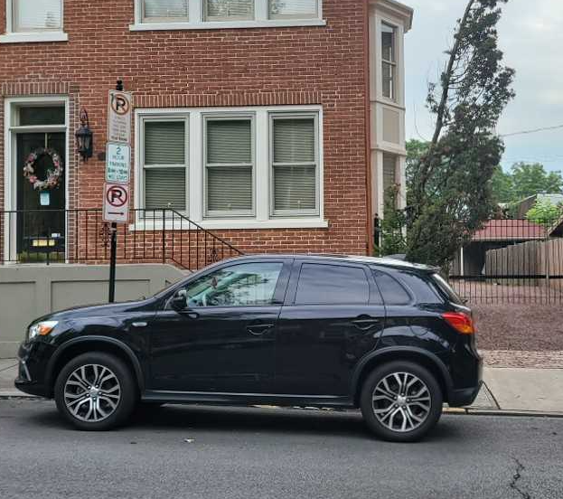
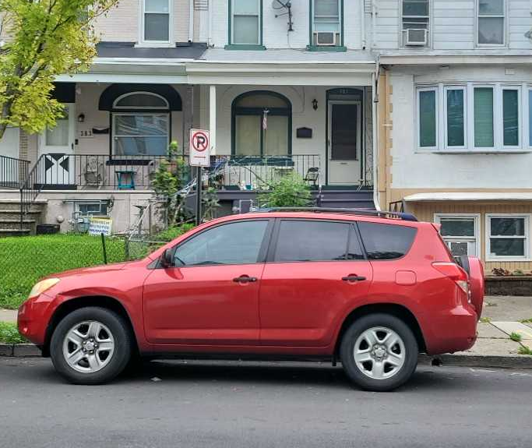
2E: No Parking Anytime
Ordinance States: 617-47 Parking Prohibited in Specific Areas: At any place where official signs have been erected prohibiting standing and parking.

Slide 11
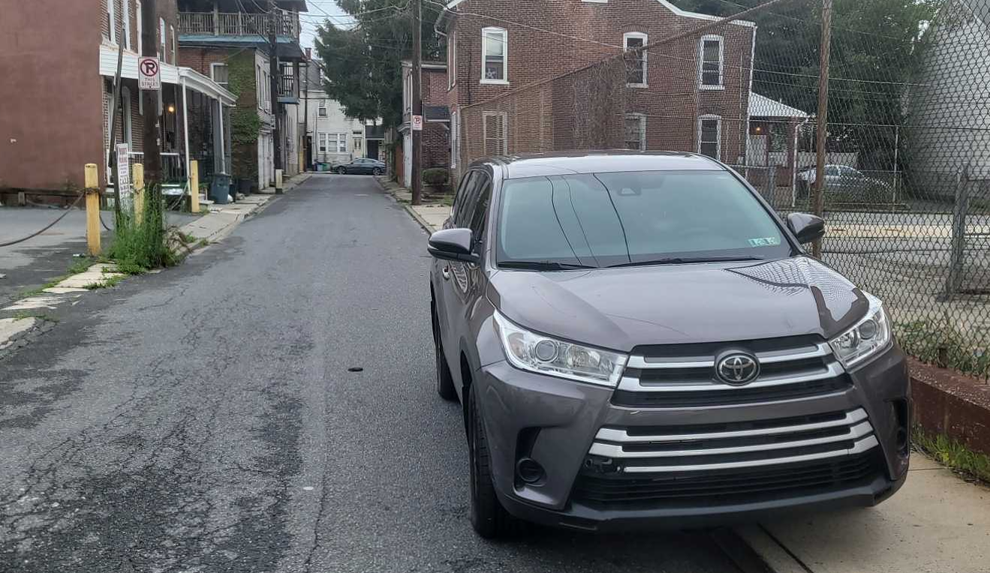
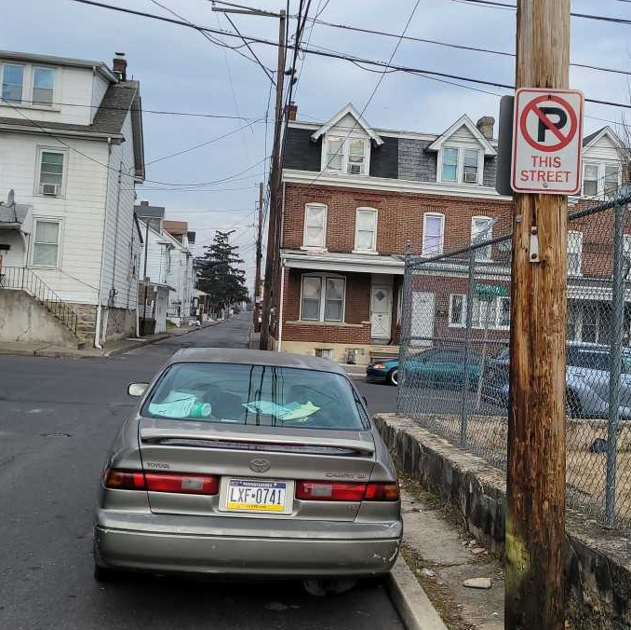
No Parking This Street
Ordinance States: 615-45 Parking in Prohibited Areas: When signs are erected lawfully giving notice thereof, no person shall park a vehicle at any time upon any of the streets or parts of streets designated as prohibited parking areas by the Traffic Control Maps, or by temporary regulations in conformity with Article III.

Slide 12
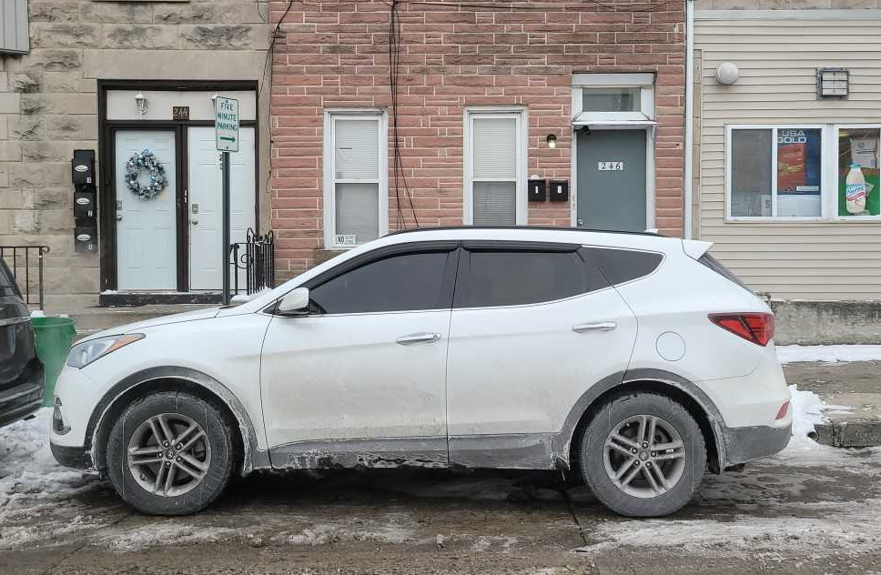
Time Zone
Ordinance States: 615-46 Parking limited in designated areas: When signs are erected lawfully giving notice thereof, no person shall park a vehicle longer than the time permitted upon any street or parts of streets designated as limited parking areas by the Traffic Control Maps, or by temporary regulations in conformity with Article III.

Slide 13
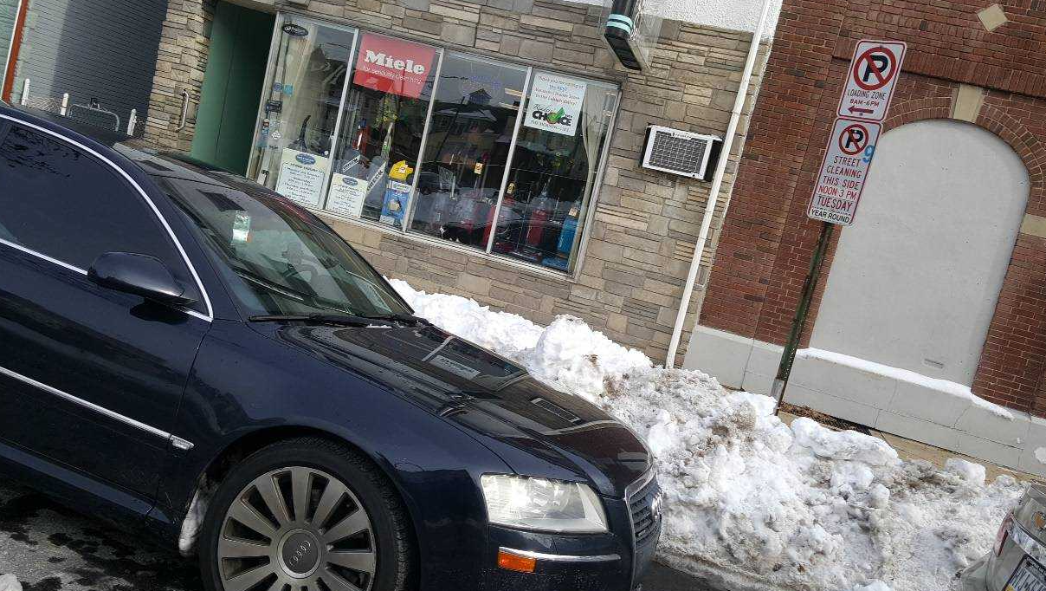
LOADING ZONE/NO STOPPING-STANDING
Ordinance States: 615-56 Parking, stopping, standing, or drifting prohibited in loading zone or five-minute zone: No person shall allow a vehicle to be parked, stopped, standing or drifted to conceal an officer's chalk mark without loading activity for more than 20 minutes in a marked loading zone or more than five minutes in a five-minute zone.

Slide 14
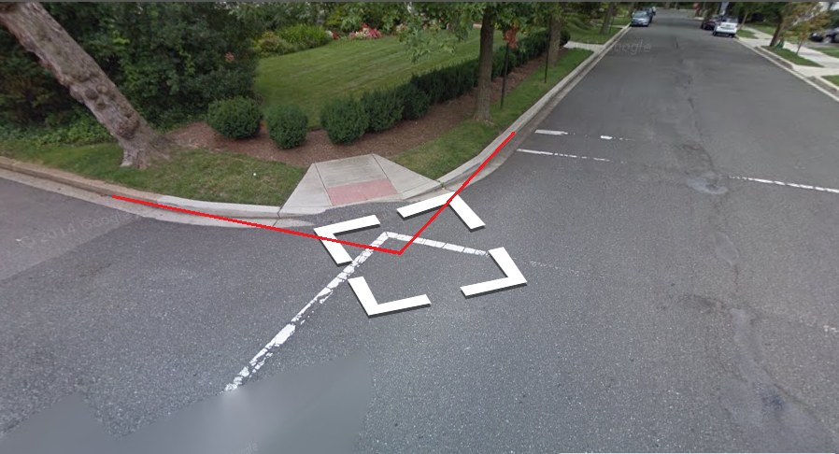
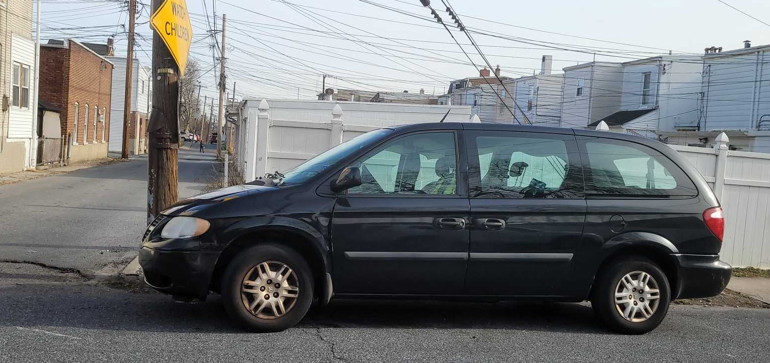
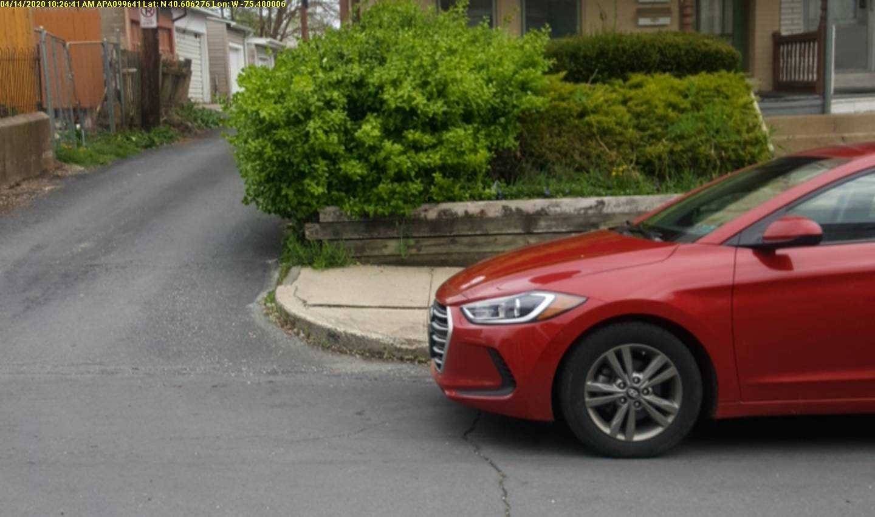
Too Close to Corner
Ordinance States: 617-47 Parking Prohibited in Specific Areas: Within 25 feet from the intersection of curblines or, if none, then within 15 feet of the intersection of property lines at an intersection of highways.
Rounded Corners, measure to the beginning of the next street

Slide 15
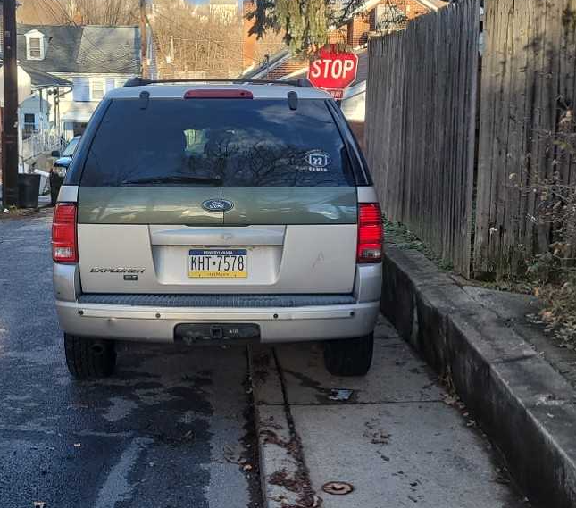
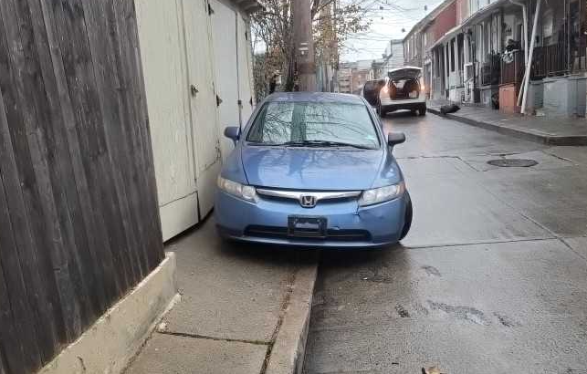
No Parking on Sidewalk
This violation is written when any portion of a vehicle is parked on a city sidewalk.
This vehicle impedes the PUBLICS RIGHT OF WAY
City Ordinance States: 615-47 Parking Prohibited in specific areas: On a sidewalk unless otherwise provided for by legislative action.

Slide 16
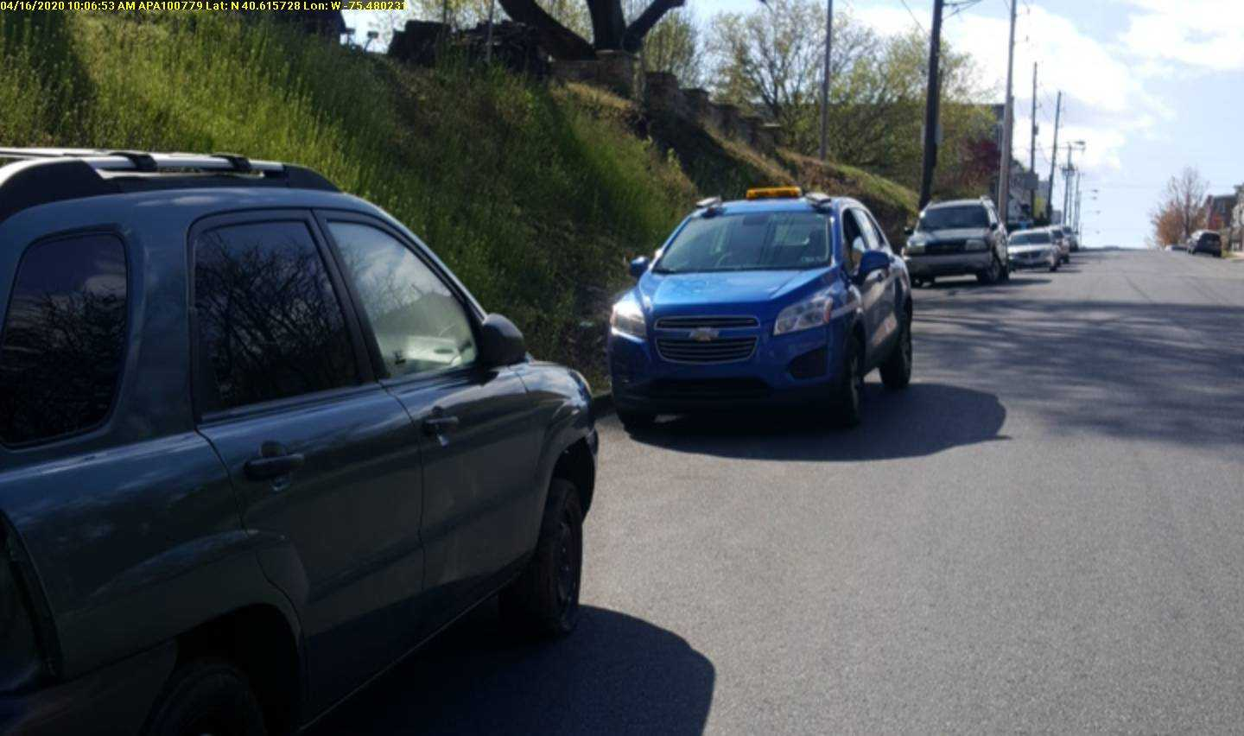
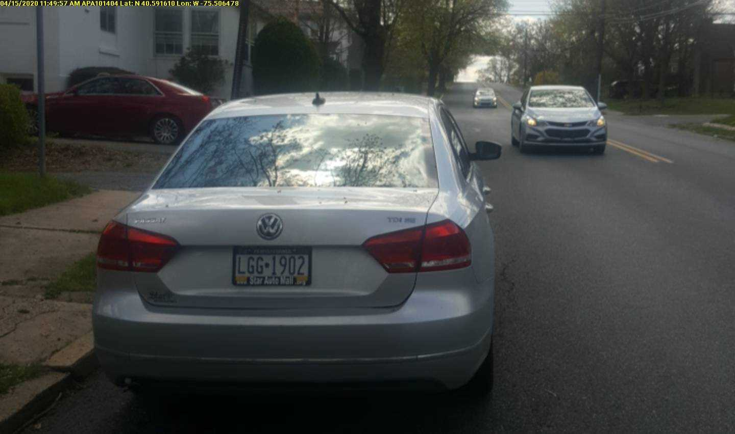
Parked Opposing Traffic
Vehicles that are parked against the grain of traffic are in violation of a city ordinance
Ordinance States: 615-45 Parking Prohibited areas: Except when necessary in obedience to traffic regulations or traffic signs or signals or where angle parking is permitted, the operator of a vehicle shall not stop, stand or park such vehicle on the highway within a business or residence district other than parallel with the edge of the highway, headed in the direction of authorized traffic movement and with the right-hand wheels on a two-way highway or the curbside wheels on a one-way highway within nine inches of the edge of the highway or curb. Vehicles which, because of the type or construction, cannot load or unload parallel to the curb shall be exempt, while loading or unloading only, from the requirements of standing parallel to the curb.

Slide 17
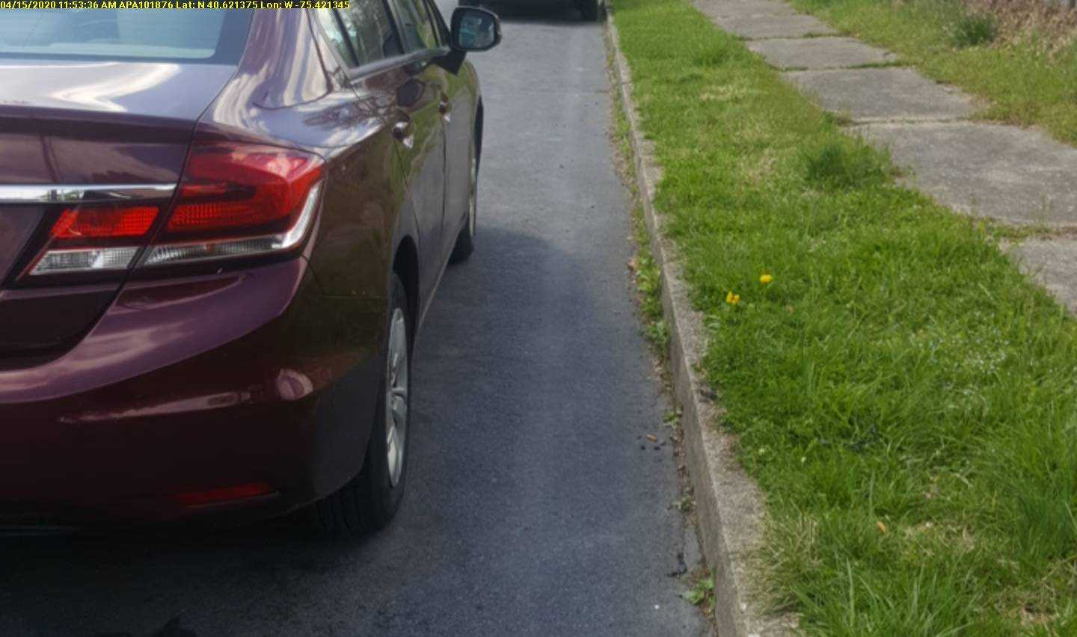
Too Far from the Curb
Ordinance States: 615-45 Parking Prohibited areas
Except when necessary in obedience to traffic regulations or traffic signs or signals or where angle parking is permitted, the operator of a vehicle shall not stop, stand or park such vehicle on the highway within a business or residence district other than parallel with the edge of the highway, headed in the direction of authorized traffic movement and with the right-hand wheels on a two-way highway or the curbside wheels on a one-way highway within nine inches of the edge of the highway or curb. Vehicles which, because of the type or construction, cannot load or unload parallel to the curb shall be exempt, while loading or unloading only, from the requirements of standing parallel to the curb.

Slide 18
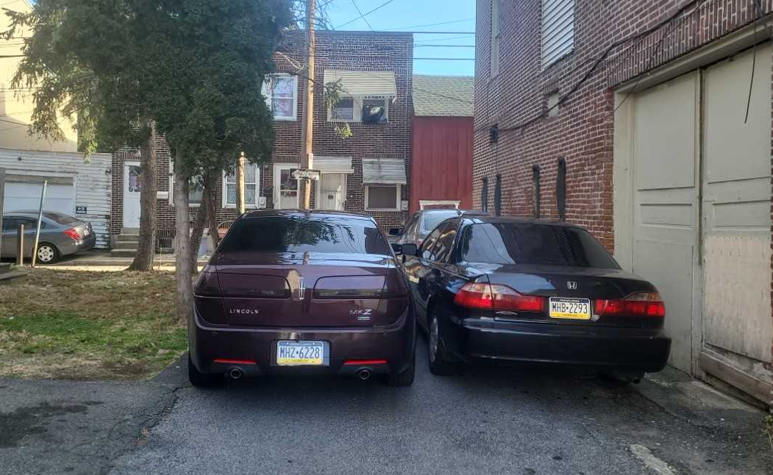
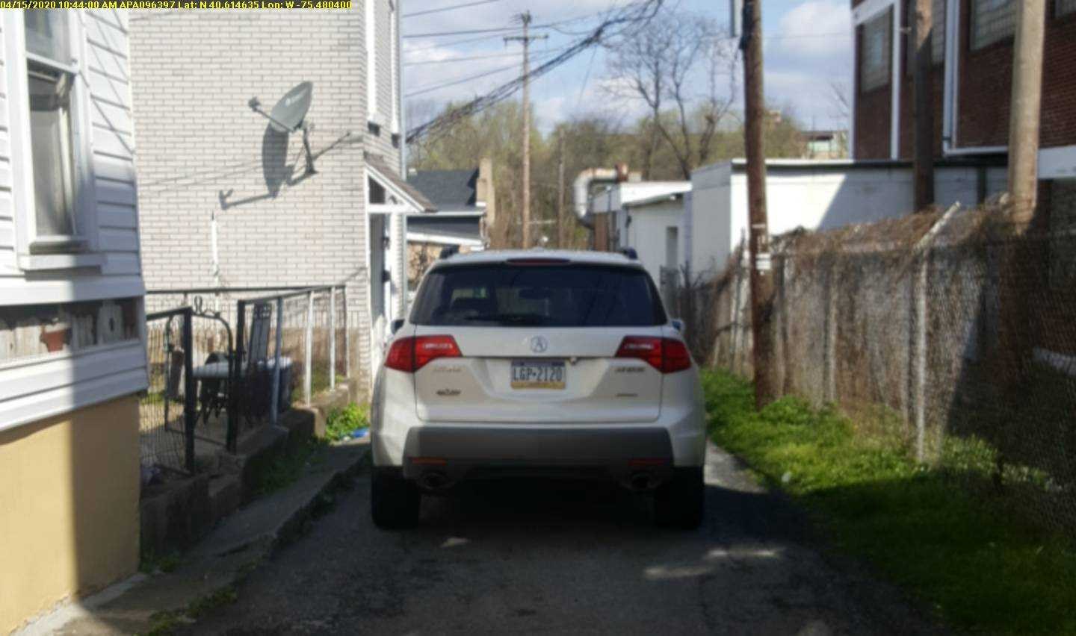
Blocking Street or Lane
Any vehicles in a lane or street that limit other vehicles getting by is considered blocking
Blocking a street or lane can be considered a hazard.

Slide 19
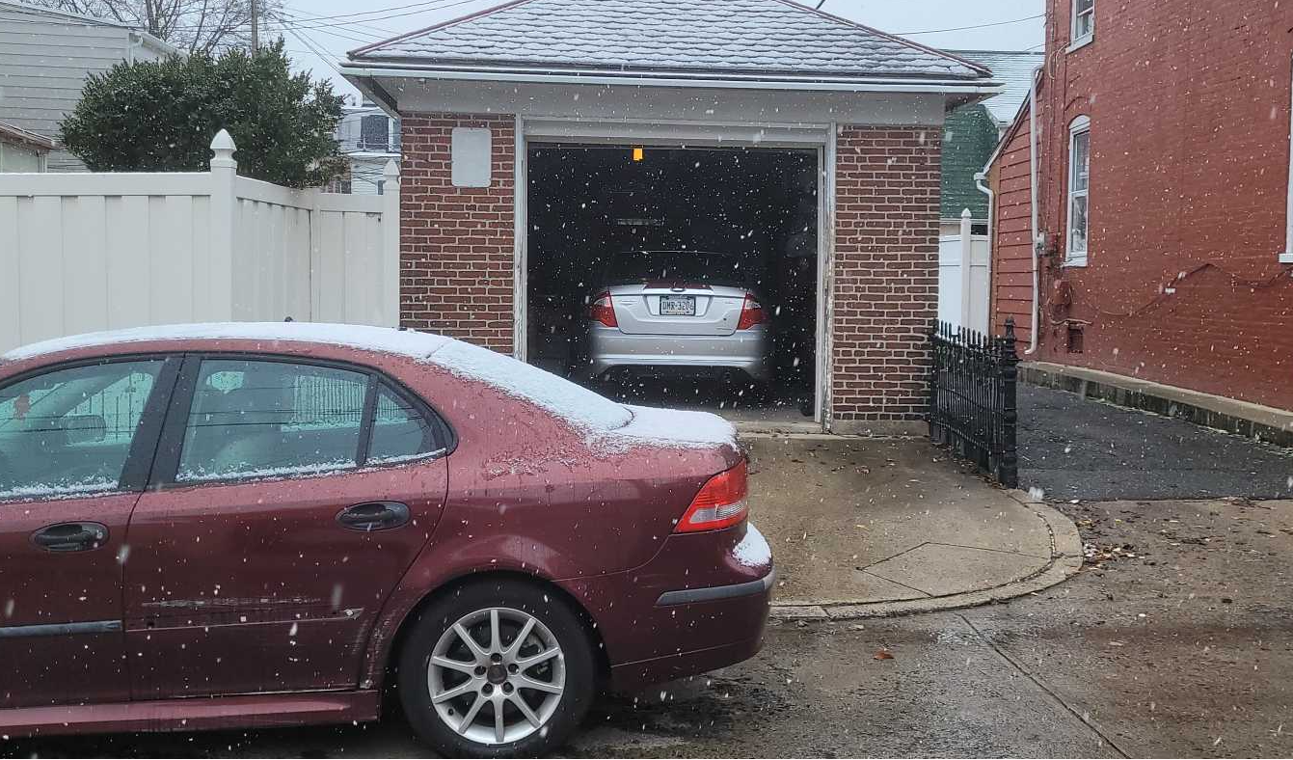
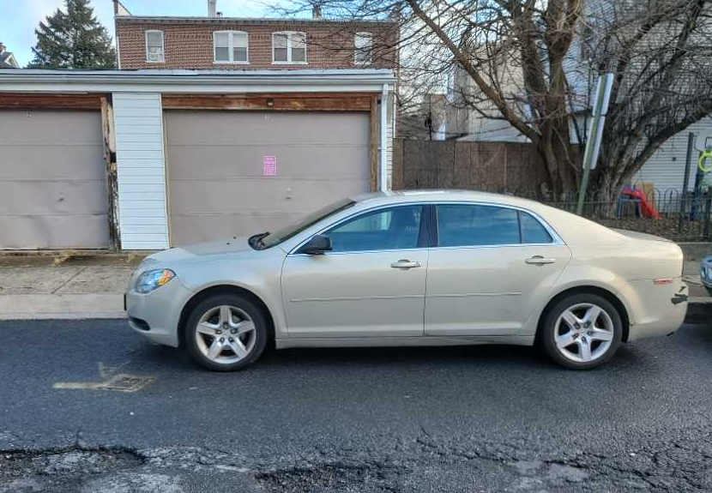

Blocking Garage
City Ordinance states: 615-48 Blocking garage entrance: No person shall park a vehicle at any time in front of, opposite to, or in such a position as to block entrance to or exit by a vehicle from a garage or driveway. The only exception to this is on streets with widths of 20 feet or more where said vehicle is able to park on an apron to a garage and it is able to be more than 50% off the roadway, and it is not parked on a sidewalk.

Slide 20

72 Hour
City Ordinance States: 615-52 Storage of vehicles on streets
No vehicle shall be stored upon any street. As used herein, "stored" shall mean the parking of a vehicle in one place upon any street continuously for over 72 hours.

Slide 21
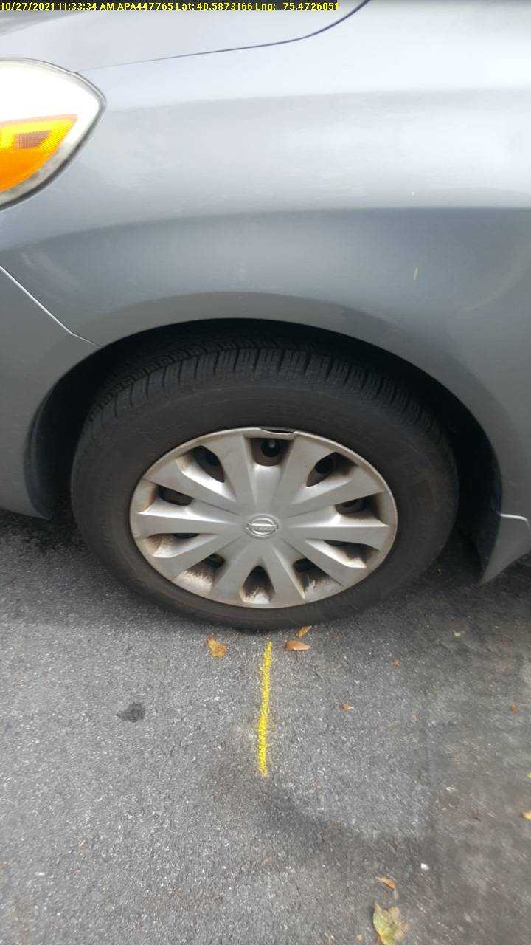
72-HR Process
A 72-hour complaint was made either by an officer or the public
The tires that are closest to the street will get chalked
Chalk will start at the center of the tire and go out about a foot and a half
We also document the stem locations of the tire

Slide 22
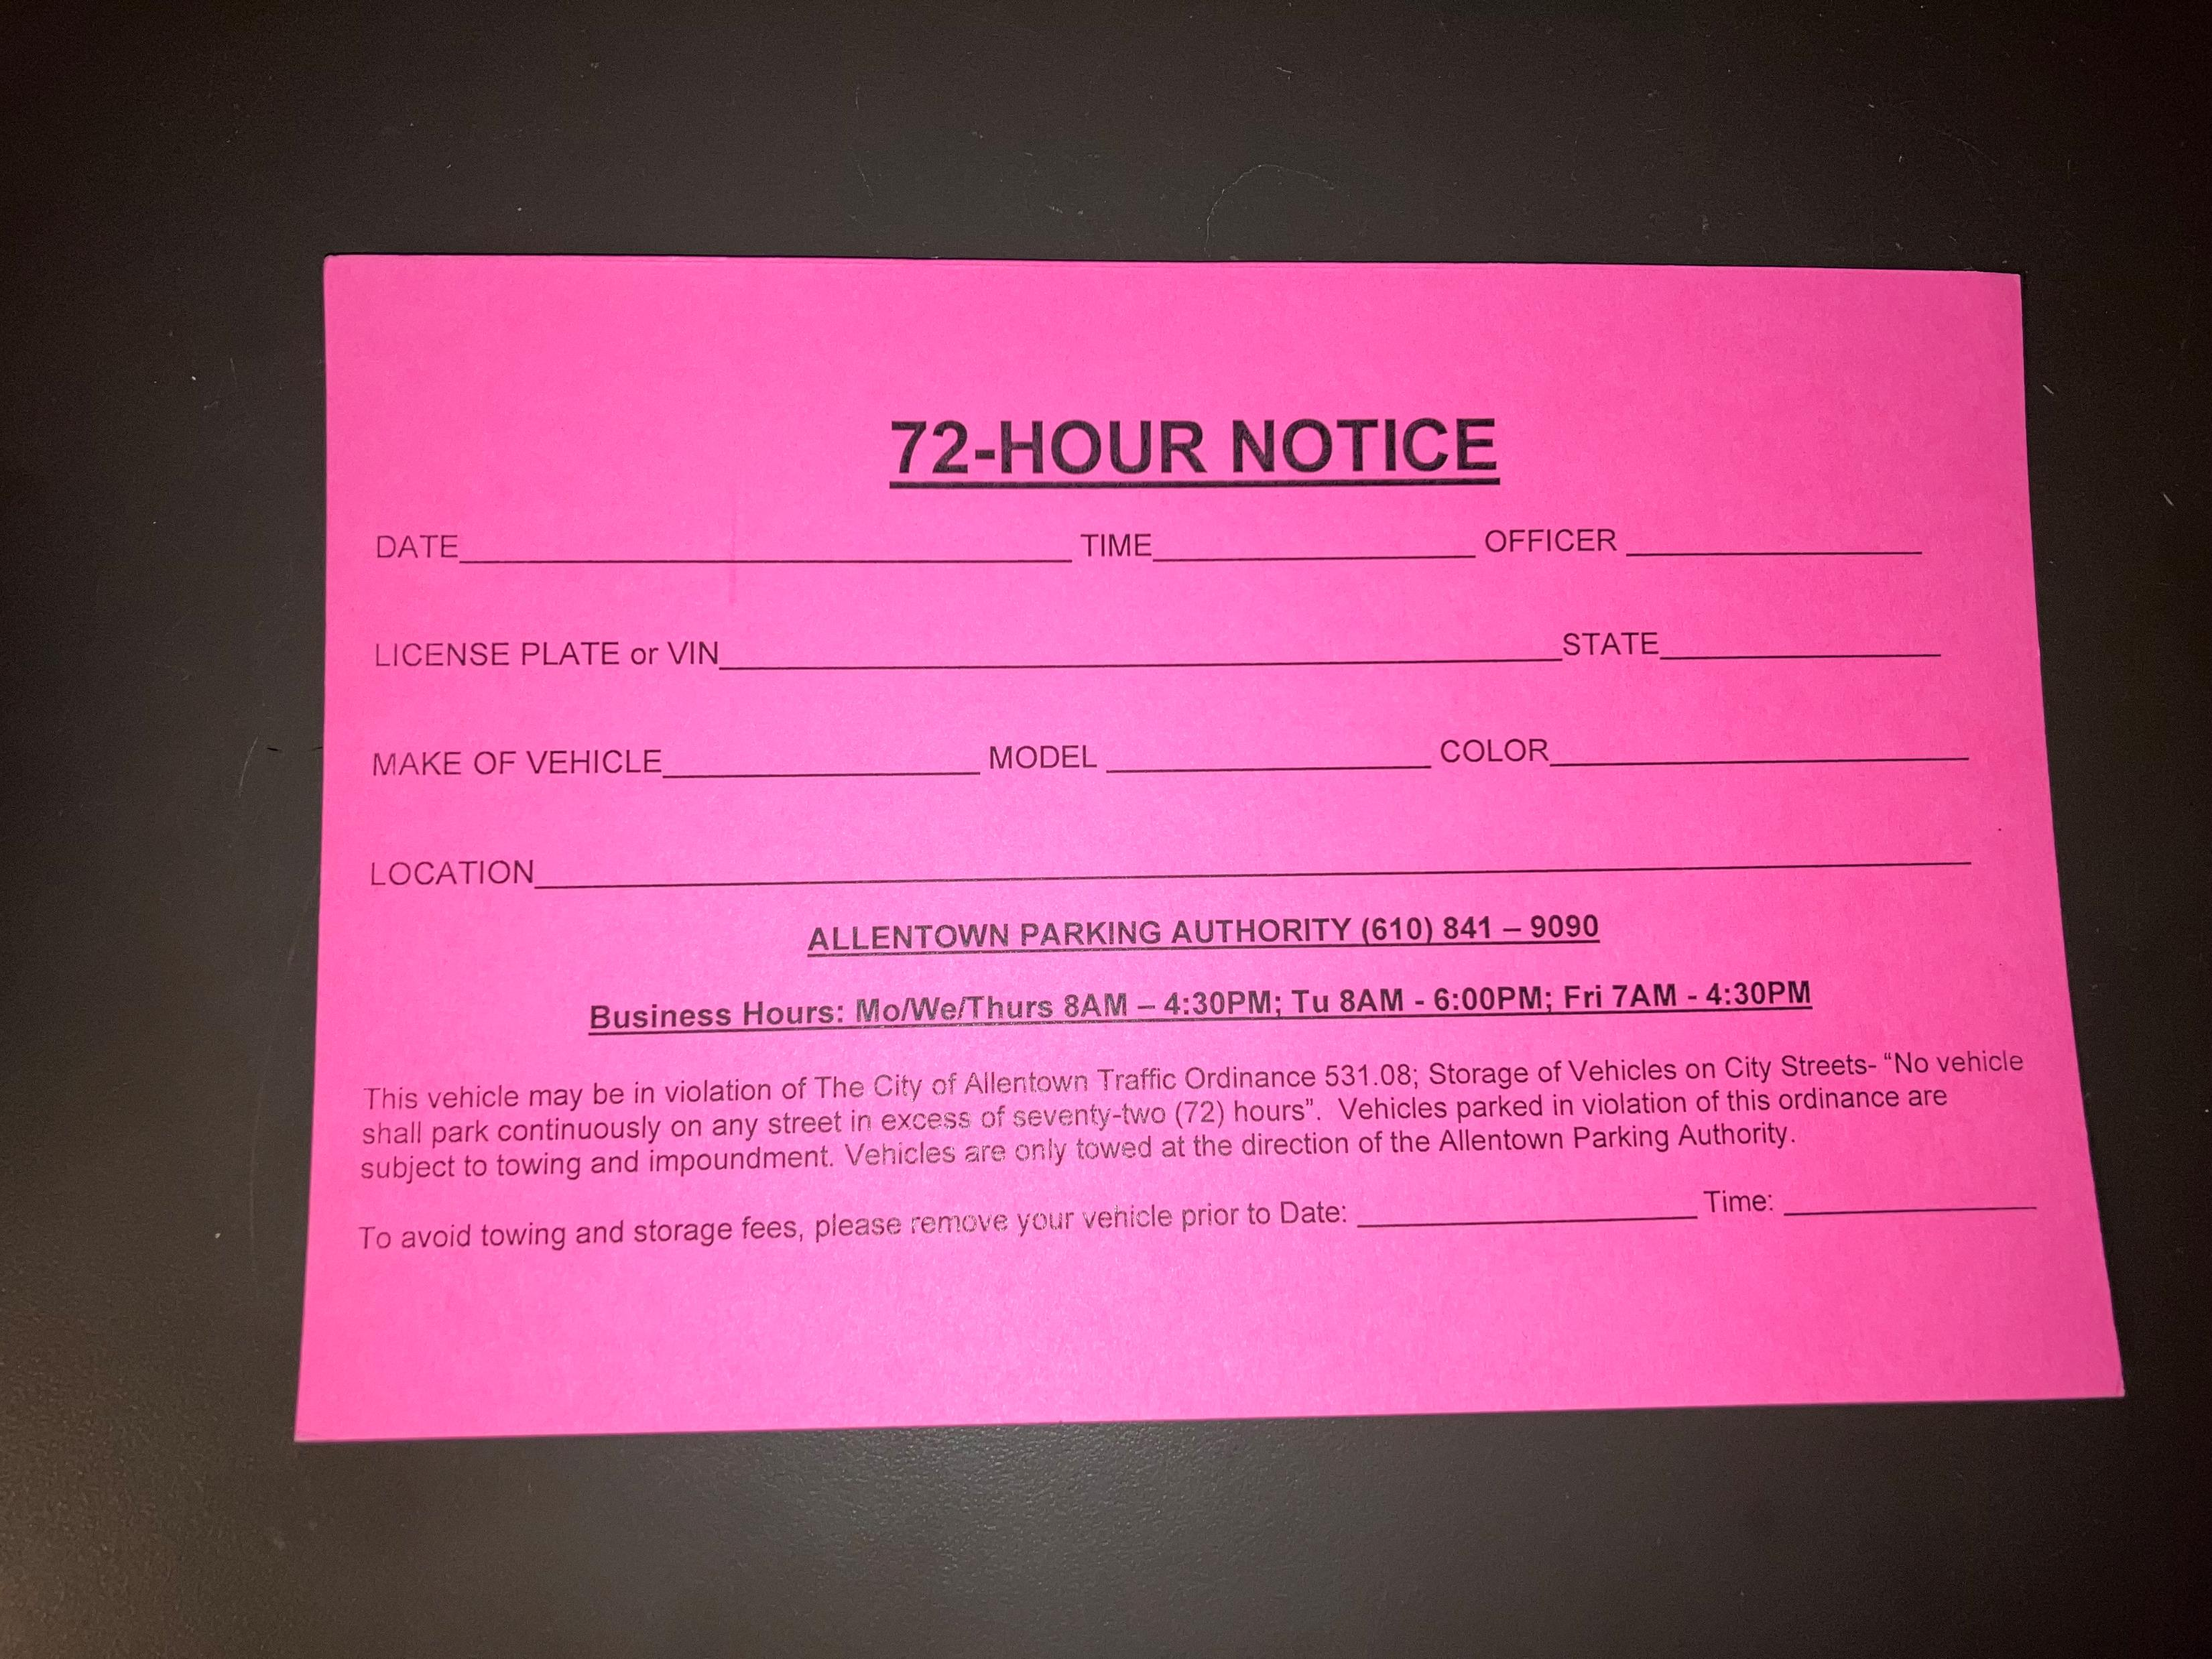
72- HR Process Cont’d
After we chalk the tires, we come back to recheck the vehicle in 3 days. If the vehicle is still present, we put a notice on the vehicle of when we plan to remove it from the street.

Slide 23
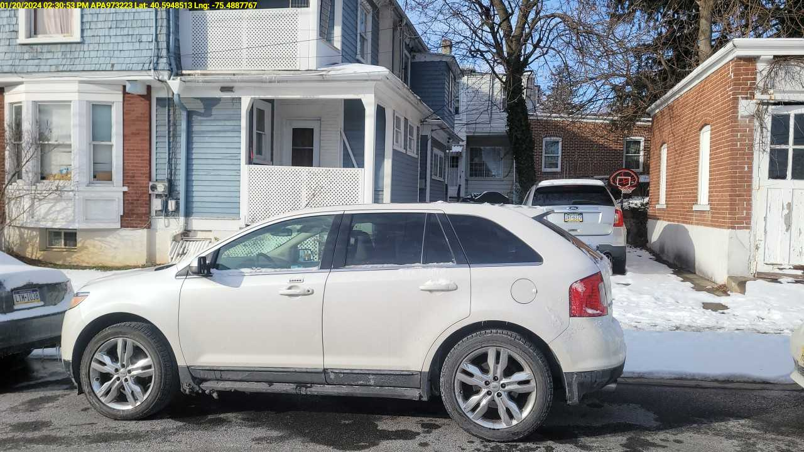
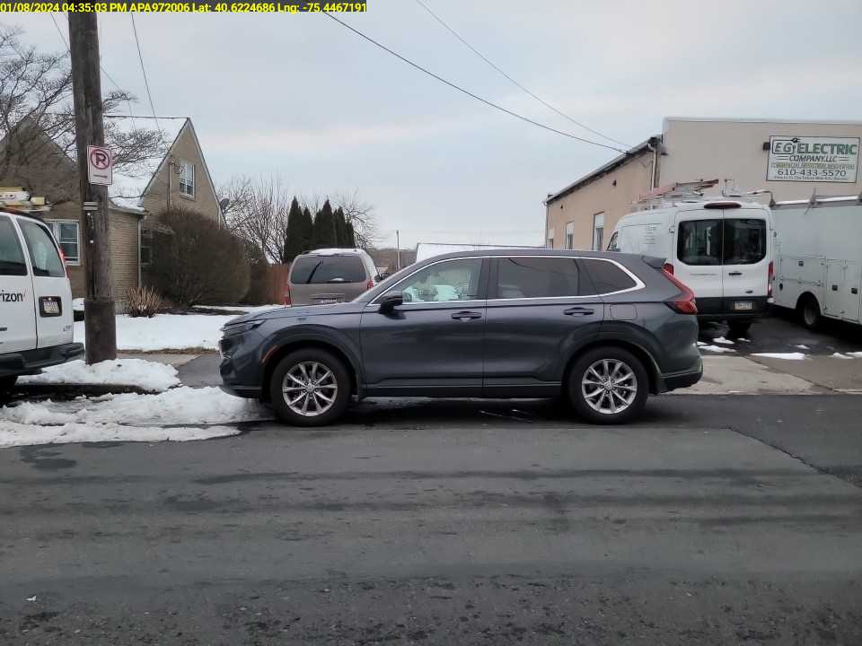
NO PARKING INFRONT OF DRIVEWAY
City Ordinance States: 615-47 Parking prohibited in specific areas
In front of a private driveway or alongside any street or highway excavation or obstruction, or opposite the same, unless a clear and unobstructed width of not less than 20 feet upon the main traveled portion of the street or highway shall be left free for passage of other vehicles thereon unless otherwise provided for in this chapter.

Slide 24
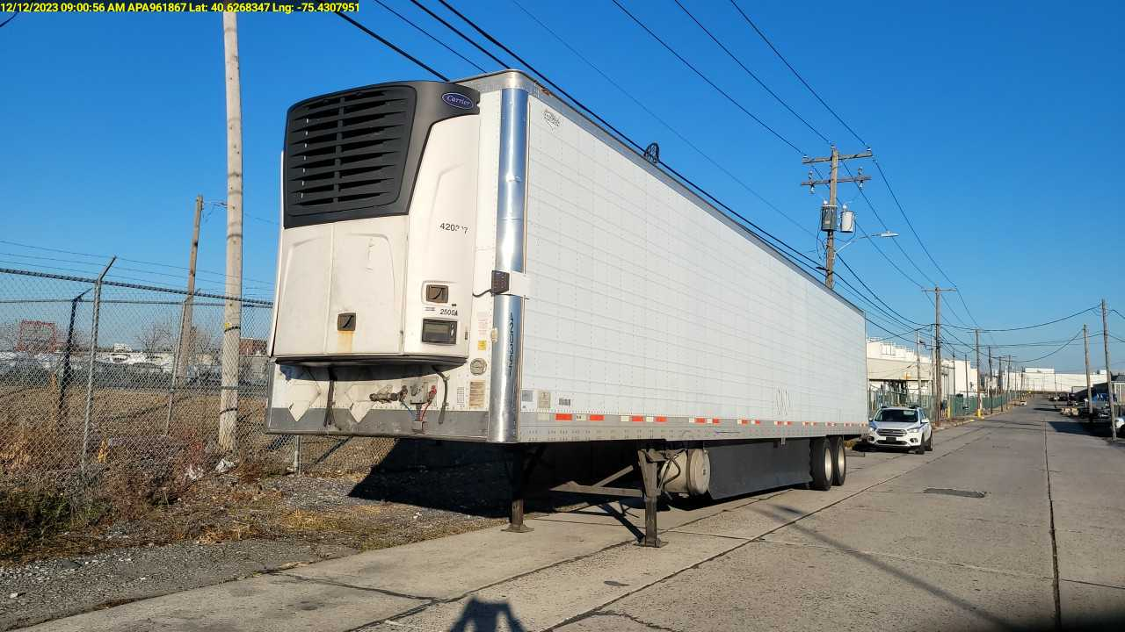

Unhitched Trailer
Ordinance states: 615-51: Parking truck and trailers: No truck trailer or trailer shall be parked upon any street without having attached thereto a means of mechanical traction constructed or designed for the purpose of pulling or drawing such trailer.

Slide 25
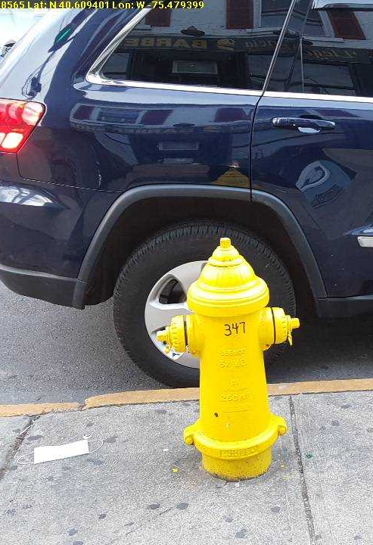
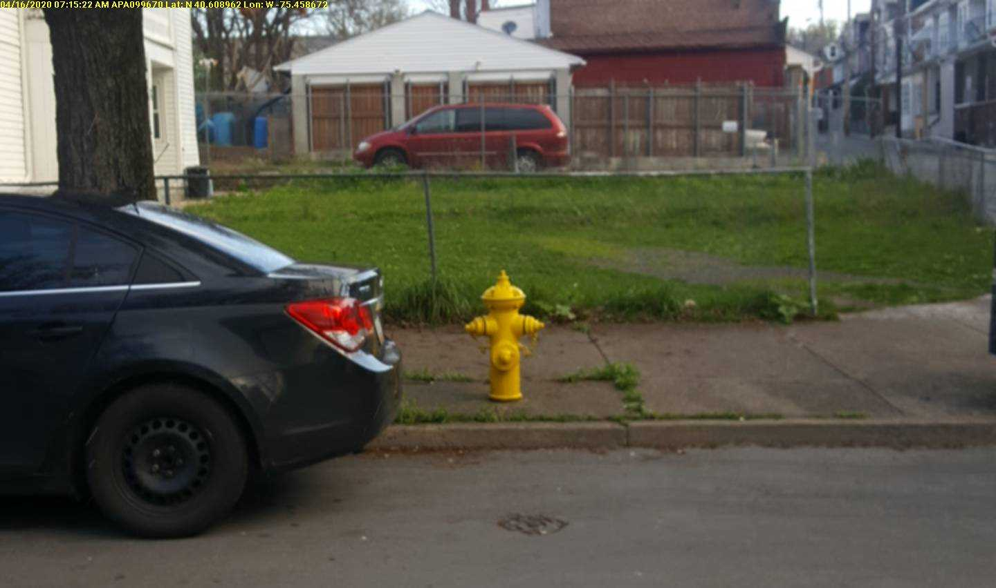
No Parking within 15ft of a Fire Hydrant
Ordinance states: Parking prohibited in specific areas: Within 15 feet of a fire hydrant.

Slide 26
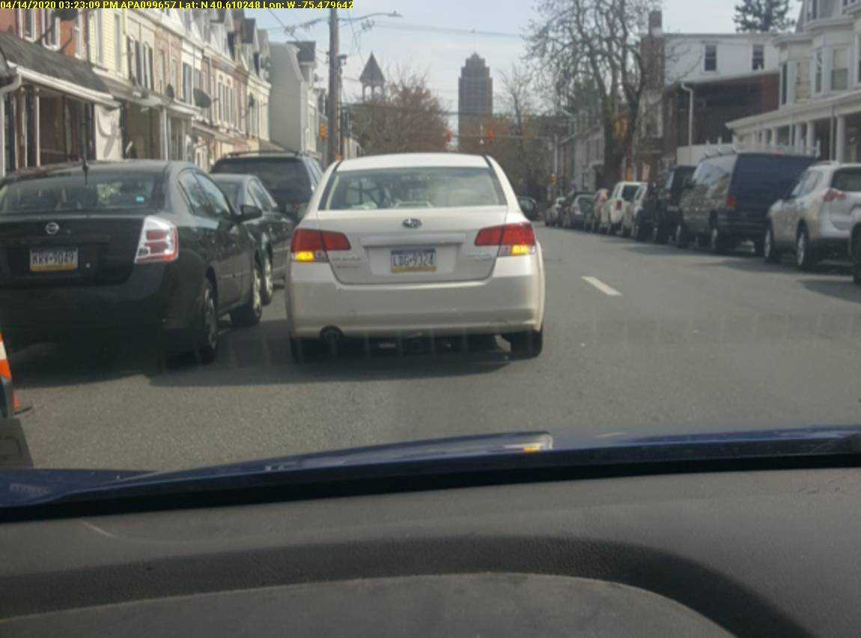
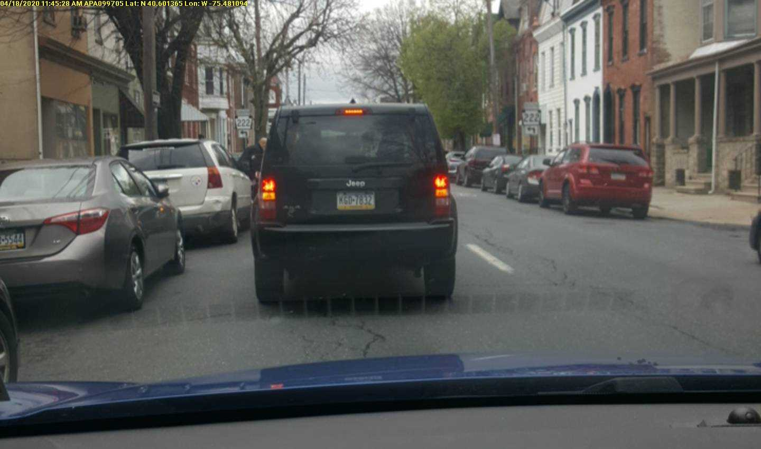
Double Parking
City Ordinance States: 615-47 Parking Prohibited in specific areas: In the lane ordinarily used by moving traffic or on the roadway side of any vehicle stopped or parked at the curb or edge of the highway.

Slide 27
Escalation of Double Parking Violation
As written by City Council:
For violation of § 615-47J, Parking prohibited in a lane ordinarily used by moving traffic or on the roadway side of any vehicle stopped or parked at the curb or edge of the highway, the owner or operator, within 10 days of the time when such notice was issued, pay as a penalty and in full satisfaction of each violation the sum of $100 and, if after 10 days but within 20 days of the violation, the sum of $150. On the second violation offense, the owner or operator, within 10 days of the time when such notice was issued, pay as a penalty and in full satisfaction of each violation the sum of $200, and if after 10 days but within 20 days of the violation, the sum of $250. On the third and subsequent violation offense, the owner or operator, within 10 days of the time when such notice was issued, pay as a penalty and in full satisfaction of each violation the sum of $300 and, if after 10 days but within 20 days of the violation, the sum of $350.

Slide 28
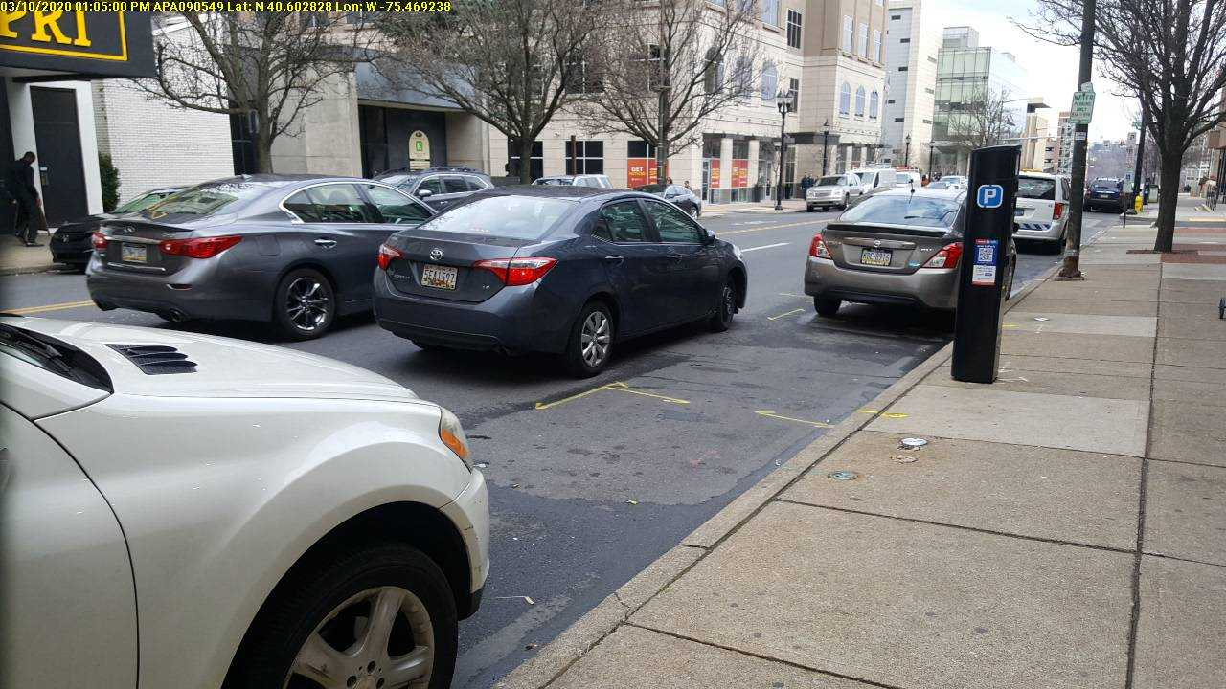
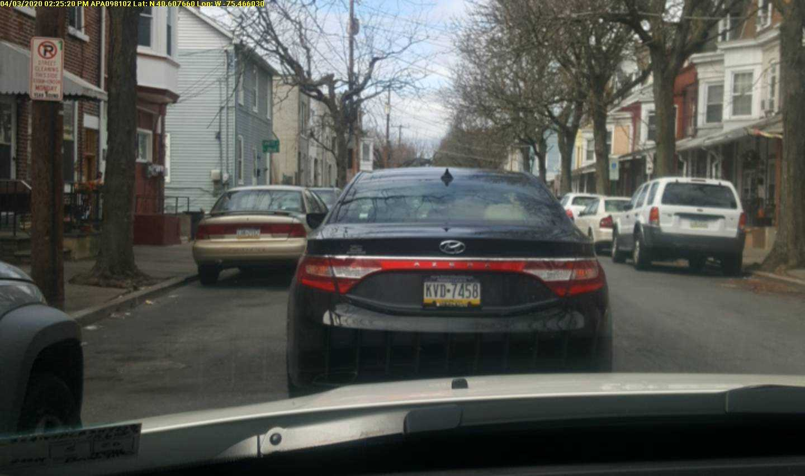
Lazy Double Parker
When a double-parking violation occurs, but there is an immediate, legal, and available space next to the vehicle in violation.
City Ordinance States: Lazy parker provision. If the violator of § 615-47J is adjacent to an open space within 10 feet of an available parking space, an additional $100 shall be added to the penalty.

Slide 29
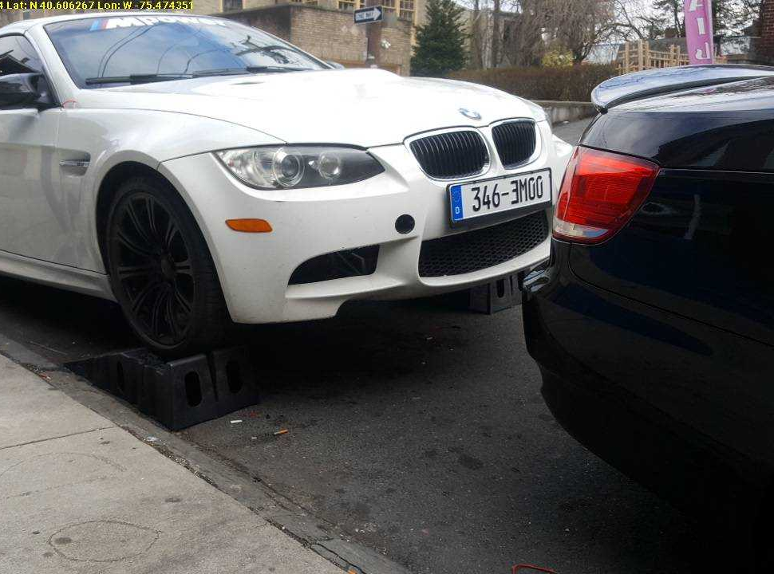
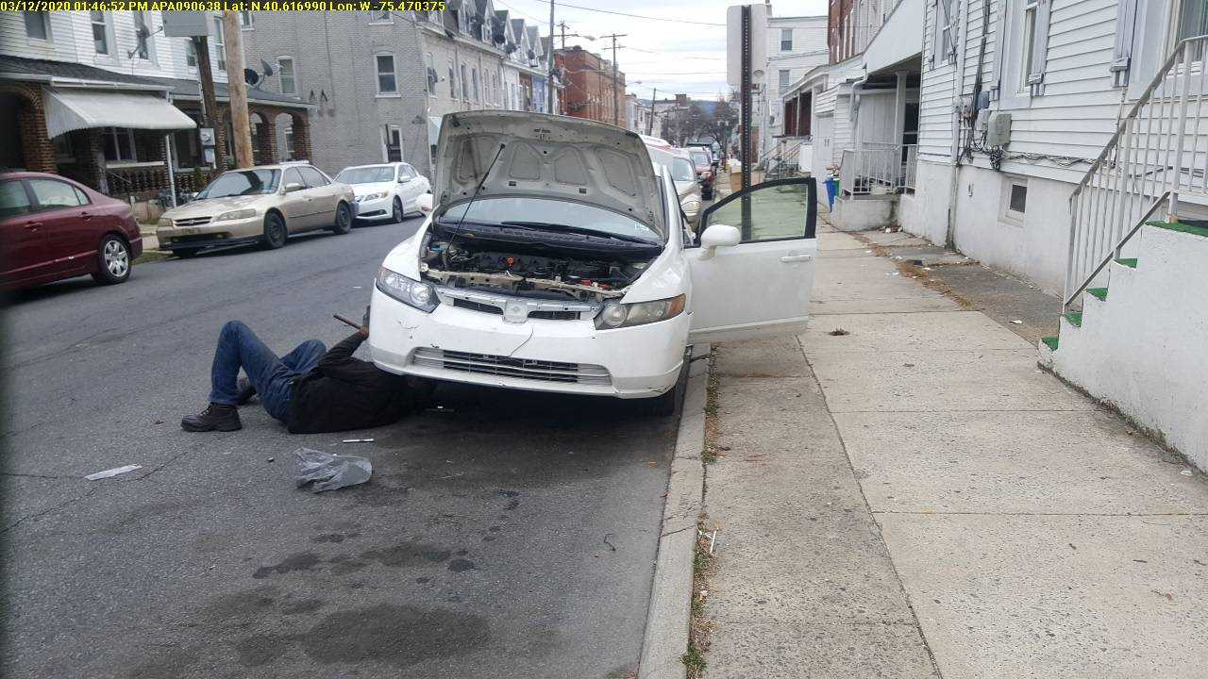
No Repair Work
The ordinance states: 615-49 Greasing or repair work: No vehicle shall stand on any street or sidewalk for the purpose of greasing or repair work except in case of emergency repairs.

Slide 30
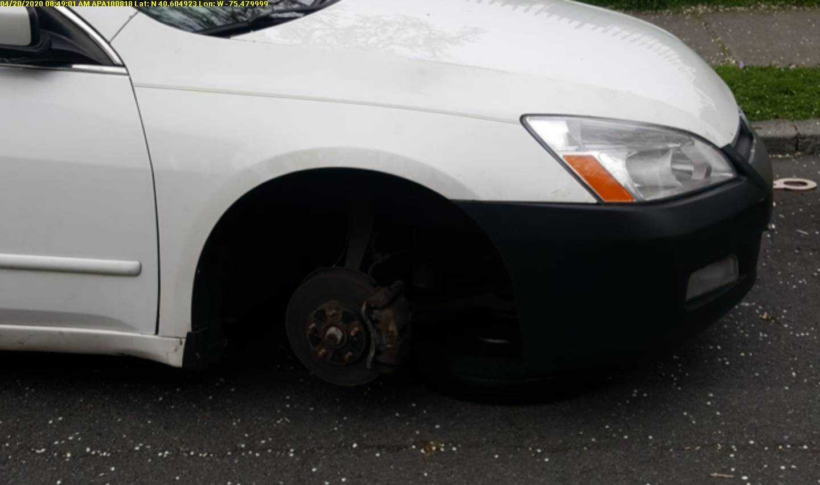
3JA: No Current Reg/ *INOPERABLE*
Even if the registration is current on a vehicle, it can still be tagged for 3JA if the vehicle is unable to be moved.
  Up on a jack
  Vehicle is gutted
  No engine
  The ordinance states: 615-53 Parking of inoperable or illegally registered vehicles
  No person shall park or leave on the streets, highway or public property of the City any mechanically inoperable vehicles or vehicles without current registration plates.

Slide 31
NO CURRENT INSPECTION
City Ordinance States: Parking Inoperable or illegally registered vehicles: No person shall park or leave on the streets, highways or public property of the City any vehicle without a current inspection sticker

Slide 32
Reasons to get Inspection Tickets
1. Inspection is expired
2. Inspection is fraudulent
3. No inspection
4. Out of state inspection

Slide 33
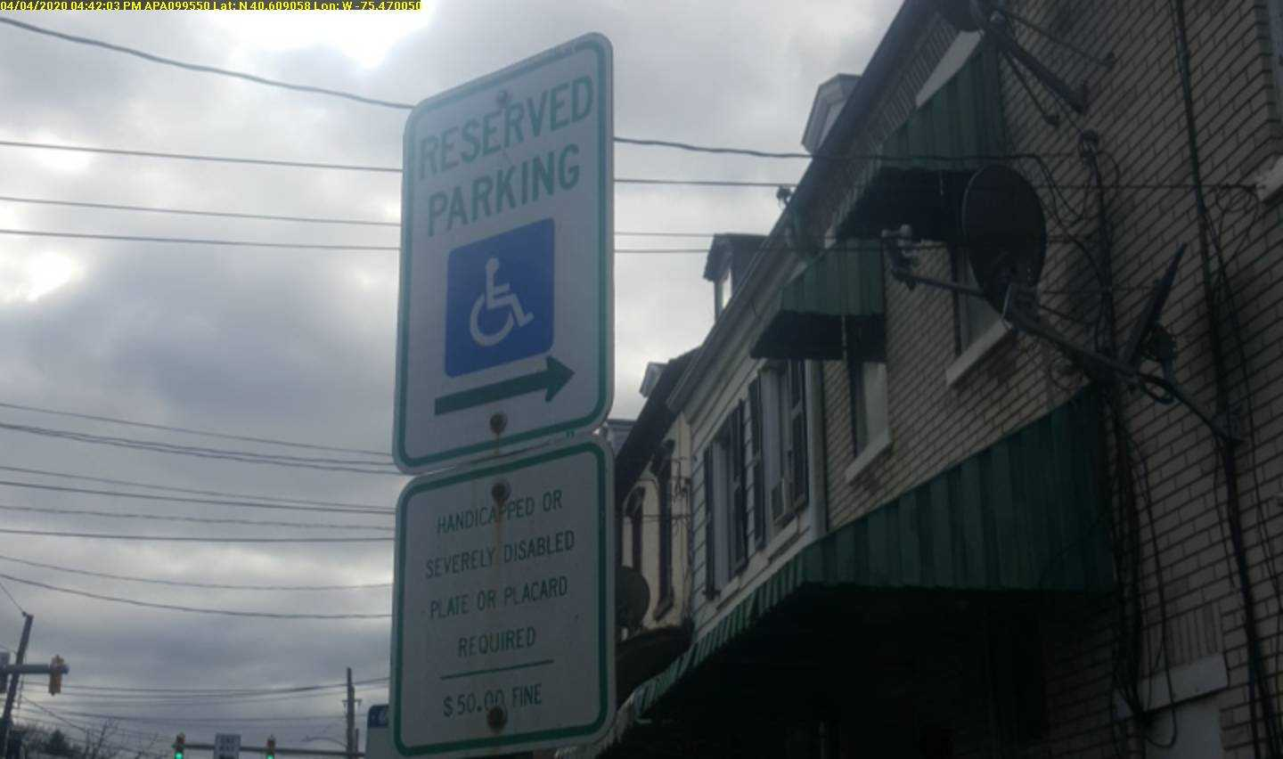
No Parking in Posted Handicap Area
  Ordinance States: 615-55 Parking Prohibited at handicapped areas
  No person shall park or leave unattended a vehicle at any place specifically reserved for handicapped parking, unless the parked vehicle has a state issued plate or placard (displayed in a conspicuous manner) for a handicapped person or severely disabled veteran and is being used in the immediate service of a handicapped person or severely disabled veteran.

Slide 34
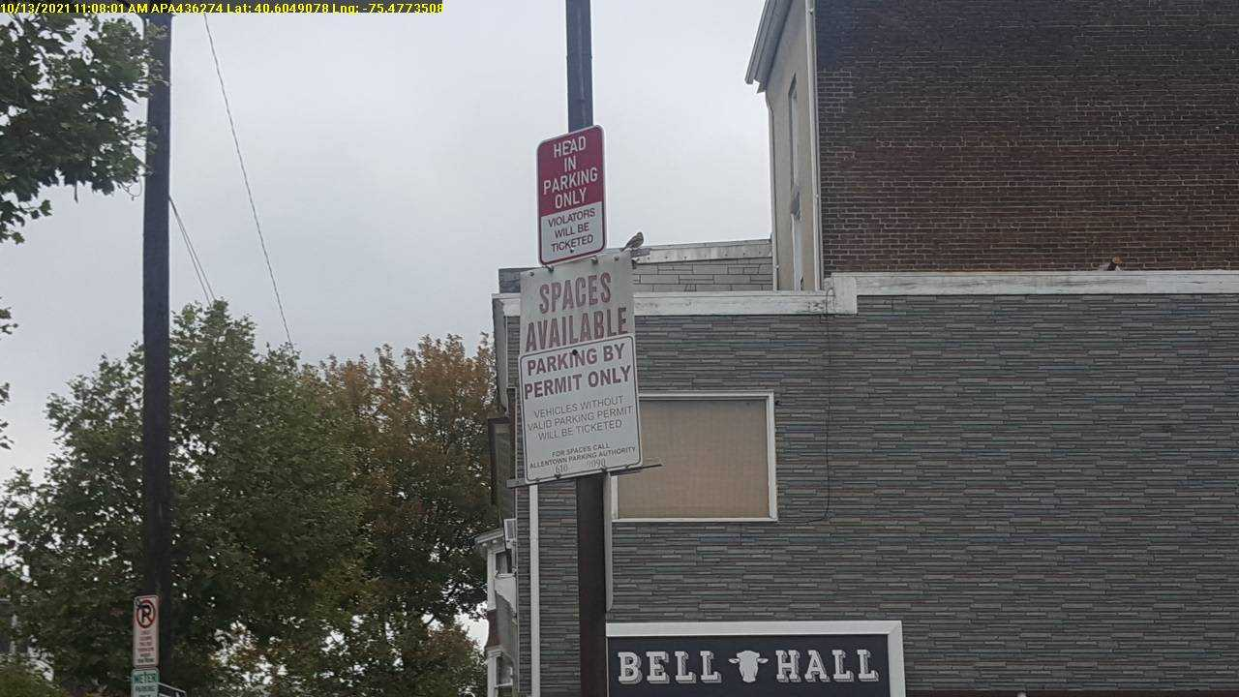
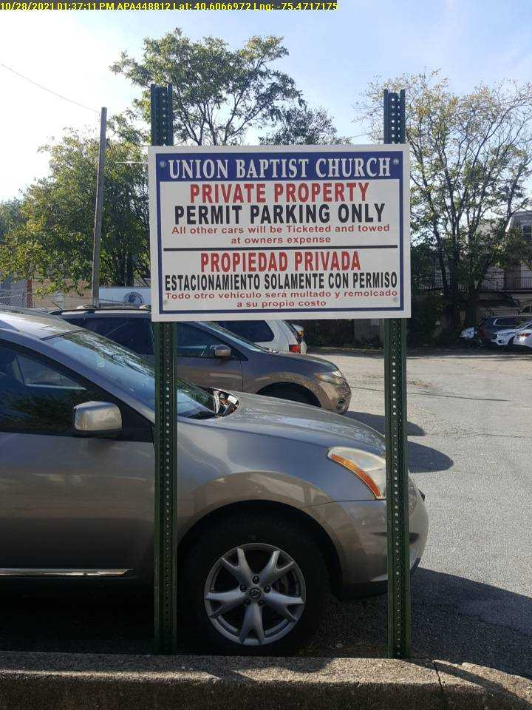
Private Property
The ordinance states: Parking Prohibited on private property
No person shall park or leave unattended a vehicle on private property without the consent of the owner or other person in control or possession of the property, except in the case of emergency or disablement of the vehicle, in which case the operator, within 24 hours, must show proof of the emergency and disablement and remove the vehicle from the private property.

Slide 35
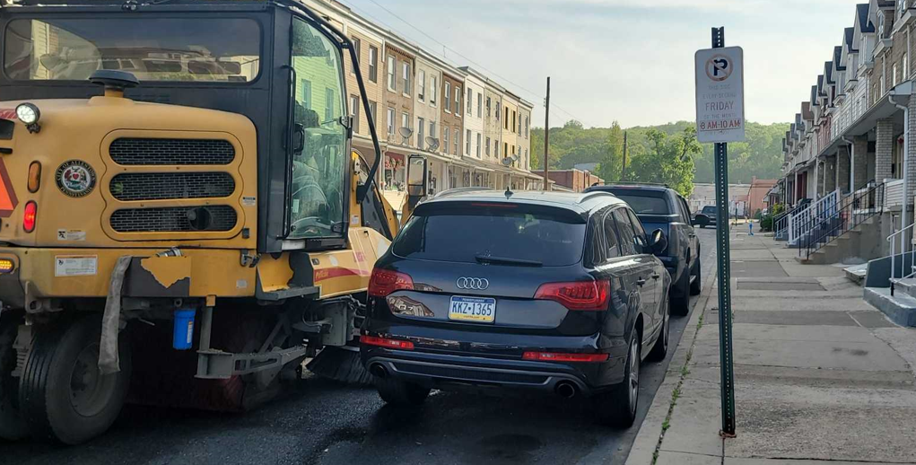
Street Cleaning, sweeping, leaf collecting, snow plowing
Ordinance States: 615-111 Parking restrictions; exceptions: No person shall stop, stand or park a vehicle, or cause or permit a vehicle to be parked or left unattended on a City street posted for "No Parking/Street Cleaning" during the designated days and hours chosen by regulations promulgated by the Director of Public Works or his designee.

Slide 36

HOW DO I REPORT AN ILLEGALLY PARKED CAR?

Slide 37

24/7 DISPATCH NUMBER
Our dispatching department is open 24/7 including holidays.
The phone number is 610-349-0400

Slide 38

DO YOU TICKET 24/7?
We have staff working 24/7
Between the hours of 11PM-7:00AM we patrol our parking garages, lots, contracted lots, dispatch complaints, and any hazard violations in between

Slide 39
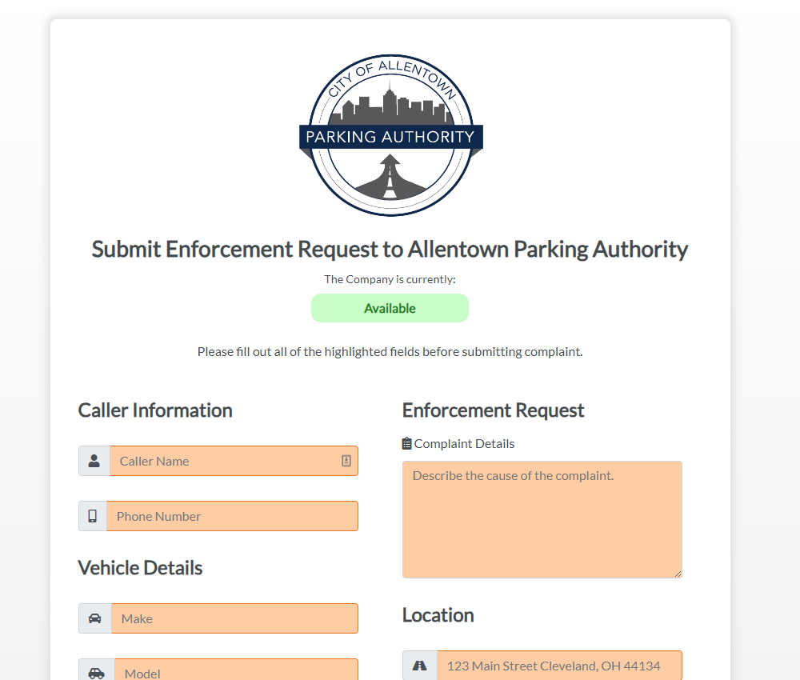
Is there another way to report illegally parked vehicles?
Yes!
You can report illegally parked cars online through our website’s digital dispatch tab.

Slide 40
Do I have to give my name and phone number?
There are some complaints where we do need a name and phone number to send an officer such as 72 hours, private property, blocked garages/driveways.
All other complaints may remain anonymous if need be
We use the information to call you back if we have any questions or can't locate the vehicle in violation

Slide 41

ANY QUESTIONS?

Slide 42
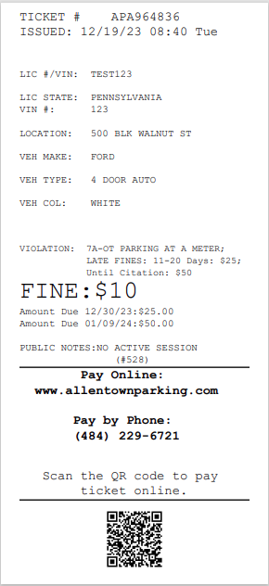
Ticket number
If you would like to appeal your ticket you can do so by going on our website and click “Appeal a Ticket” under the Violations drop down.
You may also appeal the ticket by calling our Customer Service Department at 610-841-9090.
Date, time & day of the week ticket was issued
Plate number or last 8 of vin
State of plate or VIN only if written by last 8 of vin
Vin number if visible
Location vehicle is parked when ticketed
Make of vehicle
Vehicle type ex: 4 door, coupe, truck
Color of Vehicle
This is the reason a vehicle is receiving the ticket
This amount showing is what the ticket starts at
The ticket will escalate to these amounts on these days shown
This will give more of a description of what the ticket may be for
Payment Options:
* Online www.allentownparking.com or scan QR
code at the bottom of ticket
* By Phone 484-229-6721
* In the office at 603 W Linden St

Slide 43
Permits
the APA
offers
Vacation Permits
RV Permit
Residential Parking Permits
Monthly Permits for lots or decks

Slide 44
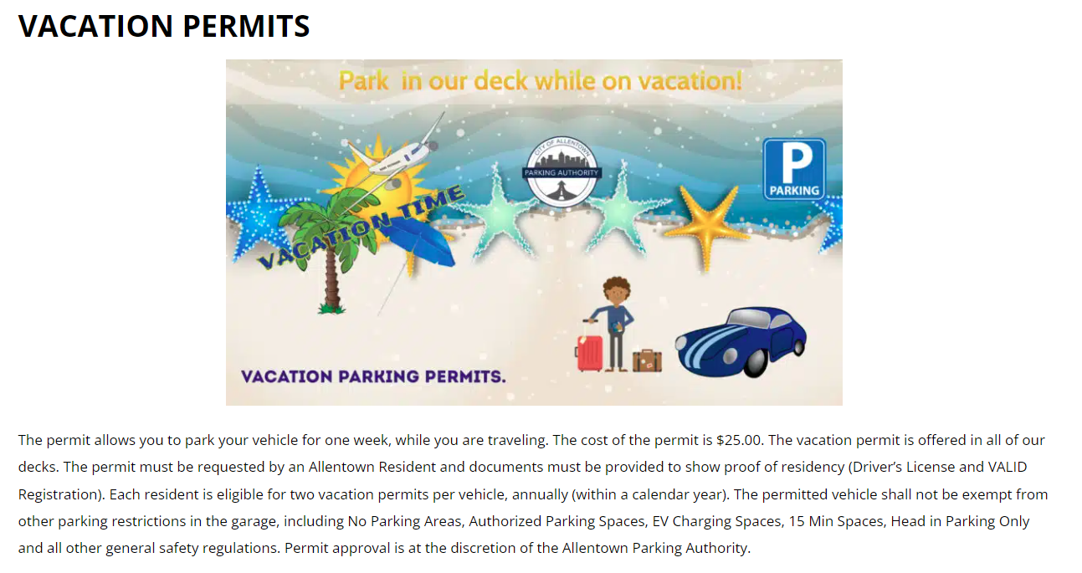

Slide 45
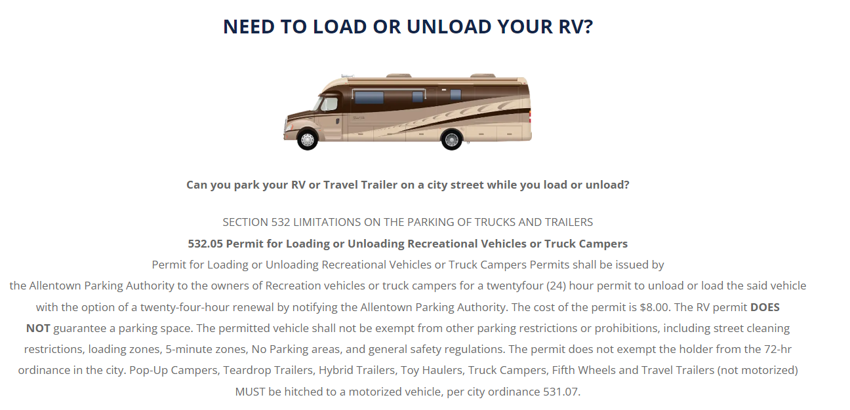

Slide 46
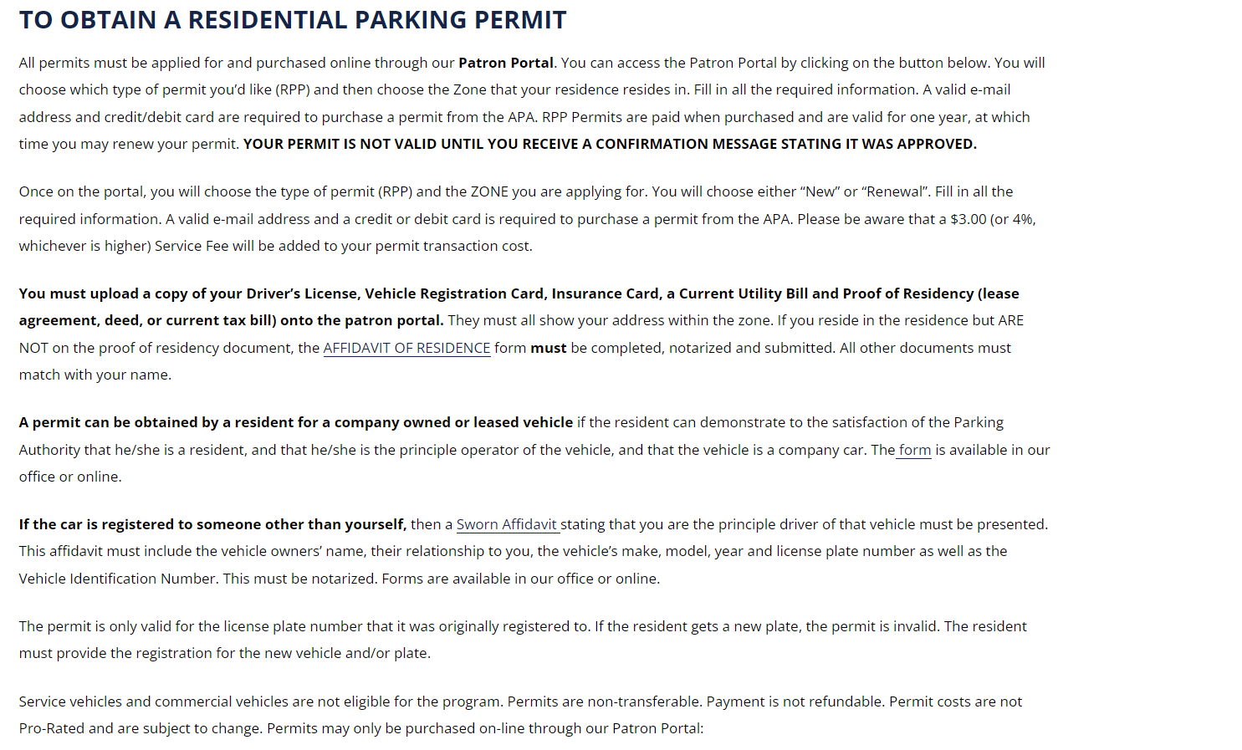

Slide 47
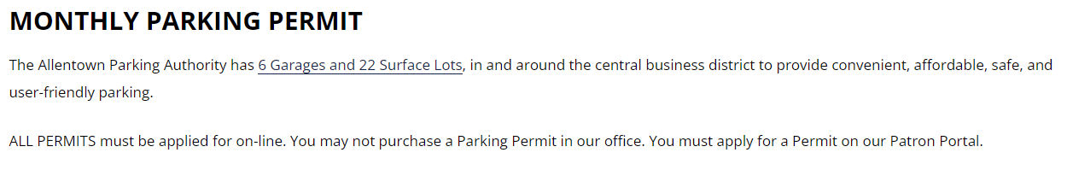

Slide 48
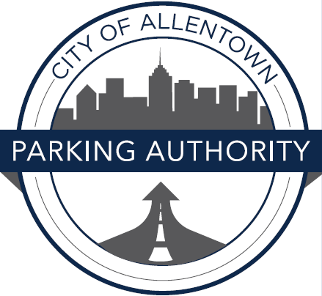
It would be very beneficial to visit our website at www.allentownparking.com.
It has a vast amount of great information that can help you with all your parking questions!
On our website when you click on “Violations” you can either pay a ticket, appeal a ticket, or report an illegally parked vehicle.
You can also go to the Patron Portal and sign up for email alerts so if the vehicle you have registered gets a ticket you will receive an email!
Under the “Parking” tab you will find a lot of useful information such as the lots/decks we have along with their amounts, where you can park large trucks, all about our parking permits, signs, Parkmobile, Pay-by-Phone, and street cleaning.
You can also go right to the city website if you click on ordinances under the “Parking” tab if you have any questions about what we can ticket for and the details of each one.

Slide 49

CodeRED is a free* community notification system available to Allentown residents, workforce, and visitors that sent you text alerts concerning parking, emergency, and safety information that may impact your area, via text messages.
The Allentown Parking Authority encourages you to actively participate in up-to-date parking information and emergency preparedness by remaining informed by registering for these alerts. Sign up today it only takes 5 minutes!
*Standard Message & Data Rates May Apply
You can sign up for alerts regarding the following:
-General Parking Information
-Street Cleaning Notifications
-Parking Decks
-Surface Lots
-Residential Parking Permits
-Street & Road Closures
-APA Business
-Emergencies
Text the word “APAalert” to:99411
Follow the prompts too create a “Managed Account”
Choose your categories and you are set!

Slide 50

If you have any other questions or would like more information, please feel free to call our Customer Service Department at 610-841-9090.

Slide 51
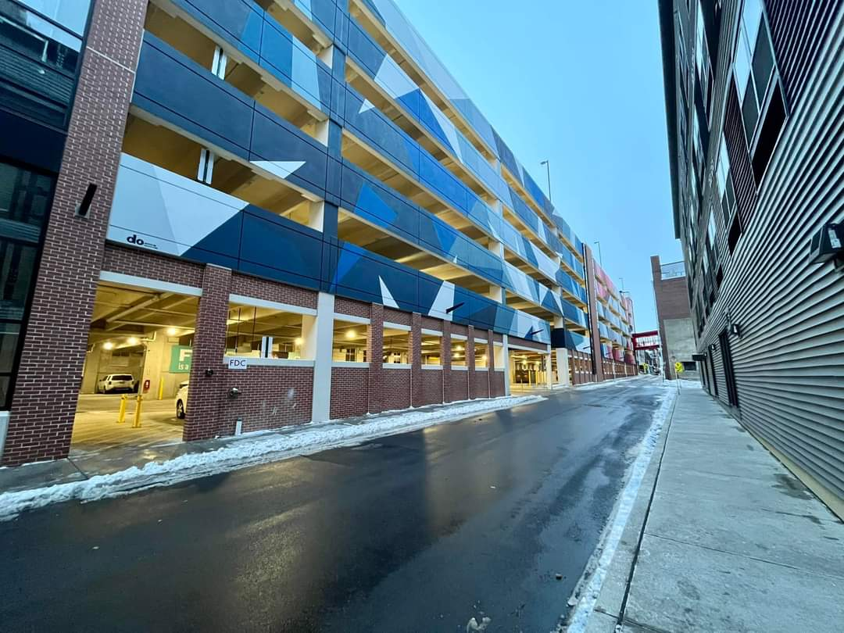
APA Lots and Decks

Slide 52


Introduction
The Allentown Parking Authority owns and/or operates six Parking Garages in downtown, totaling over 3,600 parking spaces and 22 Surface Lots in and around the Allentown area, adding an additional 1,000+ spaces of off-street parking. There are various permits available for each garage and surface lot..

Slide 53

Lots
Permit vs. Public & Permit:
In the 1st and 6th ward, we have 8 residential permit only lots.
Permit only lots require a permit to park there. If you do not have a permit, you are subject to a parking ticket under COA ordinance §615-54
Permits are digitally recorded and tracked per license plate. If you are interested in a permit, you may contact the customer service department at 610-841-9090x2 for more information
In the downtown, center city area, we have 13 lots.
  6/13 lots are permitted and public
If a lot is public, a kiosk will be located on the lot for a rate of $1.00/HR.

Slide 54

Equipment

Slide 55

Decks
Decks are permit only or through an hourly fee of $1.00/HR
Permits can be obtained via our online application, please contact our customer service department for assistance
610-841-9090x2
Once a permit has been granted, access methods will be through LPR cameras or QR code access
To obtain a ticket through the hourly rate, you will arrive to the garage and follow the prompts on the equipment to receive a paper ticket.
Strata Upper and Lower have capacity limiters enabled

Slide 56
Validations
Validations are obtained by any number of organizations, private groups, etc. If you visit or operate the locations in the center city district, you may receive a validation from them. This is how you apply a validation to your ticket.

Slide 57






Tiba Equipment (Spiral)
TIBA EQUPMENT (Maple)
Flash Equipment (Govt, Comm, ATC, Strata)

Slide 58

Event Locations
During special events, events staff will collect payment upfront at a set price per the board of directors.
  Event parking is only valid until end of event
This price will range from $3, $10, and $15.
These APA locations are used for event parking:
ATC Deck
North Lot
Germania Lot
Community Deck
Spiral Deck
Maple St deck*
  *will be used for overflow parking

Slide 59
GROUP QUESTIONS for discussion
What are the biggest parking-related challenges you face or notice in your community?
What role do you think community collaboration and communication play in addressing parking concerns? How can we better engage with residents, businesses, and community groups to develop effective parking strategies that best address everyone's needs?
How can we as a community work together to demonstrate that parking is not just alleviating congestion but increasing the quality of life in the City of Allentown?
How can the Parking Authority be a more involved member of our community?

